Slide 1
﻿LCBB5001
﻿Entrepreneurship
Week 1
Introduction to Entrepreneurship

Slide 2
Aim of the Unit
To introduce the concept of entrepreneurship and gives the student the theoretical and practical knowledge to engage in the entrepreneurial process.
To critically evaluate current and emerging entrepreneurial themes, and through an investigation of a specific market with the production of a professional business plan.

Slide 3
Learning Objectives
To evaluate the theoretical knowledge of entrepreneurship;
To apply the methods and techniques that they have learned, to review, consolidate, extend, and apply their knowledge and understanding, to initiate and carry out a Business Plan.

Slide 4
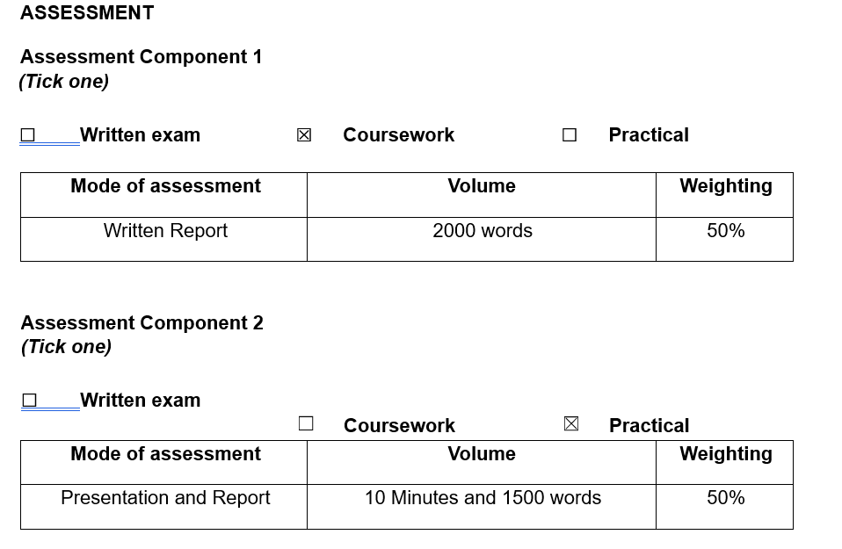
Assessment

Slide 5
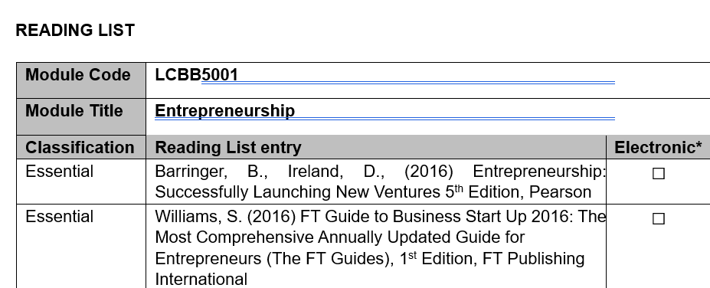
Core Reading Book

Slide 6
Assessment submission date
Assessment / Component 1 – Business Report
Weekday: 22/11/24 @ 14:00:00
Weekend: 24/11/24 @ 14:00:00
Assessment / Component 2 – Week 10 depending on group size
In Class Presentation – Pitching of the Business Idea ( Presentation) – Component 2
Weekday – Thursday morning 09.00 to 13.00 on the 12th December 2024
Weekend – Sunday Afternoon 13.45 to 18.00 an on the 15th December 2024
Submission of Evaluation Report – Component 2 Task 2
Weekday: 16/12/24 @ 14:00:00
Weekend: 18/12/24 @ 14:00:00

Slide 7
Introduction to Entrepreneurship
There is tremendous interest in entrepreneurship in the U.S. and around the world.
According to the 2015/2016 G E M study, 11.9% of Americans are actively engaged in starting a business or are the owner/manager of a business that is less than three years old.

Slide 8

Entrepreneur
Entrepreneur comes from a French word “Entreprendre” meaning taking over. Here the simple meaning of Entrepreneurship is taking over responsibilities, Curious, being Flexible and adaptable, persistent, passionate, Willing to learn, visionary and Motivated

Slide 9
Entrepreneur
Entrepreneurs can have the personality and skills that help them to meet their desired goals of setting up and running a successful business.
For some people the key question is: Is an entrepreneurial personality made or is someone born with it? Recent discussions over the last few decades have mostly explored the opportunities to become an entrepreneur and are concerned with the actual actions and motives behind them.

Slide 10
What is Entrepreneurship ?
Entrepreneurship refers to an individual or a small group of partners who strike out on an original path to create a new business.
An aspiring entrepreneur actively seeks a particular business venture and it is the entrepreneur who assumes the greatest amount of risk associated with the project. As such, this person also stands to benefit most if the project is a success.

Slide 11
Why becoming an Entrepreneur
There are several personality factors that influence prospective entrepreneurs into starting up new businesses. Before we get into the main concepts of the Business Start-Up module, let’s assess ourselves through an Entrepreneurial Aptitude Quiz and see where we stand.

Slide 12

Start Up Activity
Complete the Questionnaire ( The Questionnaire is also available on Moodle Week 1 )
Entrepreneurial Aptitude Test (cornerstoneresults.com)

Slide 13
Let’s Look at an example : Scenario 1
Mark is a recent graduate from a university who, after completing his degree in mechanical engineering, now wants to apply his knowledge to innovate and present new products to the market. In the hope of doing this he joins one of the best engineering firms in a graduate scheme.
After a year’s training and experience, he’s gained new knowledge of practical business opportunities and resources needed for him to achieve his goal. He has also realised that there can be chances of failure and loss in business; however, now he wants to set up his own business in the hope of profiting from his new ideas, so he is called an entrepreneur.

Slide 14

Let’s dive further :
What is Entrepreneurship ?
Let’s watch this together,
What is Entrepreneurship |

Slide 15

Activity 2 20 Minutes – Work Individually
Think further and try to explain in your own words :
What kind of attitude and skills are needed to be a successful entrepreneur?
Login to Moodle and Post your answer in the discussion forum

Slide 16
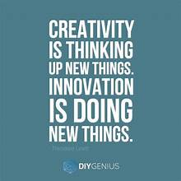
Entrepreneur abilities
Innovativeness
is the entrepreneur’s capability to commit to and support new ideas and experiment with new products, services or processes. This involves a willingness to change existing situation, embrace new ideas and seek creative, unusual, and novel ways to satisfy customer needs. This may involve utilising new opportunities.

Slide 17

Entrepreneur abilities
Proactiveness
is the entrepreneur’s ability to take the initiative in the pursuit of market opportunities. Proactive entrepreneurs are forward-looking and are usually first-movers in the industry.

Slide 18

Entrepreneur abilities
Risk Taking
is the entrepreneur's willingness to take risks to gain higher returns. This may involve committing a lot of resources to opportunities that may not always produce immediate returns or may even lead to loss making.

Slide 19
The Entrepreneurial mindset - MAD
M for Means - Capital. Access to resources. Be it angel funding, self-funding, access to political capital, the ability to harness labour, high tech assembly, etc or some combination of the above.
A for Ability - Having the physical and mental capacity to understand vision in ways required to succeed in planned goals. Ability generally refers to being sufficiently adept in organising the resources available to you in novel ways.
D for Desire - Lots of great ideas are out there. But it takes the alignment of ability, means AND the desire to invest in those ideas to make them happen.

Slide 20
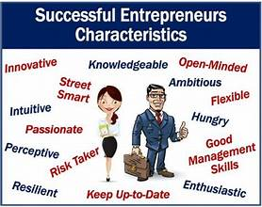
There are five common characteristics of people with an entrepreneurial mindset.
They passionately seek new opportunities. Habitual entrepreneurs stay alert, always looking for the chance to profit from change and disruption in the way business is done.
They pursue opportunities with enormous discipline. Habitual entrepreneurs not only are alert enough to spot opportunities, but they also make sure that they act on them.
They pursue only the very best opportunities and avoid exhausting themselves and their organisations by chasing after every option.
They focus on execution—specifically, adaptive execution.
They engage the energies of everyone in their domain. Habitual entrepreneurs involve many people—both inside and outside the organisation—in their pursuit of an opportunity.

Slide 21

Pause for thoughts
To create an idea is good but how to apply it in the real world entails the art of entrepreneurship which requires having a business mindset and an insight to pinpoint the gaps that can be filled in with your ideas. However, the leadership skills of being a good listener and a motivator to lead others is very important. In addition to this, business skills and some basic questions as to how you will produce, finance and market your products, are the key to success. This brings valuable benefits to the business and/or product you are aiming to develop due to an entrepreneurial mindset. Nevertheless, benefits tend to be surrounded by challenges

Slide 22

End of First Session
Enjoy your break

Slide 23
Welcome to Session 2
Entrepreneurship LCBB5001

Slide 24
Reasons To become an Entrepreneur
Services growth
Technology
Specialization and networks
Sub contracting and fragmentation
Deregulation and privatisation
Unemployment
Enterprise culture
Environmental and alternative movements

Slide 25
BUSINESS CHURN
Churn – movement in business population caused by:
  new venture start ups and
  business closure
Start up and Closure rates typically 10% of total population
Positive effect on innovation
But disruption of micro economy

Slide 26
Other Definition of What Is Entrepreneurship?
Academic Definition (Stevenson and Jarillo)
  Entrepreneurship is the process by which individuals pursue opportunities without regard to resources they currently control.
Alternative View
  Entrepreneurship is the art of turning an idea into a business.
Explanation of What Entrepreneurs Do
  Entrepreneurs assemble and then integrate all the resources needed – the money, the people, the business model, the strategy – to transform an invention or an idea into a viable business.
  Any other explanations?

Slide 27
Corporate Entrepreneurship (1 of 2)
Corporate Entrepreneurship
  Is the conceptualization of entrepreneurship at the firm level.
  All firms fall along a conceptual continuum that ranges from highly conservative to highly entrepreneurial.
  The position of a firm on this continuum is referred to as its entrepreneurial intensity.

Slide 28
Corporate Entrepreneurship (2 of 2)
Entrepreneurial Firms
Proactive
Innovative
Risk taking
E.g., tech companies like Uber
Conservative Firms
Take a more “wait and see” posture
Less innovative
Risk averse
E.g., hairdressers

Slide 29
Why Become an Entrepreneur?
The three primary reasons that people become entrepreneurs and start their own firms.
  Desire to be their own boss
  Desire to pursue their own ideas
  Financial rewards

Slide 30
Common Myths About Entrepreneurs (1 of 6)
Myth 1: Entrepreneurs Are Born, Not Made
  This myth is based on the mistaken belief that some people are genetically predisposed to be entrepreneurs.
  The consensus of many studies is that no one is “born” to be an entrepreneur; everyone has the potential to become one.
  Whether someone does or doesn’t become an entrepreneur is a function of their environment, life experiences, and personal choices.

Slide 31
Common Myths About Entrepreneurs (2 of 6)
Although no one is “born” to be an entrepreneur, there are common traits and skills of successful entrepreneurs
Traits: Creative
Need for achievement
Self-confidence
Innovativeness
Stress tolerance
Need for autonomy
Proactive personality
Persuasive
Perseverance
Skills: Promoter and networker
Resource assembler/leverager
Self-starter
Decision making,
HR management,
Marketing,
Finance
Tenacious and Visionary

Slide 32
Common Myths About Entrepreneurs (3 of 6)
Myth 2: Entrepreneurs Are Gamblers
  Most entrepreneurs are moderate risk takers.
  The idea that entrepreneurs are gamblers originates from two sources:
    Entrepreneurs typically have jobs that are less structured, and so they face a more uncertain set of possibilities than people in traditional jobs.
    Many entrepreneurs have a strong need to achieve and set challenging goals, a behavior that is often equated with risk taking.

Slide 33
Common Myths About Entrepreneurs (4 of 6)
Myth 3: Entrepreneurs Are Motivated Primarily by Money
  While it is naïve to think that entrepreneurs don’t seek financial rewards, money is rarely the reason entrepreneurs start new firms.
  In fact, some entrepreneurs warn that the pursuit of money can be distracting.
  Money is only a measure of their success and hard work, most cases, the passion to solve a problem brings about the money.

Slide 34
Common Myths About Entrepreneurs (5 of 6)
Myth 4: Entrepreneurs Should Be Young and Energetic
  Entrepreneurial activity is evenly spread out over age ranges.
  While it is important to be energetic, investors often cite the strength of the entrepreneur as their most important criterion in making investment decisions.
    What makes an entrepreneur “strong” in the eyes of an investor is experience, maturity, a solid reputation, and a track record of success.
    These criteria favor older rather than younger entrepreneurs.

Slide 35
Common Myths About Entrepreneurs (7 of 7)
Myth 5: Entrepreneurs Love the Spotlight
  While some entrepreneurs are flamboyant, most of them do not attract public attention.
  As evidence of this, consider the following question: “How many entrepreneurs could you name?”
    Most of us could produce Jeff Bezos of Amazon.com, Mark Zuckerberg of Facebook, Larry Page and Sergey Brin of Google or maybe Elon Musk of Tesla and SpaceX.
    But few could name the founders of Netflix, YouTube, or DIRECTV, even though we frequently use those firms’ services.

Slide 36
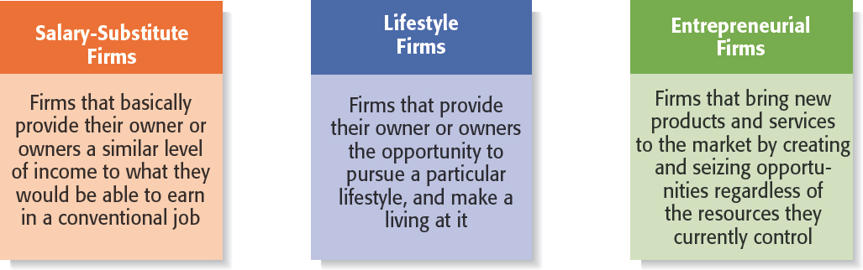
Figure 1.2 Types of Start-Up Firms

Slide 37
Changing Demographics of Entrepreneurs (1 of 3)
Women Entrepreneurs
There were 22,257 women- owned businesses in the UK in 2020 (according to Correa, 2020)
This number was up 15% from 2016.
There are a growing number of organizations that support and advocate for women-owned businesses.

Slide 38
Changing Demographics of Entrepreneurs
2 of 3
Senior Entrepreneurs
Minority Entrepreneurs
The percentage of U.K.
entrepreneurs who are seniors (over 55’s) increased by 63% from 2008 – 2018 (research conducted by Barclays).
The increase is attributed to corporate downsizing, a desire among older workers for more fulfillment in their lives, a need for additional income, and
similar factors.
There has been a substantial
increase in minority
entrepreneurs in the U.S. from
1996 to 2010.
The biggest jump has come in
Latino entrepreneurs, which
increased from 11% to 23%
from 1996 to 2010.

Slide 39
Changing Demographics of Entrepreneurs (3 of 3)
Millennial Entrepreneurs
Interest among young people in entrepreneurial careers is high.
According to a Harris Interactive survey, 40% of people eight to 21 years old said they’d like to start their own business
someday.
A total of 59% of the 8- to 21-year-olds said they know someone who has started their own business.

Slide 40
Economic Impact of Entrepreneurial Firms
Innovation
  Is the process of creating something new, which is central to the entrepreneurial process.
  Small innovative firms are 16 times more productive than larger innovative firms in terms of patents per employee.
Job Creation
  Small businesses create a substantial number of net new jobs in the United States.
  Firms with 500 or fewer employees created two million of the roughly three million private sector jobs in 2014.

Slide 41
Entrepreneurial Firms’ Impact on Society and Larger Firms
Impact on Society
  The innovations of entrepreneurial firms have a dramatic impact on society.
  Think of all the new products and services that make our lives easier, enhance our productivity at work, improve our health, and entertain us.
  Any examples ?
Impact on Larger Firms
  Many entrepreneurial firms have built their entire business models around producing products and services that help larger firms become more efficient and effective.

Slide 42
The Entrepreneurial Process
The Entrepreneurial Process Consists of Four Steps
Step 1: Deciding to become an entrepreneur.
Step 2: Developing successful business ideas.
Step 3: Moving from an idea to an entrepreneurial firm.
Step 4: Managing and growing the entrepreneurial firm.

Slide 43
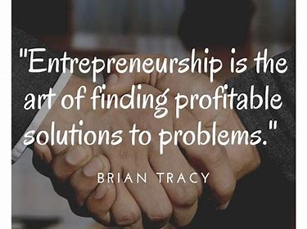
End of Day activity
Summarise your understanding of the first lesson in 50 words and post your answer to the discussion Forum on Moodle
Thank you and see you next week ☺

Slide 44
Sources
Barringer, B., Ireland, D., (2019) Entrepreneurship: Successfully Launching New Ventures. Sixth edition; Global edition. Harlow, England: Pearson.
Dumitriu, S., (2019) ‘Managemant matters’ The entrepreneurs network. Available at: https://www.tenentrepreneurs.org/research/management-matters Accessed: 12th May 2020
Hisrich, R.D., Peters, M.P., Shepherd, D.A., (2020) Entrepreneurship. Eleventh edition, New York: McGraw-Hill
Correa, G., (2020) ‘UENI’s 2020 Report on Gender and Small Business’ Available at https://www.latimes.com/business/technology/la-fi-tn-uber-ipo-travis-kalanick-cloudkitchens-20190509-story.html Accessed: 20th October

