Slide 1

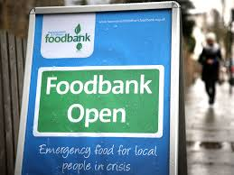

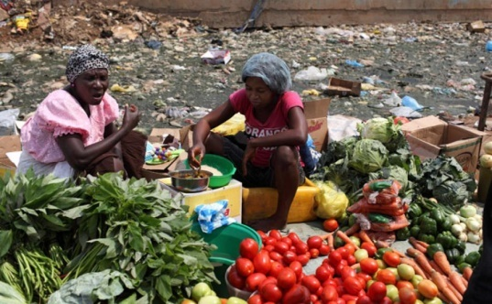
What is a Sustainable Community?

Slide 2
The 3 Elements of Sustainability
Economic Growth
Environmental Protection
Equity / Social Justice

Slide 3
What is a sustainable community?
Share your thoughts on what makes a sustainable community.
You need to consider what a sustainable community would look like in terms of;
Economic factors
Environmental factors
Social Factors

Slide 4
What is a sustainable community?
Definition of a 'sustainable community'
Sustainable communities are places where people want to live and work, now and in the future.
They meet the diverse needs of existing and future residents, are sensitive to their environment, and contribute to a high quality of life.
They are safe and inclusive, well planned, built and run, and offer equality of opportunity and good services for all.
(Department for Communities and Local Government, 2005)*

Slide 5

What is a sustainable community?
For communities to be sustainable, they must offer:
decent homes at prices people can afford
good public transport
schools
hospitals
shops
a clean, safe environment.
People also need open public space where they can relax and interact and the ability to have a say on the way their neighbourhood is run.
(Department for Communities and Local Government, 2005)*
As researchers what can we infer from the fact that this has now been ‘archived’?

Slide 6
What is a sustainable community?
Sustainable communities acknowledge the link between place and context
i.e. the design of buildings and services etc. reflect the locality in terms of landscape, ecology, water and energy use etc.
What does this mean?
Sustainable communities promote the localisation of services
  challenging the current trend of car reliance for shopping, accessing services
  Challenging ‘out of town’ locations for shops & services chosen because they are cheaper to build

Slide 7
Sustainable Communities – Access to Services
One aspect of deprivation measured in the Engand Index of Multiple Deprivation (IMD) is access to services
The move towards large ‘out of town’ developments means that access to services is an issue for deprived urban areas as well as rural areas
‘The purpose of this domain is to capture deprivation as a result of a household's inability to access a range of services considered necessary for day-to-day living. This covers both material deprivation (for example not being able to get food) and social aspects of deprivation (for example not being able to
attend afterschool activities)’.
(WG, 2014, p.1)

Slide 8
Sustainable Communities – Access to Services
The domain is calculated from the following indicators:
average travel time by public and private transport to a food shop;
average travel time by public and private transport to a GP surgery;
average travel time by public and private transport to a primary school;
average travel time by public and private transport to a secondary school;
average travel time by public and private transport to a post office;
average travel time by public and private transport to a public library;
average travel time by public and private transport to a leisure centre;
average travel time by public and private transport to a pharmacy; and
average travel time by private transport to a petrol station.
(Welsh Government, 2014, p.11)

Slide 9


What is a sustainable community?
Sustainable communities rebuild the relationship between the ‘social capital’ of the community and the locality
Handout 2: OECD – What is social capital?
Local activities are organised and valued on the basis of local identity and need
Put simply a sustainable community considers both people and place
Community groups and citizens are seen as partners in the process of planning and developing their community
Governance International – Co-production
= ‘Co-production’
Co-production Wales
NHS – Co-production

Slide 10
Models of Sustainable Communities
There are many models of sustainable communities just as there are many theories of sustainability
It is important to remember that a ‘model’ is created in order to illustrate an argument or theory
Models tend to be neat and tidy
They represent an ideal model of society
The reality is often more complex

Slide 11
An IDEAL: The Eco-Village
“The village would be a balanced community for people of all ages and incomes, where people can live, work and enjoy a vibrant community life, the majority without the need to commute and where everyone could feel a sense of personal belonging. It would provide affordable housing, work opportunities, food production, energy and water conservation as well as self-reliance for its residents in an ecologically aware and sensitive way”
(Littlewood, 1998, cited in Barton, 2000, p.11)

Slide 12
‘Sustainable Communities’
Barton’s Model
Environmental Capacity
Social Needs
Economic Needs
Does this look familiar?
(Barton (Ed), 2000, p.8)

Slide 13
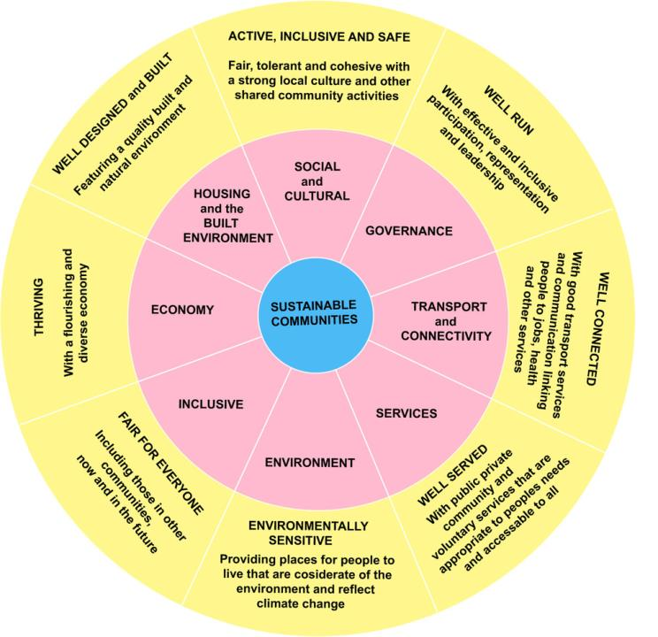
(Based on: Academy for Sustainable Communities, 2005)

Slide 14

What is a sustainable community?
Using the model of sustainable communities created by the Academy for Sustainable Communities re-evaluate your description of a sustainable community .
Is there anything that you would like to add to the description?
Is there anything that you would like to remove?

Slide 15

The 20 Minute Neighbourhood
This is a growing movement in Town and Country planning across the world.
The 20-minute neighbourhood is all about living locally, giving people the ability to meet most of their daily needs within a 20-minute walk from home, with safe cycling and local transport options.
The COVID-19 pandemic lockdown has put a spotlight on the importance of the livability of our local neighbourhoods, with people spending more time locally, working at home if possible, using public green space, cycling and walking instead of using cars and connecting with neighbours.
Town & Country Planning Association (2020)
What is this organisation?

Slide 16

The 20 Minute Neighbourhood
Melbourne, Australia is one of the cities leading in this development.
1
What is a 20 minute neighbourhood?
Department of Environment, Land, Water & Planning Victoria (2019)
2
A 20 Minute City
Melbourne School of Design (2013)
Living Locally: 20 Minute Neighbourhoods
Geography Teachers Association Victoria [GTAV] (2019)
What are your initial thoughts on this concept?

Slide 17

What is Truly Sustainable?: Guided Learning
Watch the the video examples of experiments in sustainable living.
In each case, identify the strengths and weaknesses.
Can you detect the influence of any of the eco-theories that we have looked at in the examples?
Lammas Eco-Village
Pembrokeshire
Tipi Village
Carmarthenshire
One Brighton
https://www.bioregional.com/projects-and-services/case-studies/one-brighton-showing-that-sustainable-homes-can-be-a-commercial-success

Slide 18
How to Secure Sustainable Communities
Funding
Https://www.local.gov.uk/council-funding
Education/ Awareness

Slide 19
United Nations
Sustainable urbanization critical to COVID-19 recovery, better quality of life
https://news.un.org/en/story/2020/10/1076532

Slide 20
Cop 26- Glasgow 2021
What is this?
See what you can find out and feedback

Slide 21
Cop 26- Glasgow 2021
Conference of Parties to the United Nations Framework Convention on Climate Change (UNFCCC)
Four Main Goals
secure global net zero by mid-century and keep warming to 1.5 degrees Celsius within reach;
adapt to protect communities and natural habitats;
mobilise finance; and
work together to deliver

Slide 22
Other Useful Websites
Diggers and Dreamers: The Guide to Communal Living in Britain
http://www.diggersanddreamers.org.uk/index.php?one=dat&two=det&sel=creuynni
Co-Production Wales
https://allinthistogetherwales.wordpress.com/
United Nations Development Plan: Sustainable Cities and Communities
http://www.undp.org/content/undp/en/home/sustainable-development-goals/goal-11-sustainable-cities-and-communities.html

Slide 23
Bibliography
Barr, S (2008) Environment and Society: Sustainability, Policy and the Citizen, Aldershot, Hamps: Ashgate Publishing.
Barton, H [Ed.] (2000) Sustainable Communities: The Potential for Eco-Neighbourhoods London: Earthscan
Barrett, S., Kidd, J., 1991 Pathways: Towards an Ecosystem Approach. Royal Commission on the Future of the Toronto Waterfront, Toronto, 168 pp.after Macdonald, D. 1991. The Politics of Pollution.
Fukuyama, F (2008) ‘The Latin American Experiences, Journal of Democracy, Vol. 19. No. 4, pp.69-79.
GTAV (2019) Living Locally: 20 Minute Neighbourhoods Available at: https://www.gtav.asn.au/products/books-2/living-locally-20-minute-neighbourhoods [Accessed 06/09/2021]
Governance International (2020) Co-Production Available at: https://www.govint.org/good-practice/publications/co-production/ [Accessed 06/09/2021]
Kuhlman T & Farrington J (2010) ‘What is Sustainability? ‘Sustainability, Vol. 2. pp. 3436-3448.
Merriam-Webster (2004) Merriam-Webster Online Dictionary, Halo Press.

Slide 24
Bibliography
NHS (2014) Sustainable, Resilient, Healthy People & Places, Cambridge: The Sustainable. Development Unit.
NHS Wales (2013) Co-producing services - Co-creating health Available at http://www.1000livesplus.wales.nhs.uk/sitesplus/documents/1011/T4I%20%288%29%20Co-production.pdf [Accessed 24/09/2020]
OECD (2002) Glossary of Statistical Terms: Social Capital Available at: https://stats.oecd.org/glossary/detail.asp?ID=3560 [Accessed 24/09/2020]
Town and Country Planning Association (2020) The 20 Minute Neighbourhood Available at: https://www.tcpa.org.uk/the-20-minute-neighbourhood [Accessed 24/09/2020]
UK Government: Department for Communities and Local Government (No Date) What is a sustainable community? Available at http://webarchive.nationalarchives.gov.uk/20120919132719/http://www.communities.gov.uk/index.asp?id=1139866 [[Accessed 24/09/2020]
UK Government: Office of the Deputy Prime Minister (2003) Sustainable communities in London: Building for the future London Available at http://webarchive.nationalarchives.gov.uk/20070506093800/communities.gov.uk/pub/455/SustainableCommunitiesinLondon_id1163455.pdf [Accessed 24/09/2020]

Slide 25
Bibliography
WCED (1987) Our Common Future: World Commission on Environment and Development, Stockholm: UN.
Webster (2012) Webster’s Encyclopedic Dictionary, Halo Press.
Welsh Government (2014) Welsh Index of Multiple Deprivation 2014: A guide to analysing deprivation in rural areas – Revised Available at http://gov.wales/docs/statistics/2015/150812-wimd-2014-guide-analysing-deprivation-rural-areas-revised-en.pdf [Accessed 06/09/2021]
Welsh Government (2015) Interactive tool – maps and data Available at https://wimd.gov.wales/ [Accessed 06/09/2021]
Wilderer, P (2007) ‘Sustainable Water Resources Management: the Science behind the Scene, Sustain Science, Vol. 2, pp. 1-4.

Slide 26
Video References
Department of Environment, Land, Water & Planning Victoria (2019) What is a 20 minute neighbouthood? Available at: https://www.youtube.com/watch?v=1oYvbrDVjcY&feature=youtu.be [Accessed 24/09/2020]
Melbourne School of Design (2013) A 20 minute city Available at: https://www.youtube.com/watch?v=7_1ol1AYnYs [Accessed 24/09/2020]
The Guardian (2011) Lammas: The eco-village that lives off the grid Available at: https://www.theguardian.com/environment/gardening-blog/video/2011/mar/22/lammas-eco-village-off-grid-video [Accessed 24/09/2020]
Rainforth, E. (2013) Life in Tipi Valley Available at: https://www.youtube.com/watch?feature=player_detailpage&v=jCZCv_m1xkY [Accessed 24/09/2020]
Trotters, S (2017) Brithdir Mawr The Community Available at: https://www.youtube.com/watch?v=M32i_5myQL0 [Accessed 24/09/2020]

