Slide 1
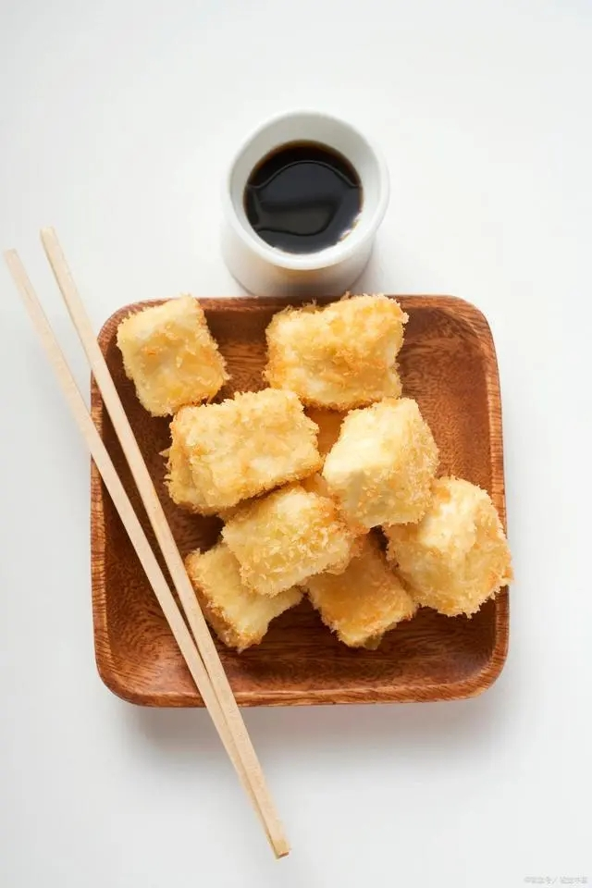
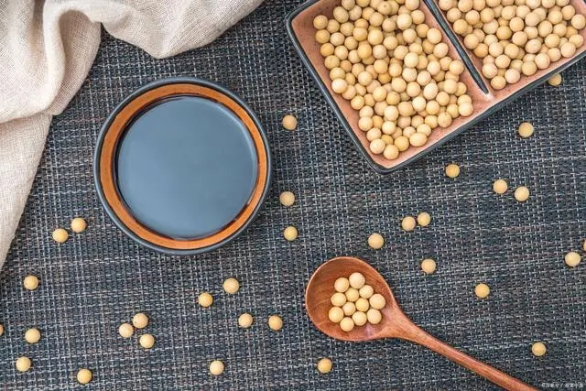
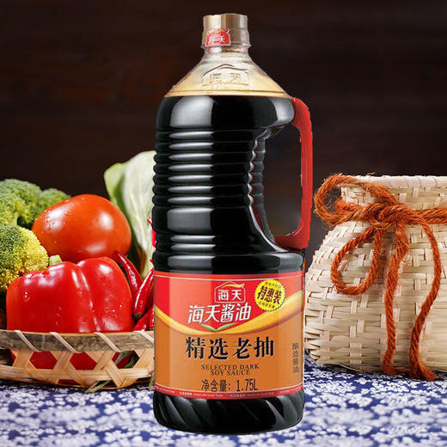
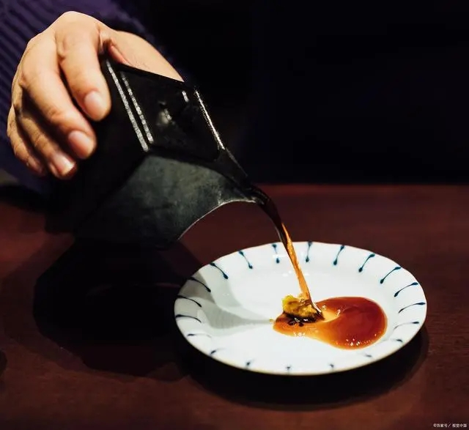
Improvement in the Marketing of Haitian Flavor Industry
Student: Peng Guo(2216865)

Slide 2
1
Layout high-end market late, no leading edge.
2
The problem of brand building and technology iteration.
Problems
&
Improvement
3
Sales channel construction is not comprehensive
4
Corporate publicity and corporate responsibility.

Slide 3
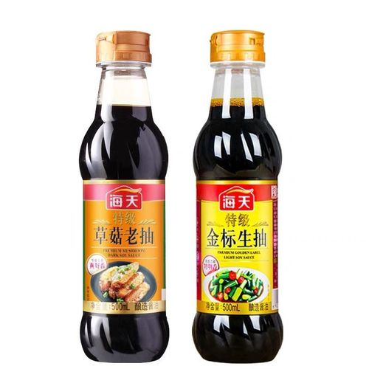
1
Layout high-end market late, no leading edge.
Competition for high-end soy sauce is fierce.
Haitian wei industry's recent weakness, and the high-end soy sauce block is related.
Haitian soy Sauce forces the high-end market, with the "full 180 days in the sun" as a gimmicky, which also brings it a certain brand premium. Among the products in the same category, Haitian soy sauce has been on the high side, and was once dubbed "Moutai" and "Chivas" by consumers. But in the condiment market, the layout of high-end soy sauce is not only one, Xinhe, Luhua, Qianhe and other brands even earlier than the layout of Haitian soy sauce, and now has occupied half of the high-end soy sauce.
Notes:
1. Hatian is a professional condiment manufacturer in China with a long history and eight series of more than 200 specifications and varieties. Stock code 603288. Ranked first in the Hurun Top 10 Food and Beverage Companies in China 2020
2.At present, consumers' awareness of high-end soy sauce brands is low, and the added value of the brand has not been formed. The high price still needs the support of high marketing, and most consumers still prefer the soy sauce with a more affordable price.

Slide 4
SWOT Analysis
Strengths：
Foshan in Guangdong Province has a humid climate and abundant sunshine, which provides Haitian with high-quality raw materials - soybeans.
Haitian Flavor Industry has developed into a brilliant "soy sauce City", which is the world's largest "carrier-class" seasoning comprehensive production base. Besides soy sauce, it also produces a variety of condiments including oyster sauce, chicken essence, sauce and vinegar. Continuously increase investment in scientific research, promote product development and quality upgrade.
Haitian Taste Industry has the largest natural glass tanning pool group in China.
Weaknesses
At present, the level of competition in the condiment market is low, and ordinary consumers have low brand recognition. Foreign-funded enterprises occupy the advantages of capital and talents, making Haitian at a disadvantage in the competition with foreign products, and unable to further develop radical competition with domestic products.
Haitian WeiYe is well-known only in soy sauce, while other products such as chicken essence, vinegar and chicken powder are not as popular as other brands such as TAITAILE. Haitian soy sauce based products, Haitian signature bibimbap sauce to be further publicity.
Opportunities
Fast pace of life, people's demand for fast food life increases, which is a favorable social environment for the promotion of Haitian products.
Haitian products have already opened the market and been recognized by consumers, which provides a channel opportunity for Haitian brand.
Threats
Market competition is further intensified, due to the existence of a large number of competitors and make the market competition more cruel and fierce, which brings more challenges and pressure to enterprises.
Competition in the domestic seasoning industry is fierce. Only in Guangdong Province, where Haitian is located, there are four well-known brands. Local competition pressure is one of the threats to Haitian.
Potential competitors are strong, with Japanese brands entering the Chinese market. At the same time, domestic brands are strong.
Notes:
As described in our model：
It has a long history；
Many brands; It didn‘t move up the market too early. The cost is too high and there are not many channels；
The epidemic is over. The demand for this product will increase.
Competition is fierce, not only from local brands but also from foreign brands.

Slide 5
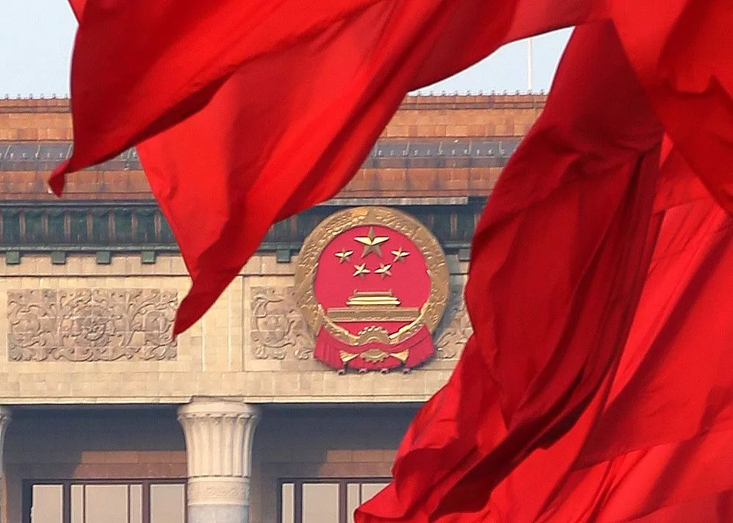
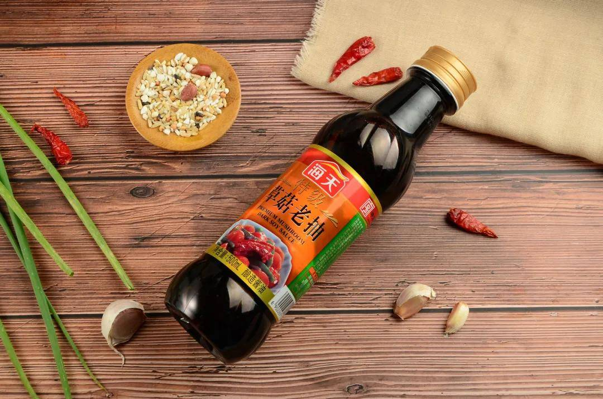



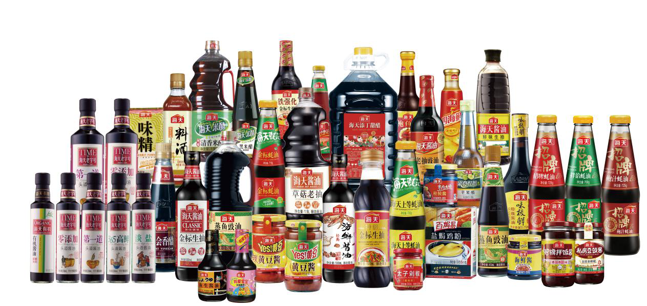


Political：
The owner of Haitian Wei Ye wants to be in the domestic market of China, which is politically stable. Company in the condiment industry has not been suppressed by the policy.
Economic：
China's economy continues to grow. GDP growth is expected to be no less than 5% in 2023. The condiment market is just what the Chinese people need. The economic crisis has little impact on business revenue and net profit. At present, China's exchange rate is stable, which does not have a great impact on export trade.
Sociocultural：
China's aging is relatively serious, and the aging population will have little impact on enterprises in the next ten years. Chinese traditional culture, religious belief and life style have little influence on enterprises.
Technological：
The use of automated means, and unmanned chemical plants, black light factories into use, and fermentation technology to improve the enterprise is a very good news.
Environmental：
In terms of environmental protection, Haitian Group is mainly engaged in the food industry. It belongs to conventional discharge and meets the standards of environmental protection. At the same time, new green energy can be used and waste can be recycled again.
Legal：
There is a lot of confusion in the sauce industry. But for the formulation of industry standards and laws and regulations, Haitian is the drafting unit, which is a guiding role for industry access and norms. Rather, it is one of the manifestations of its moat.
PESTEL Analysis
Notes:
1.

Slide 6
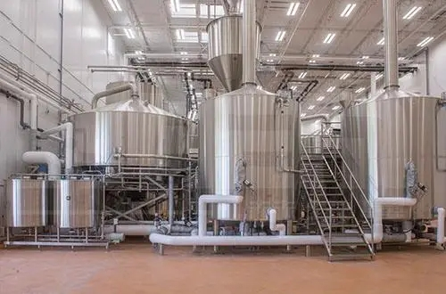

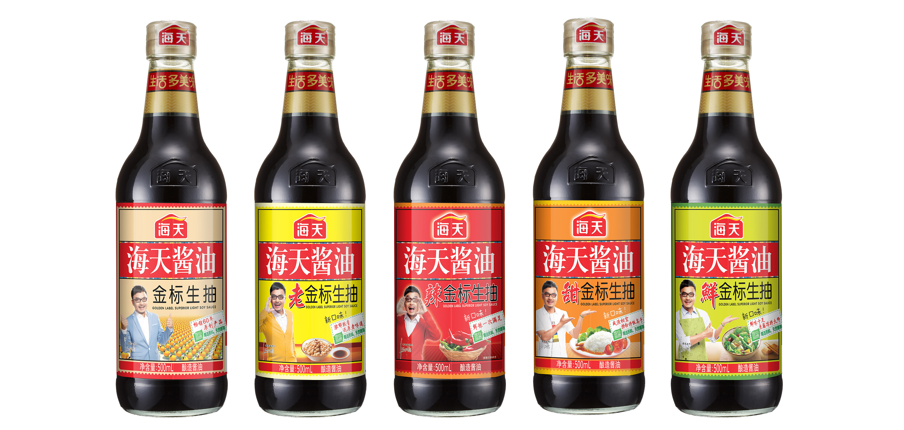
2
The problem of brand building and technology iteration.
In 2020, the penetration rate of compound condiments in China is 26%, while that in the United States is 73.4% and that in Japan is 65.8%, which is seriously low. Compared with the soy sauce industry in Japan, South Korea and other developed countries, China's soy sauce industry is relatively backward in terms of brand influence and manufacturing process, and there is still a big gap between the overall market and foreign developed countries. Although the market has a huge potential for development, condiment enterprises have failed to find a way to crack the rapid expansion of territory.
Notes:
From the perspective of China's condiment industry, although Haitian Flavor industry is rich in products, it mainly covers the middle and low-end market, and there is still room for improvement in quality. Consumers are positioned as a mass consumption brand, but lack of high-end cognition, which requires Haitian to spend a lot of time and money to build.

Slide 7
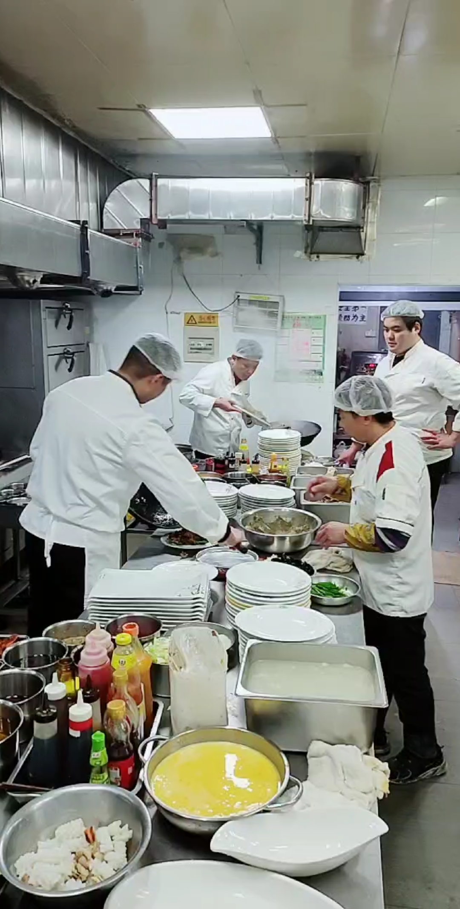
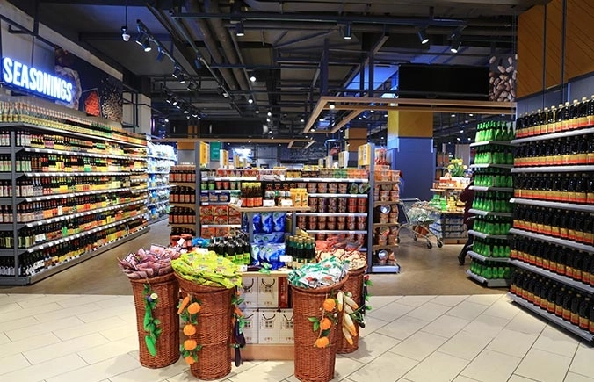
3
Sales channel construction is not comprehensive
The catering channels account for 60% of Haitian soy Sauce industry, followed by consumers. In other words, the catering industry contributes more than 60% of the revenue of Haitian soy Sauce, while household consumption is only less than 40% of its composition. Affected by the epidemic, many cities have banned in-store meals, resulting in a large number of catering enterprises unable to operate normally. Even in cities with lax controls, consumers are eating out less often because of the pandemic.
Notes:
Channel operators, terminal stores and large gathering groups have strong demand for purchasing. On the contrary, the consumer side has fewer customers.

Slide 8
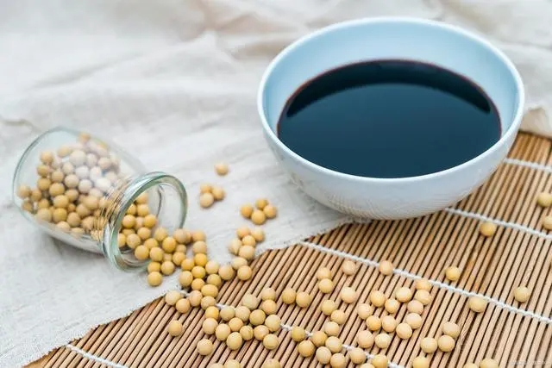
4
Corporate publicity and corporate responsibility.
Although the government has the responsibility of supervision, it can only ensure that enterprises fulfill the necessary social responsibilities. In terms of values, enterprises need to practice their own social responsibilities.
One thing is clear: Haitian Soy Sauce should not regard the bottom line of corporate social responsibility as the upper limit. If the upper limit of corporate social responsibility is not raised, the brand image of the enterprise cannot be improved in any case. Keeping firm the bottom line of corporate social responsibility can "solve the crisis", but can not "solve the opportunity".
Notes:
The food safety crisis caused by additives is one of the most serious crises. If Haitian soy Sauce has a crisis response system, this crisis should be the highest level of response, but the performance of Hatian soy Sauce is not like the highest level of response at all.

Slide 9
Conclusion
To sum up, Haitian Soy Sauce, as the leader in the soy sauce industry, has the advantages of brand awareness and market share. At the same time, it also needs to face the challenges of market competition. It needs to constantly carry out technological innovation and brand upgrading, expand diversified business segments, expand the international market, and improve global competitiveness, so as to maintain its leading position in the industry.
Notes:
Technological innovation and brand upgrading: With the constant change of consumer demand and the intensification of market competition, Hatian soy Sauce needs to strengthen technology research and development and product innovation, launch more products with differentiated competitive advantages, and improve the added value of the brand and market competitiveness.
Diversified development and business expansion: With the upgrading of consumption and the change of lifestyle, Hatian soy Sauce needs to explore more products and business areas, expand diversified business segments, and improve the company's profitability and market share.
Brand internationalization and market expansion: Hatian soy Sauce already has a high popularity and market share in the domestic market. In the future, it can explore the international market to realize brand internationalization and market expansion and improve the company's global competitiveness.

Slide 10
Reference
Jyezccz (2022) Baidu terms of service. Available at: https://baijiahao.baidu.com/s?id=1736136184659620893&wfr=spider&for=pc (Accessed: April 24, 2023).
TYL.D (2023) 'Analyzing the competitive advantages and development trends of Haitian soy sauce from an industry perspective', Official account of Guangzhou Wangdao Marketing Advertising Co., Ltd, April 7th. Available at: https://baijiahao.baidu.com/s?id=1762506950704893521&wfr=spider&for=pc (Accessed: April 24, 2023).
Haitian-food (2023) baidu terms of service. Available at: http://www.haitian-food.com/index.php?ac=article&at=list&tid=31(Accessed: April 24, 2023).
Yu Chaochen. Science in Soy Sauce Bottles [J]. Science Course, January 2010
TYL.D (2023) 'Analyzing the competitive advantages and development trends of Haitian soy sauce from an industry perspective', Official account of Guangzhou Wangdao Marketing Advertising Co., Ltd, April 7th. Available at: https://baijiahao.baidu.com/s?id=1762506950704893521&wfr=spider&for=pc (Accessed: April 24, 2023).
Jin Tao. Research on conflict management of Enterprise Marketing Channels [j]. SME Management and Technology, July 2010
HWW.J (2022) 'Haitian taste industry high-end go impassable? ', Handkith Marketing Consulting, April 7th. Available at: https://baijiahao.baidu.com/s?id=1746093570033643877&wfr=spider&for=pc (Accessed: October 8th, 2022).

Slide 11
Thank You

