Slide 1

Introduction to Health and Social Care (LCHS4003)
Assessment 1
Marilyn Mcleish – 2316784
Lecturer – Patronella Ganza

Slide 2

How Mental Health Services Have Developed Over The Years.

Slide 3

Mental Health Services in the 1900s.
In 1948 mental illness was not considered important so it was not a product of the new National Health Service.
Recognition of the importance of mental health happened after the second world war. Civilians and surviving soldiers were suffering with mental health.
The mentally ill were housed in largely isolated Victorian institutions that had been built over the past century.
In 1959 The Mental Health Act was approved by parliament.
In 1961, The minister of health Enoch Powell planned to get rid of Victorian asylums.
(Thomson, 2016)

Slide 4
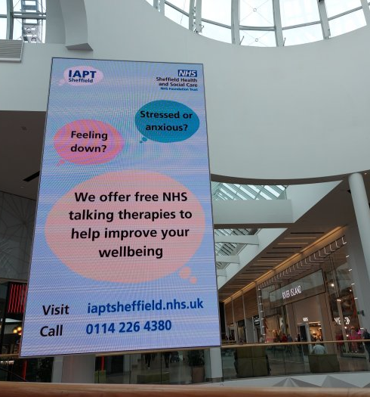
Mental Health Services in the 2000s.
IAPT(Improving Access to Psychological Therapies) launched in 2008.
IAPT Services treat up to 560,000 people per year.
Apps and digital technologies continue to advance in Mental Health Care.
In 2016 nearly £12 billion was spent on Mental Health Services.
(Indepth.nice.org.uk, n.d)

Slide 5

Mental Health Services Now.
Around 1.5 million people are in contact with Mental Health Services each month.
The covid-19 pandemic heightened the importance of Mental health.
Mental health services are still facing significant challenges from increasing demand.
Services are struggling with funding and need to tackle inequalities.
(Goodwin,2022)

Slide 6
Conclusion
Mental health services have come a long way since 1948.With advancements in healthcare there has been a greater understanding of the importance of mental well being. Technology has further expanded the reach of mental health services, making them more convenient. However, there is still work to be done to ensure quality care for all.

Slide 7

Questions?

Slide 8
Reference list
1. Goodwin, O. (2022). Challenges for today’s Mental Health Services. Available at: https://www.carnallfarrar.com/challenges-for-todays-mental-health-services
2. Indepth.nice.org.uk. (n.d). Mental Health and the NHS. Available at: https://indepth.nice.org.uk/mental-health-and-the-nhs/index.html
3. Thomson, M. (2016). Mental Health. Available at: https://peopleshistorynhs.org/encylopaedia/mental-health/.

