Slide 1

Module Title: Professional Development within Health and Social Care
Module Number: LCHS 4009(LON)
Assignment No: Assignment 1
Student Name: Swapna Khanam
Student ID: 2510691
Lecturer’s Name: Tola Odugbesan
Submission Date: 17/07/2026

Slide 2
Acknowledgement of AI
For this presentation, I got help from AI.
Such as: Claude AI, Chat Gpt4 AI

Slide 3
Introduction
Name: Swapna Khanam
Student ID: 2510691
Topic:
The Importance of Communication in Health and Social Care
Presentation Overview:
Communication is a key skill that supports safe, effective and person-centred care.
This presentation explores different types of communication and their importance in practice.
It explains how effective communication builds trust, improves patient safety and supports teamwork.
Objectives:
Understand the role of communication in health and social care.
Explore methods and principles of effective communication.
Explain how communication improves quality of care.

Slide 4

What is Communication?
Communication in health and social care is the foundation of high-quality, person-centred support.
In health and social care it is essential because it:
Builds trust
Protects patient safety
Supports person-centred care
Helps patients understand treatment
Improves teamwork

Slide 5




Types of Communication
Four essential channels in health & social care practice
Verbal
Non-Verbal
Speaking clearly
Avoiding medical jargon
Giving treatment explanations
Eye contact
Facial expressions
Body language
Tone of voice.
Written
Specialist Methods
Care records
Reports
Medication charts
Sign language
Picture cards
Translation services
Communication boards
Notes:
There are four key types of communication: Verbal, Non-Verbal, Written, and Specialist Methods. Each is essential in different situations. For example, written communication keeps records accurate while specialist methods ensure we include everyone, including those with hearing impairments or learning disabilities.

Slide 6




Core Principles of Effective Communication
Active Listening
Empathy & Respect
Paying full attention to the individual — making them feel heard and valued. Involves nodding, reflecting, and not interrupting.
Acknowledging the emotions, values and dignity of the person being supported. Never dismissing how someone feels.
Clarity
Confidentiality
Adapting the message to the service user's level of understanding — avoiding complex medical jargon and using plain language.
Sharing information only on a need-to-know basis. Upholding the individual's right to privacy under GDPR and professional codes of conduct.
Notes:
The core principles you noted — Active Listening, Empathy, Clarity, and Confidentiality — are the backbone of effective care communication. These are not soft skills; they are professional and ethical obligations. GDPR, the Care Act, and professional codes all require these standards.

Slide 7
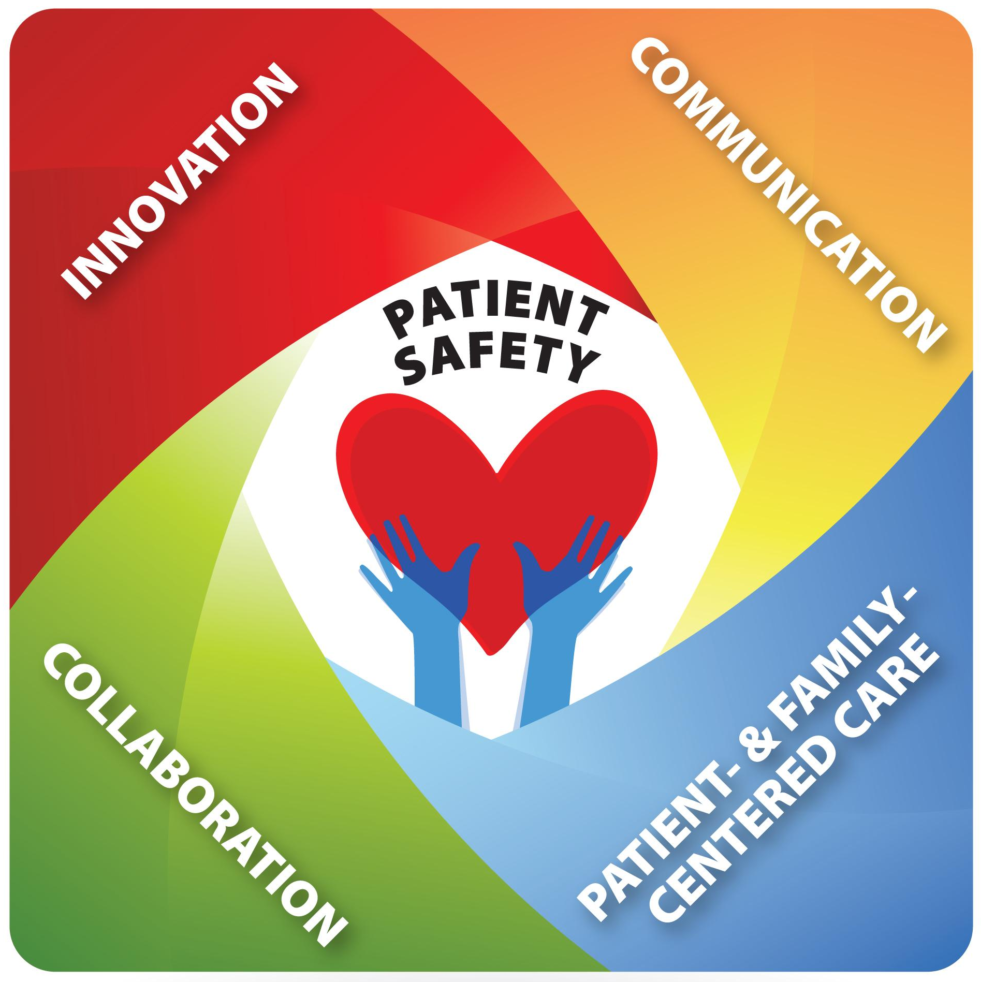
Why is Communication Important?
Effective communication:
Improves patient safety
Reduces medical errors
Builds trust
Reduces anxiety
Encourages shared decision-making
Improves quality of care
Supports multidisciplinary teamwork

Slide 8
Communication Model
SBAR Communication Model
S – Situation
What is happening now?
B – Background
Relevant patient history.
A – Assessment
What do you think is wrong?
R – Recommendation
What action should happen next?
Example
Situation: A patient suddenly complains of chest pain.
Background: The patient has a history of heart disease and high blood pressure.
Assessment: The patient appears pale, short of breath, and rates the pain as 8/10.
Recommendation: Inform the doctor immediately, monitor vital signs, and prepare for further assessment.

Slide 9
Practical Example
Imagine I am working as a Healthcare Assistant.
An elderly patient tells me:
"I feel dizzy."
Instead of ignoring the patient, I would:
Listen carefully
Stay calm
Ask simple questions
Check if the patient feels safe
Inform the registered nurse immediately using SBAR
Reassure the patient while waiting for help

Slide 10

Benefits of Good Communication
For Patients
Better understanding
Less anxiety
Greater confidence
Improved health outcomes
For Healthcare Staff
Better teamwork
Fewer mistakes
Improved efficiency
Higher quality care

Slide 11
Communication Barriers in Health and Social Care
What are Communication Barriers?
Communication barriers are factors that prevent clear understanding between healthcare professionals and individuals.
Communication Barriers
Language Differences – Difficulty understanding due to language problems.
Medical Jargon – Complex terms can confuse individuals.
Emotional Barriers – Fear, stress, or anxiety may affect communication.
Cultural Differences – Different beliefs may influence understanding.
Impact:
Can cause misunderstandings, reduce trust, and affect patient safety.

Slide 12
Strategies to Improve Communication
Use Clear Language – Avoid complex words and explain simply.
Active Listening – Give attention and check understanding.
Use Non-Verbal Skills – Maintain eye contact and positive body language.
Show Empathy – Respect feelings and individual needs.
Outcome:
Improves trust, safety, and person-centred care.

Slide 13
Conclusion
Effective communication is the foundation of high-quality health and social care.
Improves patient safety by reducing misunderstandings and errors.
Builds trust, respect, and strong relationships between patients and healthcare professionals.
Supports person-centred care by involving individuals in decisions about their health.
Encourages teamwork and collaboration among healthcare staff.
Enhances emotional well-being, patient satisfaction, and overall quality of care.

Slide 14
References
NHS England (2023) Effective communication in healthcare.
Royal College of Nursing (2022) Communication in nursing practice.
Health and Care Professions Council (2024) Standards of conduct, performance and ethics.

Slide 15
THANK YOU FOR LISTENING

