Slide 1

Session 3:
The Big Picture
&
The Strategy

Slide 2
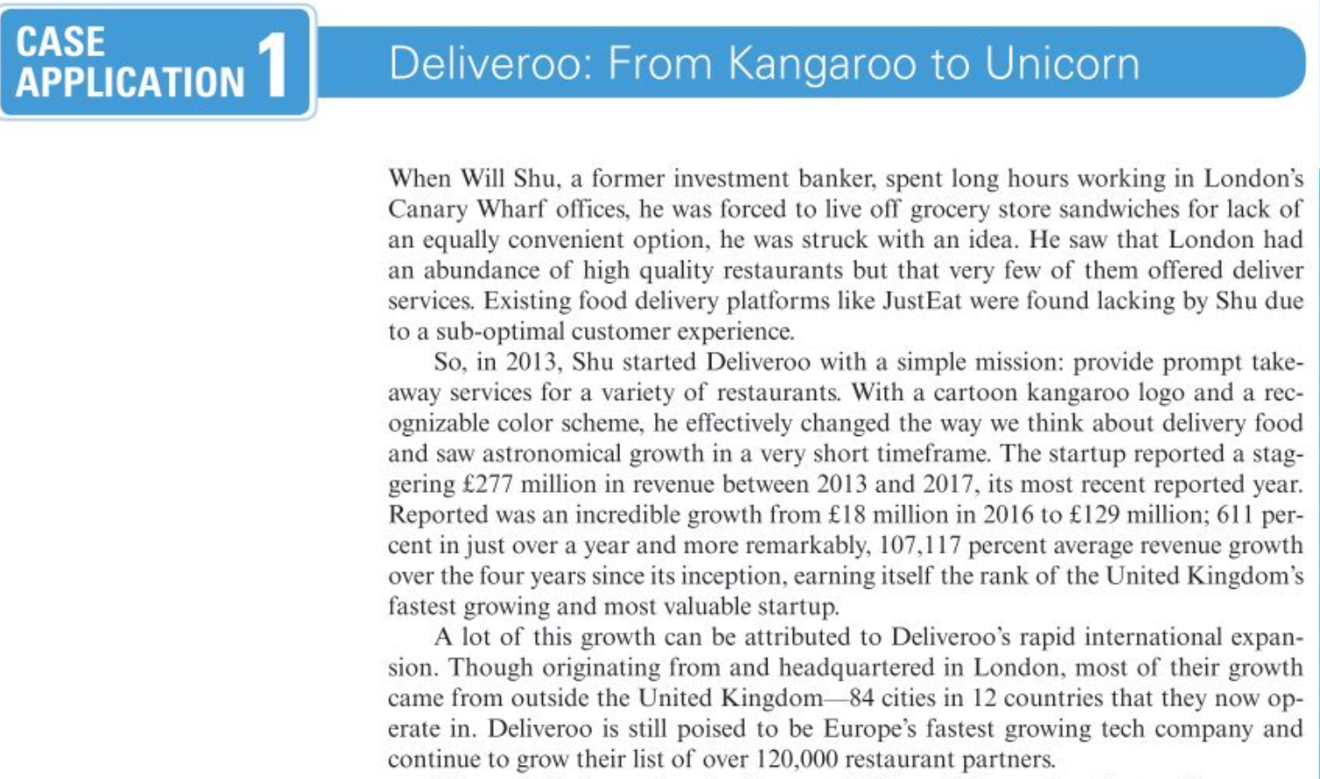

Slide 3
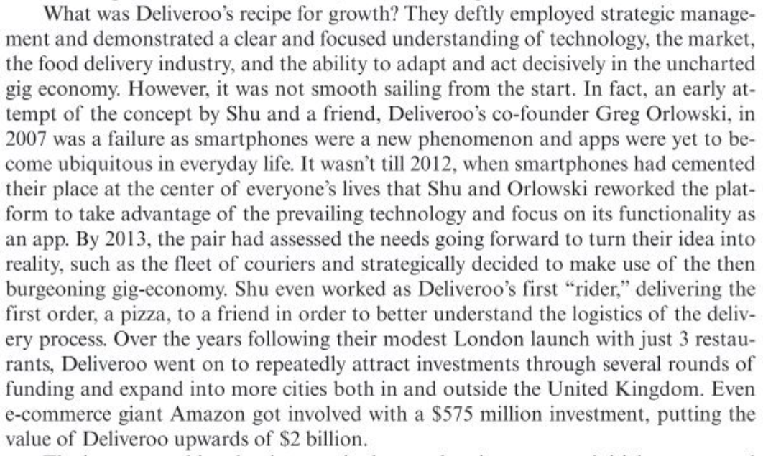

Slide 4
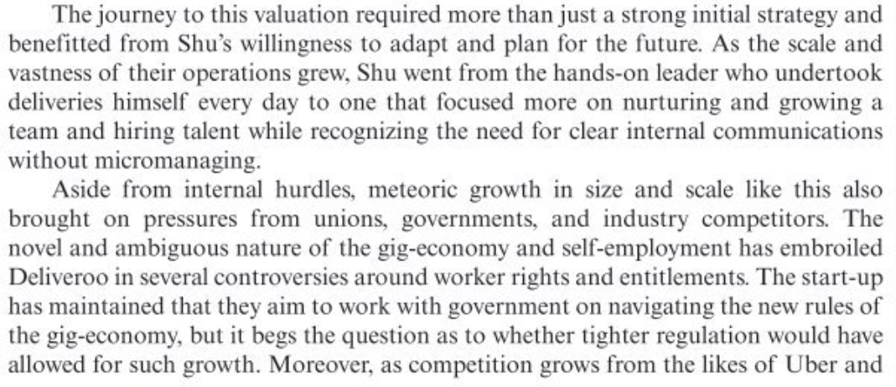

Slide 5
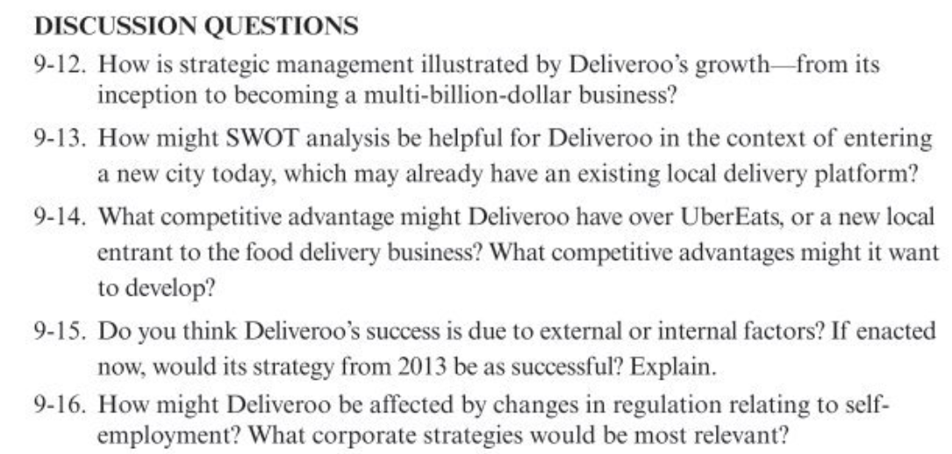

Slide 6
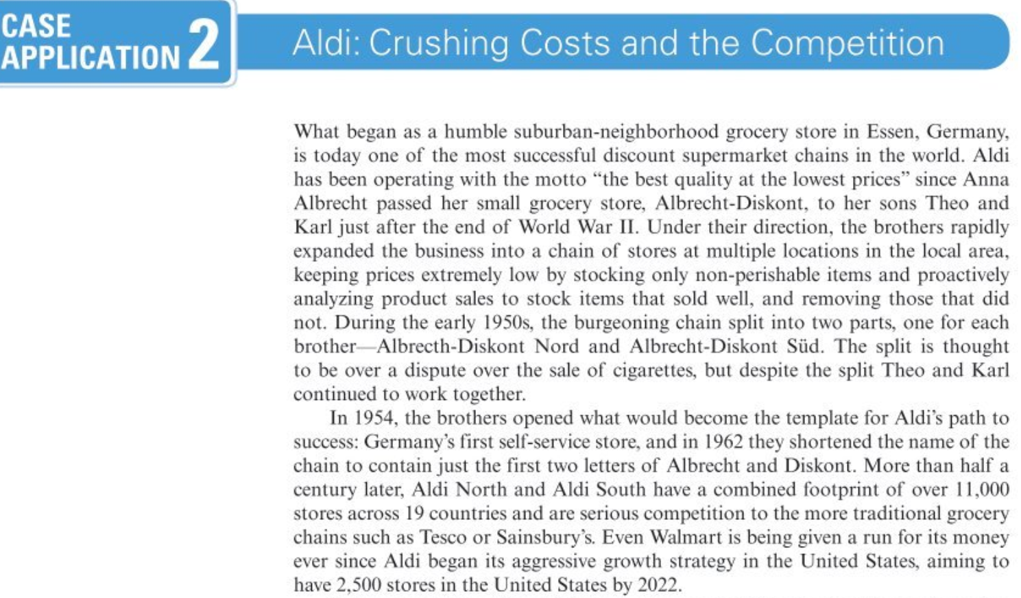

Slide 7
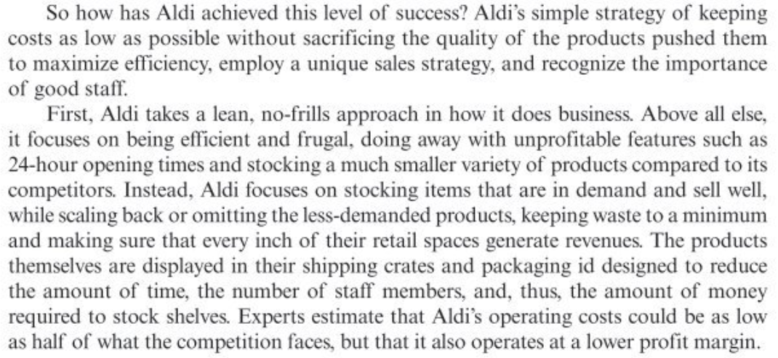

Slide 8
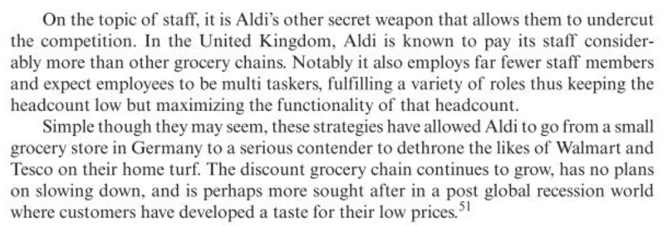

Slide 9
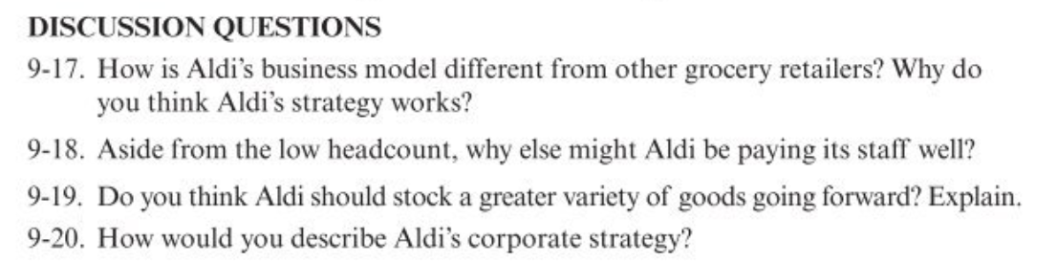

Slide 10
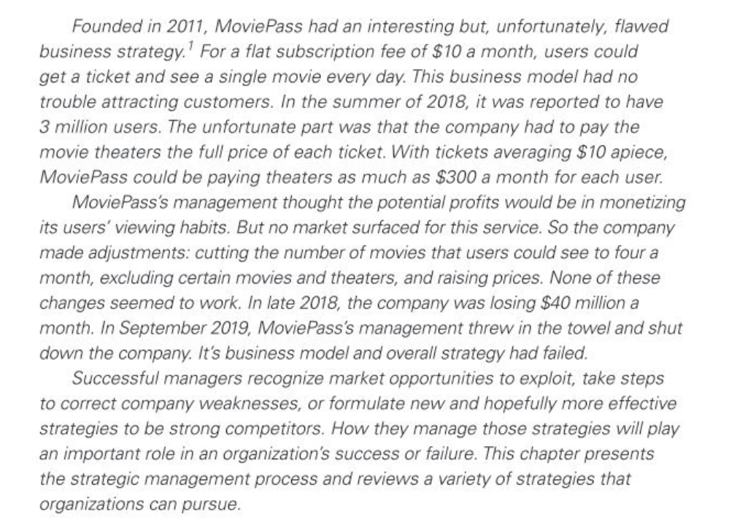

Slide 11
Handling The Big Picture
Michael E. Porter determined 2 factors above all influenced a business's chance of making superior profits
Firstly, the attractiveness of the industry or the business environment where the business organization primarily operates (in light of PESTEL analysis and Stakeholder analysis)
Secondly, how the business positions itself within that industry and business environment

Slide 12
PESTEL
P = Political Environment
E = Economic Environment
S = Socio-cultural Environment
T = Technological Environment
E = Ecological Environment
L = Legal Environment

Slide 13

Stakeholder Analysis
Stakeholder" is a person, group or organization that has interest or concern in an organization. Stakeholders can affect or be affected by the organization's actions, objectives and policies. Post, Preston, Sachs (2002)
Analysis of the interaction between stakeholders is critical

Slide 14

Stakeholder Analysis
Stakeholders are:
Owners/Investors
Employees
Customers
Suppliers
Competitors
Government
Trade Union/Employee Association
Owners' Association
Media
Social activist group
Community

Slide 15
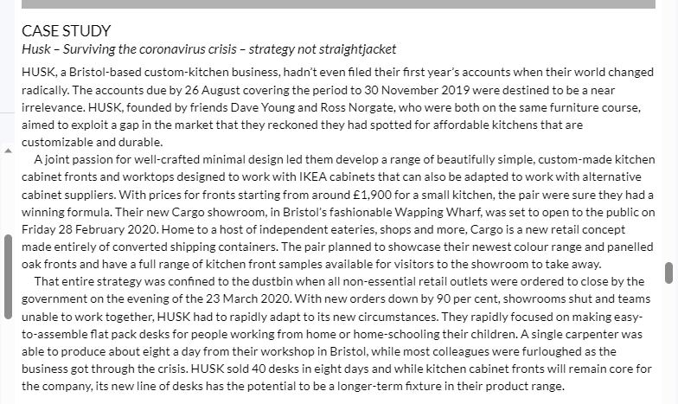

Slide 16
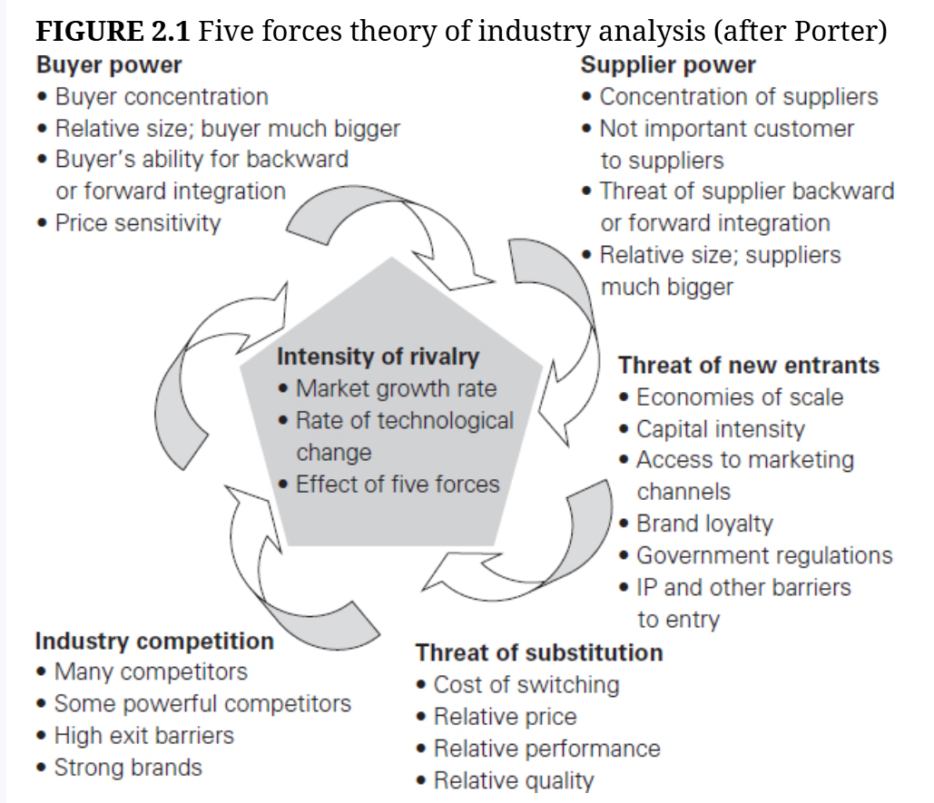

Slide 17
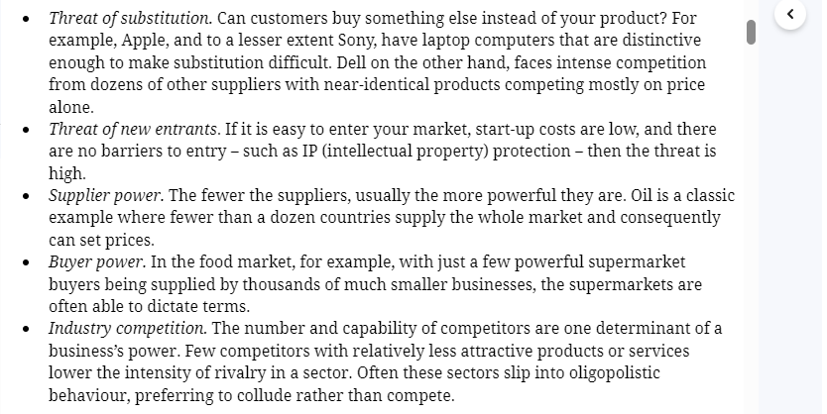
The five forces theory of industry structure

Slide 18
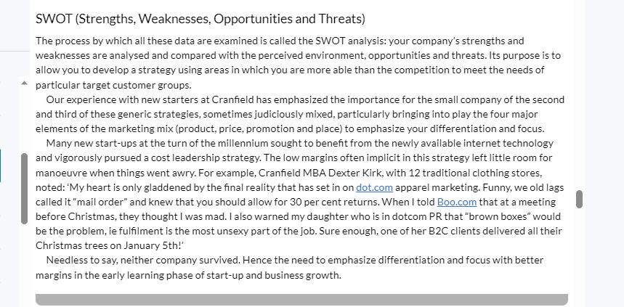

Slide 19
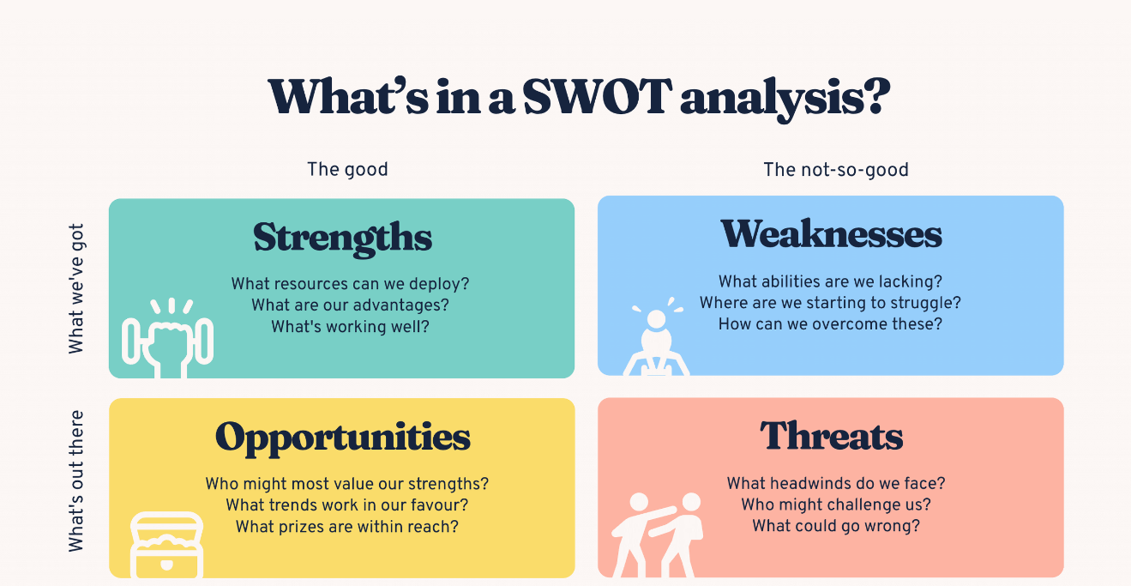
What is a SWOT analysis?
A SWOT analysis is a strategic planning technique that helps organizations identify their Strengths, Weaknesses, Opportunities, and Threats. (That’s what SWOT analysis stands for!) By examining these four elements, you gain valuable insights into your company's current position – and future potential.

Slide 20
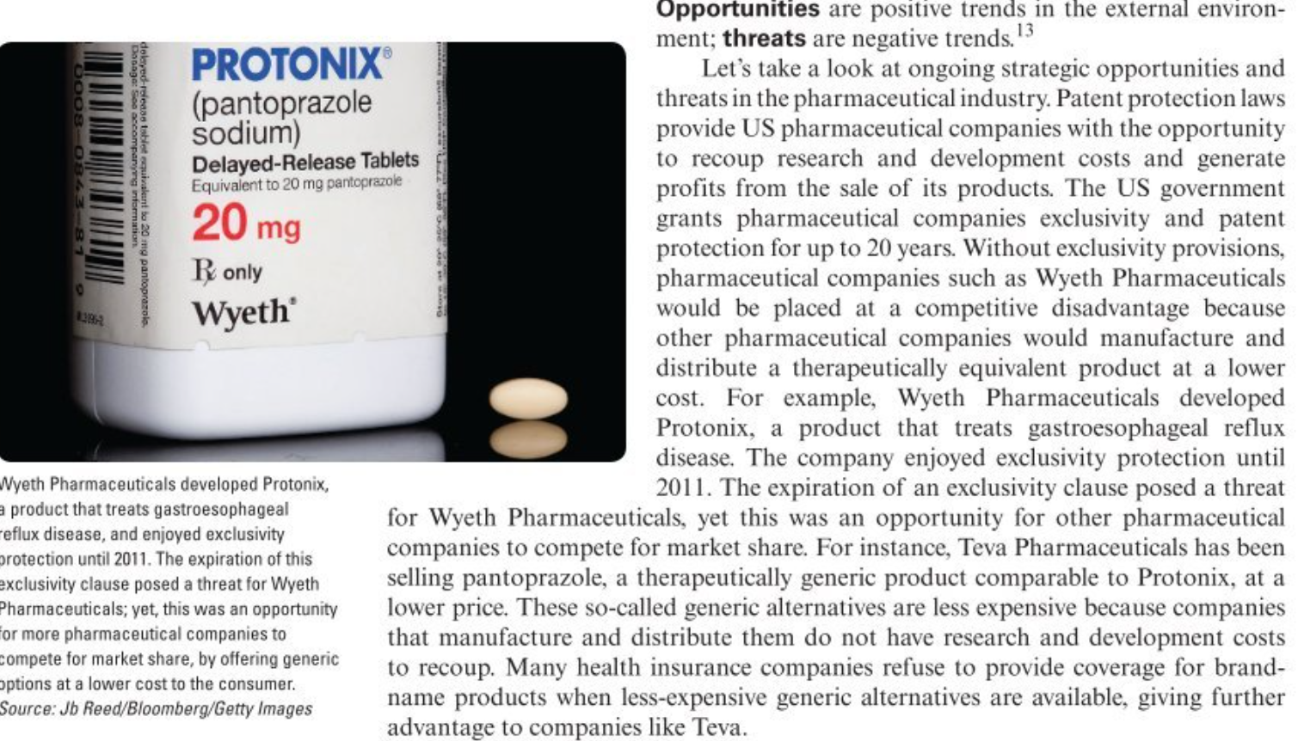

Slide 21
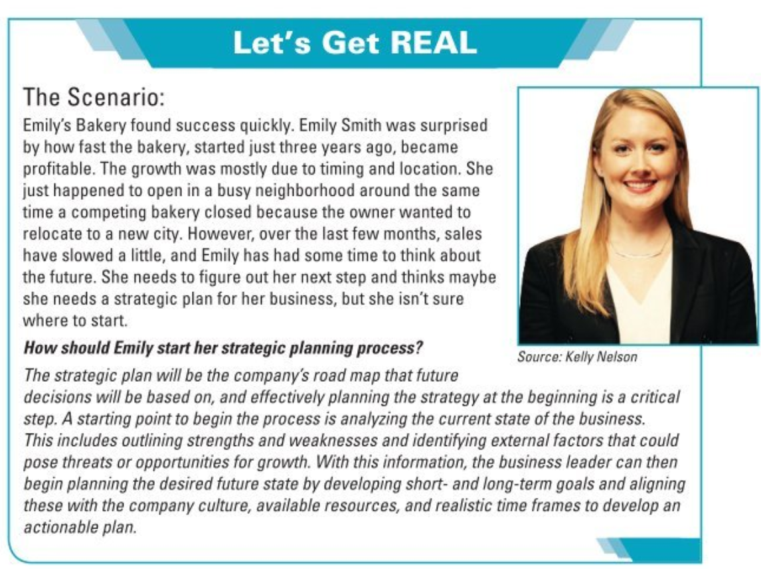

Slide 22
Generic Strategic Options
In Porter's view, a business can only pursue one of three generic strategies to deliver superior performance.
1. It can have a cost advantage in that it could make a product or deliver a service for less than others (Cost leadership strategy)
2. It could be different in a way that matters to consumers, so that its offer would be unique, or at least relatively so; (Differentiation strategy)
3. It could concentrate on a narrow, specific segment, either with a cost advantage or differentiation (Focus strategy)

Slide 23
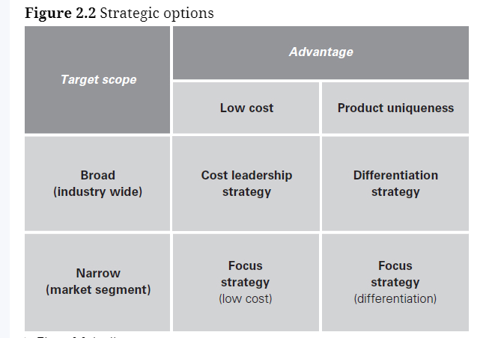
Generic strategic options

Slide 24
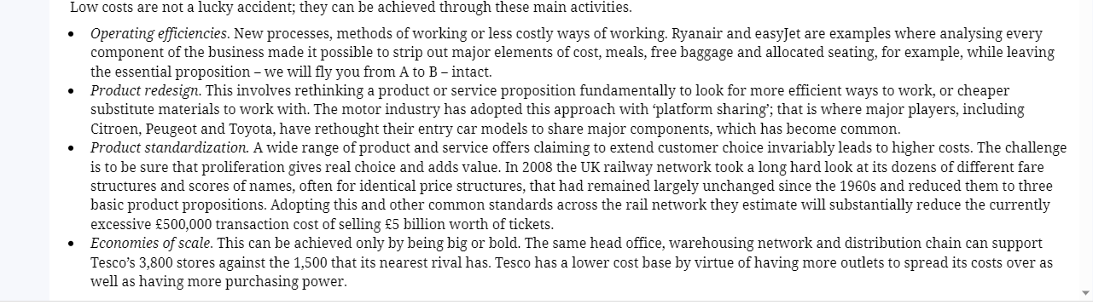
Cost leadership

Slide 25
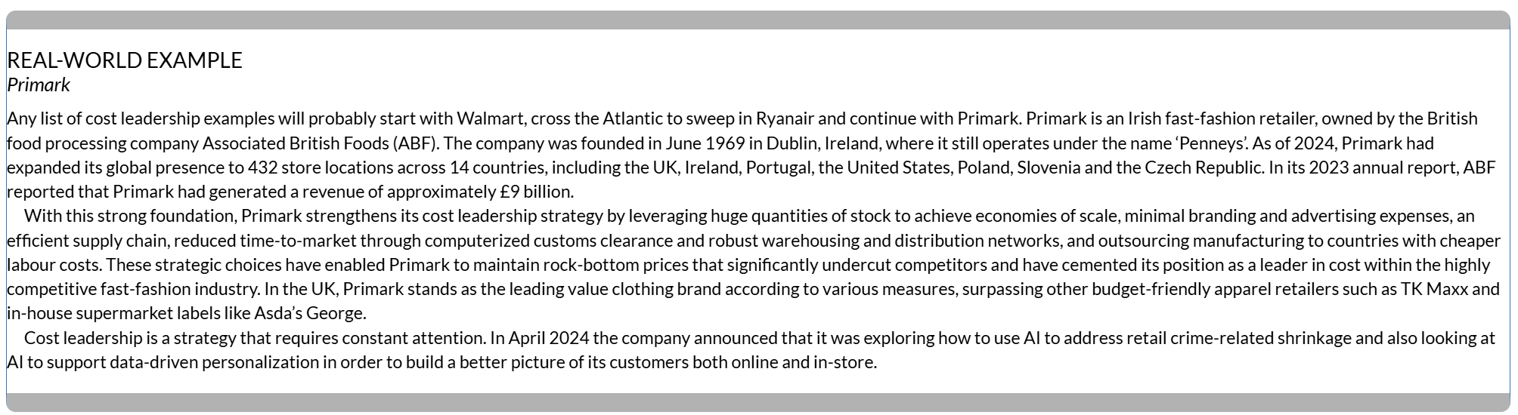

Slide 26

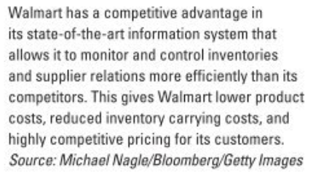

Slide 27
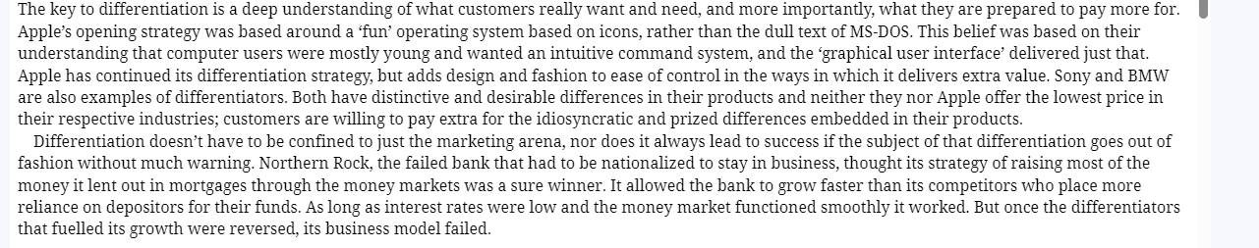
Differentiation

Slide 28
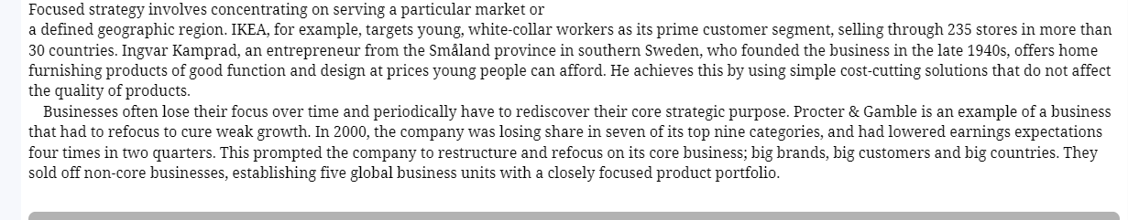
Focus

Slide 29
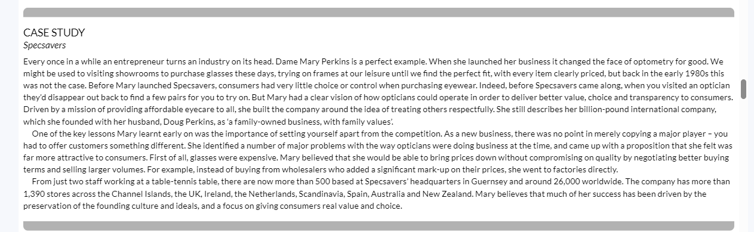

Slide 30
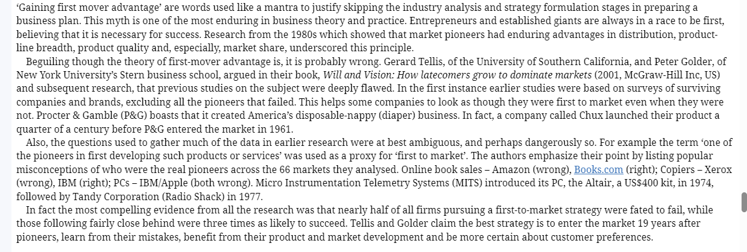
First-to-Market Fallacy

Slide 31
In-In-Class Exercises
Using Porter's five forces, analyze the factors at work in your industry
If you are expecting to be first to market, what other advantages for your proposition can you expand on in your business plan?
Describe the strategic direction being pursued by the business you are/will be competing with, i.e. focus, differentiation, cost
What strategic option will you be going for and why?
Explain how you arrived at your proposition.
What makes you believe it will succeed?

Slide 32
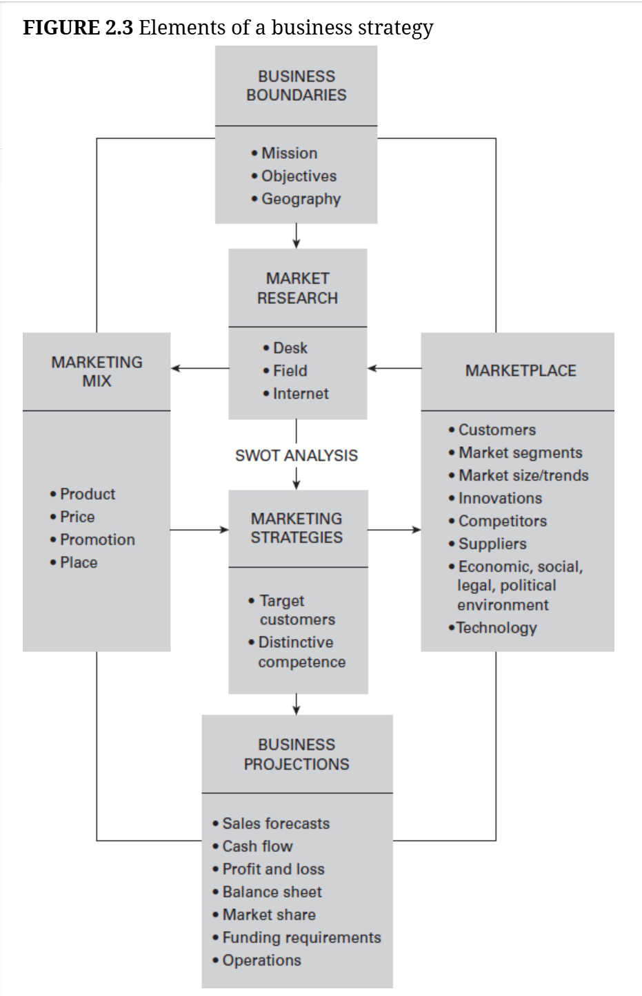

Slide 33
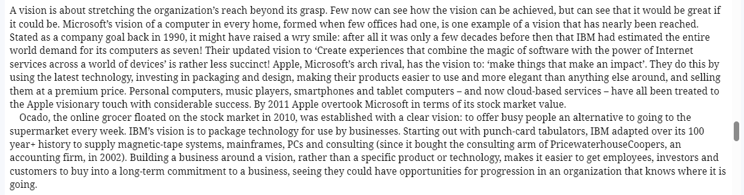
Vision

Slide 34
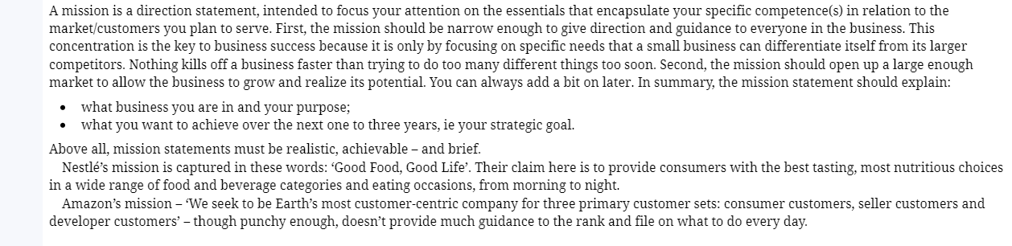
Mission

Slide 35
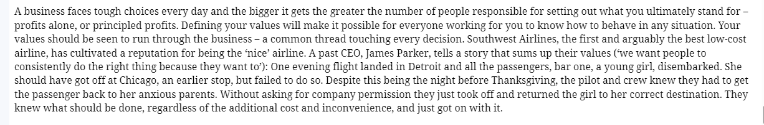
Values

Slide 36
Vision and Mission
Vision Statement – A mental picture of what you want to accomplish or achieve.
Example – Improving standard of life through a successful family dairy business.
Mission Statement – A general statement of how the vision will be achieved. The mission statement is an action statement that usually begins with the word "to".
Example – To provide unique and high-quality dairy products to local consumers.

Slide 37
Core Values
Core Values– Core values define the organization in terms of the principles and values the leaders will follow in carrying out the activities of the organization.
Core Values of the Example Business:
Focus on new and innovative business ideas
Practice high ethical standards.
Respect and protect the environment.
Meet the changing needs and desires of clients and consumers.

Slide 38
Strategies, Goals, Objectives and Action Plans
Once you have created statements of vision and mission, and possibly core values, you can then develop the strategies, goals, objectives and action plans needed to activate your mission and achieve your vision.
Strategies – A strategy is a statement of how you are going to achieve something. More specifically, a strategy is a unique approach of how you will use your mission to achieve your vision. Strategies are critical to the success of an organization because this is where you begin outlining a plan for doing something. The more unique the organization, the more creative and innovative you need to be in crafting your strategies.

Slide 39
Strategies, Goals, Objectives and Action Plans
Goals – A goal is a general statement of what you want to achieve. More specifically, a goal is a milestone(s) in the process of implementing a strategy.
Examples of business goals are:
Increase profit margin
Increase efficiency
Capture a bigger market share
Provide better customer service
Improve employee training
Reduce carbon emissions

Slide 40
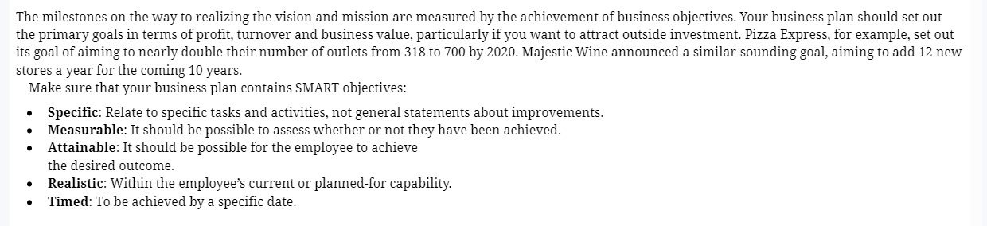
Objectives

Slide 41
Strategies, Goals, Objectives and Action Plans
Objectives – An objective turns a goal’s general statement of what is to be accomplished into a specific, quantifiable, time-sensitive statement of what is going to be achieved and when it will be achieved. Examples of business objectives are:
Earn at least a 20 percent after-tax rate of return on our investment during the next fiscal year
Increase market share by 10 percent over the next three years.
Lower operating costs by 15 percent over the next two years through improvement in the efficiency of the manufacturing process.
Reduce the call-back time of customer inquiries and questions to no more than four hours.

Slide 42
Strategies, Goals, Objectives and Action Plans
Action Plans – Action plans are statements of specific actions or activities that will be used to achieve a goal within the constraints of the objective.

Slide 43
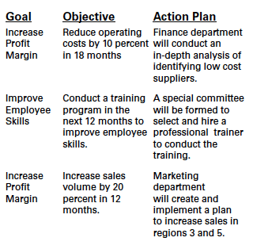

Slide 44

In-Class Exercises
Write a mission statement linking your product or service to the customer needs it is aimed at.
Write vision and values statements.
What are your principal objectives: short term and long term.
List your tasks and action plans as you see them at present.

