Slide 1
Changemakers: Building your Personal Brand for Sustainable Employment
Assignment 1 – Personal Development Plan

Slide 2
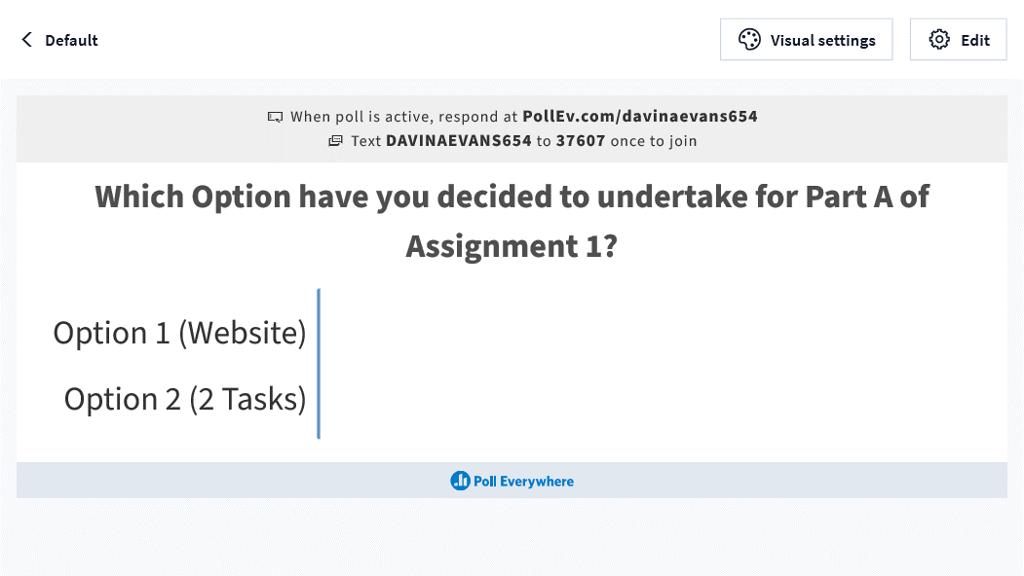

Slide 3

Personal Development Plan (PDP)
What is a PDP?
A PDP is a structured framework you can use to:
  become aware of skills you have
  identify and develop skills you need
  work out what you want to achieve and how to achieve it
  focus on potential study, career and personal development options and goals
  develop a source of information……………

Slide 4

for CVs, job applications and interviews
to support appraisals at work
to demonstrate your readiness for promotion or for development opportunities

Slide 5

PDP Process
Personal development planning is a process, which can help you to achieve your goals in three key areas.
Your Career and employability, your Study and your Personal development.
The time and effort you invest in planning around these areas will enable you to continue developing effectively throughout your life.
So, what does Personal Development Planning involve? There are five stages.

Slide 6





There are five stages:
Identify
Plan
Action
Record
Review

Slide 7
Identify:
First identify your strengths, the skills you wish to develop and then set yourself realistic goals for each area you wish to focus on: careers and employability, study, or personal development. Are there smaller short-term goals that will lead to your larger goals?
Plan:
Plan what resources you need and when you intend to work on the goals that you’ve set. Think about how much time you have available each week. Be realistic to ensure your plans are achievable.
Action:
Carry out the tasks you’ve set yourself for each goal, and be aware of any new skills that you’re picking up along the way.
Record:
Record how the process is going: the progress you’ve made and the skills you’re gaining. Where might you need to develop further? Recording your insights will help to inform your CVs, job applications and developmental reviews. It may also reveal other aspects involved in achieving your goals.
Review:
Take a step back, collate everything you’ve recorded and review what you‘ve learnt. You should be more aware of your skills and also be able to identify the next area or skill for development.

Slide 8

Remember …….
The process is flexible. You may identify new areas for development at any time or realise that you’ve gained a new skill through your work or day-to-day activities.
It's important to record what you’ve achieved and use each stage of the process to help you develop further.

Slide 9


How to Identify Your Skills

Slide 10
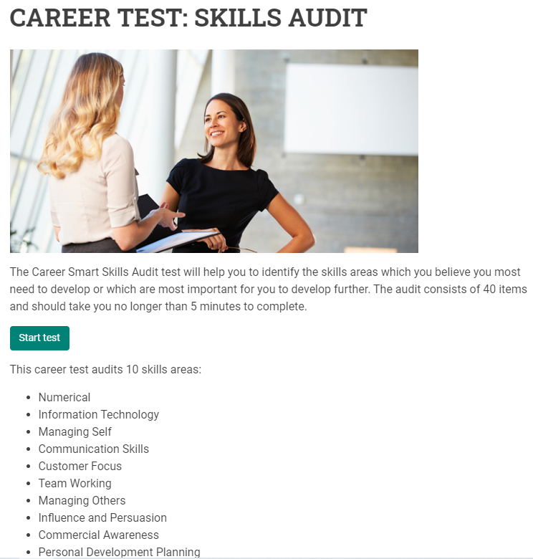
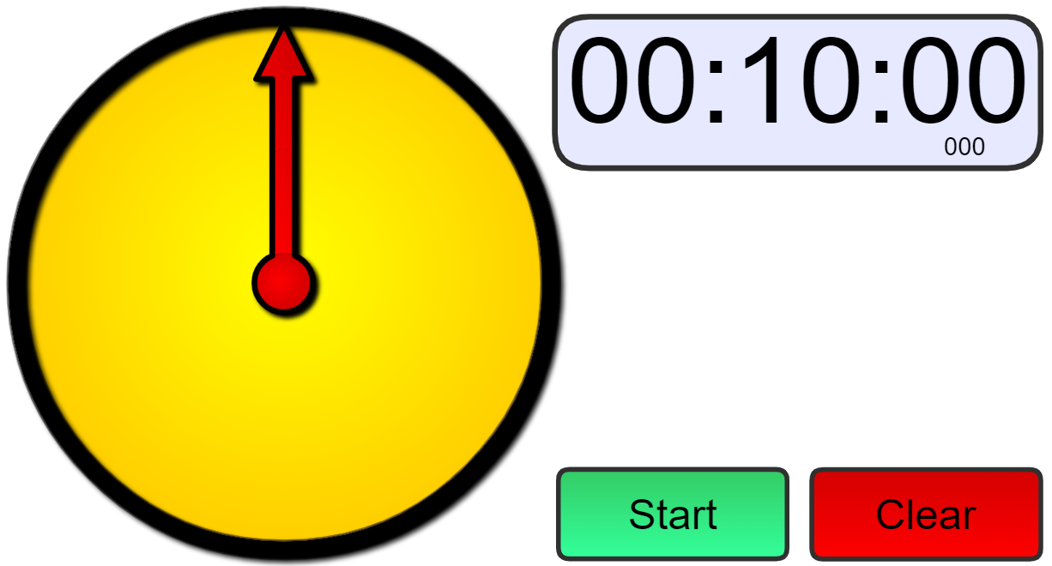
https://careersmart.org.uk/tools/career-test-skills-audit
Notes:
https://careersmart.org.uk/tools/career-test-skills-audit

Slide 11
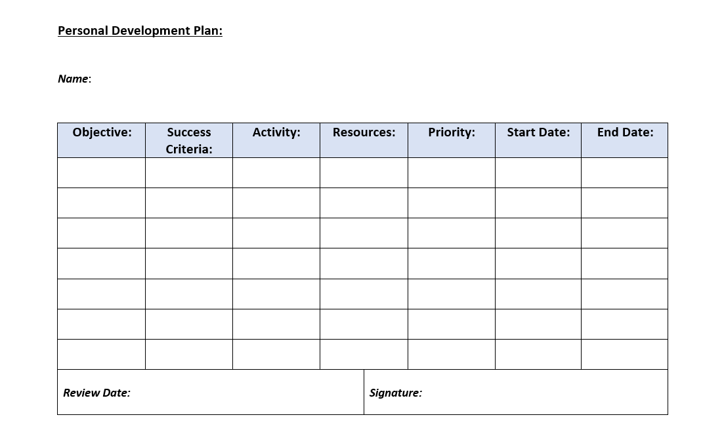

Slide 12

Plan
Identify a development need in column 1 – what objective are you specifically going to set yourself?
In column 2 you will then need to identify the success criteria – how will you know if you have achieved the objective you set yourself?
In column 3 a development activity is needed to help you with the objective you have set yourself.
In column 4 you must identify the resources you will need, this could be time, money, help form a particular person, access to specialist IT etc.
In column 5, prioritise your objectives – High / Medium / Low.
Columns 5 & 6 is where you record when you will start to work on your objectives and when you predict that you will complete it by – therefore set yourself a time-scale.

