Slide 1


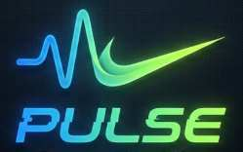
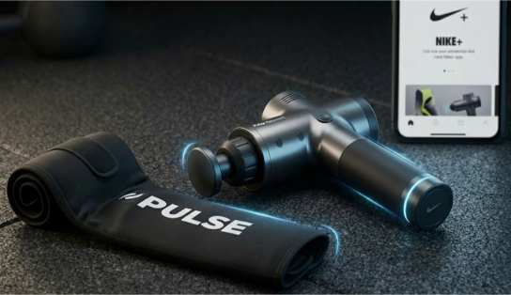
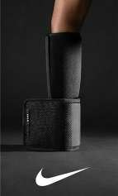
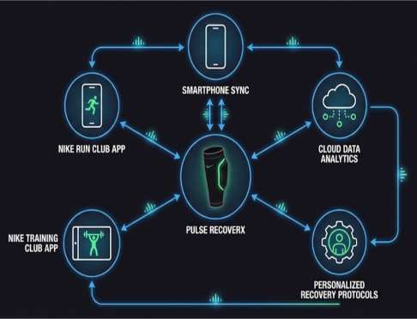
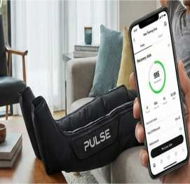
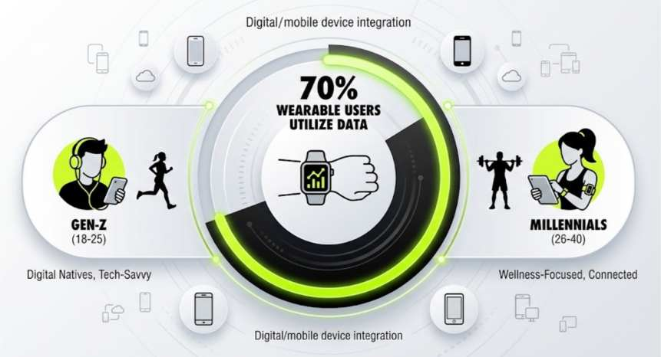
Marketing Strategy Pitch – “Pulse” by Nike
NEW BRAND DEVELOPMENT
MARKETING MIX
HOW IS THE NEW BRAND ALIGNING WITH CUSTOMER TRENDS?
Market Opportunity:
Targets $3.1 billion global sports recovery technology market
Projected growth to $10.5 billion by 2033
Recovery evolved from trend to cornerstone of modern fitness (Kisner, 2024)
Flagship Product: Pulse RecoverX
AI-powered recovery algorithms
Percussive therapy and compression technology
Seamless Nike+ ecosystem integration
Product:
Pulse RecoverX with AI-driven recovery insights
Personalized recovery protocols based on workout data
Perceived usefulness and design aesthetics focus (Wang et al., 2023)
Promotion:
Digital platforms (Instagram, TikTok, YouTube) with recovery-focused content
"Recover Like a Champion" campaign aligned with Nike's performance heritage
Consumer Demand for Recovery Solutions:
Over 70% of wearable users actively apply data to inform recovery strategies (A'Naja et al., 2024)
Recovery-focused gym memberships surged in 2024 (Kisner, 2024)
Market Growth Trajectory:
Fitness tracker market: $62.03 billion (2024) → $290.85 billion (2032) (Fortune Business Insights, 2023)
Athletes increasingly recognize recovery as essential as training itself
Gen-Z demonstrates high adoption rates for wearable fitness technology (Ezurike, 2023)
CONCLUSION
Pulse aligns with Nike's commitment to athlete-centered innovation (Nike.com, 2025), positioning Nike to capture the recovery revolution. Investment opportunity: Transform post-workout recovery with Nike's performance heritage.
REFERENCES
A'Naja, M. N., Batrakoulis, A., Camhi, S. M., McAvoy, C., Sansone, J. S., & Reed, R. (2024). 2025 ACSM worldwide fitness trends: future directions of the health and fitness industry. ACSM's Health & Fitness Journal, 28(6), 11-25.
Ezurike, N. (2023). Awareness and adoption of wearable technology amongst Gen-Z in selected Fitness Centres in Lagos State, Nigeria. Int. J. Manag. Technol, 10, 20-37.
Fortune Business Insights (2023). Fitness Tracker Market Size, Share, Trends | Global Analysis, 2020-2027. [online] www.fortunebusinessinsights.com. Available at: https://www.fortunebusinessinsights.com/fitness-tracker-market-103358.
Kisner, K. (2024). Recovery Redefined: How 2024 Transformed Fitness and Wellness. [online] Athletech News. Available at: https://athletechnews.com/recovery-redefined-how-2024-transformed-fitness-and-wellness/ [Accessed 24 Nov. 2025].
Nike.com. (2025). Nike Creates New Innovation Engine to Power Athletes Faster — NIKE, Inc. [online] Available at: https://about.nike.com/en/newsroom/releases/nike-new-innovation-engine-announcement.
Wang, Z., Fang, D., Liu, X., Zhang, L., Duan, H., Wang, C., & Guo, K. (2023). Consumer acceptance of sports wearables: The role of products attributes. Sage Open, 13(3), 21582440231182653.
SEGMENTATION
Demographic: Gen-Z and Millennials (ages 18-40), mid-to-high income fitness enthusiasts
Geographic: Urban centers with high fitness culture adoption (North America, Europe, Asia-Pacific)
Psychographic: Tech-forward, data-driven consumers who prioritize holistic wellness and active recovery (Ezurike, 2023)
Behavioural: Wearable technology users who actively track fitness metrics and seek performance optimization
Notes:
Nike introduces a new product, Pulse, a smart fitness recovery device that targets $3.1 billion sports recovery technology market in the world and would reach 10.5 billion billion in the year 2033 (Futuredatastats.com, 2024). Pulse RecoverX is our flagship product, and it responds to the underlying paradigm change recovery has turned into trend and staple of contemporary fitness (Kisner, 2024). Gen-Z and Millennials make up our target market and have high levels of embrace of wearable-based fitness technology products (Ezurike, 2023), with more than 70 percent of the wearable users currently utilizing the data to inform their recovery plans (A'Naja et al., 2024). The wider market in fitness trackers shows a spectacular growth of $62.03 billion to an expected of 290.85 billion by 2024 and 2032 respectively (Fortune Business Insights, 2023).
The points of differentiation offered by Pulse include AI-based recovery algorithms, built-in Nike+ systems, and professional-level technology previously only available to professional athletes. Our premium offering taps into the expanding consumer readiness to spend their money on recovery-based solutions: recovery-based gym memberships are rising in 2024 (Kisner, 2024). These features can be used to align the Pulse brand with the sport-related innovation that Nike is dedicated to ( Nike.com, 2025) as it focuses on perceived usefulness and design aesthetics, which were the most important drivers of adoption (Wang et al., 2023).
Investment prospective: Reclaim the revolution of performance with Nike performance heritage.

