Slide 1
Engaging with Anthropological Theory:
An Overview
Module AHAN 7036
Module convenor : dr Adrian Davis

Slide 2
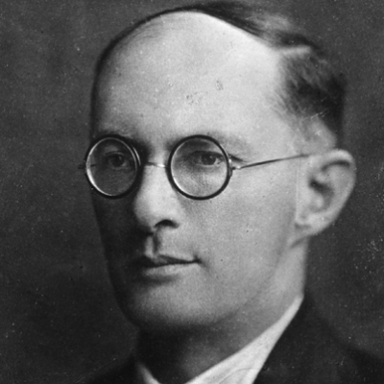
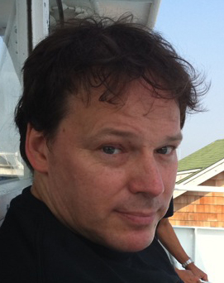
Social Anthropology: Now and Then
It is extraordinarily difficult to compare the incipient ‘Functionalism’ of a Social Anthropologist like Branislaw Malinowski and his pioneering field work in the Trobriand Islands with the contemporaneous Social Anthropology and ‘Anarcho-syndicalism’ of an advocate like David Graeber and his activities with the ‘Occupy movement’ at ‘Wall Street’.
This module proposes to account for this difference by triangulating the theories of Karl Marx, Michel Foucault and Bruno Latour around a hypothesis in the context of contemporary anthropological theory.
Notes:
Why is there this difficulty? Is it even possible to talk about the same discipline : Social Anthropology? What if anything do they have in common? Do they share an underpinning ‘theoretical’ outlook or not? Moreover, when one examines the detached, descriptive and patrician functionalism in Malinowski’s (1922) concept of ‘reciprocity’ and ‘exchange’ set out in his Argonauts of the West Pacific and contrast this with the emancipatory activities and radicalised prose of David Graeber in works such as his 2012 republished (2006) essay Dead Zones of the imagination: On violence, bureaucracy, and interpretive labour it is evident that the theoretical underpinnings are paradigmatically different.

Slide 3
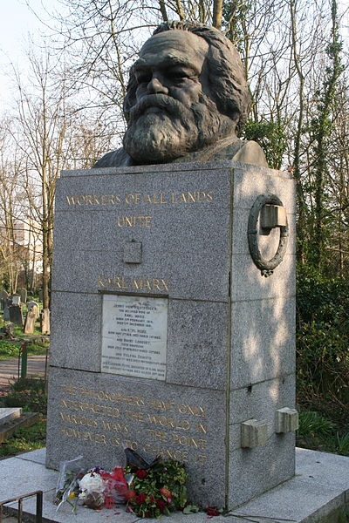
Marx: from ‘Interpretation’ to ‘Change’
Hypothesis: the theoretical shift from Malinowski's (1922) Argonauts of the West Pacific to Graeber’s (2012) Dead Zones of the imagination in Social Anthropology is one which resolutely substitutes ‘interpretation’ for ‘change’.
This ‘hypothesis’ contends that there has been a paradigmatic shift in anthropological theory which turns on a much older philosophical embrace of Marxian dialectics and especially the final injunction in Marx’s (1888) ‘Theses on Feuerbach’: ‘Philosophers have hitherto only interpreted the world in various ways; the point is to change it’.
Notes:
We might begin by assessing how a variant of this ‘change’ appears to be asserted implicitly in Graeber’s (2012) republished essay Dead Zones of the imagination: On violence, bureaucracy, and interpretive labour when he observes how ‘Anthropologists are drawn to areas of density. The interpretive tools we have at our disposal are best suited to wend our way through complex webs of meaning or significance : to understand intricate ritual symbolism, social dramas, poetic forms, or kinship networks. What all these have in common is that they tend to be both infinitely rich, and at the same time open-ended’.
It is inevitable that there are - as one would expect, many extant theories in contemporary anthropology which differ from this hypothesis and it would be hugely difficult to do justice their many eminent exponents and apologists. This fact should not worry us unduly: our task will be to put this hypothesis to work and to the test.
However, we need to unpack these ‘tools’ Graeber (2012) refers to as he does not give us the level of detail that we need. This will be another task over the coming weeks: unpack these ‘interpretive tools’. These may have been sufficient for several generations of anthropologists but are they still fit for purpose?

Slide 4
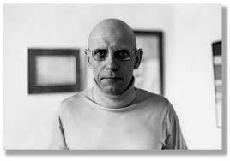
Foucault: the concept of ‘problematization’
Following on from an overview of Marx and the Marxian dialectic in weeks 2 – 5, we then turn to an examination of the rich, critical and conceptual possibilities afforded within Foucault's’ oeuvre – weeks 5 – 8 before looking specifically at what the conceptual tool of ‘problematization’ offers Social Anthropological theory – a tool which he outlines and ably abridges thus:
‘[M]y attitude isn’t a result of the form of critique that claims to be a methodological examination in order to reject all possible solutions except for the one valid one. It is more on the order of ‘problematization’—which is to say the development of a domain of acts, practices and thoughts that seem to me to pose problems to politics” (Foucault, 1984).
For Freire (1972) problematization is a pedagogical practice that disrupts taken-for- granted “truths”. This objective is accomplished by posing the “myths fed to the people by the oppressors” as “problems” (Freire, 1972: p. 132).
Notes:
We will look at the vast range of Foucault through the ‘specificity’ (to borrow his terminology) of his notion of problematization. Moreover, if Freire (1972) et al are broadly correct then the ‘myth’s fed to the people by the oppressors’ as ‘problems’ would take us deep into Marxian horizons of ‘ideology’ or ‘alienation’ and ‘false consciousness’.

Slide 5
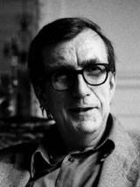
Bruno Latour: ‘Reassembling the Social’
We need to reassemble what Latour calls the ‘older definitions of the social’ or their ‘assemblies and ‘assemblages’ (Latour 2005: 248).
My sense here with Latour is that we might easily substitute Graeber’s (2012) ‘interpretive tools’ for Latour’s ‘older definitions of the social’ or outmoded ‘assemblies’ and ‘assemblages’ once fit for purpose but perhaps in need of a conceptual and philosophical overhaul . It would therefore be our task to reassemble these ‘interpretive tools’ as a means of engaging critically with Anthropological Theory.
There is little doubt we are well equipped with ‘interpretive tools’ (Geertz 1973 and Graeber 2012) but this is no longer sufficient - or at least that is the working hypothesis. The task before us then is to ‘reassemble’ (Latour) these ‘tools’ and ‘problematize’ them (Foucault).

Slide 6
The interpretation of Cultures is substituted for the reassembling and ‘problematization’ of the concepts (tools) we use to examine them
When Clifford Geertz (1973) wrote – paraphrasing Max Weber, that ‘… man is an animal suspended in webs of significance he himself has spun, I take culture to be those webs, and analysis of it to be therefore not an experimental science in search of law but an interpretive one in search of meaning’ he privileges ‘interpretation’ over change or changing as Marx asserted we needed to.
If my hypothesis holds and we substitute ‘interpretation’ for ‘change’ the question then becomes ‘if we are not in the business of interpreting what Graeber (2012) calls this anthropological ‘Density’: what are we to do? How are we to change it?’
My sense is that we will need to problematize and ‘reassemble’ the very conceptual tools that have hitherto served us so well in Anthropology. The restless search for meaning that characterises ‘interpretation’ and its open endedness may not be serving our needs as theoreticians in anthropology.

Slide 7
Selected bibliography/reference list
Foucault, M. (1984). Polemics, politics and problematizations, based on an interview conducted by Paul Rabinow. In L. Davis. (Trans.), Essential works of Foucault (Vol. 1), Ethics, New York: New Press.
Freire, P. (1972). Pedagogy of the oppressed. Harmondsworth: Penguin.
Geertz, C (1973). The Interpretation of Cultures 2000 paperback.
Graeber (2006/2012). Dead zones of the imagination: on violence, bureaucracy, and interpretive labor, H AU : Journal of Ethnographic Theory 2 (2): 105–28
Latour (2005). Reassembling the Social: An Introduction to Actor-Network-Theory. OUP.Oxford.
Marx (1848/59) The German Ideology/A Contribution to a Critique of a Political Economy (MIA)

