Slide 1

Name: Katie Pettitt
Student Number: 2127724
Lecturer Name: Opeyemil odejimi
Module Code: LCHS4005_BIRM
Professional development within health and social care

Slide 2


The focus of my presentation will be on the value of effective communication in the context of health and social care. The talk will give a real-world illustration of when and how communication is employed in the health and social care industry.
. Explaining how communication plays an instrumental role in health and social care and is a core aspect of your working relationships. Being able to communicate effectively is a skill that has a range of benefits, perhaps most importantly that it helps you to deliver person-centred, high-quality care.
Notes:
A positive attitude in a Health and Social care setting is very important as the care giver you can make a huge difference in how your patients feel it can help them feel they are being cared for with compassion.
A positive attitude is essential for providing exceptional care to patients, for people to feel comfortable around you

Slide 3
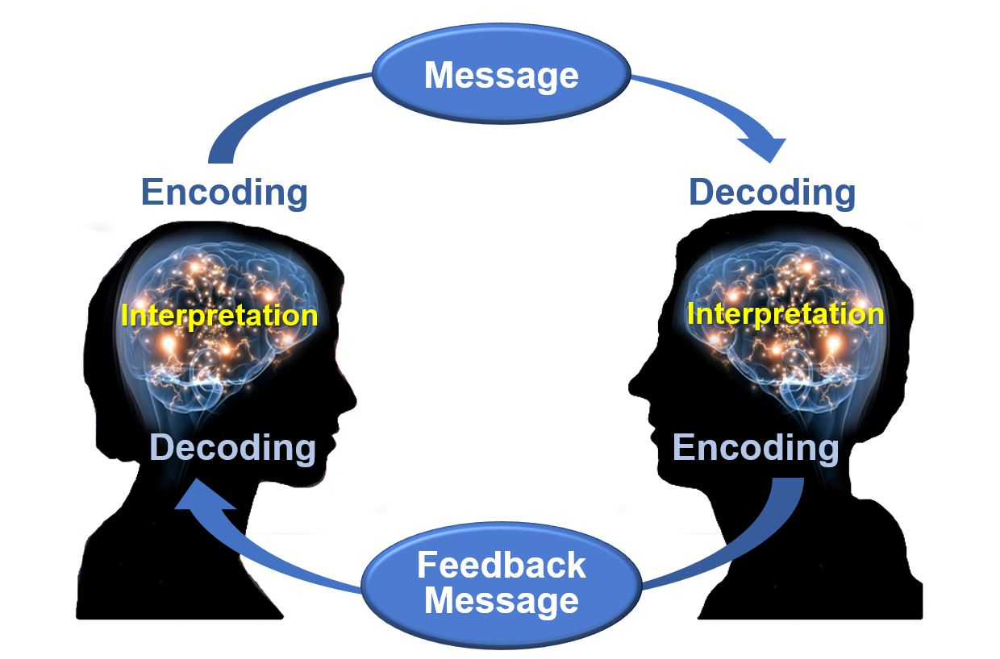


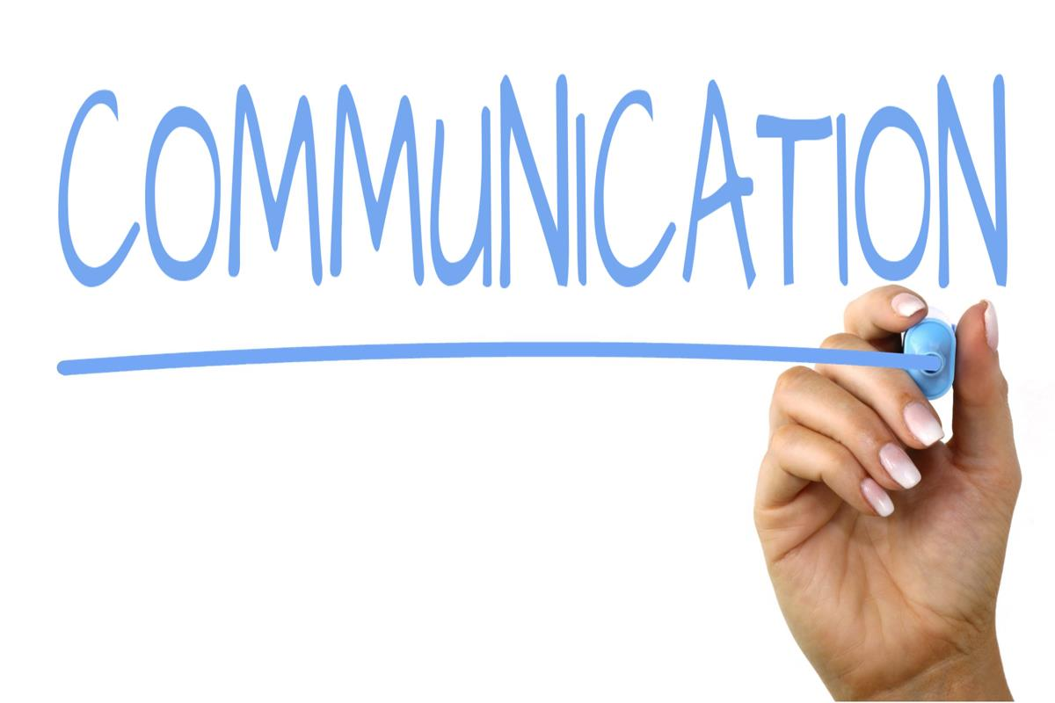

This Photo by Unknown author is licensed under CC BY.
Communication is an essential skill for nurses, midwives and allied health professionals when delivering care to patients and their families.interacting with people and their environment is the process of communication for instance, when two or more individuals interact, their opinions and thoughts are influenced.
Good communicators pay close attention, listen carefully, and speak clearly. it's important to communicate clearly in both professional and personal contexts.
Empathy improves our ability to understand other people and situations, settle disputes, build relationships based on trust and respect, and promotes an atmosphere that is suitable to the discussion of novel concepts and the resolution of problems.
Communication in health and social care refers to the exchange of knowledge and directives between experts in these fields as well as between those individuals and patients or family members. This is important because it has an impact on how people are treated medically and socially
. https://www-vlebooks-com.ezproxy.uwtsd.ac.uk/Product/Index/1665377?page=0#:~:text=Communication%20is%20an%20essential%20skill%20for%20nurses%2C%20midwives%20and%20allied%20health%20professionals%20when%20delivering%20care%20to%20patients%20and%20their%20families.
This Photo by Unknown author is licensed under CC BY-SA-NC.
This Photo by Unknown author is licensed under CC BY-NC.
This Photo by Unknown author is licensed under CC BY.
This Photo by Unknown author is licensed under CC BY-SA.

Slide 4

Communication is Key
Effective communication has a positive effect on health outcomes, so all staff members working in a health and social care environment must be able to do so.
Patients and those who matter to them want to be informed or even involved in making decisions in regard to their own health care.
When doctors use communication skills effectively, both they and their patients benefit. Firstly, doctors identify their patients' problems more accurately.1 Secondly, their patients are more satisfied with their care and can better understand their problems, investigations, and treatment options.
Maguire, P. and Pitceathly, C., 2002. Key communication skills and how to acquire them. Bmj, 325(7366), pp.697-700.
Effective communication generates a positive connection between people. Ineffective communication can lead to confusion, frustration, conflict and low morale. The function of effective communication is to relay a particular message in such a way that results in a mutual understanding. There is a process of encoding and decoding
involved.https://www.bing.com/search?q=effective+vs+non+effective+communication&FORM=R5FD1#:~:text=Date-,Effective%20communication%20generates%20a%20positive%20connection%20between%20people.%20Ineffective%20communication%20can,mutual%20understanding.%20There%20is%20a%20process%20of%20encoding%20and%20decoding%20involved.,-Effective%20%26%20Ineffective%20Communication
This Photo by Unknown author is licensed under CC BY-NC-ND.

Slide 5
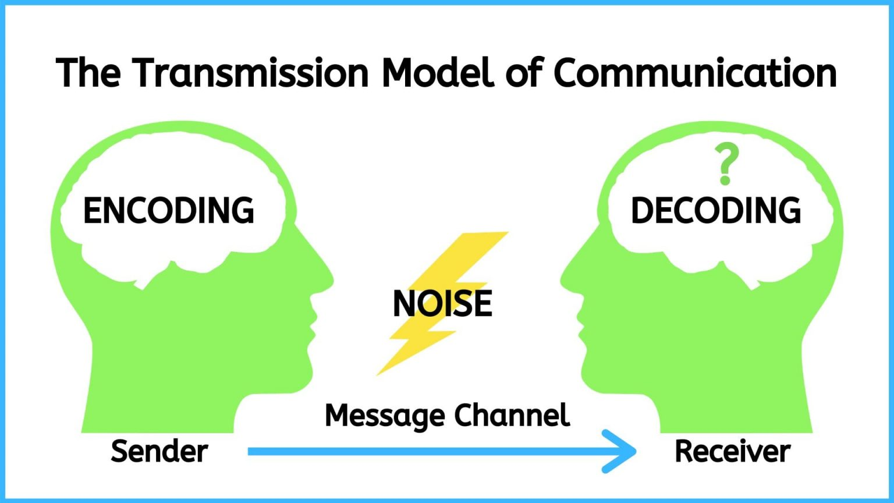
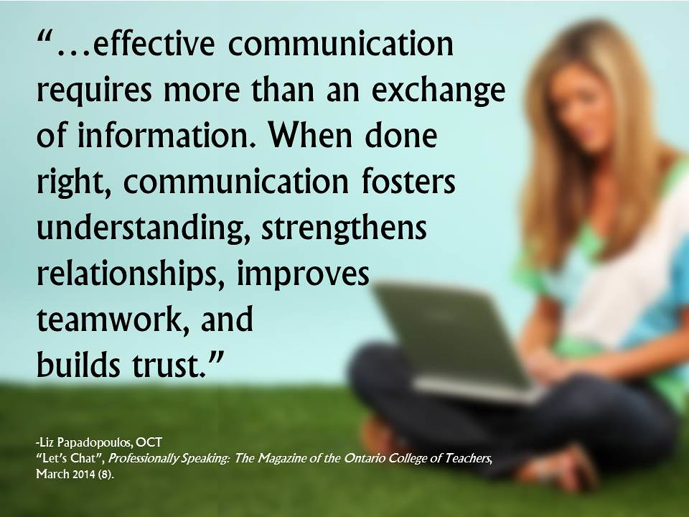
5 Keys to Effective Communication.
Choose
Choose your words wisely.
Listen
Listen to what others say.
Consider
Consider your tone, inflection, and body language.
Write
Write less say more.
Know
Know when to stop.
This Photo by Unknown author is licensed under CC BY-NC.
This Photo by Unknown author is licensed under CC BY-NC.

Slide 6

Practical Example
Verbal communication, such as giving instructions to a care worker or conversing with a colleague about a client, is a real-world illustration of the importance of good communication in a health and social care context. I looked after a lady who required round-the-clock care, and in order to provide her the greatest care possible, we all had to communicate as effectively as we could. She was unable to talk/walk after suffering a terrible stroke, so we were her voice while also helping her to determine what she desired on a daily basis. She was set in her ways and liked things to be done in a certain way so we needed to be patient and compassionate and when new members of staff started we had to make sure they knew the routine the way we do it so Erika was happy and comfortable the last thing anybody wanted was for her to be upset so again this has a lot to do with Communication between everyone.

Slide 7
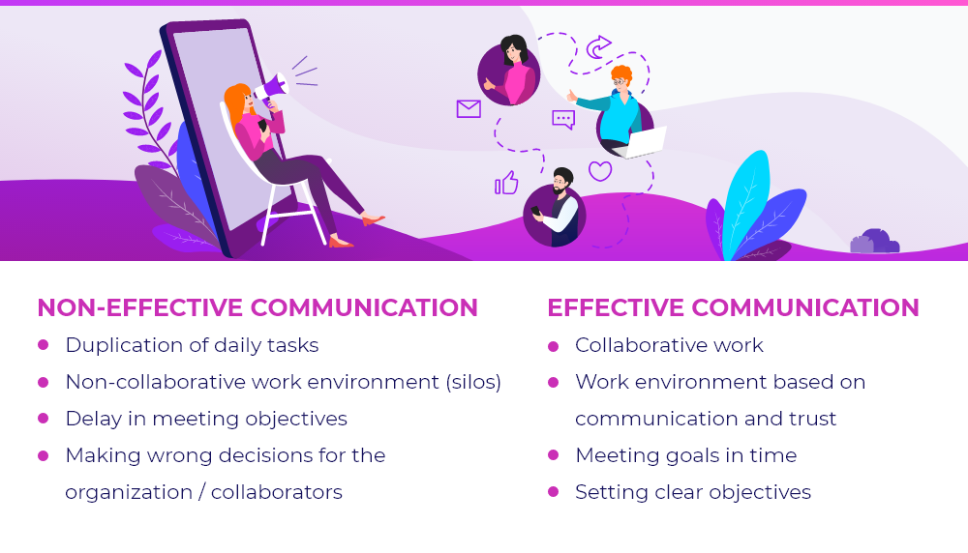
Conclusion
The most crucial aspect is communication. To live a fuller and happier life, it is important to share one's thoughts and feelings.
The more we communicate, the less suffering we experience and the better we feel about everything around us.
Communication skills are also crucial for patient safety, customer service wellbeing, and satisfaction.
Effective communication methods will guarantee that the audience is aware of the speaker's or writer's intended message.

Slide 8

Humanistic psychologist Carl Rogers (1902–1987) is most known for his theories on personality and self-actualization as well as his opinions on the therapeutic relationship.
According to Rogers (1959), a person can only "develop" in a setting that fosters authenticity (openness and self-disclosure), acceptance (being treated with unwavering positive esteem), and empathy (being listened to and understood). Similar to how a tree won't grow without sunlight and water, relationships and healthy personalities won't flourish the way they should without these characteristics. According to Rogers, everyone is capable of achieving their life's objectives.
Self actualization happened once they did it, or rather if they did it. For a person to realise their full potential, this was one of Carl Rogers' most significant contributions to psychology.
Hence, Carl Rogers' idea is an appropriate analogy to communication because it contends that we should be more concerned with communicating with individuals than pointing out their mistakes.
Theory (Carl Rogers)

Slide 9
https://www-vlebooks-com.ezproxy.uwtsd.ac.uk/Product/Index/1665377?page=0#:~:text=Communication%20is%20an%20essential%20skill%20for%20nurses%2C%20midwives%20and%20allied%20health%20professionals%20when%20delivering%20care%20to%20patients%20and%20their%20families. https://pressbooks.senecacollege.ca/buscomm/chapter/1-3-the-communication-process/
References

