Slide 1

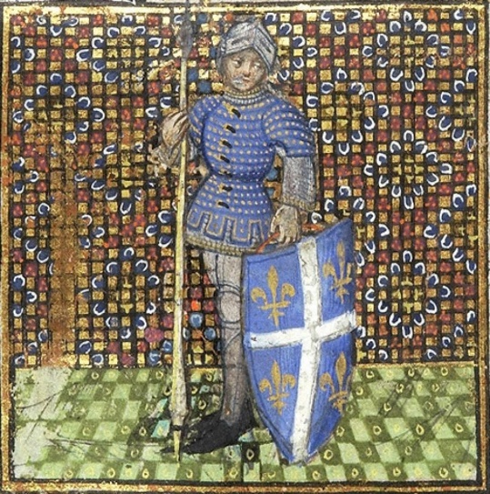
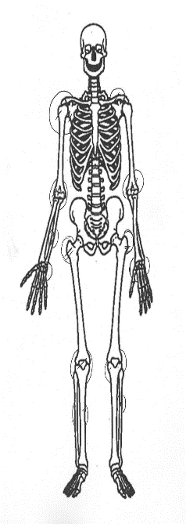

Introduction
This research is to see if it is possible to identify an individual’s social status by analysing battlefield related trauma in skeletal remains¹ by using medieval manuscript iconography² to create uniform harness sets. And The mass grave from the Battle of Towton was used for evidence of battlefield related trauma. Then place the individuals into the harness sets. The Battle was fought during the War of the Roses a period of almost constant conflict between the houses of York and Lancaster which created arguably the bloodiest period of British history. the end of the fighting it was recorded that 27,000 laid dead at the end of the fighting the river ran red with blood for months after. ‘Twenty seven thousand the rose killed in the field’³
Methods
Manuscript iconography from 15th century Europe was used as well as skeletal remains from Towton. the initial focus was on iconography from England but an expansion of the area was needed due to the minimal data which is in the public domain an example of this can be seen in figure 3 this was then used to create 5 uniform harness sets, once the iconography had been analysed taking each part of the armour and identifying the popular pieces due to the frequency the piece appears within the iconography. Attention shifted to the skeletal remains. Emphasis at first was concentrated on the cranial wounds looking at wound type as seen in figure 1. Once the skeletal remains had been put into their groups it became clear for the need to analyse how many of these individuals’ sustained post cranial wounds further to obtain information as to what protection the individuals were using on the rest of their bodies as seen in figure 2. This is then used to identify where the individual was lacking protective equipment. And to then place each individual to one of the harness sets linked to their perceived status.
The Beauty of Art & the Beast of War
Can social status be inferred when comparing medieval manuscript iconography relating to conflict with battle related trauma present in skeletal remains?
Results
The analysis of the iconography provides clear indication of 5 uniform sets which were created. The archer, poorly equipped man at arms, suitably equipped man at arms, well equipped man at arms, and the harness of a nobleman. from the analysis of the iconography and the skeletal trauma all of the individuals were able to be placed within the uniform harness sets with 11 being placed in the archers set due to the volume of sharp cranial trauma, 1 in the poorly equipped category, 6 in the suitably equipped, 1 in the well-equipped and 1 individual in the nobility category. Showing that in principle it is possible to identify social status by comparing battlefield related trauma and manuscript iconography.
Discussion and conclusions
From the results it is clear to see that there are successes to this research. All of the individuals were able to be placed within one of the 5 uniform harness sets. But a theory has been proposed by Andrew Boardman that would explain the large amount of cranial wounds. The theory is that these men were cut down in the route of the battle which would explain the large amounts of cranial wounds and the direction of attack as in the route individuals would have made themselves as light as possible by removing any pieces of armour that could have been taken off in haste. Applying this theory to the research conducted in this report it is clear to see that the real successes can be seen in Towton 11, 22 and 9 as the nature of the cranial and post cranial trauma suggest that they were wearing helmets and full plate armour. Something that no one else seems to have been wearing during the battle, placing them in the higher status sets. there are multiple successes to this research topic and the methodology behind this research supports the fact that it is possible to identify social status from battlefield related trauma.
Place holder
References and figure list
¹The Blood red rose, archaeology of the battle of Towton AD 1462. Edited by V. Fioranto, A. Boylston and C. Knusel, Oxbow books, Oxford 2007
²Morgan M.63 Book of Hours 1440
³Extract from the rose of Rouen, anonymous, circa 1461
Figure 1. graph showing the nature of cranial trauma
Figure 2 . Depiction showing location of postcranial trauma
Figure 3. Morgan M.63 Book of Hours 1440
Created by Adam Mackelden

