Slide 1
BMST4004
Cartilage Healing

Slide 2
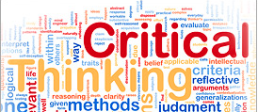

Learning Outcomes
Describe types of Cartilage found in the body
Discuss cartilage healing including timescales and timeframes
that facilitate appropriate cartilage healing
Discuss cartilage tolerance to loading and types of cartilage injury

Slide 3
Articular Cartilage
Thin layer of hydrated soft tissue covers end of bones of diarthrodial (synovial) joints
‘Perform their functions so well that we are often not aware of their existence nor their function until injury strikes or arthritis develops’ (Mow, Ratcliffe & Poole. 1992)
Type II collagen principal fibrous protein in hyaline cartilage
These collagen fibres are recruited as a tensile load is applied

Slide 4
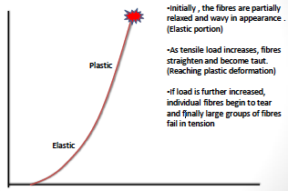
Hyaline Cartilage and Tensile Load

Slide 5
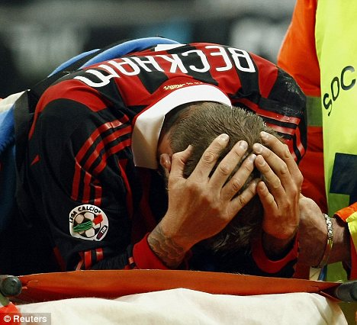
Cartilage Loading
Cartilage has a natural tendency to swell
Deformed cartilage draws water into the extracellular matrix
Cartilage also susceptible to creep (constant load)
Cyclic loading required for normal matrix and cell health
Excessive loading can be destructive to matrix
Constant pressure will cause fluid to exude from matrix: stable compressive deformation
Cyclic loading and unloading of cartilage allows for dynamic flow of fluids (with nutrients and waste products) in to and out of the tissue

Slide 6
Cartilage and Lubrication
Coefficient of friction for Articular cartilage reported as 0.01 to 0.04
Sliding on ice: 0.01-0.10
2 hypotheses
                Boundary lubrication
                Layer of molecules adhere to each of the two surfaces as they glide past each other
  Fluid-film lubrication
  2 non-parallel surfaces move past each other on a thin layer of fluid
  Fluid maintains a distance between two surfaces ‘hydrodynamic lubrication’ ‘elastohydrodynamic lubrication

Slide 7
Articular Cartilage Adaptations
Activities of Daily Living should provide enough load to provide adaption for optimal function
Too much or too little leads to breakdown in quality of cartilage
Loading facilitates exudate mobilisation
Cartilage adaptations tend to be degenerative!

Slide 8
Cartilage Use v Disuse
Exercise produces swelling
Prolonged exercise:
- chondrocyte hypertrophy
- Increase in the pericellular matrix
- Increase in # cells per unit of cartilage (Engelmark, 1961)
Changes already evident after brief burst of exercise
Long Term exercise produces more lasting change
- Increased proteoglycans (Sammanen et al 1986)
- Wear and tear changes (Vasan, 1983)

Slide 9
Cartilage Use v Disuse
Excessive Loading
- Decreased synthesis
- Degradation of Cartilage
- Leading to OA
Reduced Loading
- Decreased proteoglycans (Sammanen et al 1986)
- Decreased synthesis
- Increased fibrillation of cartilage surface
Changes are greater with immobilisation

Slide 10
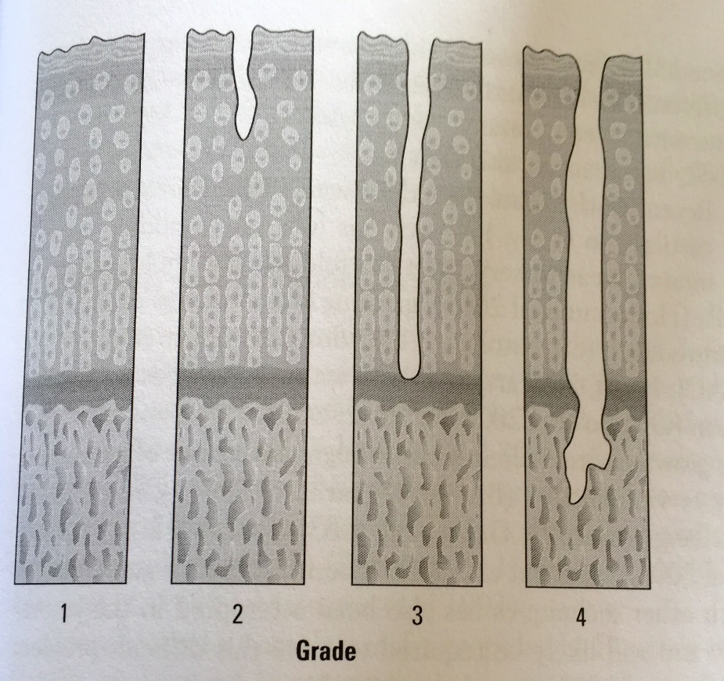
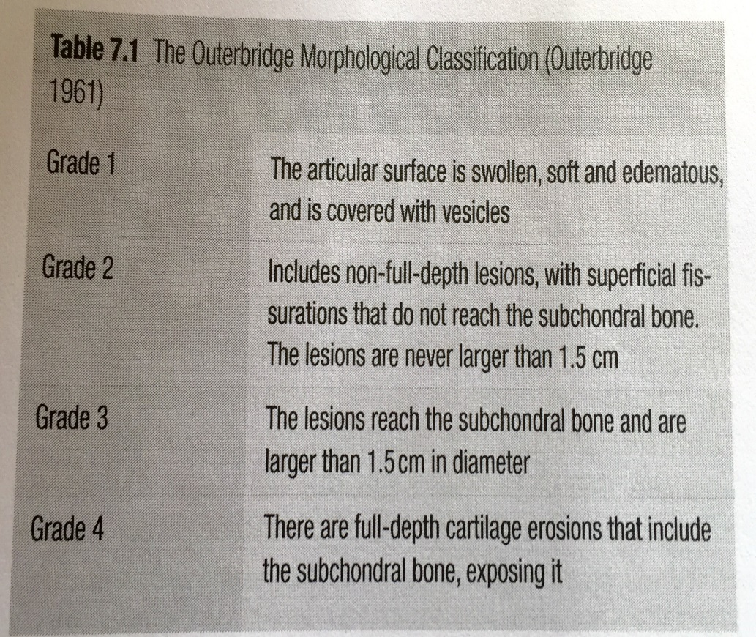
Cartilage injury classification

Slide 11
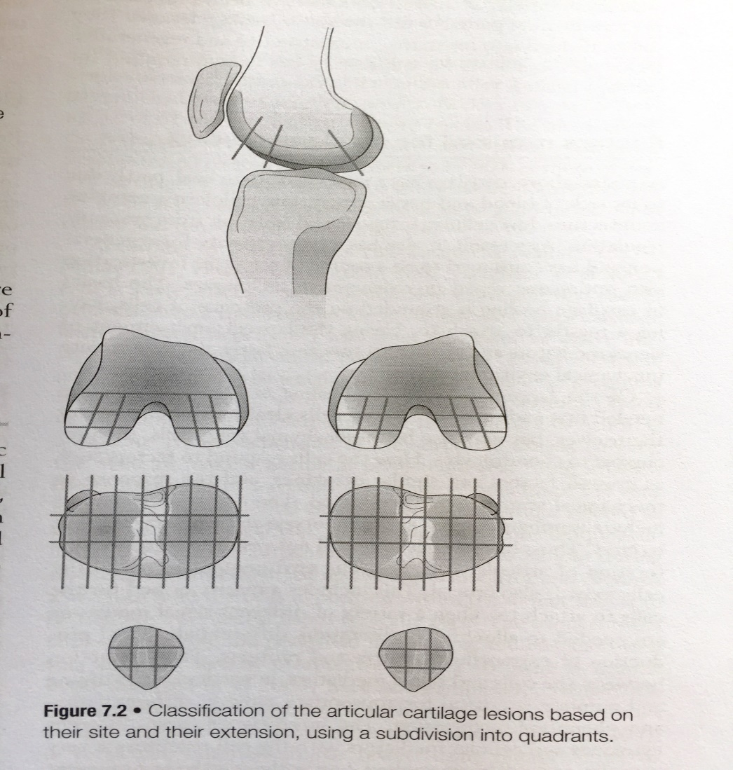
Cartilage injury classification
Sites of common injury around the
knee joint

Slide 12
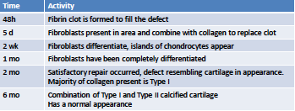
Articular Cartilage Healing

Slide 13
Task
Please read the chapter in Kolt Synder-Mackler in relation to
cartilage healing

