Slide 1

Plato and the Stoics
Foundations module week 2
Nick Campion

Slide 2
This seminar
This seminar:
Nick: Plato and the Stoics
Discussion and questions on Timaeus
Bernadette on Aristotle
Writing and essay discussion
Why is this important?
Because the Greek philosophers gave the first surviving written, theoretical accounts of the nature and working of the cosmos.
Relationship to broader course:
The material in this seminar underpins all topics you will study in the MA which deal with western culture in an after the classical period.
Primary Sources:
All the surviving works of classical philosophy are available on line. You should get used to citing them directly from the original whenever you need to.

Slide 3
Why are the Greeks important?
the Greek philosophers gave the first surviving written, detailed, theoretical accounts of the nature and working of the cosmos.
carried by the conquests of Alexander the Great in the 330s-20s BCE, Greek thought influenced all people to the east of Greece, through to India and, carried by Roman conquests, it suppressed the oral cultures of conquered people to the west.
Key Readings
Everything you need should be on Moodle.
Nick’s lecture notes give a good introduction.
Origins
Influences from outside the Greek world (India)
Plus
Orphics: evidence from 7th-6th c BCE
Pythagoras: deeply influenced by Orphism
Socrates: developed dialogue form of inquiry. All philosophers prior to Socrates known as Presocractics
See Nick’s notes
CAUTION
In 19th and early 20th c scholarship, classical Greek culture was generally seen as the ancestor of western democracy, science and philosophy. Current scholarship maintains that, while the Greek contribution was profound, the contributions of other near-eastern cultures (Egypt, Babylon, Persia) are also pervasive.

Slide 4
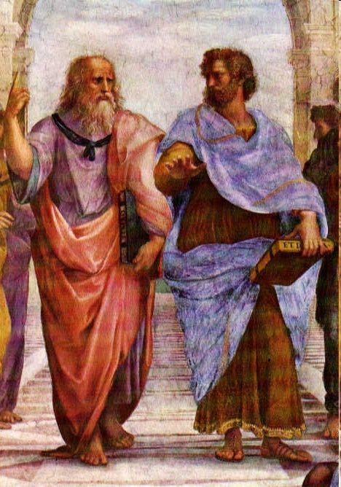
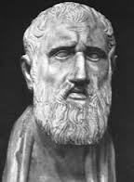
Greek Philosophy
The major strand of Greek philosophy assumed the existence of pattern and purpose in the cosmos.
Plato c. 428-348
Aristotle c. 384-323
Zeno of Citium c. 334 – c. 262 BC: The Stoics
Plato and Aristotle, detail from
The School of Athens, Raphael (1483-1520).
Left: Zeno

Slide 5
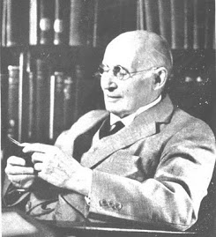
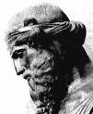
Importance: why study Plato? 1
‘The safest general characterization of the European philosophical tradition is that it consists of a series of footnotes to Plato. I do not mean the systematic scheme of thought which scholars have doubtfully extracted from his writings. I allude to the wealth of general ideas scattered through them.’
Alfred North Whitehead, Process and Reality, p. 39 [Free Press, 1979];
Specifically, Plato has a decisive influence on all western astrology, including modern astrology.
He was influenced by the Orphics – and sometimes is considered an Orphic.
His influence on Christianity was profound – St Augustine said that Plato was the pagan philosopher that Christians could study and learn from.
His influence is also detected in some modern political theor, including Marxism, science and, via Neoplatonism and Theosophy, in the arts.

Slide 6
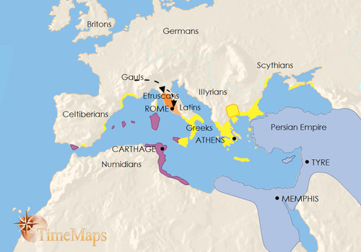
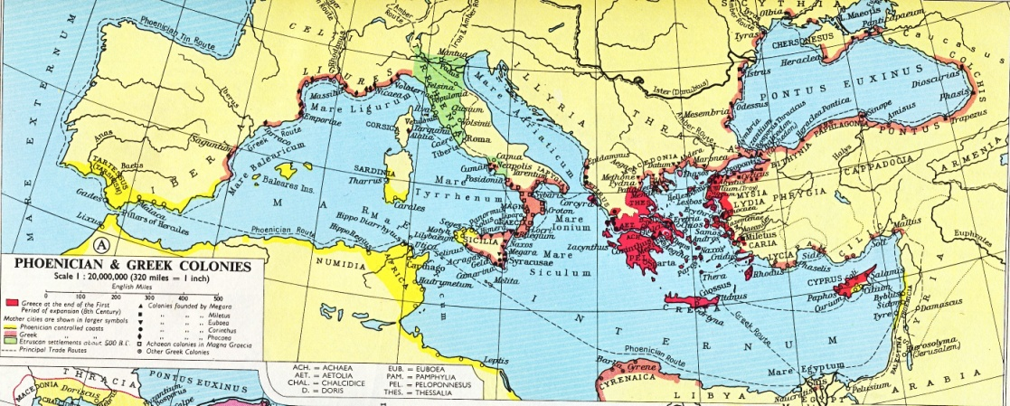
Plato and the Greek world
Athens, c. 428-348.
Student of Socrates
The Greek world had direct contact with Celtic and north African culture to the west, Egypt to the south, and Turkey, Babylon, Persia and India to the east.
Cultural boundaries are fluid

Slide 7
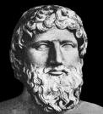
Plato and Source Problems
All or almost all of the written works attributed to Plato survive
HOWEVER:
He often taught using metaphor, allegory and parables.
THEREFORE
It is not always clear when he is stating what be believes to be the case, or when he is illustrating a point using metaphor.
AND
We do not know what he wrote himself or what was written by his students.
YET
We still have a general body of work and set of assumptions –a cosmology – we can call Platonic, and we refer to an ‘ism’ called Platonism, sometimes Platonistic
In his Timaeus Plato is the source of the Atlantis myth.
Is this wholly based on real events?
Entirely fictitious?
A combination of the two
Plato is normally regarded as arguing that the body imprisons the soul. Crystal Addey argues that the same language can imply that the body protects the soul.
Instead of Platonism – the ideology created out of Plato’s thought.
Should we talk of Platonisms?

Slide 8
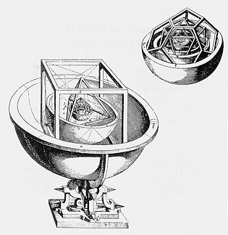

Plato: Key Ideas and Texts
Single Creator/Source
The creator is ‘Mind’ or Nous
(Therefore rationality is very important)
World soul (anima mundi in Latin)
Forms or Ideas (Archetypes)
Idealism
Being and Becoming
(Being = eternal, timeless, perfect, unchanging)
(Becoming = in time, changing, imperfect)
Emanation (rather than creation)
Everything in the cosmos is interconnected But materiality emerges from, and is contained within, consciousness.
Cosmos is a musical/mathematical/ geometrical order
Timaeus: contains the cosmogony – creation of the cosmos, along with description of the cosmos as infused with soul, based in consciousness, and ordered according to mathematical/musical harmonies.
Republic: Book X contains the account of the soul’s descent from the stars at birth.
Paradoxes: Plato’s cosmos is
Transcendent (soul transcends matter)
But also Immanent (matters emerges out of soul and is therefore infused with it)
Monist (there is a single source)
But also dualist (Being is contrasted with Becoming)

Slide 9

Plato on the Planets
Plato laid the foundation for a rational of astrology in the notion of planets as time-keepers:
'Wherefore, as a consequence of this reasoning and design on the part of God, with a view to the generation of Time, the sun and moon and five other stars, which bear the appellation of "planets" [i.e., 'wanderers'], came into existence for the determining and preserving of the numbers of Time.' (Timaeus 38C).
The planets are time pieces, not influences or causes.
In modern language we might say that planetary movements correlate or coincide with events on Earth, and that the pattern made by the planets relates to the patterns in the lives of people.
'But the choric dances of these same stars and their crossings one of another, and the relative reversals and progressions of their orbits, and which of the gods meet in their conjunctions, and how many are in opposition, and behind which and at what times they severally pass behind one another and are hidden from our view, and again re-appearing send upon men unable to calculate alarming portents of the things which shall come to pass hereafter, - to describe all this without an inspection of models of these movements would be labour in vain'
(Timaeus 40C-D).

Slide 10
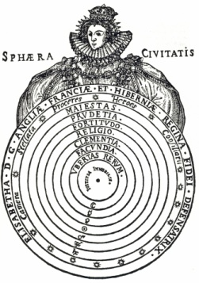
Plato on the Soul
Timaeus: The world, or collective soul, is part of the fundamental foundation and origin of the material world. Everything is connected by soul.
(The Greek Psyche and Latin Anima Mundi are feminine)
(Carl Jung’s Collective Unconscious is an adaptation of the Platonic world soul )
The individual soul exists before birth and survives death, being subject to a cycle of reincarnation.
The process of birth is set out by Plato in his ‘Myth of Er’ (Republic Book X).
Before birth, each soul chooses a life, with material circumstances and destiny.
At the moment of birth the soul descends through the planetary spheres.
Later astrologers took from this theory the idea that the pattern of planets at birth described the current life, with its circumstances, fate and destiny.
However, adherence to a Platonic theory means that there is always a part of one’s self that preceded birth and is not subject to the planetary patterns at birth.

Slide 11
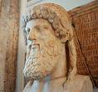
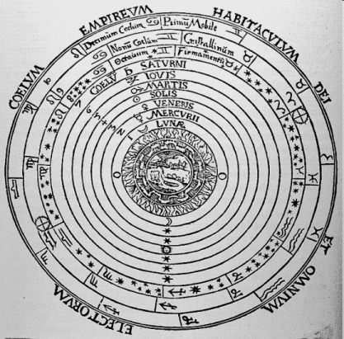
Plato: the individual soul and the stars
Each individual soul has a star (metaphorical?)
The individual soul originates in the sphere of the stars
The individual soul incarnates via the planetary spheres
The levels of the soul:
Rational: we could call this the higher mind; roughly equates to the immortal part of the soul; can contact the divine.
Emotional: feelings, desires; irrational.
Animal: the physical body and its needs; irrational.
Sometimes Platonic writers talk of these as of they are three distinct kinds of soul, but they can also be separate functions of a single soul, each of which is a fragment of soul which permeates the entire cosmos

Slide 12
Plato: the soul and wisdom
‘he showed them [the souls] the nature of the Universe, and declared unto them the laws of destiny'.[1]
[1] Plato, Timaeus 41E-42A.
Personal Responsibility
‘The blame is he who chooses: God is blameless’
Plato, Republic X.617E; see also 619D; Plato, Phaedrus, trans H.N.Fowler, Cambridge Mass., London: Harvard University Press, 1914, 249 B.
(‘The fault, dear Brutus, is not in our stars, but in ourselves, that we are underlings.’
William Shakespeare, Julius Caesar, I, ii, 140-141. )
‘For a human being must understand a general conception formed by collecting into a unity the many perceptions of the senses; and this is a recollection of those things which our soul once beheld, when it journeyed with God and, lifting its vision above the thing as which we now say exist, rose up into real being’.
Plato, Phaedrus, trans H.N.Fowler, Cambridge Mass., London: Harvard University Press, 1914, 249 B-C.
Through the soul we can experience ultimate truth

Slide 13
Plato: better and worse births
Plato concerned by the whole question of what he called 'better' and 'worse' births.
Children born at the appropriate season and phase of the planetary cycles would be 'better' and more likely to grow into upright, virtuous citizens and hinted that it would be possible to breed such people, a matter which could be achieved if couples married and hence conceived at the right time.
Plato, Republic VIII, 546 A.
Evil in the Platonic cosmos resulted from error, that people subject to ‘worse births’, presumably victims of poor choices made by their daemons, were incapable of developing their rational souls and instead lived through the animal souls.

Slide 14
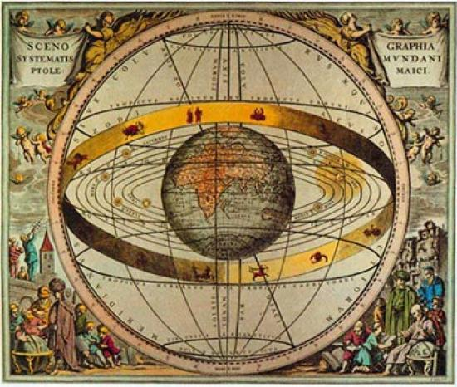
Plato: Implications for Cosmology and Astronomy
Implications for Cosmology
Purpose and Pattern
Freedom is restricted by the universal order
Freedom can be attained by
remembering the source from which the soul came,
recalling the knowledge the soul had before birth
contacting divinity
Implications for Astronomy
It is necessary to create models
Emphasis on number and mathematics

Slide 15
Implications for Astrology
Against detailed astrology
Because everything in the material world is ‘Becoming’, i.e., is a constant state of change, physical observation of planetary positions can not yield detailed truths about the world.
(On the other hand, gazing at the sky can elevate the soul)
For detailed astrology
If accurate models are created astrology can be accurate.
(then a complex horoscopic astrology develops)
The Platonic tradition is therefore at once both supportive of detailed astrology and sceptical of it.
It is, though, universally supportive of the idea of a general psychic/soul connection with the stars and planets

Slide 16
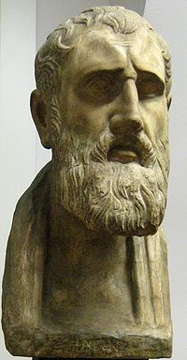
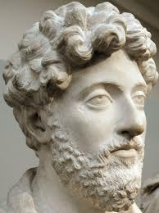
Stoicism
Zeno of Citium (334-262 BCE)
Similarity to Platonism:
Cosmos is a single, interdependent, interconnected, living whole.
It is broadly fated but education and self-knowledge can bring freedom.
At its most restricted, freedom is freedom only to adjust one’s attitudes to fated events
Right Marcus Aurelius

Slide 17
Stoicism
Difference to Platonism:
Rejects transcendence. Everything is physical.
Enhancement of Platonism:
Everything is bound together by sympathy and tension.
(Associated with Posidonius (c 135-51 BCE) – also credited with introducing high-brow astrology to Rome)
In Rome tended to be combined with Plato (and also Aristotle) to produce a general philosophy in which the cosmos is seen as ordered, patterned, purposeful and in which matter and consciousness are interdependent.
Astrology
The Stoics were generally keen advocates of astrology and said to be responsible for introducing astrology to philosophy at Rome in the 1st century BCE (as distinct from the practice of astrology)
In Stoic cosmology/astrology, freedom comes from living in accord with one’s nature which, in turn, is indicated in the stars.

Slide 18
as Chrysippus says in the first book of his De finibus; for our individual natures are parts of the nature of the whole universe. And this is why the end may be defined as life in accordance with nature, or, in other words, in accordance with our own human nature as well as that of the universe, a life in which we refrain from every action forbidden by the law common to all things, that is to say, the right reason which pervades all things, and is identical with this Zeus, lord and ruler of all that is. And this very thing constitutes the virtue of the happy man and the smooth current of life, when all actions promote the harmony of the spirit dwelling in the individual man with the will of him who orders the universe.
DL VII.88

Slide 19
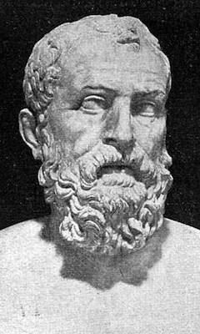
The Stoic Soul
‘A nature capable of perception…the breath of life, congenital with us’; A body; A warm breath; It animates us and enables us to move
Soul of the Universe is indestructible
Individual soul is a part of the soul of the universe; survives death, although is perishable (Chrysippus says continues to exist until the general conflagration, Chrysippus says only souls of wise do so
Diogenes Laertius’ biography of ‘Zeno’ in Lives of Eminent Philosophers, trans R.D. Hicks, London: William Heinemann, 1925, vol. 2, pp. 110-263 (156-7)

Slide 20
Understanding Stoic freedom
‘Provided that we accept our role as moral or rational agents, we are not only free to give our lives this or that shape; we are actually required to choose modes of living that suit our inclinations and aptitudes, so long as these are means of acting harmoniously with our full identity, as specified by the four personae.’
Long, A.A., Stoic Studies, Cambridge: Cambridge University Press, 1996, p. 166.
The four ‘personae’ are:
Our identity as human beings – qualities derived from being human, and shared with other humans – natura
Our identity as individuals – psychological and physiological
Our life circumstances – fortuna - including roles, such as jobs, which we adopt as part, and a result of, our individual identity.
Individual choice – at its best, the appropriate choices we make through understanding our individual and human identities – our nature.
Long, A.A., Stoic Studies, Cambridge: Cambridge University Press, 1996, pp. 164-5.
The Stoic paradox, in which freedom is the acceptance of one’s fate, is evident in the quote attributed to Karl Marx: ‘Necessity is blind until it becomes conscious. Freedom is the consciousness of necessity’.

Slide 21
Neoplatonism
The Platonic philosophers of the later Roman Empire were retrospectively classified as Neoplatonists by 19th c German historians, and the name has stuck.
Key names: Plotinus, Iamblichus, Proclus
Generally hostile to horoscopic astrology used for mundane (worldly) analysis and prediction.
Advocate use of astrology to engage with the divine – ‘Theurgy’ – literally ‘God work’

Slide 22
History and significance: transmission to the modern West
The Roman Empire in western Europe disintegrated in the 400s and 500s. Most Greek texts were lost. Platonic ideas survived in Latin summaries the first section of the Timaeus.
The Roman Empire in the Greek-speaking east survived (the ‘Byzantine’ empire). However, ‘pagan’ ideas were subordinated to Christianity, even though direct knowledge of Plato and Aristotle continued (both being Greek)
In the Islamic world after the 700s there was a major translation of classical material into Arabic.
12th-13th c: Major translation of Aristotelian material into Latin = rediscovery in western Europe.
15th c: Platonic ideas introduced into Italy from Byzantine empire (prior to its final conquest by the Turks in 1453), followed by major translation of Platonic, Neoplatonic material into Latin by Marsilio Ficino.
15th c to present: Platonic ideas underpin the western esoteric and magical tradition.

Slide 23
The legacy
Although, Platonism, Aristotelianism and Stoicism are distinct, they were often combined from the 1st c BCE onwards.
Key Question: In what ways does modern western astrology embody Platonic, Stoic and Aristotelian concepts? Can we read astrological texts and distinguish these three components?
The key questions:
What is the relationship of the soul (and in the modern world, the self) with the stars/planets?
To what extent is the universal order implied by the mathematically predictable movement of the stars and planets reflected in predictable order in individual lives?

Slide 24
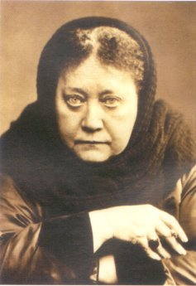
The legacy in modern esotericism:Plato
‘It is the Platonic philosophy, the most elaborate compend of the abstruse systems of Old India, that can alone afford us this middle ground. Although twenty-two and a quarter centuries have elapsed since the death of Plato, the great minds of the world are still preoccupied with his writings. He was, in the fullest sense of the world, the world's interpreter’.
Blavatsky, H.P., Isis Unveiled, Pasadena: Theosophical University Press, 2 Vols., 1976 [1877], p. xi.

Slide 25
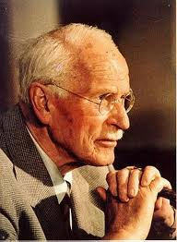

The legacy in modern astrology and esotericism: stoic?
‘human beings do not earn free will except through self-discovery, and they do not attempt self-discovery until things become so painful that they have no other choice’.
Liz Greene, Saturn, p. 11.
Platonic? Stoic?
‘What happens to a person is characteristic of him. He represents a pattern and all the pieces fit. One by one, as his life proceeds, they fall into place according to some predestined design’.
Jung, Psychological Reflections, p. 322.
Jung described free will as “the ability to do gladly which I must do”. Carl Jung quoted in Francis Wickes, The Inner World of Choice (Boston: Sigo Press, 1988), p. 8.
(NB this quote is cited frequently with no source)

Slide 26
The Legacy – Plato?
A self outside the birth chart?
‘That mysterious, elusive entity which psychology calls the self – that thing or life which looks out through a person’s eyes, to which he refers when he says, “I” – has not yet been found among the glyphs and symbols of the horoscope; it may be seen working through a behaviour and a personality suggested by that horoscope, but it remains standing outside the framework, aloof, objective, numinous, and able to be invoked at any point during the life so that the personality – and the chart – acquire a new and more meaningful expression’.
Greene, Saturn, p.194.
Platonic?
‘The Self is the totality of the horoscope, but is also more than the horoscope’.
Greene, Astrology of Fate, p. 317
On p. 317 Astrlgy of Fate she says that the Self is the totality of the horoscope, but is also more than the horoscope.

Slide 27
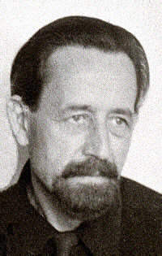
A modern perspective
Dane Rudhyar: The Birth Chart
“The symbolic meaning of the birth-chart of an individual…is actually, and as far as its psychological value is concerned, an archetype in his unconscious. It is perhaps the most powerful of all archetypes, when it is brought up to the light of the consciousness, inasmuch as it can determine the entire conduct of the individual, his entire attitude towards himself and his life, and the quality of his expectancy with reference to future events and his destiny as a whole.”
Rudhyar, Dane, Astrology and the Modern Psyche, (Davis: CRCS Publications, 1976), 33.

Slide 28
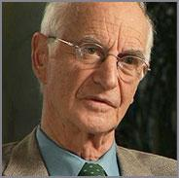
The Legacy: Archetypal Psychology
Archetypal psychology was developed by the Jungian psychologist James Hillman, adapting Jung who himself was part of the intellectual tradition going back to Plato. Hillman wrote that:
‘In extending the tradition of Jung and Corbin forward, archetypal psychology has had to go back to their predecessors, particularly the Neoplatonic tradition via Vico and the Renaissance (Ficino), through Proclus and Plotinus, to Plato (Phaedo, Phaedrus, Meno, Symposium, Timaeus) and most anciently to Heraclitus’.
Hillman, James, Archetypal Psychology (London, Spring Publications, 2013 [1981]), p. 15.

Slide 29
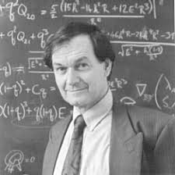
The Legacy: Pure Maths and Theoretical Physics
Roger Penrose, Professor of Mathematics at Oxford University. Penrose's explanation for the manner in which mathematics allows for intellectual inquiry is instructive (Penrose was Stephen Hawking’s teachers):
‘How is it that mathematical ideas can be communicated in this way? I imagine that whenever the mind perceives a mathematical idea, it makes contact with Plato's world of mathematical concepts…when one 'sees' a mathematical truth, one’s consciousness breaks through into this world of ideas, and makes direct contact with it ('accessible via the intellect‘).’
Penrose, Roger, The Emperor's New Mind: concerning computers, minds and the laws of physics (London: Vintage 1991) p.554.

Slide 30
Conclusion
Classical Greek philosophy laid the foundation for most modern western philosophies.
One strand of classical philosophy, based in Platonism, Aristotelianism and Stoicism, assumed (1) a level of order, pattern and purpose in the cosmos and (2) a symbiotic relationship between consciousness and matter.
This the n becomes the foundation for western esotericism – the theory that the inner life, ideas and consciousness are prioritised over material existence.
An understanding of classical philosophy is therefore essential for an understanding of the history and modern culture of esotericism.
An understanding of classical philosophy is therefore essential for an understanding of the history of both western astronomy and astrology.

Slide 31
Reading: on Moodle
Nick’s Notes on Plato
Nick’s notes on the Stoics
Nick’s notes on the Neoplatonists
Campion, Nicholas, History of Western Astrology, Vol. 1, London: Continuum 2008, chap 10.
Wallis, R.T., Neoplatonism, London: Duckworth, 1995, chap. 1 (PP. 1-14). PDF ON MOODLE
Hussey, Edward, The Presocratics, London: Duckworth 1983, chap 4 (pp. 60-77). (Pythagoras) CLA PDF ON MOODLE
Kirk, G.S, J.E., Raven, M.Schofield, The Presocratic Philosophers, 2nd edition, Cambridge: Cambridge University Press 1983, Chap. 1, pp. 7-74. CLA PDF ON MOODLE
AND SEARCH JSTOR and the University Library

