Slide 1
WHAT IS MENTAL HEALTH
AND WELL-BEING?
Define mental health
How is it different from well-being?

Slide 2
Definition: Mental Health
Mental health is a level of psychological well-being, or an absence of a mental disorder; it is the "psychological state of someone who is functioning at a satisfactory level of emotional and behavioural adjustment“ (Children’s Society, 2008)
Related to the promotion of well-being, the prevention of mental disorders, and the treatment and rehabilitation of people affected by mental disorders

Slide 3

Mental health
It affects how we think, feel, and act.
It also helps determine how we handle stress, relate to others, and make choices (NHS, 2016).

Slide 4
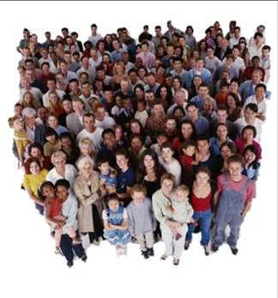
What is mental health?
Health is the state of complete physical, mental and social well-being and not merely the absence of disease or infirmity
More than the mere lack of mental disorder
State of well-being whereby individuals recognise their abilities, able to cope with normal stresses of life, work productively and fruitfully, and make contributions to their communities
Concerns ALL OF US!
World Health Organisation ( 2003 )

Slide 5

Definition: Wellbeing
Well-being’ describes the quality of childhoods as they are lived.
Well-being draws in the many different factors which affect children’s lives:
material conditions
housing and neighbourhoods
how children feel and do at school
their health
exposure to dangerous risks
quality of family and classmate relationships they develop.
Why are mental health and wellbeing important?

Slide 6
ONS, (2017)
Mental Health
Mental illness
Anxiety
ADHD
mental/psychological
Well-being
Is life worthwhile ?
Depression
Bi-Polar disorder

Slide 7

Why are mental health and wellbeing important?
Child mental health problems are a strong predictor of adult mental health problems
Mental health problems in young people are associated with educational failure, family disruption, disability, offending and anti-social behaviour
May continue into adult life and affect the next generation

Slide 8
HOWEVER…
Risk of mental health problems is higher among:
The poor
Homeless
Unemployed
Persons with low education
Victims of violence
Migrants and refugees
Indigenous populations
Abused women and elderly
Children and adolescents

Slide 9
The Global Situation
Around 20% of the world's children and adolescents have mental disorders or problems
About half of mental disorders begin before the age of 14. Similar types of disorders are being reported across cultures. Neuropsychiatric disorders are among the leading causes of worldwide disability in young people.
Yet, regions of the world with the highest percentage of population under the age of 19 have the poorest level of mental health resources. Most low- and middle-income countries have only one child psychiatrist for every 1 to 4 million people.
(World Health Organisation, date unknown)

Slide 10
Covid-19 and the nation's mental health:
worked with NHS colleagues to build a model based on the best available evidence to forecast how many people may need mental health support as a result of the Covid-19 pandemic.
Nationally, in England, the model predicts that up to 10 million people (almost 20% of the population) will need either new or additional mental health support as a direct consequence of the crisis. 1.5 million of those will be children and young people under 18.
Centre for Mental Health (2020)

Slide 11

Mental Health and
Wellbeing
Traditionally children have been considered as the ‘property’ of their parents (Giddens, 1998) and have consequently had few entitlements in their own right.
The concept of children having specific entitlements has developed over the last century, culminating in the 1989 production of the United Nations Convention on the Rights of the Child (1989).
It is therefore important that we consider children’s personal mental health and wellbeing in relation to the following:

Slide 12
Hang on… two questions you may ask.
Why are children and adolescents vulnerable to mental health problems?
What sort of mental problems?
First, we should understand the contexts in which mental health problems our children and young people emerge.

Slide 13
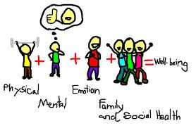
Consider these dimensions of mental health and wellbeing
Subjective wellbeing (links to social media)
Personal relationships
Material resources
Education
Behaviour and risks
Housing and the environment
Do children have agency over these dimensions?

Slide 14
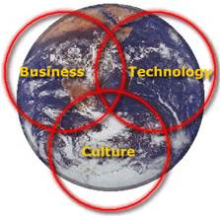
GLOBALISATION
Interdependence of individuals and nations
Rapid change in societies
Awareness of others live lives in other parts of the world, linked by active networks of communication

Slide 15
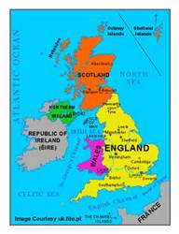
Insights into the UK national well-being
Centre for Economic Performance
Well-being has been static since the Second World War in spite of unprecedented economic growth
Wealth does not mean happiness.
BUT… what is happiness?
Layard (2014)
Happiness – ‘feeling good’, ‘enjoying life’
Unhappiness – ‘feeling bad’, ‘wish things were different’
Increase in mental health problems across all age groups, particularly among young people!

Slide 16

Joseph Rowntree Foundation, (2008)
Shared values have declined
Communities break up
Individualism is high
Poverty is corrosive
Causes?

Slide 17
Trust Levels
In the survey National Accounts for Well-being in Europe published in 2009 (www.neweconomics.org) the UK comes 20th out of 22 nations in terms of levels of trust.
For the 16-24 age group people in the UK reported the lowest levels of trust and belonging anywhere in Europe – only Bulgaria and Estonia had similar levels of response.

Slide 18
Individualist Society Core Values
Autonomy
Self – determination
Individual freedom
BUT … consider the direction of trust level in the UK.
Trust - important part in social well-being
Annual life satisfaction survey - 130 countries (Gallup Organisation 2007)
John Helliwell (2003) - trust is closely linked to satisfaction
neighbours, the police, colleagues and employers rated as highly valued so that the way people relate to each other and the extent to which they engage in helping others correlate strongly with their satisfaction with life.

Slide 19
Impact on children’s well-being
The Good Childhood Inquiry (Layard & Dunn, 2009, The Children’s Society)
Children and young people today experience childhood in a different way to previous generations
Information Technology
Demographics
Family (Break-ups, work)
School exams/performance pressure
Poverty/Lack of mobility

Slide 20
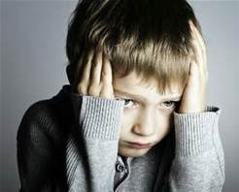

Mental Health
an essential part of children's overall health
has a complex interactive relationship with their physical health and their ability to succeed in school, at work and in society.
Both physical and mental health affect how we think, feel and act on the inside and outside
APA, (2016)
‘All children and youth have the right to happy and healthy lives and deserve access to effective care to prevent or treat any mental health problems that they may develop. However, there is a tremendous amount of unmet need, and health disparities are particularly pronounced for children and youth living in low-income communities, ethnic minority youth or those with special needs.’ APA.2016

Slide 21
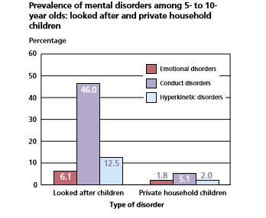
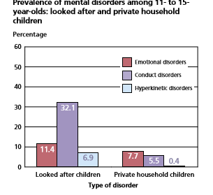
Mental health in CYP in Wales

Slide 22
What is GOOD mental health in CYP?
The capacity to develop:
Emotionally
Intellectually
Intra-personally
Finding identity
Sense of purpose
Inter-personally
Awareness and empathizing with others
Ability to enter into and maintain mutually satisfying personal relationships
spiritually
Physically
Mastery over life and self
resilience
Confidence
Self-esteem
Belonging
What about individual differences?

Slide 23
References
APA (2016) Children's Mental Health, Why Is Children's Mental Health Important? http://www.apa.org/pi/families/children-mental-health.aspx
Centre for Mental Health (2020)https://www.centreformentalhealth.org.uk/publications/covid-19-and-nations-mental-health-october-2020 (Accessed 31/10/20)
Children’s Society (2008) Available at http://childrenssociety.org.uk/what-we-do/research/initiatives/well-being/background-programme/2008-survey (Accessed 10.01.19)
Layard, R and Dunn J (2009) A Good Childhood, London Penguin Books
NHS Choices (2016) Talking to children about feelings http://www.nhs.uk/Livewell/mentalhealth/Pages/talkingtochildren.aspx
NSPCC (2016) Anxiety a rising concern in young people contacting Childline https://www.nspcc.org.uk/what-we-do/news-opinion/anxiety-rising-concern-young-people-contacting-childline/
Office for National Statistics: Insights into children's mental health and well-being (2015) Available at http://backup.ons.gov.uk/2015/10/20/insights-into-childrens-mental-health-and-well-being/ (Accessed 10.01.19)
Office of National Statistics (2017) Young People’s Wellbeing https://www.ons.gov.uk/peoplepopulationandcommunity/wellbeing/articles/youngpeopleswellbeingandpersonalfinance/2017
WHO, (date unknown) 10 Facts on Mental Health http://www.who.int/features/factfiles/mental_health/mental_health_facts/en/

Slide 24
Measure of Personal well-being
Young people’s personal well-being
April 2011, the Annual Population Survey has included four questions which are used to monitor personal well-being in the UK:
1. Overall, how satisfied are you with your life nowadays?
2. Overall, to what extent do you feel the things you do in your life are worthwhile?
3. Overall, how happy did you feel yesterday?
4. Overall, how anxious did you feel yesterday?
Any comment on these questions?

