Slide 1

How do students use technology to collaborate at UWTSD?
By
Name: Marius Tascu
ID: 2121173

Slide 2

Introduction
In recent years, the emphasis in education has evolved from teacher-centered instruction to student-centered instruction with a focus on student collaboration. (Ray, 2017; Anderson, 2013)
Collaboration encourages communication between students and frequently entails sharing. (Vacheishvili, 2021)
Collaborative learning activities, such as group projects, discussions, and presentations in class, are frequently expected of students. (Le et al., 2017)
By involving the students in understanding what they have learned and recreating information, collaborative learning can be very developmental. (Vacheishvili, 2021)

Slide 3

Cont.
In collaboration, technology plays a complex role. "Technology can provide individualized experiences that are more interesting and relevant for learning or learning itself.“ (U.S. Department of Education, 2017, p. 12)
Technology literacy is the capacity to ethically use suitable technology for communication, problem-solving, utilizing, handling, integrating, evaluating, and creating information to enhance learning across all subject areas and acquire lifelong knowledge and skills in the twenty-first century. (State of Michigan, 2009, p. 1)
The U.S. Department of Education (2017b) demonstrates that technology offers more options for collaboration and more ways to pique interest. (NGACBFCCSSO, 2010, p. 66).

Slide 4
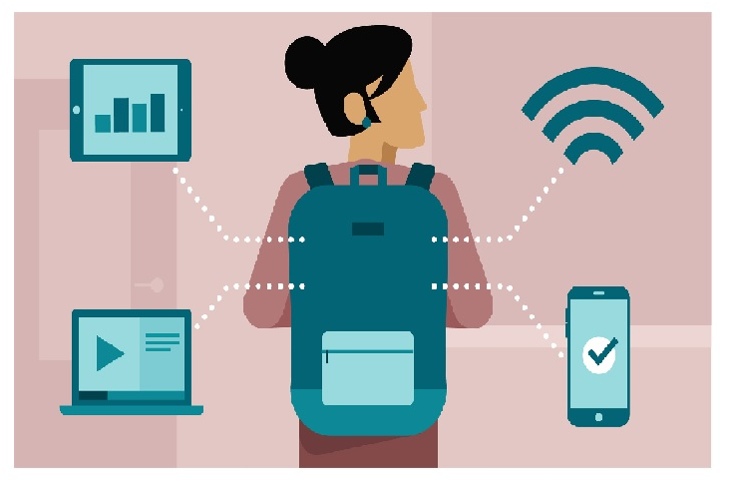
Research Question
Are students confident in using technology to collaborate?

Slide 5


Literature review
Since the internet and information technology have grown exponentially, e-learning has undergone tremendous transformation. (Gonzalez et al., 2020)
Due to the unique chances for cross-cultural engagement, learning, and self-discovery that the cyberspace of new technology offers students in this digital age, they are now more heavily exposed to a variety of developing technologies. (Sarwar et al., 2018; Gallegos, 2018)
The potential for promoting a personalized learning environment as a method of instruction to encourage self-regulated learning has also been produced by social media. (Alfadda and Mahdi, 2021)
The learner-focused pedagogy model based on collaboration is increasingly becoming more popular in education research than the more conventional teacher-focused pedagogical approaches. (Sarwar et al., 2018; Howe, 2018)

Slide 6
Literature review
Technology mediates interactions between students and teachers, and the layout of learning environments (the area where learning takes place, for example) can have a big impact on how well students learn. (Bower, 2019)
When used properly, technology enables collaboration and engagement between students and teachers. (Gonzalez et al., 2020, Bower 2019)
It is more likely that students will succeed in their academic goals if they feel confident using a variety of self-regulated thing such as digital tools. (Patricia Aguilera-Hermida, 2020)
Additionally, if students are not engaged cognitively and socially or lack confidence in the technology they are utilizing, it could have a detrimental impact on their learning outcomes. (Bower, 2019)

Slide 7



Ethical Clearance

Slide 8
Proposed method
1
2
3
What questions will be asked- The participants will be asked both open-ended and close-ended questions on their perception of using digital tools for collaboration.
Who will be the participant- Total 300 number of students of UWTSD will be chosen for gathering the study data
How the participants will be reached- During the break time between classes, students UWTSD were communicated for gathering data for the research. Online questionnaire was also used for collecting information

Slide 9

Proposed method
Quantitative Items: The questionnaire included demographic items, level of confidence in using digital tools, frequency of use, self-efficacy, previous knowledge about the tools, and accessibility of the tools. The questionnaire was modified based on previous literature where adaptation of the Technology Acceptance Model was used. (Kemp et al., 2019)
Qualitative Items: Open-ended questions about the challenges and positive changes in the students’ collaboration experience with digital tools will also be included. This is to understand the components that make students confident about using digital tools for collaboration and what can be the possible reasons to hinder that.

Slide 10
Technology acceptance models
The factors influencing user populations' acceptance of technological tools are explained by technology acceptance models. (Kemp et al., 2019)
Cognitive theories that describe the process of behavior adoption served as the foundation for the first technology acceptance model (TAM). The willingness and ongoing usage of technology by the user is implied by technology adoption. (Patricia Aguilera-Hermida, 2020)
The first set of elements includes motivation, affect, and attitudes. When someone has an attitude toward an action, they are expressing their approval or disapproval of that behavior. Students' attitudes on digital tools have a direct impact on how they learn or collaborate. (Kemp et al., 2019)

Slide 11
Technology acceptance models
The capacity and effort of the person as well as enabling circumstances that influence their ability to use educational technologies are referred to as perceived behavioral control. It comprises technology accessibility, self-efficacy, and ease of use. The degree to which a user anticipates the target system to be effortless is referred to as ease of use. It implies prior experience and knowledge which eventually shows how confident the student is about using digital tools for collaboration. (Kemp et al., 2019)
Based on prior technological experiences, students develop their confidence and self-efficacy. However, before beginning an online course, they may need instruction and support in using the platforms and tools. (Bower, 2019)
In the end, if the student feels they have the information and resources they need to support themselves, it will have a positive impact on them to use the application. (Patricia Aguilera-Hermida, 2020)

Slide 12

Result (Hypothesis)
The quantitative finding may suggest that students are generally confident in using digital tools for collaboration.
Students with prior experience with digital tools feel more confident about using them as a model of collaboration.
Using digital tools gives the student a feeling of ease as they are more used to this online era which makes them naturally confident about using those.
The qualitative finding may lead to the fact that using digital tools for collaboration increases family time. This adds up as a positive aspect that boosts confidence in using the tools more.

Slide 13

Conclusion
There is a comprehensive ecosystem for supporting students in face-to-face education (learning centers, co-curricular activities, libraries, etc.). In the same vein, building an efficient online education requires time to determine. It is important to understand that students’ confidence on using the digital tool for collaboration is related to numerous things. This study will look into whether the students feel confident about using the tools. However, extensive research on which determinants play role in students’ confidence is an interesting area to explore.

Slide 14
Reference
Alfadda, H.A. and Mahdi, H.S. (2021), “Measuring Students’ Use of Zoom Application in Language Course Based on the Technology Acceptance Model (TAM)”, Journal of Psycholinguistic Research, Springer, Vol. 50 No. 4, pp. 883–900.
Anderson, M. (2013), “Teacher confidence in using technology – ICTEvangelist”, available at: https://ictevangelist.com/teacher-confidence-using-technology/ (accessed 7 July 2022).
Bower, M. (2019), “Technology-mediated learning theory”, British Journal of Educational Technology, Blackwell Publishing Ltd, Vol. 50 No. 3, pp. 1035–1048.
Gallegos, K. (2018), “Enhancing Education with Collaboration Technology - Cisco Blogs”, available at: https://blogs.cisco.com/collaboration/enhancing-education-collaboration (accessed 7 July 2022).
Gonzalez, T., de la Rubia, M.A., Hincz, K.P., Comas-Lopez, M., Subirats, L., Fort, S. and Sacha, G.M. (2020), “Influence of COVID-19 confinement on students’ performance in higher education”, PLoS ONE, Public Library of Science, Vol. 15 No. 10, available at:https://doi.org/10.1371/JOURNAL.PONE.0239490.
Howe, A. (2018), “Why edtech can increase student confidence - Education Technology”, available at: https://edtechnology.co.uk/comments/why-edtech-can-increase-student-confidence/ (accessed 7 July 2022).
Kemp, A., Palmer, E. and Strelan, P. (2019), “A taxonomy of factors affecting attitudes towards educational technologies for use with technology acceptance models”, British Journal of Educational Technology, John Wiley & Sons, Ltd, Vol. 50 No. 5, pp. 2394–2413.
Le, H., Janssen, J. and Wubbels, T. (2017), “Collaborative learning practices: teacher and student perceived obstacles to effective student collaboration”, Https://Doi.Org/10.1080/0305764X.2016.1259389, Routledge, Vol. 48 No. 1, pp. 103–122.
National Governors Association Center for Best Practices & Council of Chief State School Officers. (2010). Common core state standards for English language arts and literacy history/social studies, science, and technical subjects. Washington, DC. Retrieved from http://www.corestandards.org/wp-content/uploads/ELA_Standards1.pdf
Patricia Aguilera-Hermida, A. (2020), “College students’ use and acceptance of emergency online learning due to COVID-19”, International Journal of Educational Research Open, Elsevier, Vol. 1, p. 100011.

Slide 15
Reference
Ray, L. (2017), “How to Increase Confidence About Digital Learning in Schools | EdTech Magazine”, available at: https://edtechmagazine.com/k12/article/2017/10/how-increase-confidence-about-digital-learning-schools (accessed 7 July 2022).
Sarwar, B., Zulfiqar, S., Aziz, S. and Ejaz Chandia, K. (2018), “Usage of Social Media Tools for Collaborative Learning: The Effect on Learning Success With the Moderating Role of Cyberbullying”:, Https://Doi.Org/10.1177/0735633117748415, SAGE PublicationsSage CA: Los Angeles, CA, Vol. 57 No. 1, pp. 246–279.
State of Michigan. (2017). Michigan integrated technology competencies for students. Retrieved from http://www.techplan.org/downloads/all_user_files/mitecs_document_final_2.2.pdf.
U.S. Department of Education. (2017). Reimaging the Role of Technology in Education: 2017 National Education Technology Plan Update. Washington D.C.: Government Printing Office. Retrieved from http://tech.ed.gov
Vacheishvili, N. (2021), “Collaborative Communication as an Effective Strategy in Education”, Collaborative Communication in Education, Vol. 34 No. 5, available at: https://www.researchgate.net/publication/353606348_Collaborative_Communication_as_an_Effective_Strategy_in_Education (accessed 6 July 2022).

