Slide 1

Management and Business Research
Mark Easterby-Smith, Richard Thorpe, Lena J. Jaspersen and Danat Valizade

Slide 2
Topic & key words
MBR 7th ed
Chapter 2
Module Name
Presenter Name
Email

Slide 3

The review process
  the topic, scope and aim of the literature review need to be established
  literature needs to be found, recorded and evaluated
  the reviewed literature needs to be summarized and organized around different themes
  writing the literature review

Slide 4
Advice on the first step of choosing a topic
Personal life
Current societal problems or organizational dilemmas
Current events
Empirical research and theories
Tracy (2020)

Slide 5
Identifying research gaps
to take a well-understood problem within a particular discipline that has been explored in a particular way, and to investigate the same phenomenon using a different approach
to identify contradictory results and try, through the research, to reconcile them or produce new findings
to identify a novel social phenomenon that cannot be explained by existing research and theorizing
to take well-understood methods from one area of the social sciences and use them (perhaps for the first time) in another

Slide 6

Before Finding and recording relevant literature
What is the topic of my research?
Why is this topic relevant, important or interesting?
How does this project relate to past research in this field?
What are the main concepts and theories that could be relevant?
What is the aim of the literature review, and how does it relate to the aim of my research?
What could be an appropriate working title for this review?

Slide 7
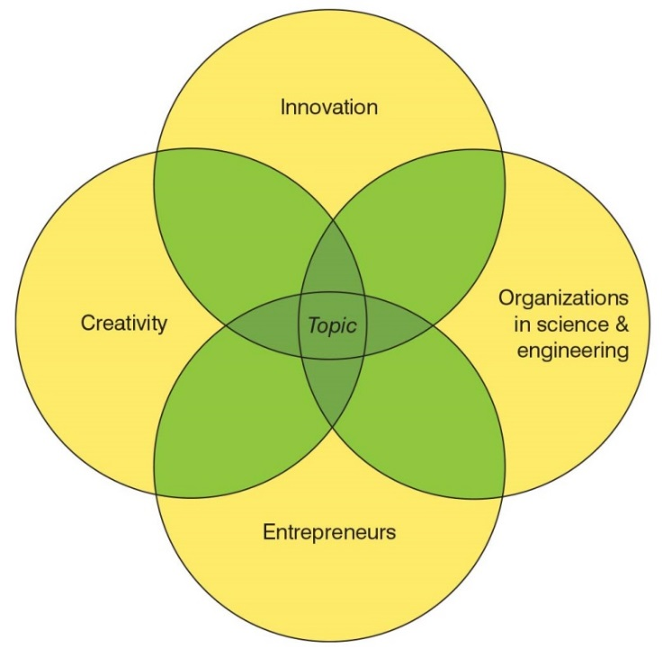
Identifying keywords

Slide 8
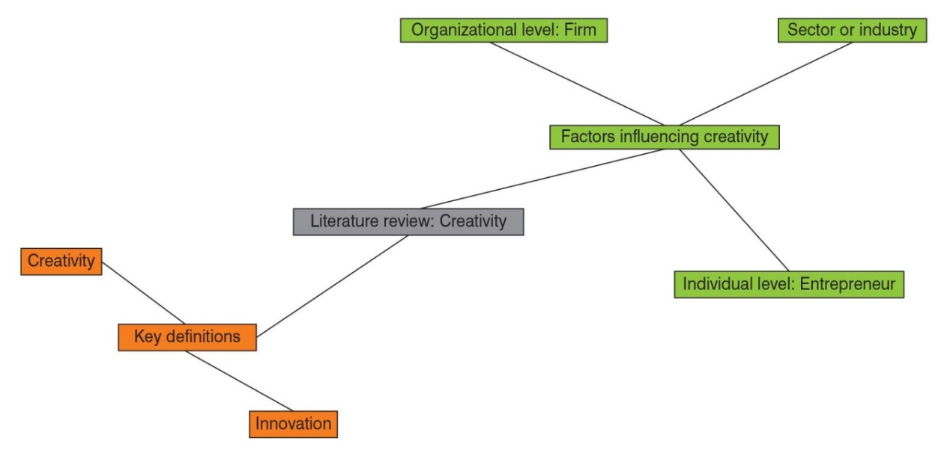
Mind-map of a literature review

Slide 9

Questions?

Slide 10
Exercise: mapping your topic 1
  Decide on a working title for your literature review and write a short research statement that addresses the six questions listed above (about 500 to 1,000 words in total). The statement should help you to articulate your ideas and assumptions. It does not have to be perfect and should be considered work in progress.
  Give your research statement to one or two students in your group and ask them to comment on it. Do they understand the topic and intention of your research? What aspects do they find most/least interesting? Why?

Slide 11
Exercise: mapping your topic II
  After re-reading your initial research summary once or twice, draw a simple Venn diagram or mind-map for your own research project, adding all the items you think your study should cover. Think about how the different items relate to one another and what keywords could be used to describe them. Prepare a list of keywords, adding alternative expressions and synonyms. Decide what kinds of truncations or wildcards could be useful. For example, the term ‘orga*’ might turn out too many results but, combined with ‘innovat*’ and ‘manag*’, could form part of a useful search.

Slide 12
Exercise: mapping your topic III
  Group exercise:
  Share your Venn diagram with two or three members of your group. Can you use it to explain your research project? What words do you use? Show them your initial list of keywords and ask them to revise this list with you. Do they have any useful suggestions

