Slide 1
Introduction to Christian Ethics – Ecology, Environment, and the Created World
HPRS4092
Dr Angus M Slater

Slide 2
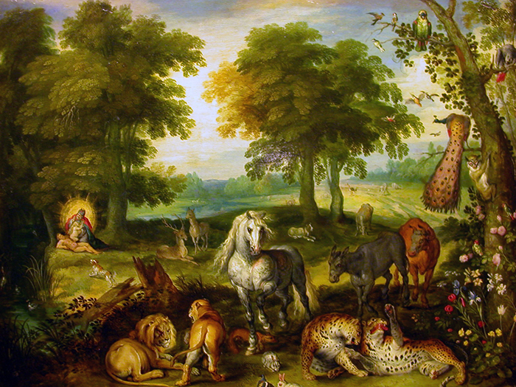
Ecology, Environment, and the Created World
In the previous section, we explored some of the contours of the Christian tradition’s attitude towards war and peace, violence and justice. In doing so, we connected with a number of prevalent themes that have been prominent in all of the issues we have considered so far – issues of moral valuation, human nature, and divine will.
In this final section, I want us to turn towards an area of ethics that has received a great deal of attention in the last few decades, despite being a relatively under-explored area in the centuries preceding – the meaning and moral valuation of the Created world, particularly with reference to ecology and the environment.

Slide 3
Ecology, Environment, and the Created World

Slide 4
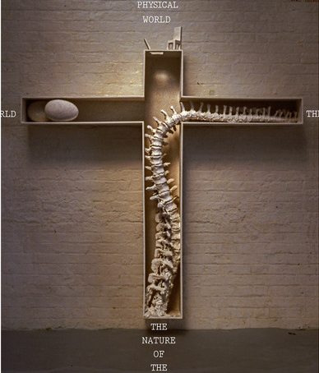
Ecology, Environment, and the Created World
It may seem rather odd to consider that environmental ethics, in the scientific and in the religious spheres, is a relatively new phenomenon given that is attempts to understand the ethical relationship between human beings and our natural environment.
Much of the earlier understanding of environmental ethics was subsumed within broader considerations of just living or discussions of technological limits, with little awareness of the need for explicit ethics about the environment, ecology, and the moral valuation of the created world.
It is only in the last few decades that we have seen a sea-change in the way in which Christian ethics has thought about these topics.

Slide 5
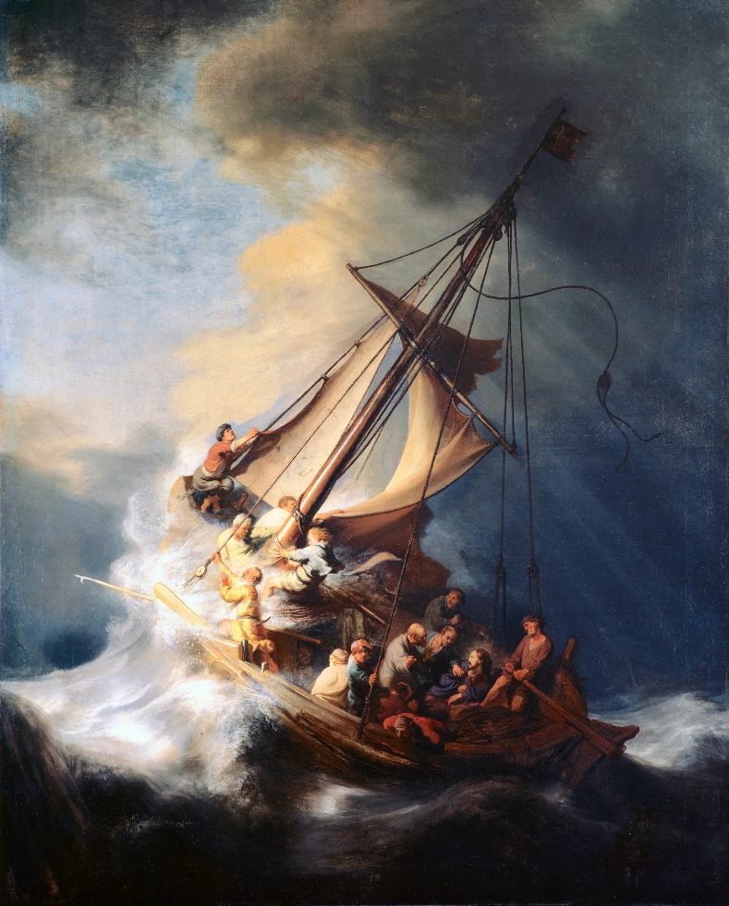
Ecology, Environment, and the Created World
So where did this surge of interest in religious environmental ethics come from?
The contemporary environmental movement is often said to begin with the publication of Rachel Carson’s book ‘Silent Spring’ in 1962 which questioned the prevailing scientific consensus on matters of ecology and highlighted the negative effect that human action has often had on the natural world.
This explicit consideration of the natural world as having some form of intrinsic value – beyond its usefulness to humanity – was a new form of ethical reasoning in both secular forms of ethics, as well as within the Christian ethical tradition.

Slide 6
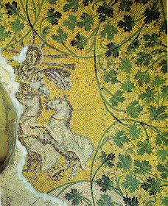
Ecology, Environment, and the Created World
This upswing in interest in ecological and environmental ethics has produced a clear distinction between two forms of ethics – anthropocentric (mankind-focused) and biocentric (living-creature-focused).
Christian ethics has, at various different times and places, drawn on both forms of ethics, but it is important to understand their distinct ethical commitments and differing moral valuations.

Slide 7
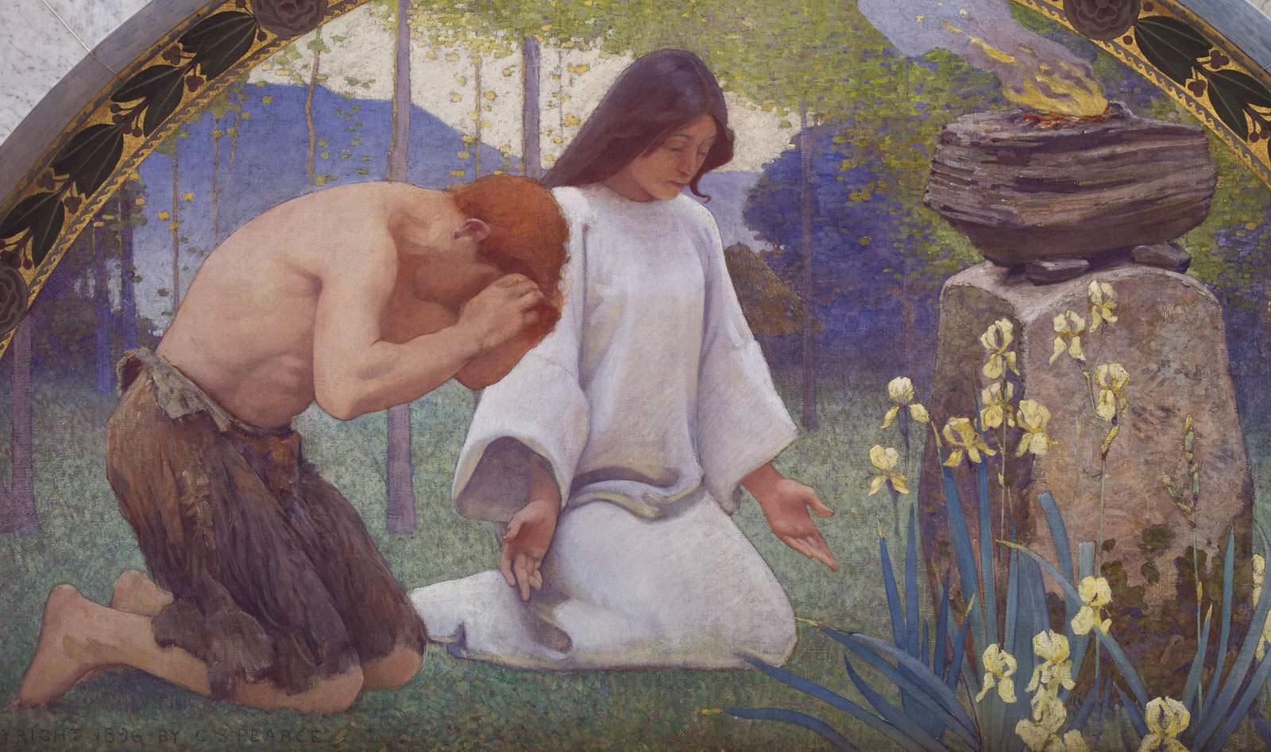
Anthropocentric
Early adopters of the environmentalist ethical approach, such as the famous scholar Lyn White Jr, heavily criticised the traditional forms of Christian ethical reasoning as being on the major reasons for the destruction of environments and the diminishment of ecological diversity.
This is because Christian ethics was seen as having placed human concerns at the centre of ethical considerations to do with matters of the environment and ecology, fundamentally viewing the natural world as a resource for humanity to exploit.

Slide 8
Anthropocentric
What did Christianity tell people about their relations with the environment? While many of the world's mythologies provide stories of creation, Greco-Roman mythology was singularly incoherent in this respect. Like Aristotle, the intellectuals of the ancient West denied that the visible world had a beginning. Indeed, the idea of a beginning was impossible in the framework of their cyclical notion of time. In sharp contrast, Christianity inherited from Judaism not only a concept of time as nonrepetitive and linear but also a striking story of creation. By gradual stages a loving and all- powerful God had created light and darkness, the heavenly bodies, the earth and all its plants, animals, birds, and fishes. Finally, God had created Adam and, as an afterthought, Eve to keep man from being lonely. Man named all the animals, thus establishing his dominance over them. God planned all of this explicitly for man's benefit and rule: no item in the physical creation had any purpose save to serve man's purposes. And, although man's body is made of clay, he is not simply part of nature: he is made in God's image.
Lyn White Jr, The Historical Roots of Our Ecological Crisis
²⁶ Then God said, “Let us make mankind in our image, in our likeness, so that they may rule over the fish in the sea and the birds in the sky, over the livestock and all the wild animals, and over all the creatures that move along the ground.”
Genesis 1:26

Slide 9
Anthropocentric
²⁸ God blessed them and said to them, “Be fruitful and increase in number; fill the earth and subdue it. Rule over the fish in the sea and the birds in the sky and over every living creature that moves on the ground.”
Gen. 1:28
The source of this traditional Christian viewpoint was connected to the initial passages of Genesis, where mankind is given dominion over the created order – the earth and everything in it.
This extended throughout Christian history, with many scholars interpreting it to mean that natural was created for the service of mankind and could be used and disposed of as mankind saw fit.
This was further influenced by the hierarchical nature of much thinking about mankind and natures relation, drawing on aspects of earlier Greek philosophy.

Slide 10
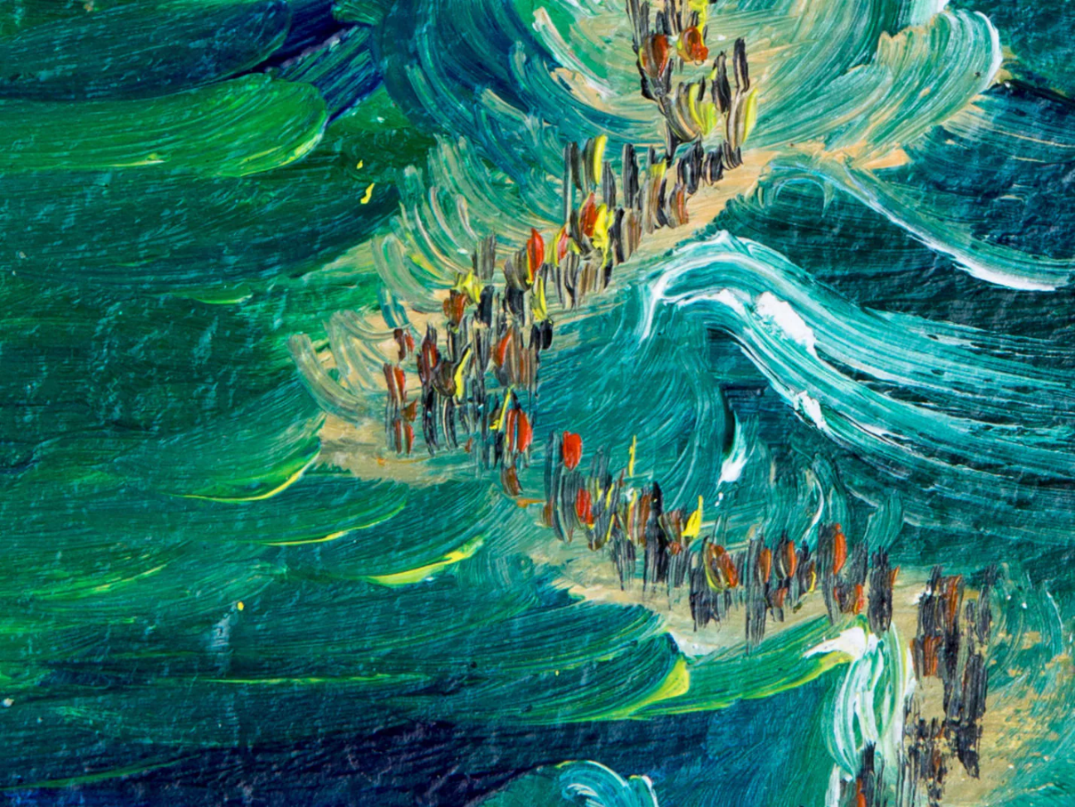
Anthropocentric
This combination of factors, one scriptural and one philosophical, resulted in a largely anthropocentric account of the meaning and value of nature – nature only had moral weight as it could be exploited for human happiness or security.
This sense of nature as functional, as having the purpose of supporting humanity, was incredibly influential on medieval Christian accounts of nature, which tended to see it as a danger to be controlled, philosophical accounts during the Enlightenment, where nature was a universal constant that served the technological progress of man, and later scientific accounts, of progress and development.

Slide 11
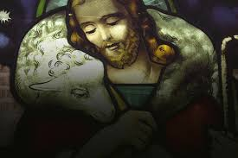
Biocentric
In contrast, we have seen the emergence of biocentric ethical models which place living creatures, beyond just humans, at the centre of ethical concern.
This alternative strand has a variety of levels ranging from just imputing some intrinsic value to the environment, to valuing it above human survival or comfort.
The milder forms of this stance have become relatively popular in the contemporary Christian ethical tradition, but we do see what are called ‘dark green’ or ‘deep ecological’ ethics as well.

Slide 12
Biocentric
“It enlarges the boundaries of the community to include soils, waters, plant, and animals, of collectively: the land”
Aldo Leopoldo, The Land Ethic
“The Earth is more like a living organism than an inanimate machine, which is made up of highly complex interacting ecosystems binding together not only the continents, oceans and atmosphere, but also its living inhabitants; and like an organism, it is (within limits) self-renewing, adjusting to changing conditions through feedback loops in order to maintain relative stability, especially of the atmosphere and temperature”
James Lovelock, Gaia Theory
These ‘dark green’ ethics proposed that ecologies, as holistic entities, must be taken as objects of ethical concern – that they matter, in ethical terms.
Further to this we see a valuation of these individual aspects of nature, and cohesive collective forms, as deserving of ethical valuation beyond their utility to humankind.
Given this, there are situations where the competing ethical demands of ecological preservation and human flourishing come into conflict, and situations where the ethical demands of humankind should be valued as less than the ethical demands of the environment.

Slide 13
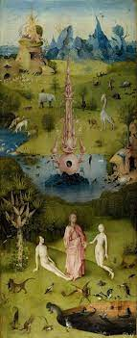
Biocentric
We have also seen an increasing influence of thinking termed ‘deep ecology’ within contemporary Christian ethical reflection.
This strand of thinking foregrounds the idea that the flourishing of both human and non-human life on Earth has intrinsic value, that the flourishing of these two kinds operate in tandem, and that there is intrinsic value to preserving the diversity of life on earth.
Often this is further developed by arguing that current human flourishing has been at the expense of non-human flourishing and that human exploitation of nature has been excessive – only through the reduction of humanity, either numerically or in terms or our impact on nature, can restore ecological balance.

Slide 14
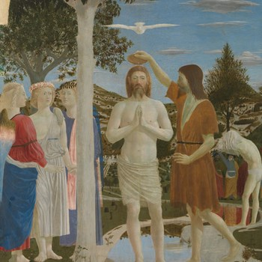
Ecology, Environment, and the Created World
Current Christian views on the environment, ecology, and the created world tend to be based on either of these two trends of thinking, or a combination of the two.
We do see a distinct connection between the scriptural texts and the anthropocentric account of nature – with traditions that foreground textual matters in ethics tending towards this viewpoint, while those traditions that look to other sources of ethics in addition to scripture have tended to move towards less anthropocentric models.

Slide 15
Ecology & Environment
¹⁵ The Lord God took the man and put him in the Garden of Eden to work it and take care of it.
Genesis 2:15
¹⁹ When you lay siege to a city for a long time, fighting against it to capture it, do not destroy its trees by putting an axe to them, because you can eat their fruit. Do not cut them down. Are the trees people, that you should besiege them? ²⁰ However, you may cut down trees that you know are not fruit trees and use them to build siege works until the city at war with you falls.
Deuteronomy 20:19-20
Yet, this notion of dominion may be a simplification of the scriptural account, which has suffered from a further simplification of ‘dominion’ as meaning a disposable asset, to do with as one likes.
Have a look at the Genesis quotation opposite – how might the notion of dominion be being expressed here?
What is the purpose of nature expressed in the quotation from Deuteronomy – and how might this run counter to the desires of man?

Slide 16
Francis of Assisi
Lord, make me an instrument of Thy peace;
where there is hatred, let me sow love;
where there is injury, pardon;
where there is doubt, faith;
where there is despair, hope;
where there is darkness, light;
and where there is sadness, joy.
O Divine Master,
grant that I may not so much seek to be consoled as to console;
to be understood, as to understand;
to be loved, as to love;
for it is in giving that we receive,
it is in pardoning that we are pardoned,
and it is in dying that we are born to Eternal Life.
Amen.
As ever, the Christian tradition, in its various forms has sought in multiple different ways to understand the meaning and value of nature within its broader story.
One figure of particular importance in delivering this diversity of viewpoints was the medieval scholar and saint, Francis of Assisi (1181-1226AD).
In his broader rejection of worldly wealth and power, he sought to bring man back into harmony with nature – he is famous for his prayers and meditations on the beauty of creation, and our responsibility to preserve it.

Slide 17
Hildegard von Bingen
“Glance at the sun.
See the moon and the stars.
Gaze at the beauty of earth’s greenings.
Now, think. What delight God gives to humankind with all these things. All nature is at the disposal of humankind. We are to work with it. For without we cannot survive.”
A second figure in this tradition, and from roughly the same time period, is Saint Hildegard von Bingen (1098-1179AD) who was the leader of a monastic community in Germany.
Her work addressed nature as a source of physical and spiritual healing, with a great deal of emphasis placed on the need for mankind to respect nature and to learn from it.
Nature and mankind adopt a co-operative mode of flourishing within her work and the presence and wonder of nature is a recurring aspect of her visions.

Slide 18
Laudato Si
The creation accounts in the book of Genesis contain, in their own symbolic and narrative language, profound teachings about human existence and its historical reality. They suggest that human life is grounded in three fundamental and closely intertwined relationships: with God, with our neighbour and with the earth itself. According to the Bible, these three vital relationships have been broken, both outwardly and within us. This rupture is sin.
The harmony between the Creator, humanity and creation as a whole was disrupted by our presuming to take the place of God and refusing to acknowledge our creaturely limitations. This in turn distorted our mandate to “have dominion” over the earth (cf. Gen 1:28), to “till it and keep it” (Gen 2:15). As a result, the originally harmonious relationship between human beings and nature became conflictual (cf. Gen 3:17-19)
Pope Francis, Laudato Si, 66
This tradition has developed further in contemporary times – with Pope Francis recently addressing the ethical concerns regarding the environment in a papal encyclical entitled Laudato Si.
In this statement, Pope Francis asserts that the historical Christian interpretation of ‘dominion’ has been a misreading of scripture – attributing absolute dominion to man over the other forms of life on earth.

Slide 19
Laudato Si
33. It is not enough, however, to think of different species merely as potential “resources” to be exploited, while overlooking the fact that they have value in themselves. Each year sees the disappearance of thousands of plant and animal species which we will never know, which our children will never see, because they have been lost for ever. The great majority become extinct for reasons related to human activity. Because of us, thousands of species will no longer give glory to God by their very existence, nor convey their message to us. We have no such right.
Pope Francis, Laudato Si, 33
Further to this revisitation of the Christian tradition, contemporary environmental ethics have had further issues to address such as species loss and climate change.
Francis, again in Laudato Si, made one of the first attempts at addressing the specific ethical import of climate change from within the Catholic tradition, as well as highlighting the intrinsic value of bio-diversity on earth – not just as potential resources for human flourishing, but as an expression of God’s goodness and wonder.

Slide 20
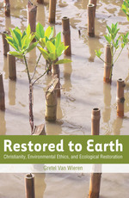
Reading
The reading for this section is:
White, L (1967) ‘The Historical Roots of Our Ecological Crisis’ in Science 155:1203-1207
Pope Francis (2015) Laudato Si’ encyclical, Chapter One
Matthew T. Riley. (2017). The Wicked Problem of Climate Change: Christianity and Environmental Ethics Fifty Years after “Historical Roots.” Worldviews : Environment, Culture, Religion, 21(1), 61–86.
VAN WIEREN, GRETEL. “For the Sake of the Wild Others: Restoration Meanings for Nature.” Restored to Earth: Christianity, Environmental Ethics, and Ecological Restoration, Georgetown University Press, 2013, pp. 55–83,

