Slide 1

Personal Brand Linkedin

Slide 2
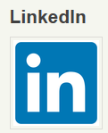
Objectives
LinkedIn profile
Joining Groups
Be visible
Endorsements

Slide 3
Personal Brand LinkedIn
What LinkedIn has become
Create a distinctive LinkedIn profile headline
Optimise your profile
Personalise your LinkedIn URL
Use a consistent look on all social media platforms

Slide 4
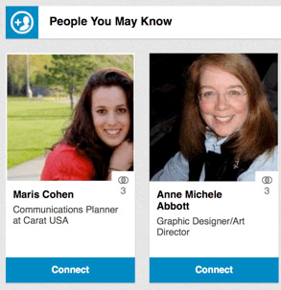
Personal Brand LinkedIn
Join groups, connect or follow others consistent with your brand
Make Meaningful Connections on LinkedIn

Slide 5
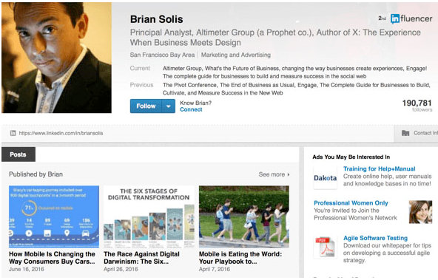
Personal Brand LinkedIn
Publish on LinkedIn
Be visible

Slide 6
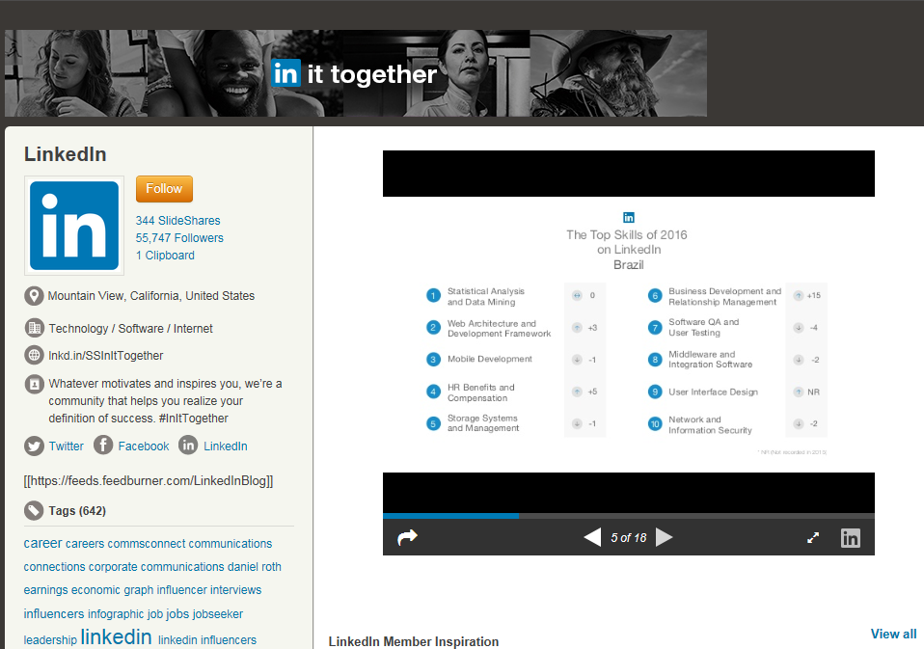
Personal Brand LinkedIn
Customize Your Feed by Following Those Who Matter Most
Create a LinkedIn SlideShare Account
Ensure your LinkedIn endorsements
reflect your brand

Slide 7
Conclusions
Your joining a network of professionals
Opportunities knocking on your door

Slide 8
Summary
LinkedIn profile
Joining Groups
Be visible
Endorsements

