Slide 1
Professional Teaching Experiences 3 - Teachers, School and the Wider Community
ECAD6002
gail.parker@uwtsd.ac.uk

Slide 2
Module aims
To consolidate the student teachers’ professional approach to classroom pedagogy and classroom management including the importance of working with stakeholders within a school environment.
To enhance the wider professional development of student teachers’ reflective enquiry with a consideration of the role of schools within the wider community and the importance of analysis of data.

Slide 3
The sessions
wk 8 20th Oct | Joe Cudd - Poverty and attainment An introduction to the role of schools in the wider community. Looking at the impact of poverty on attainment and strategies and schemes that successful schools have used to improve attainment. FAST project (Family and Schools working Together)
wk 10 10th Nov | Sarah Stewart – Community school working. Family and Community Engagement Communities first Pupil Deprivation grant, Family learning Programme, engaging the Adult community and looking at English for speakers of Other languages (ESOL)
wk11 17th Nov | Glenn Evans: How are schools interpreting assessment? Interpreting school assessment data including family of schools data, reporting to parents/carers; statutory end of key stage reporting. Core data sets. School development plans.

Slide 4
wk12 24th Nov | Russell Dwyer - The role of the Head teacher: Bringing about school improvement. Financial management of schools. School Development plan. The role of the subject coordinator: Including planning for teaching and learning; working with colleagues and others; managing resources. Monitoring and evaluating progress.
19th January | J Parker - An Introduction to School Data Schools and Communities - Professional Learning Communities; the Community schools and Extended Schools agenda; Networks of Professional Practice
25th January | Schools and Local Authorities – the role of governors and local authorities. Bringing about school improvement. Theories, researchers, evidence and the vision. How are schools using assessment? Assessment, recording, reporting and accountability: school marking and assessment policies, including benchmarking; portfolios; tracking progress; standardised assessment tests and level descriptors;

Slide 5
12th February | Presentation preparation/drop in
19th February | Presentation preparation/drop in

Slide 6

The Presentation Assignment

Slide 7
100% of Module
Based on a school’s data, present a group presentation that outlines how to improve the school’s current performance, with clear rationale and justification for any initiatives or strategies.
The six areas that you should look at are English, Maths, Science, Welsh, Gender and Free school meals/Poverty.
(equivalent 2000 words)

Slide 8
Based on a school’s data, present a group presentation that outlines how you would improve the school’s current performance, with clear rationale and justification for any initiatives or strategies.
SUBMISSION DETAILS:
You will be given a pack of school assessment data and will be asked to consider what could be done to improve the current data.
You would be expected to consider how the school would be able to use links with the wider community, as well as other strategies, to improve the school’s current performance. You would need to provide justification for any strategies or initiatives chosen, and outline their expected impact.
As part of your presentation you will be expected to provide an outline of your work for the panel to consider along with a 1500 word accompanying report. Within your group each member will decide on one of the six areas:
Maths
English
Science
Welsh
Gender
Free school meals (poverty)
Your individual presentation should not exceed 4 minutes per member.

Slide 9
So, there will be a maximum of six people in your group.
You will need to work as a group but each individual will present on one area.
Each person will receive an individual mark.
You will need to present a group file, with your names and student numbers on the outside cover.
Divide your file into the areas that you are going to talk about.
When? 26th February 2018

Slide 10
What is PBL? Problem Based Learning
Student-focused
Inquiry-based
Scenarios
Real-world contexts

Slide 11
Groups – no more than six!
I will need names and student numbers by the end of the session.

Slide 12

What makes an excellent school?
Primary school learning environments – ‘Aiming for excellence’ – what are the characteristics of outstanding schools?

Slide 13
So, what makes a ‘good’ school?
community links
fantastic resources
happy children
standards
free school meals

Slide 14
If you walked into a school, how would you know if it is a ‘good’ school?
List 10 things you would hope to see?
Is this the questions that we should be asking?

Slide 15
campus/building
facilities
technologies
staff expertise
teachers
headteacher
standards
safety
eco-friendly
ethos
uniform
answering the needs of the community
co-operation
parents
children
How would you rank these?

Slide 16



External recognition
Eco-Schools
Comenius
Quality Mark
Becta ICT Mark
Healthy Schools
International School Award
Thinking Schools Award
Dragon Sports Award
PESS School
Fair Trade School
Enterprise Award

Slide 17

So, what about Estyn?
https://www.estyn.gov.wales/changes-inspection-arrangements-september-2017

Slide 18
Excellent | Very strong, sustained performance and practice
Good | Strong features, although minor aspects may require improvement
Adequate and needs improvement | Strengths outweigh weaknesses, but important aspects require improvement
Unsatisfactory and needs urgent improvement | Important weaknesses outweigh strengths
www.estyn.gov.wales @EstynHMI

Slide 19
If you were going into school, what three key questions would you ask?

Slide 20
John Hattie
https://www.youtube.com/watch?v=9ousr8uKosk

Slide 21

School Effectiveness Framework

Slide 22


Slide 23
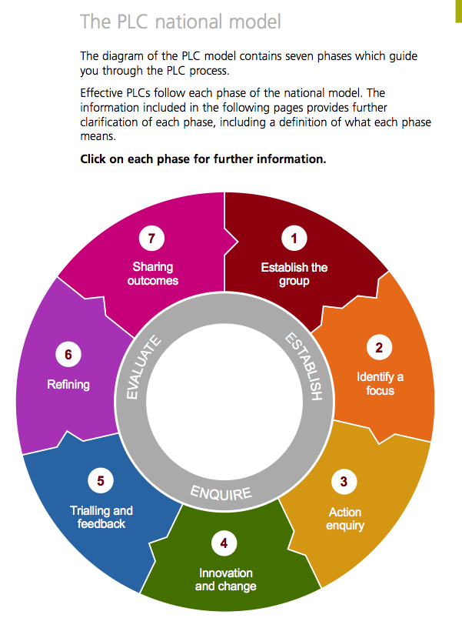
Professional Learning Communities (PLCs)
A professional learning community (PLC) is a group of practitioners working together using a structured process of enquiry to focus on a specific area of their teaching to improve learner outcomes and so raise school standards.

Slide 24
The PLC National Model

Slide 25
Task 1
Which is the ‘best’ school in Wales today?
Be prepared to give reasons for your findings at the start of the lecture on 20th October.
Look at a range of Estyn Reports &
http://mylocalschool.wales.gov.uk

Slide 26
Task 2
Consider some questions for Joe Cudd’s session related to poverty and effective interventions.

Slide 27

Ofsted (2009)Characteristics of outstanding primary schools in challenging circumstances
http://templegrove.org.uk/UserFiles/File/Twenty-two%20Things.pdf
http://www.serviceschools.co.uk/cms/what_makes_a_good_school_new/
http://www.locrating.com/
http://www.ofsted.gov.uk/resources/twenty-outstanding-primary-schools-excelling-against-odds
http://learning.wales.gov.uk/docs/learningwales/publications/121122professionallearningen.pdf
http://www.cse.ucla.edu/products/parents/cresst_GoodSchool.pdf

