Slide 1
Leadership and Management Theory and Practice
( LCBB 6003 )
Week 8
Leadership and Motivation

Slide 2
Session Aims
After this session you should be able to:
State the two categories of motivational theories.
Describe four content theories of motivation.
Reflect how motivational theories can relate to real life working situations.

Slide 3
Definition of Motivation
Motivation - the process of arousing and sustaining goal-directed behaviour
What motivates you to work harder?
Notes:
2
2
6
6
6
6
https://padlet.com/rstewart122/what-motivates-you-to-work-harder-dd4uuymvicf8hbc9

Slide 4
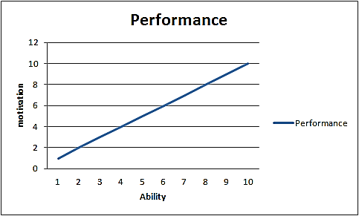
Underlying Concept of Motivation
The concept of motivation suggests that a person’s performance depends upon two factors;
1- Person’s abilities.
2- Motivation.
Notes:
Group Activity. Students to note down and discuss their responses.

Slide 5
Underlying Concept of Motivation
Performance = function (ability × motivation)
A person’s performance is, therefore, a product of abilities and motivation to perform that particular task.
Behaviour of a person in performing ANY task is equally affected by both of these factors; if either of them is missing or is low, performance of that person will be negatively affected proportionate to the impact.
Notes:
Group Activity. Students to note down and discuss their responses.

Slide 6
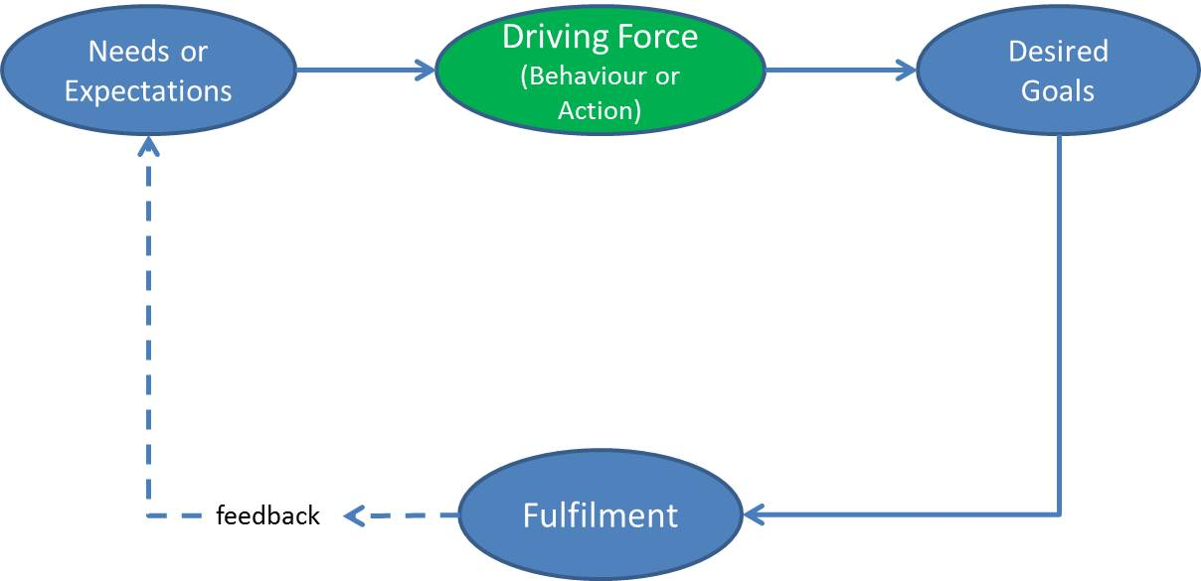
A Basic Motivational Model
A simplified illustration of Basic Motivational Model (Adapted from Mullins 2016)
Notes:
Group Activity. Students to note down and discuss their responses.

Slide 7
What Motivates Employees
Extrinsic Motivation:
Includes all tangible rewards which can be expected by an individual at work, including: bonuses; allowances; work conditions; contracts etc.
Intrinsic Motivation:
Includes all intangible rewards which can be expected by an individual at work, including: the satisfaction and happiness upon achieving a goal or completing a task; appreciation; recognition, etc.
‘The psychological rewards are those that can usually be determined by the actions and behaviour of individual managers’ (Mullins 2016).
Notes:
Group Activity. Students to note down and discuss their responses.

Slide 8
Content Theories of Motivation
Content theories include:
Maslow’s (1954) Hierarchy of needs model.
Alderfer’s (1972) Modified need hierarchy model.
Herzberg’s (1966) Two-factor theory.
McClelland’s (1961) Achievement motivation theory.

Slide 9
Maslow’s Hierarchy of needs theory
Maslow’s theory of individual development and motivation was published in 1943 and proposes that people are driven by their personal needs.
Maslow argued that our needs are arranged in a hierarchical order of priority (like a pyramid).

Slide 10
Maslow’s Hierarchy of needs theory
Starting from the bottom of the pyramid, individuals need to satisfy their physiological needs before they can even start to consider their need for safety, and so forth.
Once they satisfy their lower order needs, individuals begin to consider their higher level needs.

Slide 11
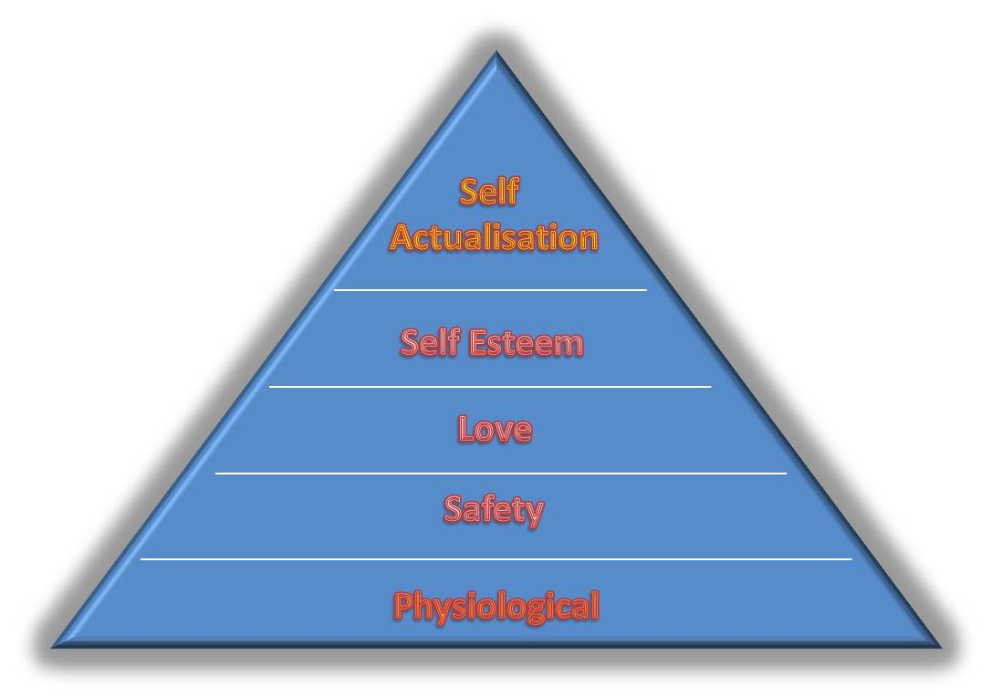
Maslow’s Hierarchy of needs theory

Slide 12
Maslow’s Hierarchy of needs theory
The five needs are shown in the previous diagram, along with general rewards and factors that organisations should consider in order to ensure that the needs are met.
Physiological needs being at the base of the pyramid have the highest priority for individuals.
Once those needs have been fulfilled, individual considers the next level, and so it continues until they reach the top of the pyramid and satisfy all their needs.

Slide 13
Maslow’s Hierarchy of needs theory
Each set of needs demand certain skills and efforts to be put in by the individual.
For example, eating and drinking are basic physiological needs for which people need to either grow their own food or earn money to buy it. Everyone needs safety and security, stability in life and protection.

Slide 14
Maslow’s Hierarchy of needs theory
Organisations try to fulfil these needs by paying salary, providing a pleasant working environment, job security and giving prestigious titles and promotions to the employees.

Slide 15
Maslow’s Hierarchy of Needs
SA
Esteem
Lowest to highest order
Love (Social)
Safety & Security
Physiological
Notes:
6
4
2
2
2
5

Slide 16
Maslow’s Hierarchy of needs theory
Needs Level | General rewards | Organisational factors
1. Physiological | Food, water, sex, sleep | a. pay b. pleasant working conditions c. cafeteria
2. Safety | Safety, security, stability, protection | a. Safe working conditions b. company benefits c. job security
3. Social | Love, affection, belongingness | a. cohesive work group b. friendly supervision# c. professional associations
4. Esteem | Self-esteem, self-respect, prestige, status | Social recognition Job title High-status job Feedback from the job itself
5. Self actualisation | Growth, advancement, creativity | Challenging job Opportunities for creativity Achievement in work Advancement in the organisation
Applying Maslow's need hierarchy (Adapted from Mullins 2013)

Slide 17


Slide 18
Maslow’s Hierarchy of needs theory
What is important to understand in the needs hierarchy is that once a need has been covered and individuals have moved on to the next level, those preceding needs should not be overlooked.
They have to be revisited regularly to ensure satisfaction is always achieved.

Slide 19
Applying Maslow’s Theory Model to Work Situation
People do not always satisfy all their needs through work, especially higher-order needs.
A more holistic appreciation of an employee’s background and social needs would enable a manager to gain a better understanding of their motivations.

Slide 20
Applying Maslow’s Theory Model to Work Situation
Let us now consider the issues that managers should consider when applying this model in a business context:

Slide 21
Applying Maslow’s Theory Model to Work Situation
The model assumes a linear progression up the pyramid.
People do not always behave in such a linear way.
Other factors can impact on how individuals prioritise their needs according to personal circumstances

Slide 22
Applying Maslow’s Theory Model to Work Situation
Individuals are unique and their prioritisation of needs may also be unique.
For example, someone may find a highly paid risky job better than a less paid job in a bureaucratic organisation.
People may have different motivating factors in respect of the same task.
For example, one football player might be interested in playing the game for money, while another player might do it for satisfaction and fame.

Slide 23
Applying Maslow’s Theory Model to Work Situation
People may not improve their performance even if achieving job satisfaction: some may like to play with risk.
Knowing that no one can replace them and that their job is secure under any circumstances, people might not put sufficient effort into improving the work standard or might take risks.
Maslow’s work was not primarily focused on a business context.
However, it has been widely adopted by managers in trying to build effective teams that deliver business benefits.

Slide 24
Motivational Theories X & Y
SA
Theory Y - a set of assumptions of how to manage individuals motivated by higher order needs
Esteem
Love (Social)
Theory X - a set of assumptions of how to manage individuals motivated by lower order needs
Safety & Security
Physiological
Notes:
7
5
2
2
2
5

Slide 25
McGregor’s X and Y Theory
Manager X
  Believes employees are lazy.
  Believes employees need control and coercion.
Douglas McGregor developed a theory relating how a managers’ belief or assume their employees behaviour.
He details two contrasting approaches:
Manager Y
  Believes that employees like work.
  Believes employees do not require controlling.
(Cole and Kelly 2011)
Notes:
https://www.youtube.com/watch?v=CXAzZRnJo2o
Further details on each manager type is contained on further slides.

Slide 26
Theory X
Theory X Managers believe that most people…
Are driven by money
Will avoid work when possible
Lack ambition and dislike responsibility
Are indifferent to organisational needs
Lack creativity and resist change.
Notes:
Douglas McGregor identified two different sets of assumptions made by managers about their staff. Each set of assumptions represents an extreme view of people.
McGregor believes that every manager’s actions are governed by how they view human nature.
A Theory X manager will attempt to exercise tight control by close supervision, demands for strict adherence to rules and threats of punishment.

Slide 27
Theory Y
Theory Y Managers believe that most people…
Are driven by job satisfaction
Actively seek work
Show ambition and seek responsibility
Are committed to organisational objectives
Are creative and welcome change
Notes:
A theory Y manager will create an environment where effort is recognised and rewarded and praise is given regularly.

Slide 28
Theory X and Y
X
Tough, autocratic, tight controls, punishment and rewards. Authoritarian
Y
Benevolent, participative, believe in self controls, Democratic
Notes:
It is important to emphasis with students that Theory X managers will aim to use their authority as a manager whereas a theory Y manager will not perceive a great need to use authority in day to day management. A theory Y manager will seek to promote staff freedom within the defined limits of their role or remit, as well as allowing staff to give suggestions and make decisions.
In practice the either/or choice proposed by theorists may be somewhat artificial. In some circumstances an authoritarian (theory X approach) could be more effective than a democratic (theory Y) Neither approach is superior to the other and may reflect the culture in which the manager is working.

Slide 29


Slide 30

Steve Jobs – X or Y?
Notes:
Watch the video as a group and decide if Steve Job illustrates traits of Theory X or Theory Y

Slide 31
Alderfer’s Modified Need Hierarchy Model
Clayton Paul Alderfer was an American psychologist who developed Maslow's hierarchy of needs by categorizing the hierarchy into his ERG theory (Existence, Relatedness and Growth).
Alderfer’s condensed model composed of just 3 levels of need, as follows (Mullins 2010:264):

Slide 32
Alderfer’s ERG Theory
SA
Growth
Esteem
Relatedness
Love (Social)
Safety & Security
Existence
Physiological
Notes:
10
Existence needs relate to survival and sustaining human existence.
They comprise of what Maslow termed as physiological and safety needs.
Relatedness Needs relate to the social needs of individuals, including affiliation, desire to be loved and belongingness.
Growth needs relate to an individual’s personal development, skills and potential.
In Maslow’s model these needs were termed self-esteem and self-actualisation.

Slide 33
Alderfer’s Modified Need Hierarchy Model
Existence needs relate to survival and sustaining human existence.
They comprise of what Maslow termed as physiological and safety needs.
Relatedness Needs relate to the social needs of individuals, including affiliation, desire to be loved and belongingness.
Growth needs relate to an individual’s personal development, skills and potential.
In Maslow’s model these needs were termed self-esteem and self-actualisation.

Slide 34
Alderfer’s Modified Need Hierarchy Model
Maslow suggests that needs are met in a structured and hierarchical manner from top to bottom, such as physiological needs have priority over safety and social needs.
Unlike Maslow, Alderfer proposed these needs to be a continuum rather than hierarchical: more than one need could be activated at the same time to satisfy the individual.
If a person is unable to fulfil one need, then another need might take over and the focus of the individual will be shifted to that; alternatively multiple needs can be satisfied at the same time.

Slide 35


Slide 36


Slide 37

McClelland’s Achievement Motivation Theory
Based on his research, McClelland came up with four arousal-based, and socially-developed, drivers that motivate people:
Achievement motive (corresponds to Maslow’s self-actualisation need).
Affiliative motive (corresponds to Maslow’s social need).
Power motive (corresponds to Maslow’s esteem need).
Avoidance motive.

Slide 38
McClelland’s Achievement Motivation Theory
The intensity of these motivational drivers is different among different individuals and depends largely upon the occupation of the person e.g. managers tend to score higher in achievement motive, compared to rest of the factors.
The research done by McClelland (1961) applied various projective tests called Thematic Apperception Tests (TATs) to measure motivation levels of an individual.
In these tests, respondents were presented (for 10-15 seconds) with a picture in which some activity was portrayed and were then asked to recall and describe what was happening in the picture and imagine what happened after the picture situation.

Slide 39
McClelland’s Need Theory:
Need for Power
Need for Power - a manifest (easily perceived) need that concerns an individual’s need to make an impact on others, influence others, change people or events, and make a difference in life
Notes:
16
2
6
6
6
6

Slide 40
McClelland’s Need Theory:
Need for Affiliation
Need for Affiliation - a manifest (easily perceived) need that concerns an individual’s need to establish and maintain warm, close, intimate relationships with other people
Notes:
17
2
6
6
6
6

Slide 41
Need for avoidance
When people do not wish to perform at the forefront and prefer to avoid unpleasant situations, this need will surface. People have fear of failure, fear of rejection and even fear of success. By avoiding situations that may trigger these fears, they think to have found a safe solution.

Slide 42
Maslow
Alderfer
McClelland
Self-actualization
Growth
Need for
Achievement
Higher
Order
Needs
Esteem
self
interpersonal
Need for
Power
Belongingness
(social & love)
Relatedness
Need for
Affiliation
Lower
Order
Needs
Safety & Security interpersonal
physical
Existence
Physiological
Notes:
18

Slide 43
Herzberg’s Two-factor Theory
Commonly known as two-factor theory of motivation and job satisfaction, Herzberg conceived this theory by conducting interviews with 203 professionals where they were asked to give reasons for, and a description of, the sequence of events giving rise to the good or bad feelings about their current and/or previous job (Mullins 2016).
The consistent responses from the interviewees revealed two sets of factors:

Slide 44
Herzberg’s Two-factor Theory
Hygiene/Maintenance Factors: Hygiene factors are the ones which, if absent, cause dissatisfaction among employees and tend to relate to Maslow’s lower level needs.
For example, if workers don’t experience equal treatment at the workplace, they will get dissatisfied and their efficiency will be affected.
work condition related to dissatisfaction caused by discomfort or pain
  maintenance factor
  contributes to employee’s feeling not dissatisfied
  contributes to absence of complaints

Slide 45
Herzberg’s Two-factor Theory
Motivators/Growth Factors: Motivators are the factors which, if present, tend to motivate employees and relate to Maslow’s higher level needs.
Managers must ensure the availability of growth factors in order to motivate employees, so that they can work efficiently.

Slide 46
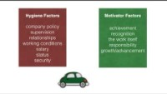

Slide 47
References
Alderfer, C. P. (1972) Existence, Relatedness, and Growth: Human Needs in Organizational Settings, New York: Free Press.
Herzberg, F. (1966). Work and the nature of man. Cleveland: World Pub. Co.
Maslow, A. (1954). Motivation and personality. New York: Harper
McClelland, D. (1961). The achieving society. Princeton: Van Nostrand.
Blanchard, K. and Johnson, S. (1982). The one minute manager. New York: Morrow.
Kets de Vries, M. (2000) Beyond Sloan: Trust is at the Core of Corporate Values. Financial Times. Mastering Management. October 2nd. 14-15
Mitchell, T. R. (1982). Motivation: New directions for theory and research. Academy of Management Review. 17 (1). 80-88.
Taylor, F.W. (1911) The Principles of Scientific Management. New York: Harper & Brothers

Slide 48
Further Reading
Mullins, L. and Christy, G. (2016). Management & organisational behaviour. 11th edn. Harlow: Pearson.
Boddy, D. (2013). Management: An Introduction. Harlow: Pearson.

