Slide 1

Executive power
By Zita Draper

Slide 2
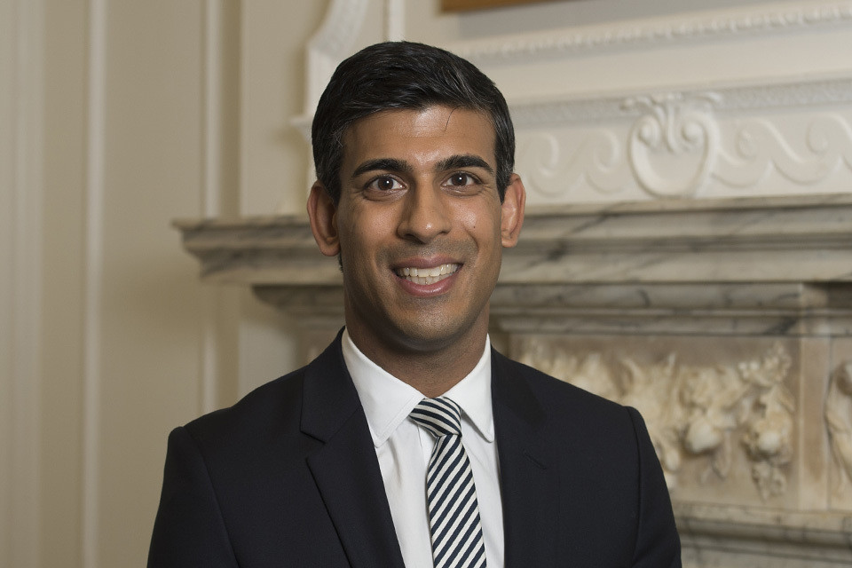
Who is the executive?
The Government.
Cabinet.
Prime minister – head of the government.
Wider government.

Slide 3
Prime Minister
Rishi Sunak- several responsibilities
Can be appointed in a number of ways.
In the past it would be the choice of the Monarchy.
But now; General elections and then appointed by the King.
Cabinet manual
Hung parliament.
Leaving – Resign / then party choose next leader.

Slide 4
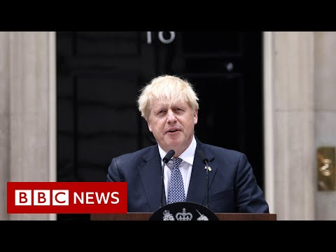

Slide 5
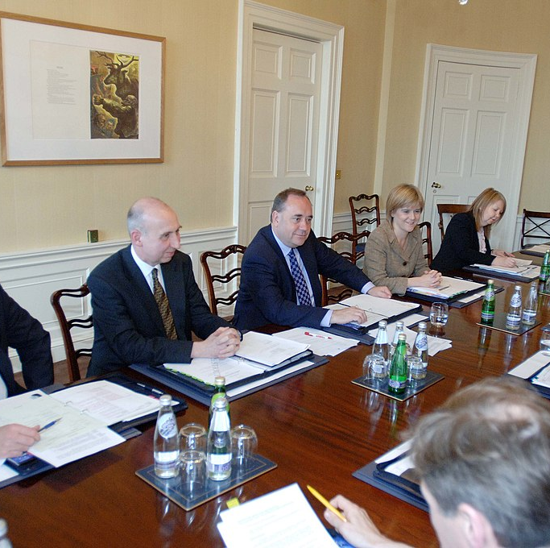
Who is the cabinet?
Prime Ministers and senior ministers.
Queen appoints on the Prime ministers say so.
All + Junior ministers and civil servants- help run the country.
Convention – house of commons / house of lords- member.

Slide 6

Wider government
Mp's
Appointed by Crown.
Limit is 95 in the House of commons.
109 can receive pay.
Grades;
1. Cabinet
2. Secretaries of State
3. Parliamentary Undersecretaries of State

Slide 7
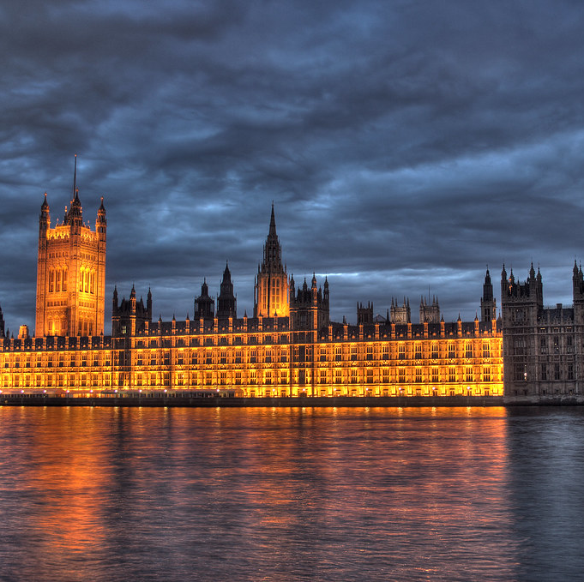
Parliament continued
Outside of parliament member- life peerage.
Can be reshuffled.
MAFF example.
New departments of the government created when needed.

Slide 8


Civil service
Run day to day functions.
Not change when the government change.
Positive neutrality
Other public bodies;
Public corporations.

Slide 9
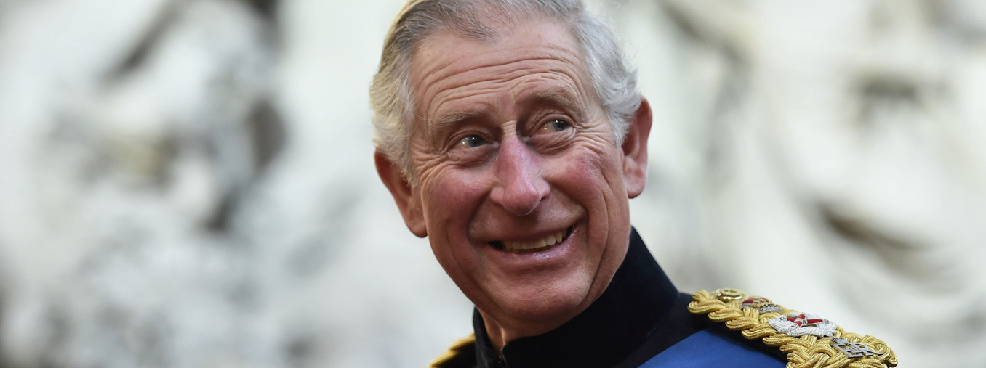
The crown
''Minister of the crown''
No new prerogative powers;
''In the Case of Proclamations [1611] Chief Justice Coke confirmed that “the King hath no prerogative, but that which the law of the land allows him”

Slide 10
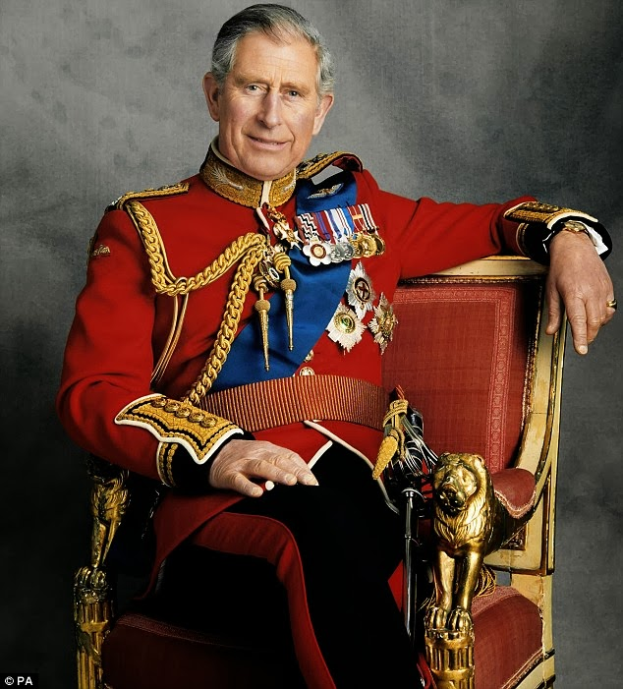
Prerogative powers
Legislative – Includes suspend/Prerogative powers
Executive- Appointing Prime Minister and Cabinet. (You're Fired)
Judicial Prerogative- Operate in the Crowns name. Case examples R V R 1991.
R v A- case where letter is used instead of a name, why?

Slide 11
Holding the executive to account
Collective cabinet responsibility.
Cabinet solidarity.
Cabinet confidentiality.

Slide 12

Resignation
Rare for departmental failures.
Reluctant to resign.
Questioning individual responsibility.

Slide 13
Holding ministers to account
Select committees
Debates
Parliament questions

Slide 14
Ministerial code
Has to be abided by my ministers.

Slide 15

The Parliamentary and Health service ombudsman

Slide 16
Summary
Government/ Executive.
Includes the prime minister / The Cabinet / Wider Government.
Monarchy.
Powers of the Crown.
Ministerial Code.

Slide 17

Thank you!
Any Questions?

