Slide 1

MARKETING CONCEPT
THE MOST EFFECTIVE FOR BUSSINES IN 2025
Ana Maria Rosu

Slide 2
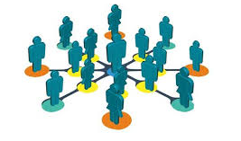
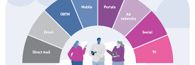

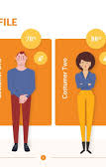
Customer-Centred Philosophy
The concept of marketing is related to how you can understand and satisfy consumer needs better than the competition. It changes the business approach from product- or sales-orientation to a customer-oriented business philosophy.
Long-term commitment to the business is built on value and relationships instead of the practice of chasing after sales in the short term.
Every function in the business, from product design to the customer service department, is aligned to create a consistent customer satisfaction level and trust with a brand.

Slide 3
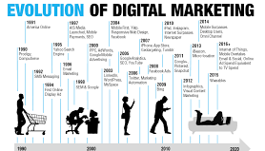
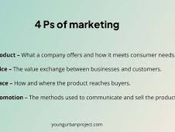
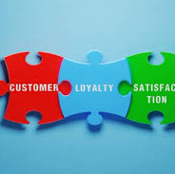
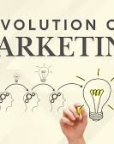
Classification and Development
The marketing concept is the fourth significant philosophy over time. It replaced aggressive selling philosophy by providing authentic consumer orientation and the strategic planning process.
Its primary advantage is that it engages with customers as part of value creation. It invites customers to enter their purchase decision and provides feedback along the purchasing process.
It's also the foundation of many contemporary thinking and practices that shape the marketing concept today, including market segmentation, data analytics, and customer relationship management, which all support customer-centric principles for deciding business.

Slide 4
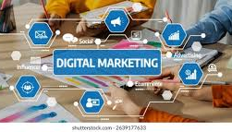


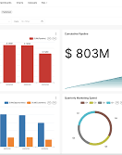
Implementation in Contemporary Business
Companies today utilise research and data analytics to know something about consumers, their behavior, trends, and needs. Then they can decide how to build their own products, approach consumers, and how the strategy needs to evolve over time.
Digital technology helps businesses provide personalised and customised marketing engagements, invite real-time engagement, and create seamless experiences across all touchpoints.
Business success will be dependent on whether and how well each department works as a team. When everyone in a business supports and promotes customer satisfaction through company defined practices, it creates loyalty and builds competitive power.

Slide 5
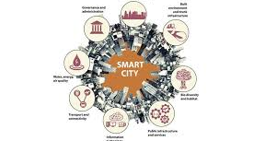
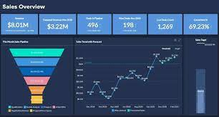
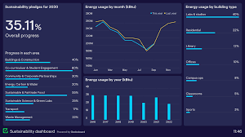
Conclusion: Why It Fits 2025 Best
The marketing concept fits 2025 perfectly. Today's consumers have, and will, demand more from businesses, while having higher expectations that include personalisation and transparency, as well as adopting an ethical posture in interactions, purchases and brand use.
Using data that provides insight into evolving consumer needs and empathy will provide lasting trust and a sustainable competitive advantage.
Lastly, focusing on value created with customer from the marketing concept lends itself well to being the most sustainable and future-oriented model for generating success in modern business.

Slide 6
References
Bazarova, M. (2024). Marketing Management Strategy's Importance and Modern Concept. Modern Science and Research, 3(6).
Firat, A. F. (2022). Marketing and market. Japan Marketing History Review, 1(1), 48-53.
Haris, A., Samosir, H. E., & Lubis, S. H. (2023). Marketing communications as strategy expanding market share in era 4.0. International Journal of Social Science and Business, 7(1), 188-198.
Keller, K. L. (2022). Understanding the changing role and functions of marketing.
Kotler, P. (2003). Kotler, marketing management.
Kotler, P., Kartajaya, H., & Setiawan, I. (2021). Marketing 5.0: Technology for humanity. John Wiley & Sons.
Kotler, P., Pfoertsch, W., & Sponholz, U. (2021). H2H Marketing. Cham: Springer International Publishing.
Okonkwo, K. (2024). Using Artificial Intelligence (AI) to Manage Buyer Persona in E-commerce based on Kotler & Keller’s 2016 Model of Consumer Behavior: Studying Consumer behavior in E-commerce through Archival Research based on Secondary Data in form of Relevant Publications.
Rachmawati, E. R., Syah, T. Y. R., Indradewa, R., & Fajarwati, D. (2021). Influence of Marketing Mix Strategy on Business Arena Corner. International Journal of Research and Review, 8(8), 76-86.

