Slide 1
Task 1: Reflection on Employability Skills
Submitted By: Caroline Akiotu
Student Id: 2133382
Course: Academic And Employability Skills
Module Code: BMSW 4001
Module Leader: Sylvia Hoffman
University Name: University Of Wales Trinity Saint David
Date: 12/08/2022

Slide 2
Table of Contents
Contents | Slide No.
Introduction | 3
Growth trends of hospitality industry of Australia | 4
Required skills as per industry trends | 5
Current employability skills | 6
Personal SWOT Analysis | 7
Potential skills to improve | 8
Personal Development Plan | 9
Conclusion | 10
References | 11

Slide 3
Introduction
Nowadays, the hotel and tourism industry is growing rapidly (Polak et al., 2019). As a result, I have a lot of growth opportunities to build my career in Food production route.
Intended Career: I want to become a food production chef and wants to involve in working with branded restaurant chains, and banquets.

Slide 4
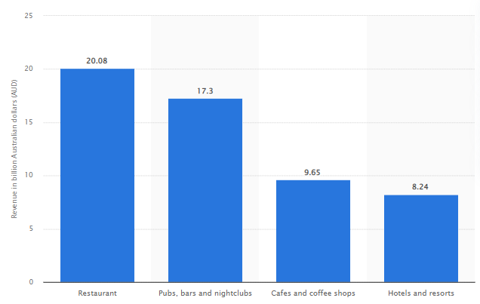
Growth trends of hospitality industry of Australia
Notes:
This statistic shows revenue in the Australian hospitality industry during the fiscal year to June 2018, by sector. In the period examined, the restaurant sector achieved 20.08 billion Australian dollars and hotels and resorts achieved 8.24 billion AUD (Polak et al., 2019).

Slide 5
Required Skills as per Industry Trends
Ability to create a specific selection of dishes or menus to extremely high standards on a mass scale
Capabilities to working in pressurized kitchen environment
Establish respectful working relationships with other team members
Notes:
Ability to create a specific selection of dishes or menus: In order to become the food production chef, it is essential to improve the abilities to create a selection of dishes or menus to satisfy guests (Mahfud and Lastariwati, 2019).
Capabilities to working in pressurized kitchen environment. In order to build career as a food production chef, I needs to develop the capabilities to work in pressurized kitchen environment.
Establish respectful working relationships with other team members: Next, I need to coordinate with other team members to strengthen the existing relationship to come up with the creative and quality food items.

Slide 6
Required Skills as per requirement agencies
Food Safety
Teamwork
Commitment to Quality
Notes:
Food safety: In most cases, it's the role of cooks to check that the food they prepare is safe for consumption. Understanding the local health regulations and industry standards on food safety can help chefs prevent foodborne illnesses (Indeed editorial team, 2021).
Teamwork: Cooks often work alongside other kitchen staff, such as wait staff, line cooks and head chefs. They may use teamwork in various situations such as cooking food and various others.
Commitment to Quality: A chef can show commitment to their work by producing quality food for their customers.

Slide 7
Required Skills as per requirement agencies
Cleanliness
Creativity
Multitasking
Notes:
Cleanliness: Cleanliness is one of the main essential skills that employers expect chef to have. Cleanliness encourages kitchen and food safety and also portrays a pleasant and healthy environment to existing and new customers.
Creativity: Another great chef skill is creativity, which allows them to experiment with different cooking techniques, potentially impressing their customers and employers (Indeed editorial team, 2021).
Multitasking: As a cook, chef may do a lot of things simultaneously. They may cook in different pots or pans simultaneously, all by themselves, to meet customer orders and move swiftly to the next dish.

Slide 8
Current Employability Skills
I have the following skills that differentiate me from other chefs and individuals;
Communication
Motivation
Problem-solving
Quality of Food
Handling pressure

Slide 9
Current Employability Skills (Cont.)
Employability Skills | Reasons behind considering these skills
Communication | Openly expression of thoughts and key considerations
Motivation | The high-level coordination with the staff members and influencing capabilities to influence behaviour
Problem-solving | Know about the practical and theoretical concepts to solve different concerns in front of chef
Quality of Food | Best knowledge of food preparation techniques
Handling Pressure | Working in pressurizing environment since beginning of my career

Slide 10
Personal SWOT Analysis
Strengths | Weaknesses
Food and Flavour Pairing Artistic food presentation style Multi-tasking Great knowledge of Culinary Science High capabilities to work in pressurized environment | Poor capabilities to develop kitchen porters as per the expectations of managers and other members of top management. Poor skills of identifying variety of ingredients for fresh food.
Threats | Opportunities
Presence of a lot of physical hazards which may cause harmful effects. | Increasing growth of the hotel and tourism industry. Increasing requirements of quality chefs in branded hotel brands

Slide 11
Potential skills to improve
Develop kitchen porters as per the expectations of managers and other members of top management.
Skills of identifying variety of ingredients for fresh food
Portion Sizing
Notes:
Cooking is a science. Every ingredient and measurement must be exact, including ordering food products or figuring out how long to cook certain items so that they're all plated at the same time. A chef needs to have an eye for details such as:
Develop kitchen porters as per the expectations of managers and other members of top management (Taylor, 2019)
Skills of identifying variety of ingredients for fresh food
Portion Sizing

Slide 12
Personal Development Plan
Target | How | Resources and Support | Time Period
Attend Commis Chef Apprenticeship | Look for the most reputed chef development and training college | Online research, library, reading real-life accounts | 6 months
Carry out Production Chef Apprenticeships | Look for the most reputed chef development and training college | Online research, library, reading real-life accounts | 6 months
Notes:
A PDP is a form of self-evaluation and self-reflection that is typically used in higher education and the workplace. However, it can also be a beneficial exercise in personal life of an individual.

Slide 13
Conclusion
Based on the findings, it can be said that the development of a career in a production chef is challenging and complex.
It is because of the presence of a wide range of physical hazards.
Besides, the development of a career as chef requires high abilities to handle pressure, manage menus, and other key critical thinking skills to take relevant decisions.

Slide 14
References
Indeed editorial team, 2021. 10 Essential Chef Skills. [online] Indeed Career Guide. Available at: <https://uk.indeed.com/career-advice/career-development/chef-skills> [Accessed 25 July 2022].
Mahfud, T. and Lastariwati, B., 2019. Chef's competency as a key element in food tourism success: a literature review. Geo Journal of Tourism and Geosites, 26(3), pp.1057-1071.
Polak, R., Finkelstein, A., Paganoni, S., Welch, R. and Silver, J.K., 2019. Cooking online with a chef: health professionals’ evaluation of a live culinary coaching module. Nutrition and Metabolic Insights, 12, p.1178638819887397.
Taylor, S., 2019. Requirements to Be a Chef | Top 10 Skills. [online] The Hub | High Speed Training. Available at: <https://www.highspeedtraining.co.uk/hub/requirements-to-be-a-chef/> [Accessed 25 July 2022].

