Slide 1
Introduction to Leadership and Management
Group Members | 1.Mrs. Andreea Alina Tudorache 2. Mr. George Alin Manole-Mihut 3.Mrs. Mihaela Hermeneanu 3. Mr. Andrei Bodiu | Student ID | 2130698 2128132 2310013 2315630
Programme: | BA Business Management
Module: | Introduction to Leadership and Management
Module code: | LCBB4008
Module Leader: Lecturer: | Dr Yousuf Kamal
Assignment Title: | Component 2: Group presentation Managerial Behaviour

Slide 2

Introduction
Effective managers make significant contributions to organizations’ performance.
Managers' behaviors are instrumental in the success of employees, their morale, and employee turnover in organization irrespective of their management styles.
Managers need to exhibit behaviors that can positively influence their teams to become better organizational leaders.
Manager behaviour is how managers act and conduct themselves, including how they treat their employees and lead their teams.
Good understanding of employee behavior at work improves employee output
Robbins (2020) claims that the most effective managerial behaviors involve:
- Supporting employees to perform their work well
-Treating them courteously and fairly in the workplace.
Notes:
Hello Everyone! Welcome to my presentation on Effective Managerial Behaviours.
Effective managers can make a significant contribution to the performance of their organization. Irrespective of the management style adopted, managers' behaviors play an instrumental role in the success of employees, their morale, and employee turnover (Cole and Kelly, 2011).
Managers must exhibit behaviors that can positively influence their teams to become better organizational leaders. Manager behavior covers how managers act and conduct themselves, including how they treat their employees and lead their teams.
Based on behavioral management theorists, a good understanding of human behavior at work, such as conflict, motivation, group dynamics, and expectations, significantly improves employee productivity (Robbins and Judge, 2020).
The most effective managerial behaviors involve supporting employees to perform their work well and treating them courteously and fairly in the workplace. Managers’ behavior is vital as it establishes the tone for the entire team.

Slide 3
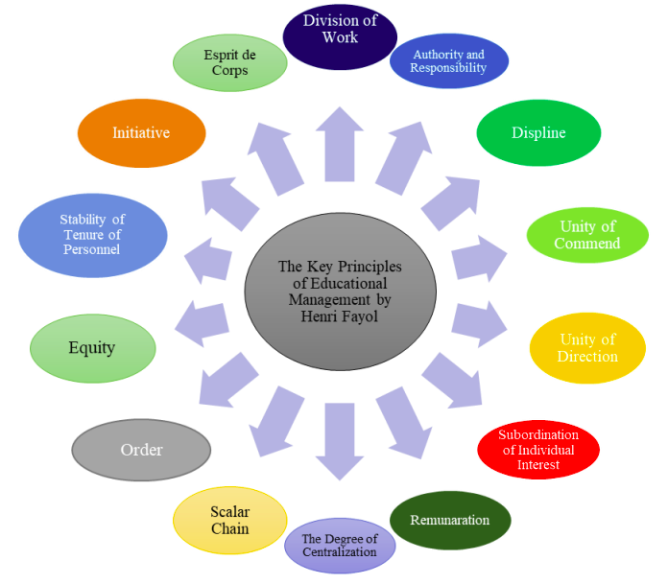
Managerial Principles
Notes:
Division of work entails dividing work into smaller manageable tasks and allocating them to different individuals (Mullins and Christy, 2016). Division of work seeks to enhance efficiency by assigning various tasks to other employees, thus reducing costs and enhancing productivity.
Balancing authority and responsibility entails dividing authority between managers and subordinates while sharing responsibilities to ensure both parties take ownership of their roles. This principle seeks to enhance efficient functioning by minimizing conflict between managers and subordinates.
Unity of command: This principle ensures that employees understand the company's goals; their individual roles that can help attain those goals, and how they fit into the larger picture (Mullins and Christy, 2016).
Subordination of individual interests to the general interest: this principle ensures that everyone works toward a shared goal instead of egoistically chasing personal goals at the expense of company goals
Remuneration: This entails rewarding employees for their work by using compensation systems based on performance, need, and merit (Mullins and Christy, 2016). This principle seeks to create a fair system so that every employee gets what they deserve for their efforts.
Equity entails fairness in every matter regarding employment. It ensures that all employees are treated fairly and equally without prejudice based on their creed, color, race, or sex (Mullins and Christy, 2016).

Slide 4
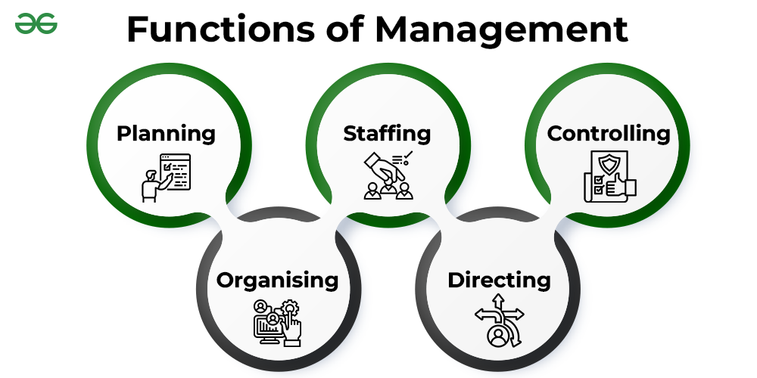
Managerial Functions

Slide 5
Managerial Functions Conti-
Planning: identifying needs, establishing objectives, and devising appropriate courses of action to achieve the goals
Organizing: allocating the resources and assigning tasks to employees to attain the established goals.
Staffing: hiring, allocating, and managing employees to undertake their assigned tasks effectively and efficiently
Controlling: ensuring that all activities are executed as planned and includes monitoring and evaluation of work performed to ensure it meets required standards
Directing: Focuses on guiding, influencing, supervising, and motivating employees to achieve organizational goals
Notes:
Planning
Planning entails identifying needs, establishing objectives, and devising appropriate courses of action to achieve the goals (Kozina, 2014). Managers must understand their companies' environmental conditions to enable them to make informed decisions.
Organizing
Organizing entails distributing the resources and delegating tasks to personnel to achieve the goals established in the planning stage (Mullins and Christy, 2016). It also involves developing systems for coordinating work efforts across teams or departments.
Staffing
Staffing involves hiring, allocating, and managing employees to undertake their assigned tasks effectively and efficiently (Kozina, 2014). Staffing requires managers to decide who should perform specific tasks, when and where the tasks should be conducted, and the time assigned for every task.
Controlling
Controlling focuses on ensuring that all activities are executed as planned and includes monitoring and evaluation of work performed to ensure it meets the required quality standards (Mullins and Christy, 2016).
Directing
Directing entails the interpersonal aspects of management, which focuses on guiding, influencing, supervising, and motivating employees to achieve organizational goals (Mullins and Christy, 2016).

Slide 6
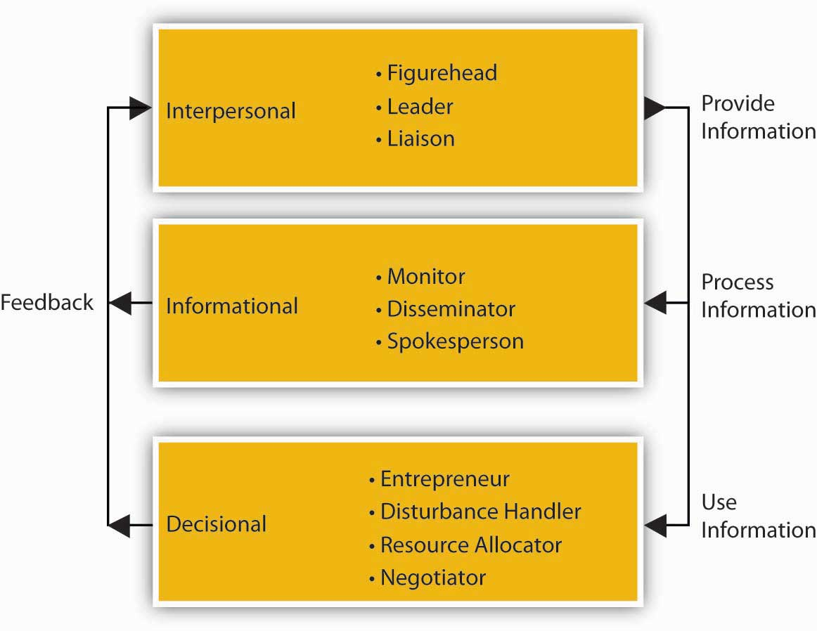
Managerial Roles

Slide 7

Managerial Roles-Conti-
Leadership: Managers supervise employees’ work and guide and influence subordinates' work in the desired direction.
Communicator/disseminator: Managers disseminate information along the chain of command, offering employees insight to those at higher levels and corporate guidance to those at lower levels
Decision –maker: manager make decisions regarding optimum utilization of resources to ensure organization meets its goals
Mentorship and advocacy: Managers also help employees feel supported and cared for by offering them mentorship and advice.
Problem-solver: Managers play the role of negotiator whenever problems arise between employees.
Notes:
Communication/disseminator
Managers perform interpersonal roles in the company, which require effective communication. Managers disseminate information along the chain of command, offering employees insight to those at higher levels and corporate guidance to those at lower levels (Kozina, 2014).
Leadership
Managers supervise employees’ work and guide and influence subordinates' work in the desired direction.
Decision-making
Managers also perform decision-making roles in the company by steering their departments or the entire company in the desired direction (Kozina, 2014). They make decisions regarding the optimum utilization of resources to ensure the organization meets its goals.
Mentoring and advocacy
Managers also help employees feel supported and cared for by treating them as genuine members (Northouse, 2016). They advance employees' needs with upper management and offer them mentorship and advice.
Problem-solving/negotiator
Managers also take corrective action when plans hardly go as expected. They also play a negotiator role whenever problems arise among employees.

Slide 8
Managerial behaviors
Supporting employees to move forward in their work
Treating employees decently and fairly within the workplace

Slide 9

Supporting Employees to Move Forward in their Work
Managers' actions and behavior significantly affect the productivity of employees and that of the organization.
The toxic manager-employee relationship can be harmful to employees as it causes stress and mental problems
Managers must consider employees as the most vital assets of the organization.
They should show genuine support to employees by developing their expertise via training to prepare them to perform their jobs better.
They should take their time to listen to the employees' concerns and offer supportive responses.
It helps employees to feel valued, thus enhancing productivity and reducing employee turnover
strive to understand employees' challenges, needs, and motivations and offer support and guidance
Also, create a positive work environment allows employees to perform their tasks effectively.
Notes:
Managers' actions and behavior significantly affect the productivity of employees and that of the organization. The toxic manager-employee relationship can be harmful to employees as it causes stress and mental problems (Robbins and Judge, 2020). Managers must consider employees as the most vital assets of the organization. They should show genuine support to employees, including developing their expertise through training to prepare them to perform their jobs better. Managers must take their time to listen to the employees' concerns and offer supportive responses (Contreras, Soria-Barreto, and Zuniga-Jara, 2021). This aspect makes employees feel valued, thus enhancing productivity and reducing employee turnover. Managers can also inspire and motivate employees to engage in professional development to improve their skills. Managers should also strive to understand employees' challenges, needs, and motivations and offer support and guidance (Huang, 2019). Encouraging them to work on the skills and tasks they excel at is a great way to boost their confidence and increase their motivation. Organizing monthly progress meetings can help employees understand how to meet expectations and how far they are from reaching their goals (Northouse, 2016). Also, creating a positive work environment allows employees to perform their tasks effectively.

Slide 10
Treating Employees Decently and Fairly within the Workplace
When employees feel unjustly handled by managers, they tend to be less productive
They are likely to engage in deceptive behavior, and likely to leave the company
Managers need to treat employees decently and fairly in the workplace to enhance their productivity and reduce employee turnover .
Managers should respect employees and give them a supportive working environment
They should strive to motivate employees through fair work packages
Provides employees with opportunities to offer their input on vital decisions affecting their work
Listen and empathize with employees’ concerns, opinions, and ideas
Create a safe and open space for employees to express themselves and acknowledge and appreciate their perspectives
Treat every employee with respect and dignity to make them feel valued
Notes:
Lack of fairness in the workplace creates implications far beyond the emotional well-being of employees. Employees who feel unfairly treated tend to be less productive, more likely to engage in deceptive behavior, and less likely to stay with the organization for long (Robbins and Judge, 2020). Therefore, managers need to treat employees decently and fairly in the workplace to enhance their productivity and reduce employee turnover (Robbins and Judge, 2020). Managers should respect employees and give them a supportive working environment. Moreover, they should strive to motivate employees through fair work packages (Northouse, 2016). Also, they should make the decision-making process transparent in the company. Also, it provides employees with opportunities to offer their input on vital decisions affecting their work (Huang, 2019).
Ensure that the codes of conduct do not discriminate to promote fairness and consistency in the treatment of employees in the organization. Another way to show fairness and equity to your employees is to listen and empathize with their concerns, opinions, and ideas (Pearl Dlamini, Suknunan, and Bhana, 2022). Managers should create a safe and open space for employees to express themselves and acknowledge and appreciate their perspectives. Also, managers can promote fairness by respecting and celebrating employees’ diversity. They should identify and value the differences and similarities among their employees, including their backgrounds, beliefs, cultures, values, styles, and skills (Pearl Dlamini, Suknunan, and Bhana, 2022). Lastly, treat every employee with respect and dignity to make them feel valued.

Slide 11
References
Cole, G.A. and Kelly, P. (2011) Management theory and practice. Australia: South-Western Cengage Learning. Available at: 1844805069 (Accessed: 15 February 2024).
Contreras, F., Soria-Barreto, K. and Zuniga-Jara, S. (2021) ‘Managerial support and innovative work behaviour in B Corps: Examining the effect of female employee work engagement and corporate reputation’, Journal of Sustainable Finance &amp; Investment, 12(3), pp. 809–831. Available at: 10.1080/20430795.2021.2017255 (Accessed: 14 February 2024).
Huang, S. (2019) ‘The impact of coaching leadership on in-role performance of employees—based on the perspective of social information processing theory’, Open Journal of Social Sciences, 07(12), pp. 223–237. Available at: 10.4236/jss.2019.712017 (Accessed: 15 February 2024).
Kozina, A.W. (2014) ‘Managerial roles and functions in negotiation process’, Business, Management and Education, 12(1), pp. 94–108. Available at: 10.3846/bme.2014.07 (Accessed: 15 February 2024).
Mullins, L.J. and Christy, G. (2016) Management & Organisational Behaviour. Harlow: Pearson Education Limited. Available at: 1292088486 (Accessed: 13 February 2024).
Northouse, P.G. (2016) Leadership: Theory and practice. Los Angeles, Calif. u.a.: SAGE. Available at: 1483317536 (Accessed: 15 February 2024).
Pearl Dlamini, N., Suknunan, S. and Bhana, A. (2022) ‘Influence of employee-manager relationship on employee performance and Productivity’, Problems and Perspectives in Management, 20(3), pp. 28–42. Available at: 10.21511/ppm.20(3).2022.03 (Accessed: 12 February 2024).
Robbins, S.P. and Judge, T. (2020) Organizational behavior. New York, NY: Pearson Education. Available at: ‎ 0134729323 (Accessed: 15 February 2024).

