Slide 1


How do we use technology to collaborate at UWTSD?
By Tehreem Arshad-2120566
Aisha Bibi-2122694
Scott Uwafiokun Eweka-2122699
Samia Waseem-2123965
Module-BMSW4003-Digital Skills and Research Methods
Lecturer-M.Zuwirai

Slide 2
Introduction
Most needed tool to survive in the modern world.
Use of technology to collaborate
What digital tool is best for the staff and student to collaborate at UWTSD?

Slide 3

Technology and collaboration
“Collaborating through Technology is a way to save information for a long time.”
(Zoonen, et al., 2021)

Slide 4
Technology and collaboration
“The use of technology is in high demand in order to communicate anywhere in the world.” (Sahakiants & Dorner, 2021).

Slide 5

Benefits of Technology and collaboration
“The Internet has gained popularity in the last 30 years.”.Knowledge@Wharton,( 2009).
Sms, video chats and much more is accessible and well stored on Cloud.”(Brans, 2018).

Slide 6





The most used digital tools for collaboration at UWTSD

Slide 7
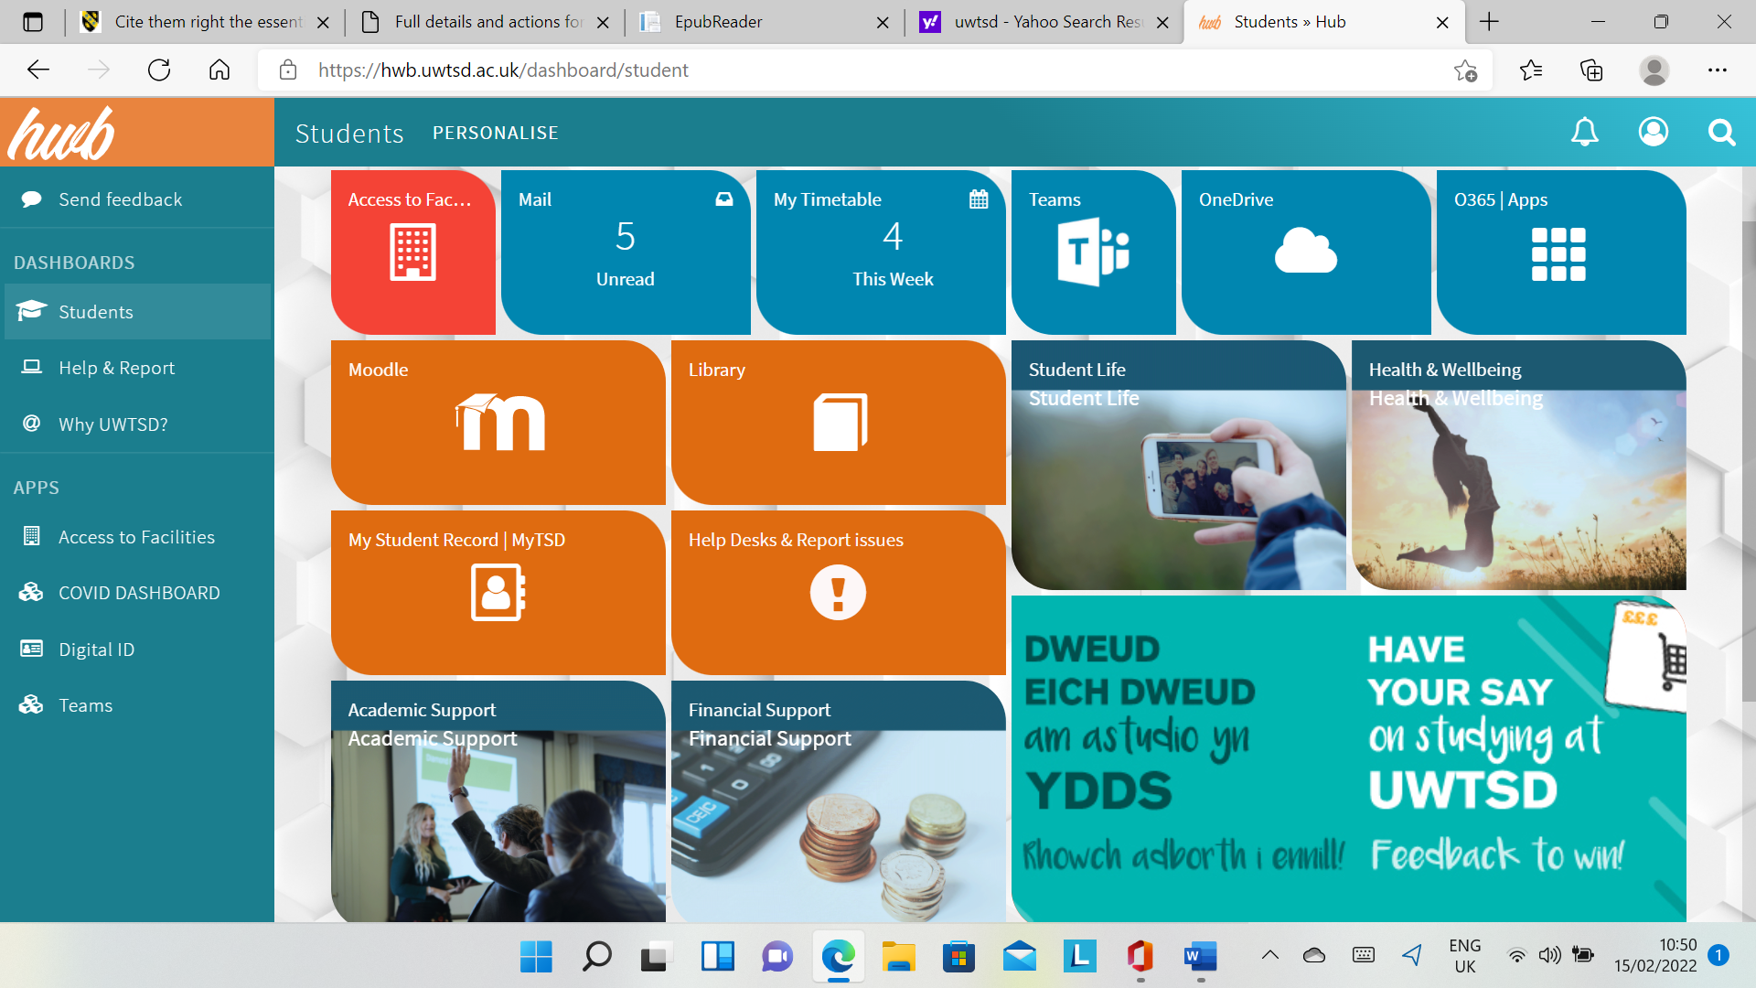
Students » Hub (uwtsd.ac.uk)
Quick links

Slide 8
Access to Facilities
Outlook-communication between Staff and students within UWTSD
“Emails are a great way to contact someone privately”.
Using social media and online collaboration technology in expatriate management: Benefits, challenges, and recommendations.
(Sahakiants, 2021)

Slide 9
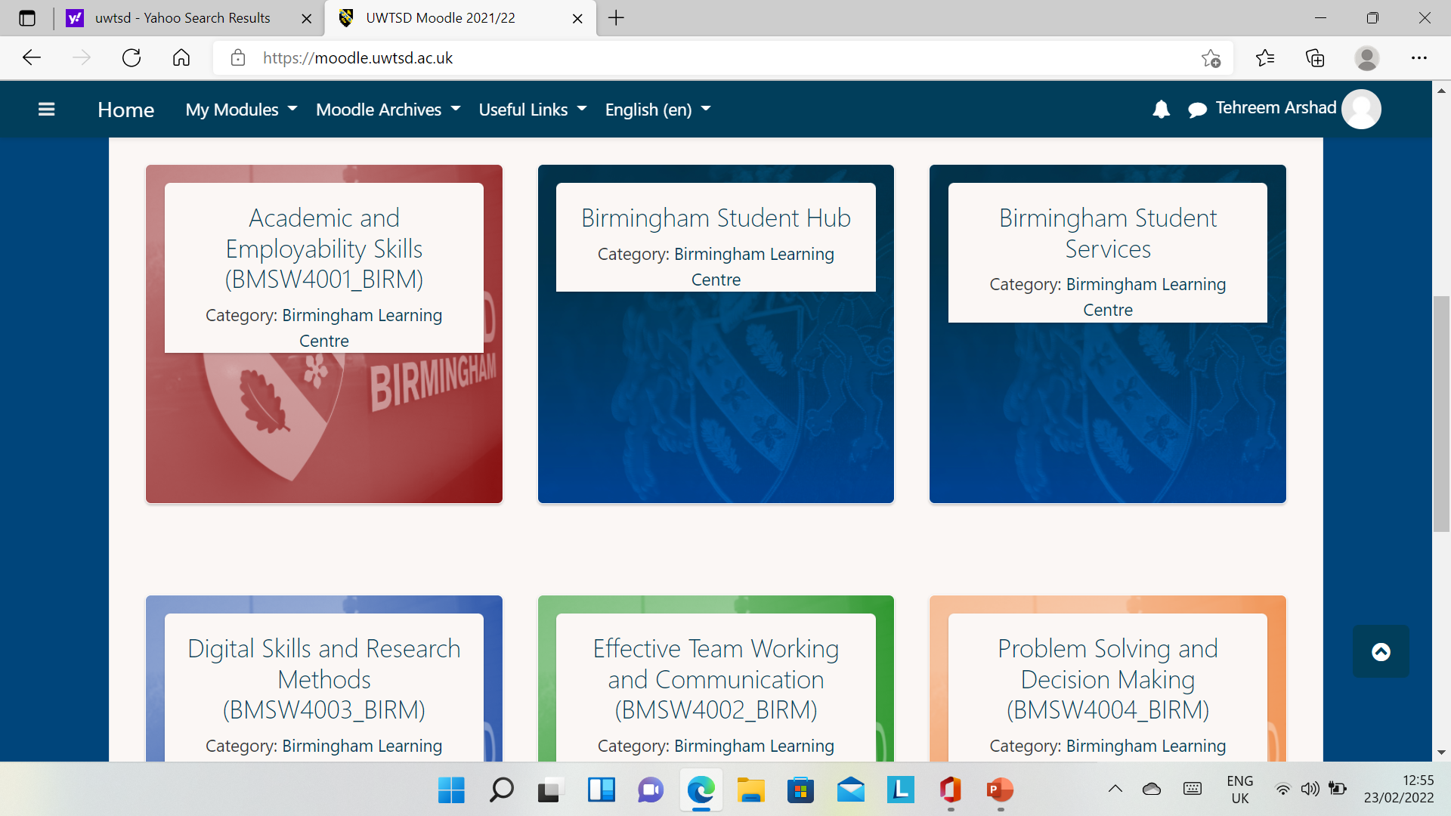
Moodle

Slide 10

Ethical Consideration
UWTSD staff and students
Research in week 7 and data Analysis
Primarily research-questionnaire
Questionnaire | Start date | End date
Quantitive | 11-02-2022 | 04-03-2022

Slide 11
Data Collection Questionnaire to add text

Slide 12
conclusion
Importance of technology and collaboration
Facilitator of remote working
Virtual collaboration
Hwb-best digital tool at UWTSD

Slide 13

Sahakiants, I. & Dorner, G., 2021. Using social media and online collaboration technology in expatriate management: Benefits, challenges, and recommendations. ThunderBird International Business Review, 63 (6), pp. 779-789.
Zoonen, W. v., Sivunen, A. & Treem, J. W., 2021. Why people engage in supplemental work: The role of technology, response expectations, and communication persistence. Journal of Organisational Behaviour, 42(7), pp. 867 - 884.
www.uwtsd.ac.uk/quicklinks
References

