Slide 1
Arachne Revisited:
Hubris and Technological Sophistication in the Friezes surrounding Domitian’s Temple to Minerva in the Forum Transitorium
Magdalena Öhrman
Centre for Textile Research
Saxo Institute
[Paper given at the EAA in Barcelona 2018]

Slide 2
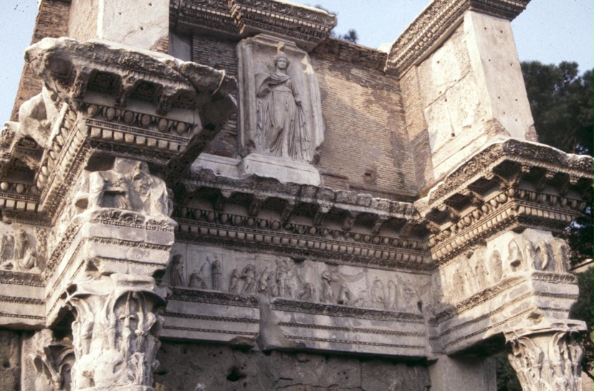
Overview of the extant parts of the frieze
Narrative panel

Slide 3
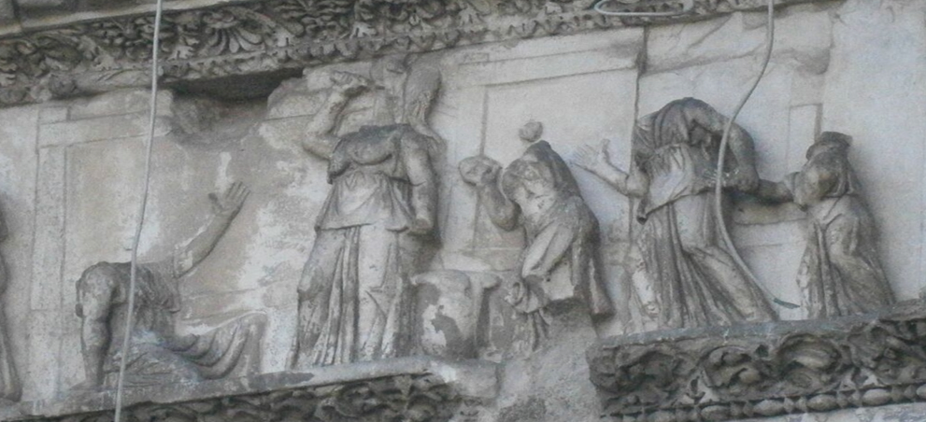
Arachne and Minerva?
The narrative panel of the frieze
For the identification of the panel as Arachne and Minerva, esp.
E. D’Ambra
Private lives, imperial virtues. The frieze of the Forum Transitorium in Rome. Princeton 1993.
Contra: M. Picard-Schmitter ‘Recherches sur les metiers a tisser antiques’, Latomus 24, 1965.
Arachne
Minerva
Old woman
Adult woman
Young girl

Slide 4
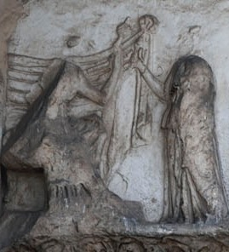
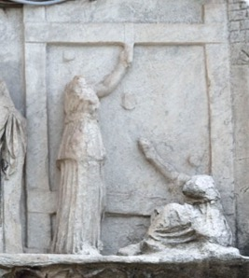
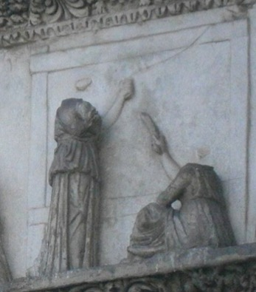
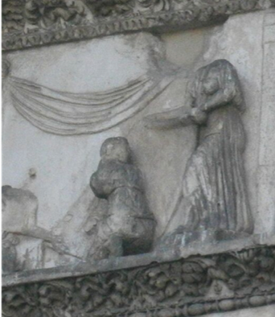
Different aspects of textile work across the frieze
Instruction in spinning
(Minerva Ergane)
(2nd left of narrative panel)
(D’Ambra section 4)
Warping or preparation of heddling mechanism
(final panel of the southernmost section of frieze)
(D’Ambra section 8)
Warping or weaving in progress
(2nd right of narrative panel)
(D’Ambra section 4)
Inspection of cloth
(left of narrative panel)
Other work processes displayed elsewhere in the frieze: weighing of wool, bringing of wool baskets, winding of yarn

Slide 5
Arachne and Minerva?
The narrative panel of the frieze
For the identification of the panel as Arachne and Minerva, esp.
E. D’Ambra
Private lives, imperial virtues. The frieze of the Forum Transitorium in Rome. Princeton 1993.
Contra: M. Picard-Schmitter ‘Recherches sur les metiers a tisser antiques’, Latomus 24, 1965.
Arachne
Minerva
Old woman
Adult woman
Young girl

Slide 6
Arachne & Minerva in Manilius’ Astronomica (4.128-139)
The Ram, rich in abundant wool, and, when shorn of this, with a fresh supply, will always take new hope: He will rise from the sudden shipwreck of his rich wealth and fall, carried by his bounty into loss. <Yet> he gives rewards to the people and through thousands of arts his fleeces grant varied benefits: now they roll up the rough wool, now they tease it apart, now with light hand they spin the fine thread, now they work the loom, now they buy and sell for profit various cloth. Even without luxury, no people survives without this. So important is this work, that Pallas claimed it for herself and deemed it worthy of her own hands, and claimed her triumph over Arachne as a great one. He [the Ram] decrees for those born these and similar arts, and shapes doubting hearts in worried breast, which always seek to sell themselves for praise.
dives fecundis Aries in uellera lanis
exutusque nouis rursus spem semper habebit,
naufragiumque inter subitum censusque beatos
crescendo cadet et uotis in damna feretur,
in uulgumque dabit fructus et mille per artes
uellera diuersos ex se parientia quaestus;
nunc glomerare rudis nunc rursus soluere lanas, 130
nunc tenuare leui filo nunc ducere telas, 131
nunc emere et uarias in quaestum uendere uestes, 132
quis sine non poterant ullae subsistere gentes 133
uel sine luxuria. Tantum est opus, ipsa suismet
asseruit Pallas manibus dignumque putauit,
seque in Arachnaeo magnam putat esse triumpho. 136
haec studia et similis dicet nascentibus artes,
et dubia in trepido praecordia pectore finget
seque sua semper cupientia uendere laude.

Slide 7
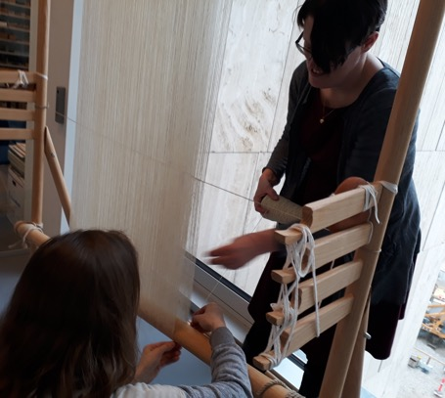
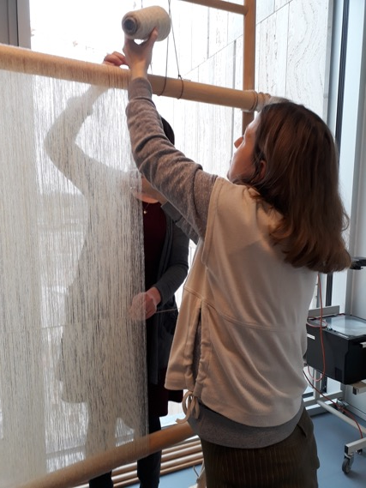
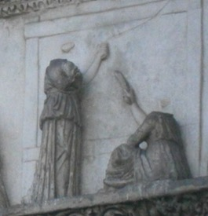
The workings of the two-beam loom: warping?
Warping a two-beam loom with a tubular set-up: experiment for the TEXREX project, CTR 2018. Weaver: Ulrikka Mokdad
On ethnographic parallels, cf. K.H. Staermose Nilsen, ‘So simple and yet so complicated’, ATN 52, 2011.

Slide 8
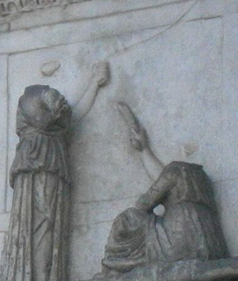
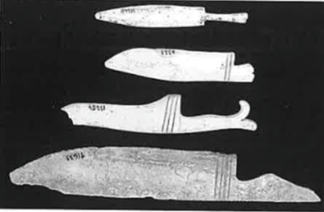
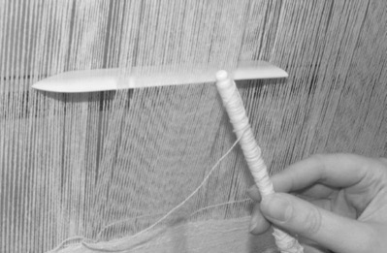
The workings of the two-beam loom: weaving?
Bone weaving swords from Pompeii, max length 20 cm.
Image after: C. Cheval, ‘Le travail de l’os au service de l’artisanat textile: l’example de pompéi’, Textiles y tintes en la ciuidad antiqua. Purpureae vestes III, 2011, 145.
Reconstructed weaving sword from Ulpia Traiana used for weaving in the two-beam loom at LVR Archaeology Park, Xanten 2015. Weaver: Barbara Köstner.
Image after: B. Köstner, ‘Auf Tuchfühlung’ T. 2, Experimentelle Archäologie in Europa, Jahrbuch 2016, 179.
Detail: weaving in progress?
(2nd right of narrative panel)
(D’Ambra section 4)

Slide 9

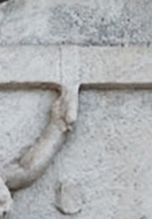
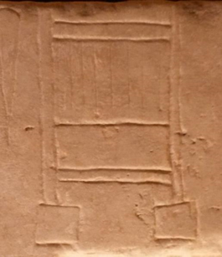
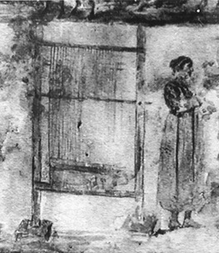
The workings of the two-beam loom: warping or completion?
Object passing over the top beam
Two-beam loom depicted in the grave inscription for Seuera Seluciane, Capitoline museum, Rome
(3rd C CE)
Two-beam loom depicted in the ipogeio degli Aurelii, Rome (3rd C CE)
(final panel of the southernmost section of frieze)
(D’Ambra section 8)

Slide 10


Acknowledgements
Special thanks to weavers Ida Demant (Lejre Land of Legends) and Ulrikke Mokdad (Centre for Textile Research)
This project has received funding from the European Union's Horizon 2020 research and innovation programme under grant agreement No 701557

