Slide 1

Module Code: LCHS4010
Module: Psychology in Health and Social Care
Assignment Title: Presentation
Student Name: Mason Tobias
Student ID: 2506377
Lecturer: Dr Kennedy Obohwemu

Slide 2

Table of Contents
Introduction ….………………………………………….3
Lifespan Development Theory ….………………….. 4
Clear explanation of the theory …..…………………5
Application of the theory to Isaac’s experiences....6
Consideration of nature and nurture .………………7
Practical and theory-informed strategies …………..8
Critical evaluation of the theory………………………9
Conclusion ………………………………….……………10
References..………………………………………………11

Slide 3

Introduction
Psychology interconnects social, biological, and behavioural factors to deliver patient-centred care to each individual and improve their health outcomes (Paton, 2025).
Social-emotional well-being and holistic development of a 4-year-old boy, Isaac, are affected by the recent relocation and mental health issues of his mother.
The primary goal of the multiagency is to support him and his mother by strengthening her caregiving capacity and building secure attachments.
Notes:
Introduction
Psychology plays a crucial role in health and social care by bridging the physical, emotional, and mental health of patients and improving their well-being (Abraham et al., 2024). Caregivers allow patients to navigate the emotional weight of long-term diseases, disabilities, and chronic pain. Here, in this context, Isaac’s mother deals with a lack of social support, low confidence and postnatal depression. Due to the shifting location of the family and unstable childcare management, his early development and attachment security have been disrupted. The main purpose of this study is to analyse the impact of early experiences of Isaac on his development and propose a suitable strategy informed by the psychological theory.

Slide 4

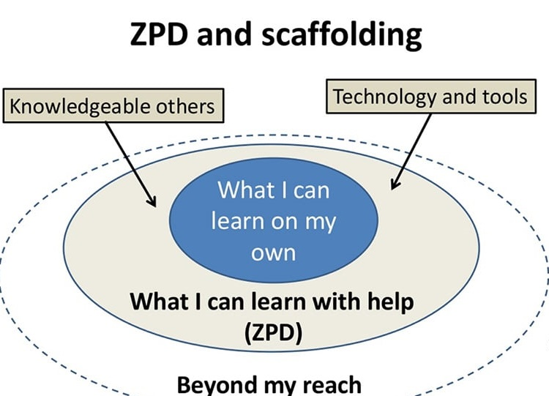
Lifespan Development Theory
Vygotsky's Sociocultural theory suggests that smooth interaction with peers, caregivers and family members is responsible for the cognitive growth of an individual (Sarmiento-Campos et al., 2022).
ZPD represents a gap between the independent action of a learner and their ability to achieve goals with the guidance of an MKO.
This theory argues that language is one of the most crucial tools to mediate and understand the environment of a learner.
(McLeod, 2025)
Notes:
Lifespan Development Theory
The Russian Psychologist Lev Vygotsky has formulated the Sociocultural theory to define the impact of social interactions and cultural factors on learning and development (Cherry, 2026). This theory depends on three core concepts, such as zone of proximal development, more knowledgeable other and cultural tools. Vygotsky’s theory focuses on evaluating the performance of learners with supportive guidance instead of assessing their own functions.

Slide 5
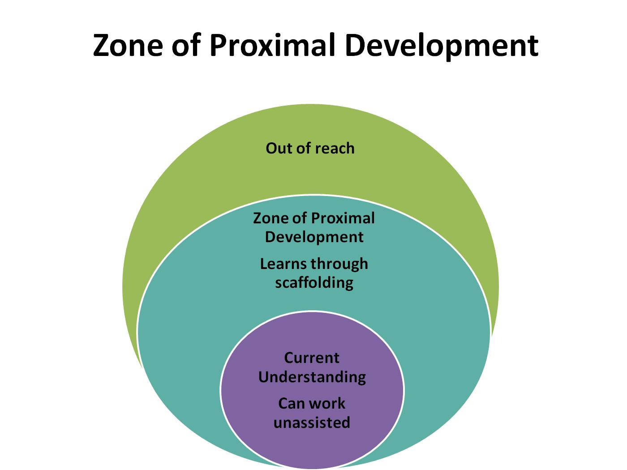
Clear explanation of the theory
Vygotsky's framework showcases that learning occurs through social interactions and is shaped by the cultural context (Poehner and Lantolf, 2024).
This theory illustrates the immense value of group work, peer-monitoring and collaborative environments, which allow children to construct knowledge and learn from each other.
The community and cultural context of Vygotsky’s theory is beneficial for creating a support system for the personal development of Isaac and the emotional well-being of her mother.
Notes:
Clear explanation of the theory
Sociocultural theory suggests that social and cognitive development are inherently social processes where children learn through active interactions with their culture, environment and people around them. Cognitive functions of an individual develop through cultural context and social relationships rather than isolated exploration (McLeod, 2025). The utilisation of this theory is crucial for supporting the multiagency early help plan for Isaac. This is the most suitable framework to address the separation anxiety of Isaac, alongside his social withdrawal and language delays, by prioritising his need for collaborative play and secure relationships.

Slide 6

Application of the theory to Isaac’s experiences
According to Vygotsky’s theory, both emotional and cognitive development of an individual heavily rely on cultural tools and social interactions (Eske, 2023).
Limited social interactions, disrupted childcare and depression of his mother restrict the collaborative support required to expand his learning.
Due to the language delay, Isaac fails to express his feelings and regulate his emotional distress proactively.
Notes:
Application of the theory to Isaac’s experiences
As children learn through interactions with an MKO, the disrupted childcare of Isaac hinders his ability to build consistent learning routines. Relocation interrupts his stable relationships with the neighbourhood, which are required to learn a new language and self-regulation. Language delays of Isaac directly impact his ability to regulate his emotions and join peer groups (Eske, 2023). Due to the lack of confidence and communication, Isaac struggles to negotiate social scenarios independently with clinginess and withdrawn behaviours.

Slide 7
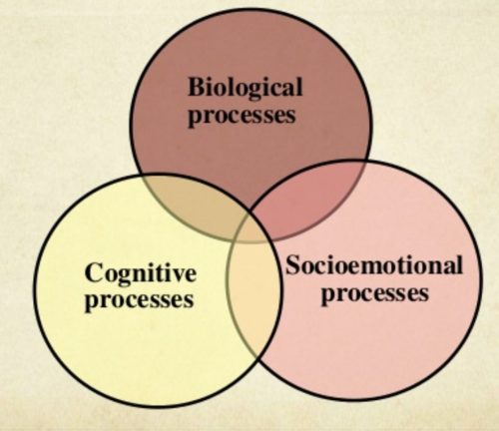
Consideration of nature and nurture
The clingy and withdrawn representation of Isaac suggests his lower threshold for adapting to changes, which leads to emotional overwhelm (Woods, 2026).
As the early years' brain architecture is highly sensitive to the environment, he suffers from elevated stress responses due to the constant transitions and postnatal depression of his mother.
Limited social supports and disrupted childcare arrangements affect his ability to trust the new environment and engage in social interactions.
Notes:
Consideration of nature and nurture
The inconsistent childcare and relocation of the family have made his life unpredictable and hindered his ability to handle sudden changes. Postnatal depression and low confidence in his mother impact the emotional security of the 4-year-old child (Woods, 2026). The lack of community networks and extended family prevent Isaac from practising social interactions with peers outside the home. Maternal depression and prolonged separation distress of the young child can enhance their cortisol levels and interrupt the neurological pathways regarding language development, social play and emotional regulation. The withdrawn behaviours of Issac directly reflect a highly sensitive temperament which is elevated by environmental instability.

Slide 8

Practical and theory-informed strategies
The early help plan can be associated with language-rich, attachment-based and collaborative strategies for Issac, rooted in Vygotsky’s theory.
Care practitioners should collaborate with various local services, such as SLT and Health Visitor, by facilitating team meetings (Bodrova and Leong, 2024).
They can use language-building and interactive storytelling techniques to engage Isaac and his mother in a shared session.
According to Vygotsky’s framework, care providers can empower Isaac’s mother to act as an effective MKO and boost her parenting confidence by providing a scaffolded environment.
Notes:
Practical and theory-informed strategies
A key person approach should be implemented, who will greet Isaac and his mother daily, and offer them a safe base (Cooper et al., 2024). Through the introduction of small group play, practitioners can pair Isaac with a socially confident peer to help him communicate his feelings and build emotional regulation. Vygotsky states that providing an MKO in the form of a peer can create ZPD for the child and allow him to practice social interactions beyond his current independent capabilities. Care practitioners should engage Isaac in 1-to-1 interactions to accelerate his vocabulary and speech development (Boster et al., 2024). As per the viewpoint of Vygotsky, language is a primary cultural tool that may assist Isaac to turn external social speech into internal mental reasoning.

Slide 9

Critical evaluation of the theory
Care practitioners can act as a social and emotional bridge to mediate interactions when Issac intends to join groups.
Through the utilisation of play opportunities, they can allow Isaac to cope with anxiety and disrupted routines in a safe environment (Harland et al., 2022).
Intense focus on sociocultural interactions within the theoretical concept may prevent caregivers from addressing the biological needs of the child with this theory.
Notes:
Critical evaluation of the theory
The zone of proximal development allows practitioners to assess the independent limits of Isaac and scaffold his learning (Sellberg et al., 2022). They can break down complex group tasks into manageable steps by using supportive interactions with the mother. Role-playing activities provide a safe space for the child to practice language and regulate his emotions. Vygotsky heavily prioritises cultural and social transmission that underplays internal neurological and biological factors. Sleep issues and Isaac's clinginess could stem from a physical need instead of a social gap, which requires a broader multiagency screening (Harland et al., 2022). Practitioners need to integrate the cultural background and family traditions of Isaac into his classroom settings to build his confidence in engaging with the local London services.

Slide 10

Conclusion
The relevance of Vygotsky’s Sociocultural Theory to early childhood and its suitability for the situation of Isaac has been described here.
Additionally, the application of this theory to the well-being and development of the child has also been explained here.
Some realistic interventions and collaborative strategies have been defined here by aligning with the chosen theory.
Notes:
Conclusion
The above-mentioned presentation has clearly explained the concept and significance of Vygotsky’s Sociocultural Theory in care settings. Language delays, emotional responses, disrupted childcare, and limited social interactions influence his well-being and development. Based on the environmental and biological influences, some supportive strategies have been illustrated here, along with the critical evaluation of the theory.

Slide 11

References
Abraham, C., Conner, M., Jones, F. and O'Connor, D. (2024) Health psychology. Routledge.
Bodrova, E. and Leong, D. (2024) Tools of the mind: The Vygotskian approach to early childhood education. Routledge.
Boster, J.B., Cordone, T. and Blosser, H. (2024) ‘Increasing reciprocal social interactions between children who use augmentative and alternative communication and peers using a collaborative learning framework.’ American journal of speech-language pathology, 33(4), pp.1748-1762.
Cherry, K. (2026) What Is Sociocultural Theory?. [Online] Available at: https://www.verywellmind.com/what-is-sociocultural-theory-2795088 (Accessed 8 June 2026).
Cooper, R.E., Saunders, K.R., Greenburgh, A., Shah, P., Appleton, R., Machin, K., Jeynes, T., Barnett, P., Allan, S.M., Griffiths, J. and Stuart, R. (2024) ‘The effectiveness, implementation, and experiences of peer support approaches for mental health: a systematic umbrella review.’ BMC medicine, 22(1), p.72.
Eske, J. (2023) What are speech disorders?. [Online] Available at: https://www.medicalnewstoday.com/articles/324764 (Accessed 8 June 2026).
Harland, J.M., Adams, E.A., Boobis, S., Cheetham, M., Wiseman, A. and Ramsay, S.E. (2022) ‘Understanding the life experiences of people with multiple complex needs: peer research in a health needs assessment.’ European Journal of Public Health, 32(2), pp.176-190.
McLeod, S. (2025) Vygotsky’s Theory of Cognitive Development. [Online] Available at: https://www.simplypsychology.org/vygotsky.html (Accessed 8 June 2026).
Paton, A. (2025) Understanding Health, Illness and Society: A Patient-Centred Approach to Healthcare. Routledge.
Poehner, M.E. and Lantolf, J.P. (2024) Sociocultural theory and second language developmental education. Cambridge University Press.
Sarmiento-Campos, N.V., Lázaro-Guillermo, J.C., Silvera-Alarcón, E.N., Cuellar-Quispe, S., Huamán-Romaní, Y.L., Apaza, O.A. and Sorkheh, A. (2022) ‘A look at Vygotsky’s sociocultural theory (SCT): The effectiveness of scaffolding method on EFL learners’ speaking achievement.’ Education Research International, 2022(1), p.3514892.
Sellberg, C., Lundin, M. and Säljö, R. (2022) ‘Assessment in the zone of proximal development: simulator-based competence tests and the dynamic evaluation of knowledge-in-action.’ Classroom Discourse, 13(4), pp.365-385.
Woods, T. (2026) 4 Ways Parents Can Hurt Children's Self-Esteem. [Online] Available at: https://www.psychologytoday.com/us/blog/liking-the-child-you-love/202307/4-ways-parents-can-hurt-childrens-self-esteem (Accessed 8 June 2026).
Notes:
References
Abraham, C., Conner, M., Jones, F. and O'Connor, D. (2024) Health psychology. Routledge.
Bodrova, E. and Leong, D. (2024) Tools of the mind: The Vygotskian approach to early childhood education. Routledge.
Boster, J.B., Cordone, T. and Blosser, H. (2024) ‘Increasing reciprocal social interactions between children who use augmentative and alternative communication and peers using a collaborative learning framework.’ American journal of speech-language pathology, 33(4), pp.1748-1762.
Cherry, K. (2026) What Is Sociocultural Theory?. [Online] Available at: https://www.verywellmind.com/what-is-sociocultural-theory-2795088 (Accessed 8 June 2026).
Cooper, R.E., Saunders, K.R., Greenburgh, A., Shah, P., Appleton, R., Machin, K., Jeynes, T., Barnett, P., Allan, S.M., Griffiths, J. and Stuart, R. (2024) ‘The effectiveness, implementation, and experiences of peer support approaches for mental health: a systematic umbrella review.’ BMC medicine, 22(1), p.72.
Eske, J. (2023) What are speech disorders?. [Online] Available at: https://www.medicalnewstoday.com/articles/324764 (Accessed 8 June 2026).
Harland, J.M., Adams, E.A., Boobis, S., Cheetham, M., Wiseman, A. and Ramsay, S.E. (2022) ‘Understanding the life experiences of people with multiple complex needs: peer research in a health needs assessment.’ European Journal of Public Health, 32(2), pp.176-190.
McLeod, S. (2025) Vygotsky’s Theory of Cognitive Development. [Online] Available at: https://www.simplypsychology.org/vygotsky.html (Accessed 8 June 2026).
Paton, A. (2025) Understanding Health, Illness and Society: A Patient-Centred Approach to Healthcare. Routledge.
Poehner, M.E. and Lantolf, J.P. (2024) Sociocultural theory and second language developmental education. Cambridge University Press.
Sarmiento-Campos, N.V., Lázaro-Guillermo, J.C., Silvera-Alarcón, E.N., Cuellar-Quispe, S., Huamán-Romaní, Y.L., Apaza, O.A. and Sorkheh, A. (2022) ‘A look at Vygotsky’s sociocultural theory (SCT): The effectiveness of scaffolding method on EFL learners’ speaking achievement.’ Education Research International, 2022(1), p.3514892.
Sellberg, C., Lundin, M. and Säljö, R. (2022) ‘Assessment in the zone of proximal development: simulator-based competence tests and the dynamic evaluation of knowledge-in-action.’ Classroom Discourse, 13(4), pp.365-385.
Woods, T. (2026) 4 Ways Parents Can Hurt Children's Self-Esteem. [Online] Available at: https://www.psychologytoday.com/us/blog/liking-the-child-you-love/202307/4-ways-parents-can-hurt-childrens-self-esteem (Accessed 8 June 2026).

