Slide 1

Understanding the role of police constable
BMPL4019A
Week 3 2026

Slide 2
Today
Understand how the police service is governed and how the police are held to account
Understand how legislation has shaped police governance today
Understand the role of His Majesty's Inspectorate of Constabulary and Fire & Rescue Service
Effectiveness of Police Governance

Slide 3

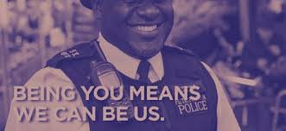
Policing by consent

Slide 4
“the police are the public and the public are the police.”
Policing by consent means that police authority comes from the public’s approval, trust, and cooperation
Not from the power of the state or the consent of any individual.
It is rooted in the Peelian principles, which emphasise public support, minimal use of force, and the idea that “the police are the public and the public are the police.”
Notes:
Definition of policing by consent - GOV.UK
Derives from the consent and cooperation from the public they serve, as a pose to the state
It does not mean consent of an individual
No individual can choose to withdraw their consent from the police, or from a law

Slide 5
Policing by Consent
The principle of policing by consent relies on the trust and confidence that the public has in the police service and the wider law enforcement community. Professional standards departments (PSDs) can play an important role in the maintenance of that trust and confidence. Trust and confidence can be undermined by a failure to vet and manage misconduct and complaints or investigate counter-corruption activities effectively. It is, therefore, essential that such issues are dealt with openly and robustly in accordance with the Code of Ethics
Notes:
Professional standards | College of Policing
Policing in England and Wales is founded on the principle of policing by consent, which means that police legitimacy depends on public approval, trust, and cooperation rather than the use of force alone. The public must have confidence that officers and staff act fairly, ethically, and in the public interest.
Professional Standards Departments (PSDs) play a vital role in maintaining this confidence. Their responsibilities include investigating misconduct allegations, managing complaints against police officers and staff, overseeing vetting processes, and supporting efforts to identify and prevent corruption within police organisations.
When misconduct, corruption, or inappropriate behaviour is not dealt with effectively, public trust can quickly be damaged. High-profile failures in vetting, complaint handling, or misconduct investigations can create a perception that the police are not accountable, undermining their legitimacy and reducing public confidence in policing.
Robust vetting processes help ensure that only suitable individuals are recruited and retained within the service. Equally, effective misconduct procedures demonstrate that officers who fall below expected standards will be held accountable for their actions.
The Code of Ethics provides the professional and moral framework for policing. It sets out the standards of behaviour expected from everyone working within policing, including principles such as integrity, honesty, accountability, fairness, respect, and leadership. PSDs must ensure that investigations and disciplinary processes are conducted openly, fairly, and in accordance with these ethical principles.
Ultimately, professional standards are not simply about enforcing rules; they are essential to maintaining public confidence, preserving legitimacy, and ensuring that policing by consent continues to operate effectively in a democratic society.

Slide 6
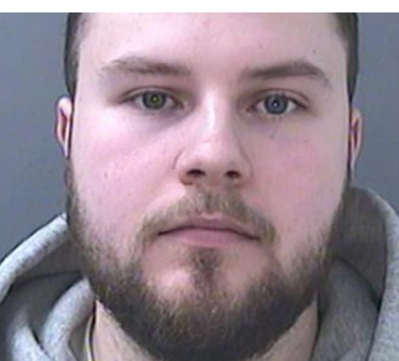
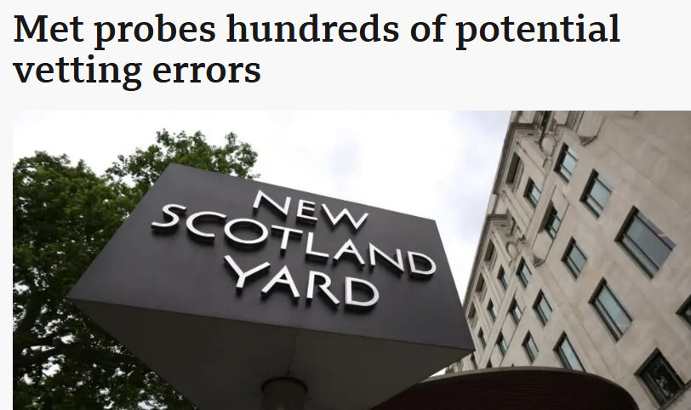
Lewis Edwards 2023
One officer who transferred from a different force had been subject to 25 public complaints over 10 years, many of which were for "excessive use of force". Four of the complaints resulted in "management action".
The officer had also been arrested for being drunk and disorderly but no action was taken. There was no evidence the force considered the incidents as a "pattern of concerning behaviour".
Notes:
Lewis Edwards SWP 24, blackmailed and threatened them into sending explicit photos of themselves on Snapchat. Police urged to tighten vetting after Snapchat sex case - BBC News 2023
MEt police Met Police investigates hundreds of potential vetting errors - BBC News 2025
'Questionable' police vetting decisions laid bare - here are some examples | UK News | Sky News 2022

Slide 7
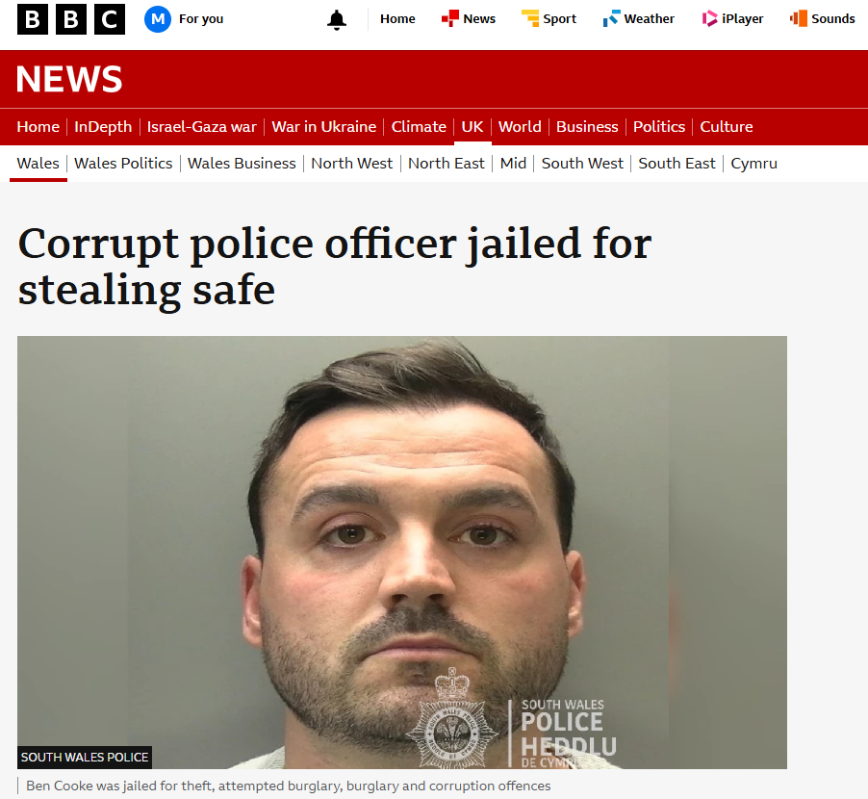
South Wales Police officer Ben Cook jailed for burglaries - BBC News

Slide 8

Sarah Everard 2021
Inquiry into "systematic failures" that allowed Wayne Couzens to continue to be a police office.
Government - "have a right to know" why he remained in the Metropolitan Police despite concerns about his behaviour.
Couzens kidnapped, raped and murdered Sarah Everard while he was a serving officer, using his police warrant card.
However, had been linked to allegations of indecent exposure.
It was revealed Couzens - who worked as an armed officer in the Met's parliamentary and diplomatic protection team - was linked to several alleged incidents of indecent exposure

Slide 9
Ethics
Policing professionals are more likely to be judged as behaving ethically when their decisions and actions are lawful and consistent with the ethical policing principles.
The principle of policing by consent relies on the trust and confidence that the public has in the police service
Professional standards departments (PSDs) can play an important role in the maintenance of that trust and confidence.
Trust and confidence can be undermined by a failure to vet and manage misconduct and complaints or investigate
It is essential that such issues are dealt with openly and robustly in accordance with the Code of Ethics

Slide 10
Police Funding
The police service is publicly funded through central government and more locally (council tax).
Currently, PCCs are given significant sums of money for policing,
Budget allocated for the financial year 2021/22 was £15.8 billion
When control of a substantial budget is involved, the public need to be reassured that money is spent wisely, value for money, and that the policing provide efficient and effective service

Slide 11
Metropolitan Police
2018 Met Police spent £3.4 million on purchasing 22,000 body-worn cameras
Also included licences that included docking stations, online storage and access to a management portal, provided by Axon.
A three-year contract that would need to be sustained.
The cost was significant and those responsible for making financial decisions needed to find the necessary funding
Was it effective?
CoP - within research state that the use of body- worn cameras does not have a significant impact on crime-related outcomes but does recognise the benefits of positive changes in behaviour by both police officers and members of the public (CoP, 2021)
Notes:
What Works Centre for Crime Reduction | College of Policing - Bosy worn cameras

Slide 12
Evidence for police legitimacy
Police legitimacy is created when the public perceive the police to be effective and, more importantly, fair.
The legitimacy of the police is central to public willingness to cooperate with the police and not break the law.
The threat of punishment is not shown to have any influence on willingness to comply with the police and the law. Perceptions of police legitimacy and personal morality (one’s sense of right and wrong) are far more important.
Legitimacy of the police Personal morality (sense of right and wrong) Perceived risk of sanction Willingness to cooperate with the police and not break the law
Notes:
Police legitimacy refers to the belief that the police have the rightful authority to exercise their powers and make decisions. Legitimacy is not simply created through effectiveness in reducing crime; it is built when the public perceive the police to be fair, impartial, respectful, and trustworthy in their dealings with communities.
Research consistently shows that when people view the police as legitimate, they are more likely to cooperate with officers, provide information, report crime, act as witnesses, and comply with the law voluntarily. This cooperation is essential because policing relies heavily on public support and engagement.
Traditionally, it was often assumed that people obeyed the law because they feared punishment. However, evidence suggests that the risk of being caught or sanctioned has a much smaller influence on behaviour than previously thought. Instead, two key factors are more important: people's perceptions of police legitimacy and their own personal morality, meaning their individual sense of right and wrong.
When members of the public believe that police officers act fairly, treat people with dignity and respect, make decisions impartially, and are accountable for their actions, confidence in policing increases. This strengthens legitimacy and encourages voluntary compliance with the law.
The diagram on this slide illustrates this relationship. Police legitimacy and personal morality have a strong positive influence on an individual's willingness to cooperate with the police and avoid criminal behaviour. By contrast, the perceived risk of punishment has a weaker influence. This highlights why modern policing places significant emphasis on procedural justice, fairness, transparency, and ethical conduct.
For police organisations, the message is clear: maintaining legitimacy is not only about enforcing the law effectively, but also about ensuring that every interaction with the public is fair, professional, and respectful. In doing so, the police strengthen public confidence and reinforce the principles of policing by consent.

Slide 13
Governance
Overseeing the use of police powers and ensuring effectiveness needs a form of governance
What does it mean?
The way in which an organisation is managed at the highest level, and the systems for doing this. (Cambridge Dictionary, 2020)
Sometimes police get it wrong
Many miscarriages of justice such as people being convicted, spent time in prison but then being released by the Court of Appeal.
Allegations of forced confessions or changing confessions.
Notes:
Governance is about ensuring that police powers are used appropriately, lawfully, and effectively. Because the police have significant powers that can affect people's rights and freedoms, there must be systems in place to oversee how those powers are exercised.
Governance can be defined as the way an organisation is managed at the highest level and the structures, processes, and accountability mechanisms that support this management. In policing, governance helps ensure transparency, ethical decision-making, public accountability, and continuous improvement.
Effective governance is particularly important because policing does not always get it right. Throughout history, there have been several miscarriages of justice where innocent people were convicted and imprisoned before having their convictions overturned by the Court of Appeal. These cases have often highlighted failures in police investigations and supervision.
Some high-profile cases have involved allegations that suspects were pressured into making false confessions, or that interview records and confessions were altered. Such failures can undermine public confidence and damage police legitimacy.
As a result, modern policing includes a range of governance mechanisms, including independent oversight bodies, professional standards departments, inspection regimes, complaints procedures, and judicial scrutiny. These measures are designed to hold the police accountable, identify mistakes, and help prevent similar failures from occurring in the future.

Slide 14
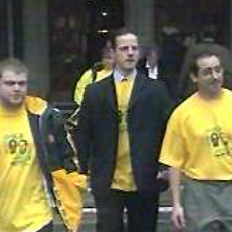
Miscarriages of Justice
Newsagents Cardiff 3
Wrongly convicted killing Phillip Saunders 1987
Michael O' Brian, Darren Hall and Ellis Sherwood spent 11 years in Prison before being cleared in 1999
Notes:
Cardiff Newsagent Three: Murder miscarriage report published - BBC News

Slide 15
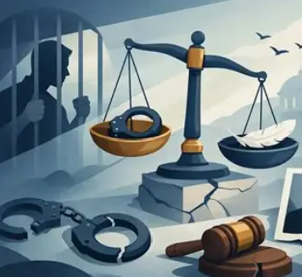
Task
Find out more about miscarriages of justice
A brief overview of the case.
What went wrong during the investigation and criminal justice process.
Whether there was any evidence of police misconduct, unethical behaviour, investigative mistakes, or failures by other criminal justice professionals.

Slide 16
Key Governance Legislation
It was not until 1964 that significant changes were made to police governance where central government, police committees and the police were given distinct roles and responsibilities.
Also, the introduction of new legislation that altered the landscape of police governance and accountability:
Police and Criminal Evidence Act 1984
Police and Magistrates’ Courts Act 1994
Police Act 1996
Crime and Disorder Act 1998
Police Reform Act 2002
Police and Justice Act 2006

Slide 17
Police Crime Commissioners
2010 the Conservative Party made a pledge to voters that they would replace what they described as ‘invisible and unaccountable police authorities’ with an elected individual who would set police priorities in conjunction with local communities.
The role required of the PCC is set out in the Police Reform and Social Responsibility Act 2011
The PCC is required to maintain the police force for the area that they are responsible for and ensure that it is efficient and effective. They are required to hold the chief constable to account for a range of issues set out in the Act.
Including the dismissal of Chief Constable

Slide 18

Avon and Somerset Police
PCC, Sue Mount-Stevens 2012
upon taking office in November 2012 required the chief constable Colin Port to reapply for his job, which he refused to do, and he quit.
She courted further controversy in 2017 when she dismissed a further chief constable, Nick Gargan.
In July 2020, Mount-stevens was reported for failing to disclose the business activities of her husband. This was in relation to a complaints that Mount-stevens and Smith had abused their roles to cover up fraud at Lloyd's Bank in Bristol, which both have a personal and professional relationships with.
November 2020 saw Mountstevens found guilty by her Police and Crime Panel for “manipulating” the Chief Constable, Andy Marsh

Slide 19
PCC Crime Plans
PCC when elected is required to produce a police and crime plan that sets out a series of:
objectives relating to a strategy for policing the area and how crime and disorder reduction will be tackled
The plan gives information about the policing area, the financial resources & performance measurements
On 1 April 2013, Bill Longmore, PCC for West Mercia Police, published his police and crime plan. Prior to producing the plan, he had spent four months walking the three counties of West Mercia, talking to local people and meeting with leaders and key people concerned with criminal justice, victim support, local government, business and other organisations concerned with policing.

Slide 20

Last week Task
Police Crime Commissioners –
Major changes happening in 2028?
What are they?
Why are they happening?

Slide 21
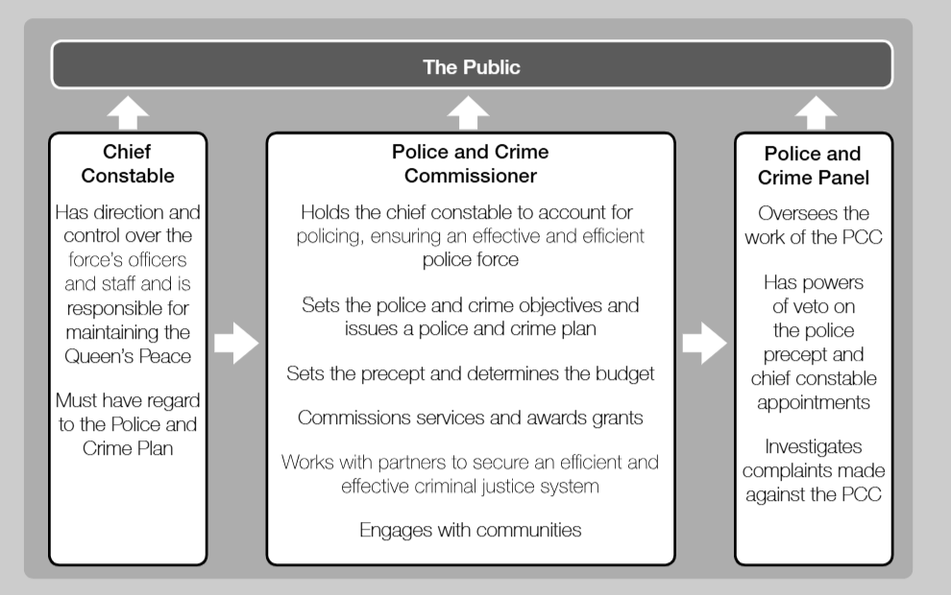

Slide 22
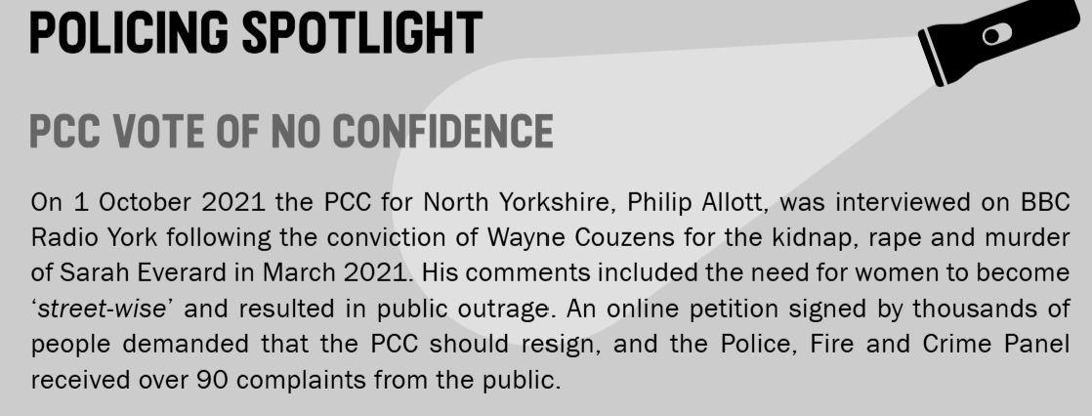
Police & Crime Panels
made up of councillors from each local authority
Over sees the work of the PCC
Can make recommendations
BUT the PCC does not need to comply with them

Slide 23

His Majesty Inspectorate of Constabulary & Fire and Rescue Services (HMICFRS)
1856 HMIC
The Policing and Crime Act 2017 extended the Inspectorate’s role to include the Fire and Rescue Service and became known as HMICFRS
Make recommendations that CC's need to take action
PEEL assessments, Prisons and Probation Inspectorates, British Transport Police, Ministry of Defence, National Crime Agency, Police Service of Northern Ireland
monitor and report on the efficiency and effectiveness of the police and FRSs

Slide 24
Task
Using the internet, find a copy of the police and crime plan for your police force area.
Identify what your PCC priorities are and how the force is held to account. Once you
understand the relevance of the priorities, consider whether they reflect the needs of
your community.

Slide 26
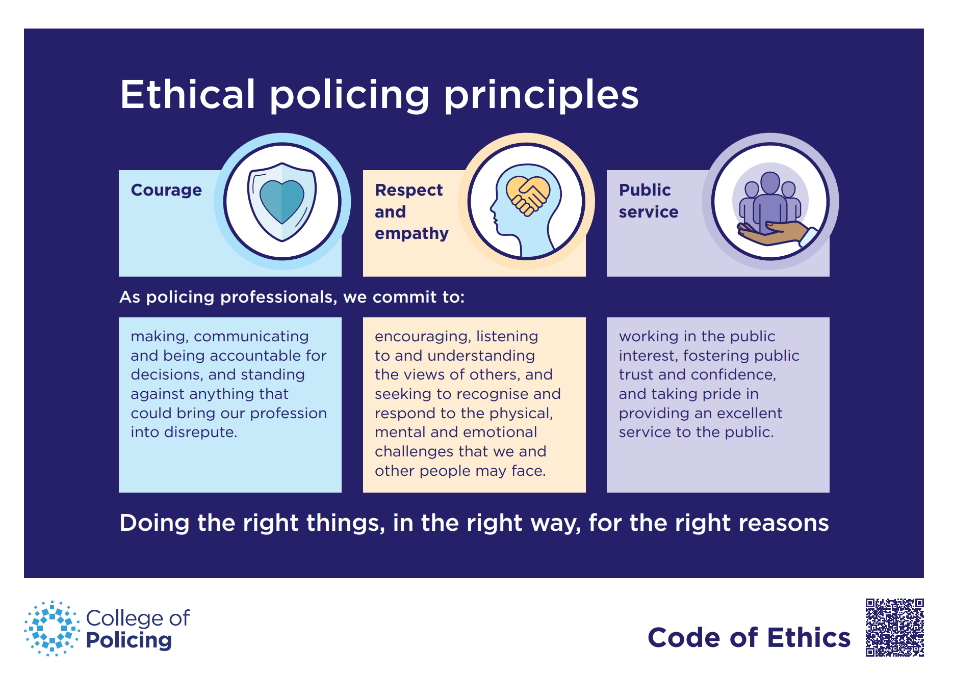
Constitutional position of the police
Accountability- in order to gain public approval of their existence, actions and behaviour.
Code of Ethics and Professional Standards
Notes:
Definition of policing by consent - GOV.UK
Definitions | College of Policing

Slide 27
What is procedural justice?
Procedural justice- the degree to which someone perceives people in authority to apply processes, or make decisions about them, in a fair and just way (HMP, 2019).
Procedural justice policing - a theoretical perspective that focuses on the informal, day-to-day interactions between the police and the public, and the ‘quality’ of these interactions (Police Now, 2020)

Slide 28
Why is procedural justice important?
Evidence suggests that when members of the public perceive their interaction with officers to be procedurally just – that is they feel that they have been treated with dignity and respect – they are more likely to view the police as legitimate. What impact does this have on policing?
Perceptions of the legitimacy of policing are very important as it governs the extent to which a person abides by the law and cooperates with the police
Notes:
Procedural justice refers to the fairness of the processes used by police officers when interacting with members of the public. It is not just about the outcome of an encounter, but about how people are treated during that encounter.
Research suggests that when individuals feel they have been treated fairly, with dignity, respect, and impartiality, they are more likely to view the police as legitimate. Even when people receive an outcome they do not agree with, they are often more accepting of it if they believe the process was fair.
Procedural justice is built on four key principles:
Treating people with dignity and respect.
Giving people a voice and allowing them to explain their perspective.
Making decisions in a neutral and unbiased way.
Demonstrating trustworthy motives and genuine concern for the public.
Perceptions of police legitimacy are extremely important because they influence public behaviour. When people believe the police are legitimate, they are more likely to:
Comply with the law voluntarily.
Cooperate with police investigations.
Report crimes and share information.
Act as witnesses when needed.
Support police activities within their communities.
This is particularly significant in the UK, where policing is based on the principle of policing by consent. The police rely heavily on public cooperation rather than the use of force. Without public trust and legitimacy, it becomes much more difficult for officers to prevent crime, gather intelligence, and maintain community safety.

Slide 29
How to police in a procedurally justice way
Respect & non-judgmental when talking to members of the public
Support and show concerns
Show an interest in them and their lives
Do not stereotype
Be open minded and never assume
Think about the bigger picture - are there any risks for the member of public by talking to you?
Show empathy and compassion
Being sincere and aim to build trust between both parties
Show you understand and that you want to help them

Slide 30
Importance of the publics input
Reporting Crime
Intelligence
Compliance
Strengthen policing
Reduce crime

Slide 31
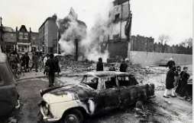
Brixton riots 1981
Over the course of the uprising 279 police officers had been injured
Over 100 cars were damaged
82 people had been arrested
The Brixton riots and the Scarman Report - The National Archives

Slide 32
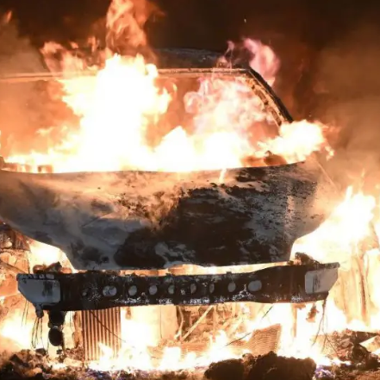
Ely Riots Cardiff 2023 sparked by the death of two friends….
Ely riot 2023: What happened in Cardiff? - BBC News
IOPC investigation into South Wales Police actions prior to the deaths of two boys in Ely near to conclusion | Independent Office for Police Conduct (IOPC)

Slide 33
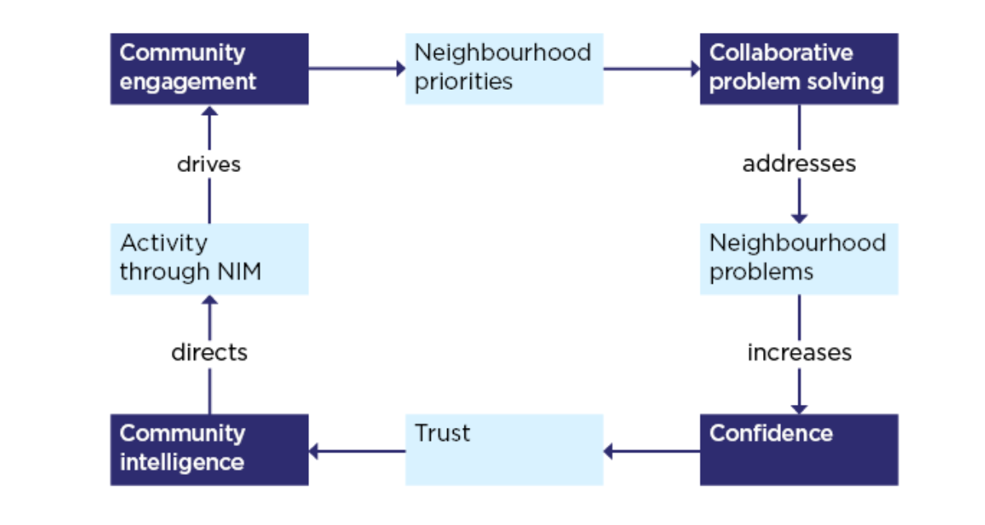
Local engagement and accountability

Slide 34
The policing mission
TASK- 10 minutes:-
Research into the Policing Values, Purpose & Mission

Slide 35
Uk Policing Values, Purpose and Mission
(College of Policing, 2023)
https://youtu.be/6Gg26onLLDY

Slide 36
Task- 20 mins
Access the Policing vision 2030 and make a note of what you feel is the biggest challenge for our future policing?
Policing future environment 2040- What are the 10 key trends?
Can you identify any differences in these two reports?

Slide 37

Workforce Transformation- 2018 and Policing Vision 2025
Intended to transform policing by investing into digitalisation, a more diverse and flexible workforce, and new capabilities to react to national threats of crime.
Particular focus on:-
Leadership
Professionalism
Restructuring
Training
Collaboration

Slide 38
Research and present to the group the differences between Policing Vision 2025 and 2030
You may have identified the following:
2025 focused on Digital policing and skills
2030 builds upon developing a more professional service with skills to undertake policing demands in the current day, but it also focuses on the need to develop the police services relationship with the public, improve culture, engagement with communities, achieve safer communities, reduce crime and deliver effective justice.

Slide 39
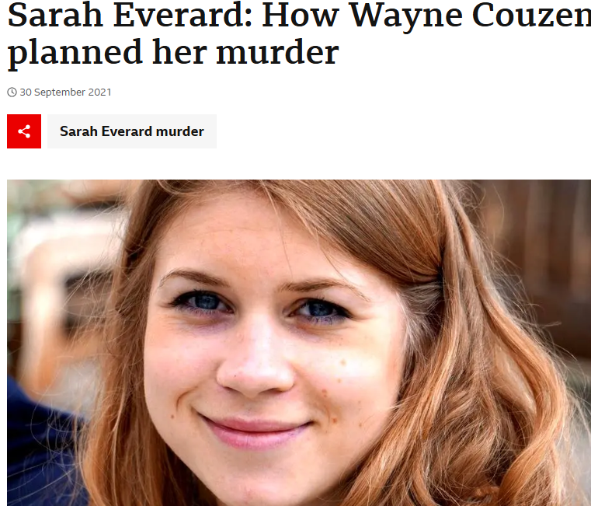
Why do you think that there was a need for a new policing vision?

Slide 40
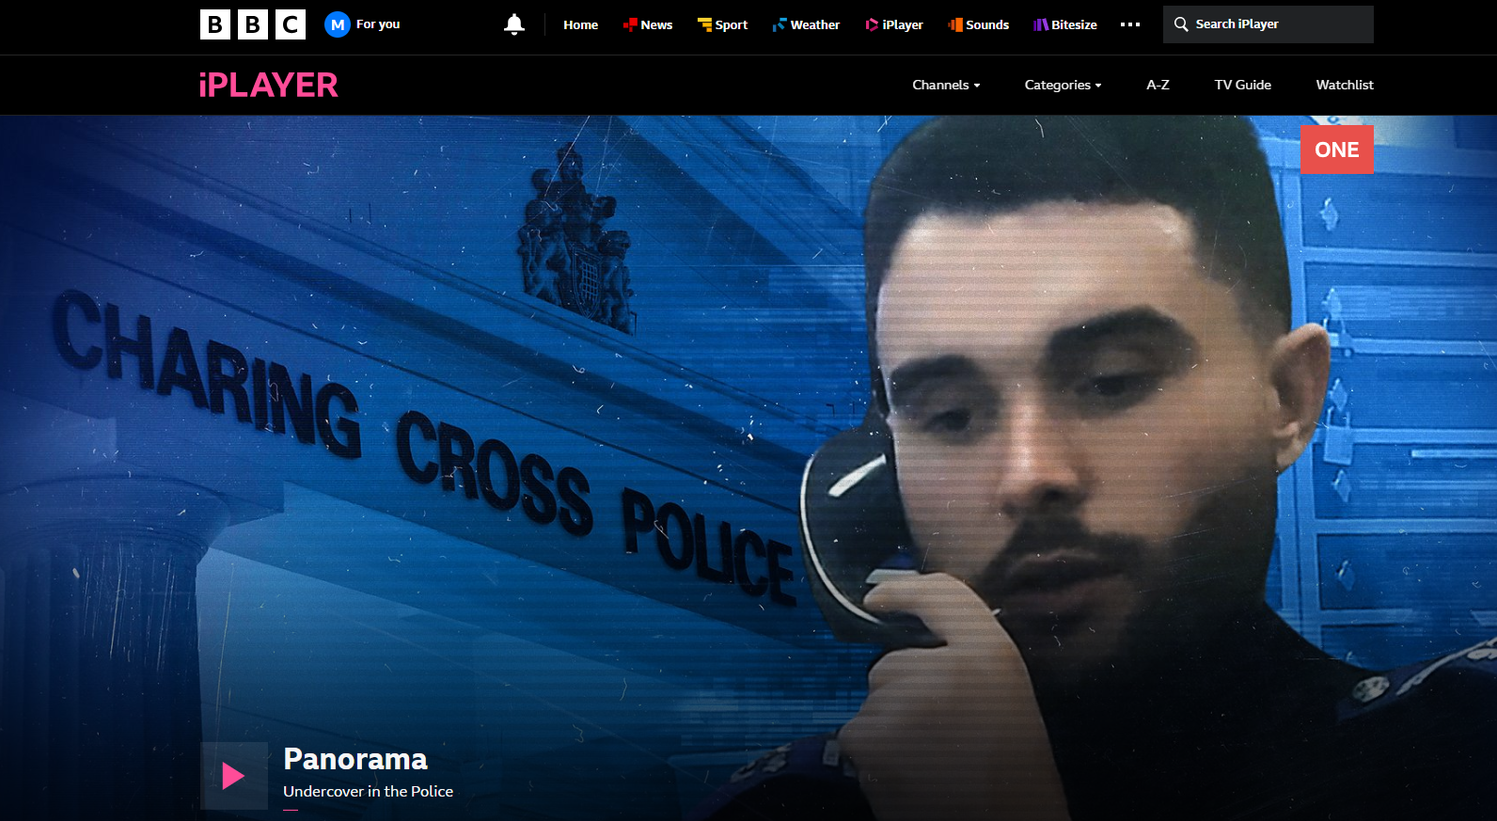
Panorama - Undercover in the Police - BBC iPlayer

Slide 41
What is a Police and Crime plan (P&CP)?
Task- research into the following:-
Group 1- South Wales police
Group 2- Dyfed Powys police
Group 3- Gwent police
What are the priorities?
What are the plans in place to overcome the challenges?

Slide 42

The home secretary
Responsibilities:-
empower the public to hold the police to account for their role in cutting crime;
free up the police to fight crime more effectively and efficiently;
create a more integrated criminal justice system;
secure our borders and reduce immigration;
protect people’s freedoms and civil liberties;
protect our citizens from terrorism
(Home Office, 2023)

Slide 43

The Home Secretary The Rt Hon Shbana Mahmood MP
The Home Secretary has a duty to issue a Strategic Policing Requirement (SPR) that sets out what are, in her view, the national threats at the time and the appropriate national policing capabilities that are required to counter them.
(Home Office, 2023)

Slide 44
Strategic context of policing
SPR- Strategic Policing Requirement
Major police reforms around 2011 introduced the creation of the SPR
Outline the commitments and priorities that require a coordinated and joint response.
Encourages police forces to collaborate to tackle serious national threat or risk.
Can you think of an example of a national threat?

Slide 45
Stagegic Policing Requirement
1st SPR issued in 2012- required both PCC's and chief constables to be ready to respond anywhere with trained, equipped and deployable resources to address incidents of:-
Violence Against Women and Girls
Terrorism
Serious and Organised Crime
National Cyber Event
Child Sexual Abuse
Public Disorder
Civil Emergencies

Slide 46

Any questions?

Slide 47
Understanding the role of police constable
BMPL4019a
Session 5

Slide 48
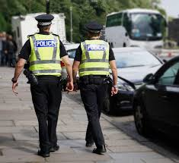
Policing Powers

Slide 49
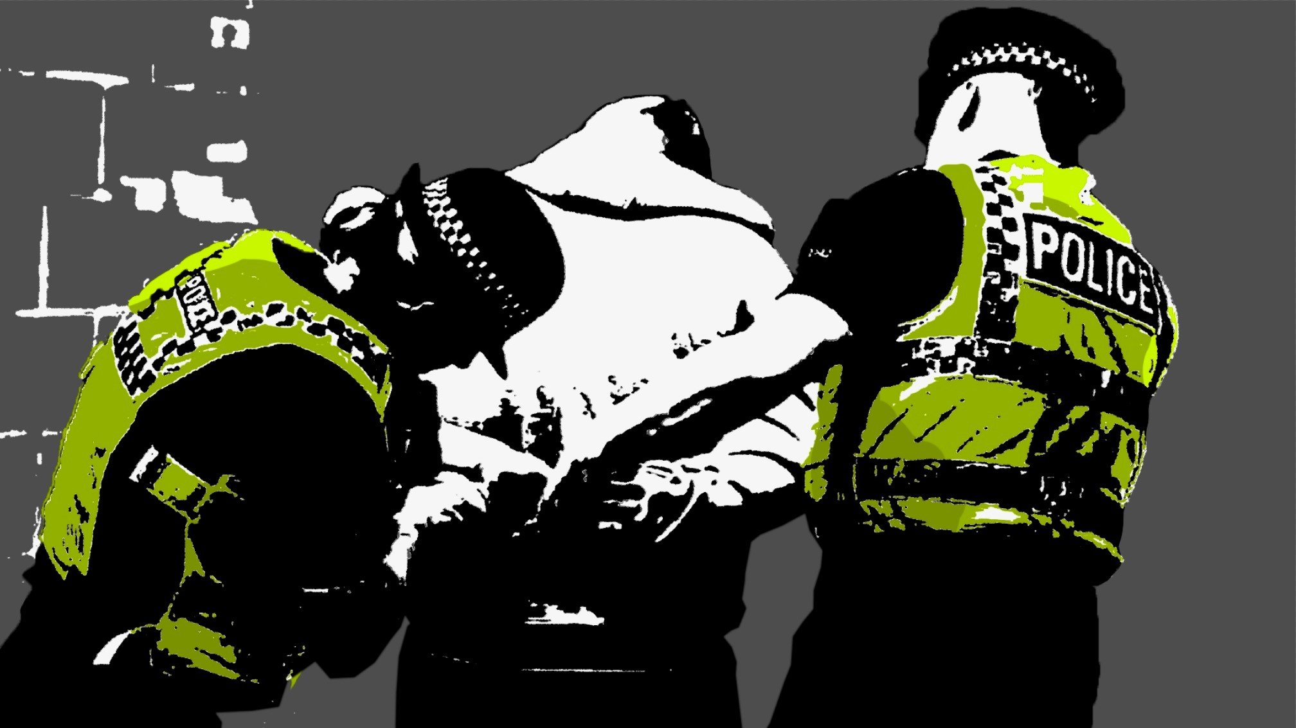
Powers

Slide 50
4 types of police personnel who have different powers
Police officers have almost all the relevant police powers. Some powers (notably authorisation powers) are reserved for officers at higher ranks.
Police specials (volunteer police officers) have the same powers as paid police officers.
Police Community Support Officers (PCSOs) and other support officers have certain powers designated to them depending on the type of support function they serve.
Civilian staff do not have any police powers. These staff perform administrative functions that do not require powers.
(House of Commons library, 2021)

Slide 51
Police Powers
Powers to investigate crime- This includes a range of powers to collect evidence needed to identify suspects and support their fair and effective trial.
Powers to prevent crime- This includes a range of powers to maintain public order, prevent anti-social behaviour and manage known offenders/ suspects.
Powers to ‘dispose’ of criminal cases- These powers allow police officers to dispose of criminal cases outside of court or charge suspects so they can be prosecuted.
(House of Commons Library, 2021)
Notes:
Grouped into 3 catagories-

Slide 52
Powers reserved for warranted police officers
The power to make an arrest,
The power to stop and search an individual or vehicle,
Any police power reserved for officers of certain ranks,
The power of a police officer to perform the duty of a custody officer when a custody officer is not available,
Any power given to police officers under terrorism legislation or the Official Secrets Acts of 1911 and 1989; and,
The power of a police officer to make an application under section 19 or 21 of the Investigatory Powers Act 2016.
PCSO's do not have the power to carry out the above.

Slide 53
PCSO's
Chief officers can designate whichever powers they want except those powers explicitly reserved for warranted police officers.
A PCSO can, for example:
give someone a fixed-penalty notice, eg for littering
demand the name and address of someone being anti-social
take alcohol off a person aged under 18
A PCSO can also ask a police officer to arrest a person.
The power of PCSOs can differ between police forces
They must wear a uniform clearly marked ‘PCSO’.

Slide 54
What it means to be a police constable
Constabulary Independence- officers should operate independently of political directives or pressures.
Crown Servant- operates under the crown (state).
Absence of employment law- being a non- civilian and appointed by the crown as a pose to a conventional sense.
Office of Constable- independent local authority granted to police constables.
Police Covenant- pledge to look after police constables, staff and their families. A commitment to protect those that devote their life to policing.

Slide 55
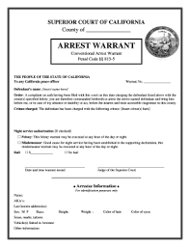
Warrants
What is a warrant?
Police arrest warrant- A definition of a police arrest warrant is a type of arrest warrant, usually issued by a Magistrates Court, and directed to the police for execution of the police warrant.
Police Search Warrant- another type of warrant issued by courts, usually by a magistrate but also a higher court Judge. Search Warrants allow the police, or other authorised officers, to conduct a search of a location or vehicle. They only relate to criminal matters.

Slide 56
Warrants
Court Warrant- warrants issued by Magistrates and other courts. They can be:
arrest warrants (which can be issued to suspects and/or witnesses)
search warrants, which are issued by a Magistrate to assist the police in obtaining evidence to support the warrant application
warrants of commitment issued under s.76 of the Magistrates’ Courts Act 1980. These are used to enforce judgments and can result in a debtor being imprisoned.
Warrant of further detention- a specific court warrant issued by a Magistrates’ Court.
It allows the police to detain a suspect for longer than the usual 24 hours without charge (this period is extended in certain cases), subject to a time limit on detention of 96 hours.

Slide 57
How police powers are regulated
Legislation- Police and Criminal Evidence Act 1984 (PACE), Police Act 1996, The police (conduct) regulations 2020, Criminal Justice Act 2003, Police Reform Act 2002, Terrorism Act 2000, Serious and Organised Crime Act 2005, Public Order Act 1986, Human Rights Act 1998, Investigatory Powers Act 2016:
Professional Standards- Code of Ethics, Authorised Professional Practice (APP), The National Police Chiefs Council (NPCC)

Slide 58
Task
Research the Human Rights Act 1998, looking into the following:-
Group 1- Article 3
Group 2- Article 5
Group 3- Article 8
Notes:
.
.

Slide 59
The Human Rights Act 1998
Article:
2 Right to life
3 Prohibition of torture
4 Prohibition of slavery
5 Right to liberty and security
6 Right to a fair trial
7 No punishment without law
8 Right to respect for private and family life
9 Freedom of thought and conscience and religion
10 Freedom of expression
11 Freedom of assembly and association
12 Right to marry
14 Prohibition of discrimination

Slide 60

What are Human Rights?
There are 16 basic rights in the Human Rights Act 1998 – all taken from the European Convention on Human Rights
They can be grouped into three broad types:
Absolute rights – such as the right to protection from torture and inhuman and degrading treatment (Article 3). The state can never withhold or take away these rights.
Limited rights – such as the right to liberty (Article 5). These rights may be limited under explicit and finite circumstances.
Qualified rights – rights which require a balance between the rights of the individual and the needs of the wider community or state interest. These include: the right to respect for private and family life (Article 8)

Slide 61

Notes:
The Human Rights Act 1998 (HRA) requires all public authorities, including the police, to act in a way which is compatible with the European Convention on Human Rights (ECHR) unless they are prevented from doing so by primary legislation, or by secondary legislation made under the primary legislation which cannot be interpreted compatibly with the convention

Slide 62
Statutory requirements
Scenario-Can a police officer approach you and place handcuffs on you without talking to you?
Certain police powers require that officers provide an explanation in advance of applying such powers, examples of this are:-
Arrest
Stop & Search
Use of force
Detention in police custody
Entry and search of premises
Search under the Terrorism Act 2000

Slide 63
When statutory requirements are not required
Can you think of an example of where such requirements may not be needed?
Some examples:-
Immediate threat or danger
Hot pursuit
Covert operations
Public order situations
Preventing the destruction of evidence

Slide 64
Considerations when carrying out police powers
Alongside JPLANE, officers will also consider other options available to them.
Is arrest always the best option?
Other options to consider:-
Community Resolution orders
Fixed penalty notices
Cautions
Penalty Notices for Disorders
Restorative Justice
Officers need to consider the balance between the effect (and implications) of using police powers and the benefit being sought.

Slide 65

Task
Research the following:-
Group 1- Community Resolution orders
Group 2- Fixed penalty notices
Group 3- Cautions
Group 4-Penalty Notices for Disorders
Group 5- Restorative Justice

Slide 66
Scenario
Jake: A 12-year-old boy, generally well-behaved but curious and easily influenced, steals sweets from the local shop. The shop owner see's this and calls the local neighbourhood police officer.
What options are available to the attending police officer?
Arrest? Why?
Best outcome- Community resolution order- allow the shop owner to express to Jake the impact of his behaviour. Jake to be spoken to by the police officer and parents in regards to the seriousness of the offence. Jake to volunteer some time to help with chores in the shop.

Slide 67
Legislation when dealing with police incidents
Can you think of a piece of legislation which the police use?
Offences against the Person Act 1861
Criminal Damage Act 1971
Misuse of Drugs Act 1971
Theft Act 1968
PACE 1984
Public Order Act 1986
Road Traffic Act 1988
Licensing Act 2003
Sexual Offences Act 2003
Anti- social Behaviour, Crime and Policing Act 2014
Investigatory Powers Act 2016
Offensive Weapons Act 2019
Psychoactive Substance Act 2016
Police and Crime Act 2017

Slide 68
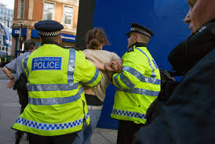
Power to arrest

Slide 69
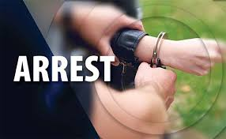
What does it mean? Arrest
JPLANE
An arrest is the taking of a person’s liberty and preventing them from going about their lawful business
Occurs when a police officer states to an individual that they are arresting them, or when they use force to restrain the individual concerned
Also occurs when, by words or conduct, they make it clear that they will, if necessary, use force to prevent the individual from going where they may want to go.
***Arrests MUST be NECESSARY!***

Slide 70
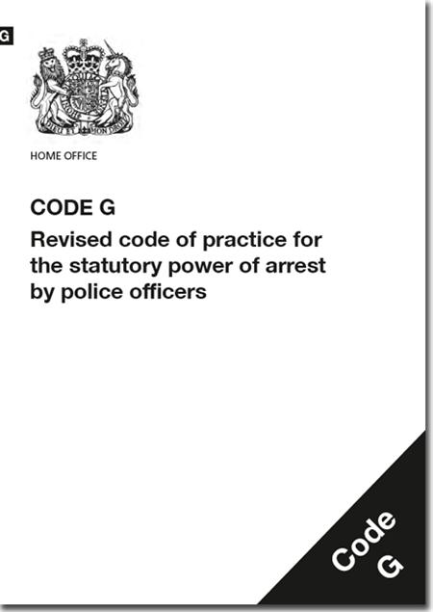
Always ask yourself…
Is there a power to arrest?
Are there grounds to arrest?
Is there a necessity to arrest?
What happens first then?

Slide 71
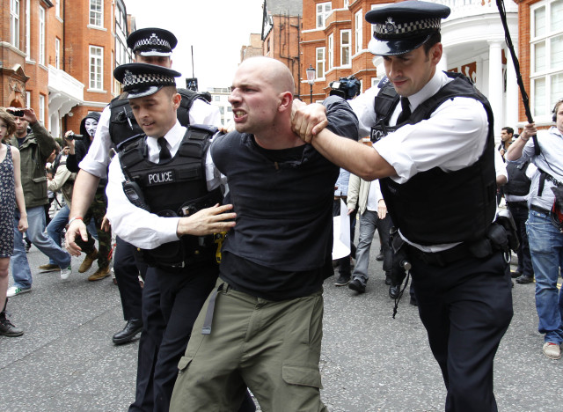
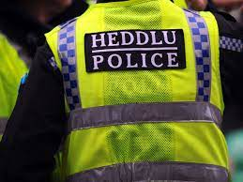
What is a ‘Lawful Arrest’?
A person’s involvement
or
suspected involvement
or
attempted involvement
in the commission of a criminal offence
AND
reasonable grounds for believing that the person’s arrest is ‘necessary’
Notes:
PACE Code G states that these two elements must be satisfied for a Sec 24 arrest to be lawful:
If the provisions of the Act and this Code are not observed, both the arrest and the conduct of any subsequent investigation may be open to question.
The law requires a person is informed of the 'grounds for the arrest'
(e.g. "I am arresting you on suspicion of stealing a stereo from a Ford Fiesta car in Acacia Ave yesterday").

Slide 72
Prior to Making an Arrest
Officers should consider information about:
5 W’S & H
The event: What has happened?
The individual’s involved
Any offence?
SHACKS
Any physical or mental ill health which requires medical attention?
NDM
Any needs of the investigative process?

Slide 73
SHACKS
SMELL
HEARD
ACTION
CONVERSATION
KNOWELDGE
SEEN

Slide 74
5 W’S & H
WHO?
WHAT?
WHEN?
WHY?
WHERE?
HOW?

Slide 75
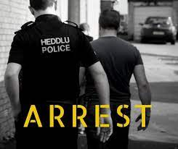
Reasonable grounds?
Knowing
Believing
Suspecting

Slide 76
Other police powers
• Safeguard potential victims and move them to a place of safety • Stopping and checking vehicles, including seizing or recovery • Roadside tests and entering premises following a ‘fail to stop’ • Entry, search and seizure (including legal privilege) • Arrest and warrants • Those relating to specific areas of policing, e.g., investigations, counter terrorism

Slide 77
Safeguarding potential victims and move them to a safe place
Children's Act 2004, Police and Criminal Evidence Act (PACE) 1984
Emergency powers to enter premises and make sure they can provide immediate protection for children believed to be suffering, or likely to suffer significant harm.

Slide 78
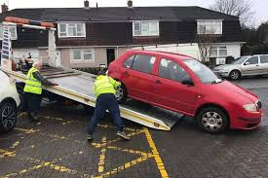
Stopping and checking vehicles including seizing and recovery
Road Traffic Act 1998- A person driving a motor vehicle on a road must stop the vehicle on being required to do so by a constable in uniform.
The police can seize a vehicle if they think it’s being used in a way that causes alarm, harassment or distress, for example careless or inconsiderate driving.
They can also seize a vehicle if they think it’s:
being driven by someone who does not have a proper licence or insurance
dangerously, illegally or obstructively parked
broken-down or abandoned

Slide 79
Roadside tests and entering premises following a 'fail to stop'
Road Traffic Act 1988 gives police the power to gain entry to any place using reasonable force if necessary in order to impose a requirement to provide a preliminary breath test if the following conditions of Section 6(5) of the Road Traffic Act 1988 are satisfied:
There was a road traffic accident on a road or public place; and
The officer reasonably believes that a person had been driving, attempting to drive or in charge of a vehicle involved in the road traffic accident.
Police and Criminal Evidence Act (PACE) 1984 grants a police officer the power to enter any premises to arrest a person under Section 4 (driving, attempting to drive or in charge when under the influence of drink or drugs) or Section 163 (failing to stop when required to do so by a constable in uniform) of the Road Traffic Act 1988.

Slide 80

Powers relating to specific areas- Terrorism
Schedule 7 of the Terrorism Act 2000- provides police officers with unique powers to examine people who pass through the United Kingdom’s borders.
It allows them to stop, question and when necessary, search and detain individuals and goods travelling through the UK’s borders to determine whether they may be involved or concerned in the commission, preparation or instigation of acts of terrorism.

Slide 81
Investigation powers
The key piece of legislation which regulates police investigation powers is the Police and Criminal Evidence Act 1984 (PACE)
PACE regulates the police powers to:
• Arrest, detain, question and take the biometric details of those suspected of a crime.
• Enter private property, search the property and seize evidence.
• Stop and search individuals and vehicles.
The powers regulated by PACE are often complemented by or related to other law.

Slide 82
Any questions?

