Slide 1


Azimul haque mustaffa gorbinda chunie singh
brother

Slide 2

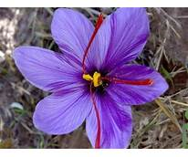
Saffron is a spice derived from the flower of Crocus sativus, commonly known as the "saffron crocus".

Slide 3
Our mission is to import the finest plant based edibles from the Ourika Valley in morocco
.

Slide 4
website www.ourikavalleysaffron.com
email addresses
admin@ourikavalley.co.uk sales@ourikavalley.co.uk
Call our sales team- 07513382027/ 07454632832

Slide 5
Media platforms

Slide 6
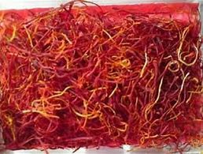
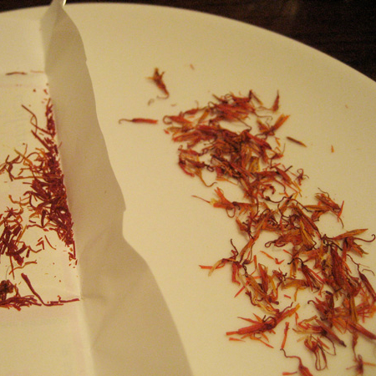
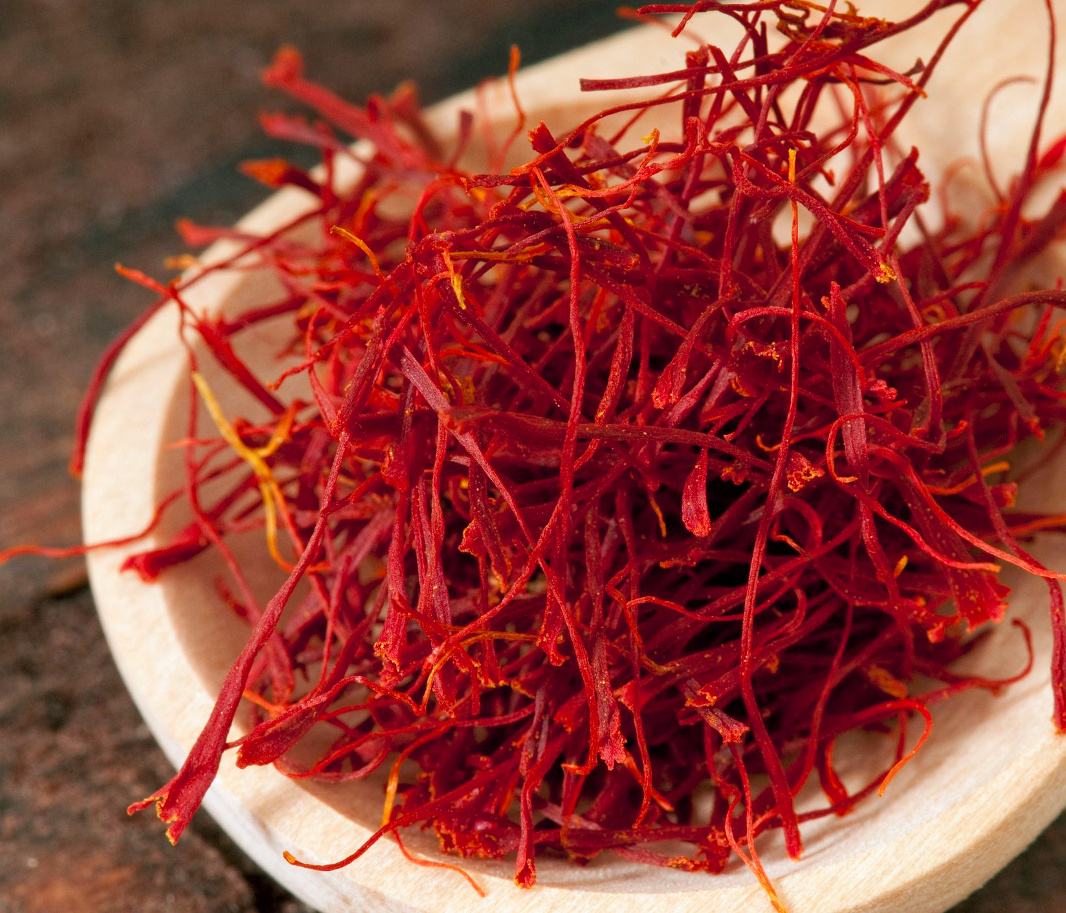
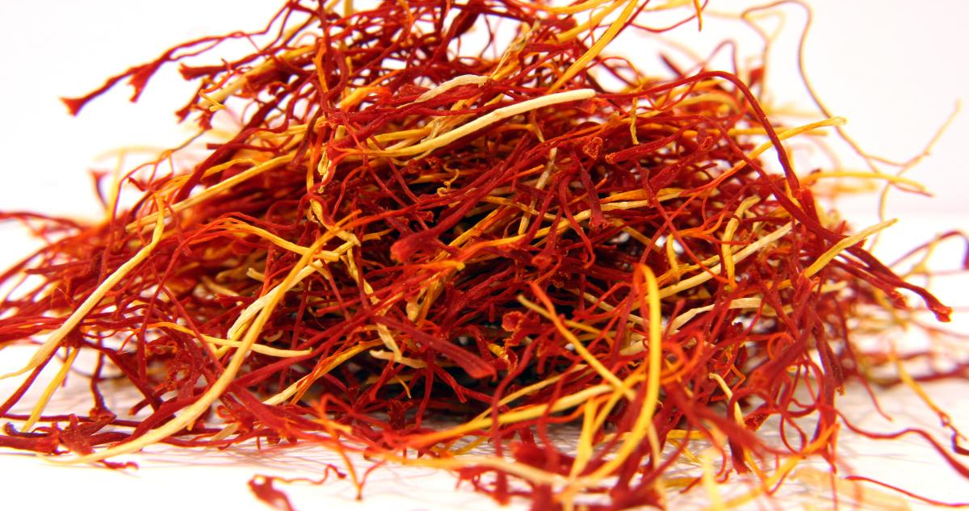
Rely on us……
Quality assured
Packaged in the u.k
Eco safe packaging

Slide 7
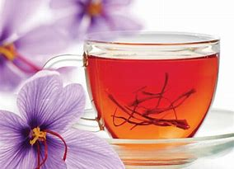

Slide 8
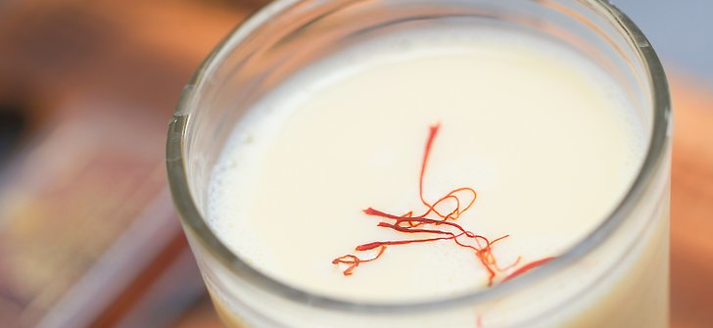
The drinks industry in wales is at the forefront of the European drinks market, Mineral water sales exceeds £15 million annually,

Slide 9



