Slide 1
University of Wales Trinity Saint David
Problem Solving and Decision Making Module
(LCLM4004)
Elvis Gjini
Dr. Chijioke Uba

Slide 2
Presentation Overview
1. Background of Green Haven Florists
2. Insight into the Problems
3. 5W2H Model
4. PESTEL Analysis
5. Cause-and-Effect Analysis
6. Key Findings
Notes:
Good morning. The presentation will be conducted by me, Elvis Gjini and it will be a strategic analysis of the issue of Green Haven Florists. It is to decompose the nature of company problems in a systematic study by applying known models of analysis to reveal the symptoms and their causes.

Slide 3
Background of Green Haven Florists
A small, independent floral business established in Norwich (2016).
Built a brand on personalised service and eco-friendly practices.
Currently facing significant financial and competitive challenges.
Notes:
Green Haven Florists is an organisation based on the following background. Green Haven Florists is a small, independent, and local floral business that was erected in Norwich in 2016. It built a brand image based on personalised services and strong commitment to eco-friendly and sustainable practices, which created a base of strong following. Nevertheless, within the recent past, the business has been experiencing a phase of enormous difficulty. It is experiencing a reduction in revenue percentage and an apparent reduction in the count of clients going into the premises. This has now presented the owners with the urgent need to re-examine its business model given the rise in the cost of doing business, the more competitive business environment and a radically rearranged retail landscape that is threatening the long-term viability of the shop.

Slide 4
Insight into the Problems
Primary Issue: 30% decrease in in-store sales over the last 12 months.
Internal Factors: Outdated website, limited digital marketing, inflexible services.
External Factors: Reduced high-street traffic, inflation, new powerful competitors.
Notes:
The most granular and measurable problem of the Green Haven Florists is a 30 per cent decrease in its in-store sales, which is an alarming decrease that has been experienced in the last twelve months. However, this headline figure is only an indicator of underlying factors which are even more complex. These may be divided into two categories. Within the company, there is some operational inertia; the company claims its site to be old-fashioned, its online marketing operations are limited, and its services are not flexible. On the outside, the company is swept along by other forces outside of its immediate influence, such as an overall slowdown in on the high street, inflationary pressurings on supplier prices and the entrance of two powerful rivals into the market. A shallow answer would only cover the sales numbers, whereas a more stringent strategy, which is espoused by the supporters of Root Cause Analysis (Hancock, 2022), would entail a process of searching into the root cause of the issue. The risk of failing to frame the issue properly at this point is a means of seeking irrelevant solutions. A very specific definition of a problem virtually insures a very specific and suboptimal decision-making process as Heath and Heath (2014) posit. Thus, the predicate to any strategic action is a full-scale diagnosis.

Slide 5
5W2H Model
What? | Who? | Where? | When? | Why? | How? | How Much?
30% drop in sales & profitability. | Owners, customers, suppliers. | Physical shop in Norwich. | Over the last year. | Competition, costs, failure to adapt to online shift. | Reduced foot traffic and transactions. | 30% revenue loss and brand damage.
Notes:
The 5W2H model offers a step-by-step approach to interrogation, enabling a granular definition of the problem. According to Brosnan (2025), the power of this tool lies in its ability to impose a systematic study of a situation through seven different perspectives, thus establishing a holistic problem statement. What in Green Haven is the 30 per cent drop in in-store sales and the loss of profitability? The Who includes the owners, Liam and Priya, their customers and the suppliers. The physical location is the shop in Norwich. The fall took place last year. The 'Why’ suggests the interplay of forces: increased competition, rising costs, and a crucial inability to adapt to changing consumer behaviour towards online stores. The manifestation of the issue is the decline in foot traffic and a decrease in face-to-face transactions. Lastly, what is the measurement of the impact, which is a direct loss of 30% of in-store revenue, exacerbated by less measurable damage to brand relevance and market position?

Slide 6

Critique of PESTEL
A tool for scanning the macro-environment to identify opportunities and threats.
Benefits: Promotes strategic thinking and comprehensive analysis.
Limitations: Can create a long, unprioritized list of factors; analysis is a static snapshot and can become outdated.
Notes:
The PESTEL model is a well-developed strategic analysis tool, which is employed to scan and make sense of the macro-environmental forces affecting an organisation. According to David Hayden (2025), it aims to see the big picture within which a business exists. Its main applicability lies in establishing the potential opportunities and threats across the political, economic, social, technological, environmental, and legal sectors. Whittington et al. (2017) position PESTEL as a causative element in the strategic planning process because it compels an organisation to move beyond its immediate area of operation and consider long-term trends and upheavals. The tool is designed to cover external influences thoroughly. However, the framework has its drawbacks. One common objection is that its use may lead to a long list of factors, which are not differentiated, and there is no clear prioritisation of their values. This has prompted some scholars to suggest a more systemic approach in analysing the dynamic relationship of factors, in which a greater weight is attached to the relationship (Ya Zhou, 2015). The analysis is also not dynamic, which may not be as helpful in a fast-changing industry. Finally, its worth depends on the quality of the data to support it and the ability of the person to interpret it, which are also supported by educational sources of Harvard University (2025). Unless it is thought through, the framework would generate descriptions rather than strategic intelligence that can be put into action.

Slide 7
Application of PESTEL
Political | Economic | Social | Technological | Environmental | Legal
Supply chain stability. | High inflation, reduced disposable income. | Shift to online shopping convenience. | Competitors' advanced e-commerce and digital marketing. | Rising cost of sustainable materials. | UK employment and consumer rights laws.
Notes:
The use of this framework on the Green Haven Florists shows which external forces influence the reality this company is in at the moment. Politically, the business is prone to supply chain shocks, which impact in importation of fresh flowers which is a variable which will be subject to international trade agreement and logistical stability. Economically speaking, the level of inflation is a threat to itself, as it is raising the prices of both the flowers and sustainable materials, at the same time lowering the amount of disposable income that consumers have to spend on non-essential goods. The social aspect is the most important perhaps, and it can be characterized by a strong consumer change to online shopping and the same-day delivery services and their urgency. Technological aspects of this trend are amplified with the popularity of advanced online shopping websites, as well as the powerful digital marketing of the competitors, which contrasts with Green Haven having an outdated webpage sharply. On the part of the environment, the company is determined to be environmentally conscious in its sourcing hence the growing consumer values although it seems a paradox since these environmentally friendly materials turn out to be costlier and will strain the cost pressures. Lastly, legal issues, including the UK employment laws and consumer rights legislation, bring about a regulatory environment, which regulates any small retail business, which adds some complexity to the compliance levels. As observed in this analysis, Green Haven is in a challenging and dynamic macro-environment in which it is operating.

Slide 8
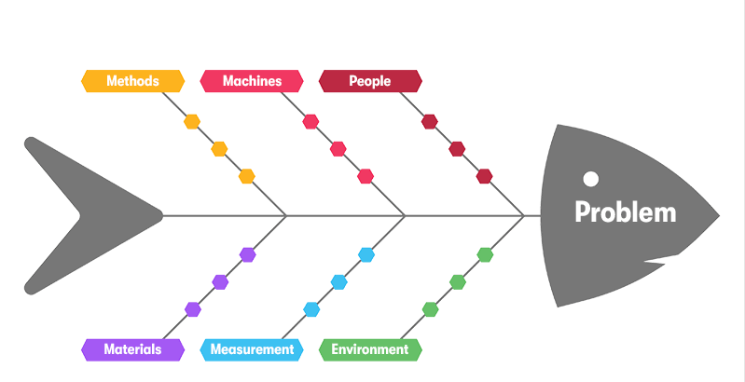
Critique of Cause-and-Effect
A visualisation tool (Fishbone/Ishikawa diagram) to categorise potential root causes.
Benefits: Structures brainstorming and clarifies relationships between factors.
Limitations: It is a hypothesis-generating tool, not a validation method. Effectiveness is limited by participants' knowledge and bias.
Notes:
The Cause-and-Effect diagram, also known as the Fishbone diagram or Ishikawa diagram, is a visualisation tool that enables one to explore and categorise the possible causes of a given problem in a systematic manner. According to ASQ (2024), this tool is used to structure brainstorming output, uncovering the root causes rather than the symptoms. One of the advantages of the given model is that it provides a systematic way of investigation, which enables a team to contemplate a wide range of possibilities, categorised into predefined groups, thereby preventing an inclination to focus on the most apparent problems early on. Oakland (2014) notes that in the scope of Total Quality Management, the method proves helpful in breaking down process variations and quality defects. The visual format of the diagram is one of its main advantages, which helps to easily understand the relations between a central problem and the factors contributing to it. Yet it has some significant limitations to its effectiveness. The model itself does not offer a way to test the possible causes it assists in determining; rather, it is a hypothesis-generating tool, not a test. Sakdiyah, Eltivia and Afandi (2022) note that its production is necessarily limited by the knowledge and biases of the people involved in its production. Another problem is that such a diagram can become cumbersome and too complicated, as it can enumerate too many possible causes that can effectively obscure rather than elucidate the underlying problems and be counterproductive to subsequent action.

Slide 9
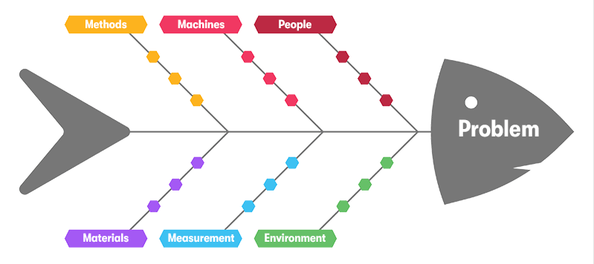
Application of Cause-and-Effect
Key causes include:
Technology: Outdated website.
Process: Over-reliance on word-of-mouth.
People: Digital marketing skills gap.
Environment: New competitors and E-Commerce shift.
Notes:
In the case of Green Haven Florists, a Cause-and-Effect analysis will help crystallise the correlation between the operational shortcomings and the central issue of a 30 per cent drop in in-store sales. Based on categories relevant to a service business, the diagram indicates several interdependent root causes. Within the technology section, the old and hard-to-navigate site is one of the main hindrances to interacting with the online customers. In the Process category, the excessive use of conventional word-of-mouth marketing and a lack of contemporary business options, such as subscriptions, are manifestations of the failure to change business practices. The skills gap that would be mentioned by the 'People' branch is in the digital marketing area. The external market, the Environment, brings the new, aggressive 'People' would identify a digital marketing skills gap. The Environment brings new aggressive entrants and the general E-Commerce movement. Finally, rising raw material costs are reducing supplier profit margins and investment funds. The application example shows that systemic deficiencies cause revenue declines. Business analysis requires understanding these complex causative layers, according to Blais (2019).

Slide 10

Key Findings
1. Core Issue: A strategic misalignment between a traditional retail model and the digital-first consumer environment.
2. Financial Pressure: Caught between rising operational costs and an inability to access the online market.
3. Root Causes: Largely internal and controllable, relating to technology, marketing, and service policies.
Notes:
The analysis makes a number of findings that are clear and which characterize the strategic challenge of Green Haven. To begin with, the core issue of the company is the underlying lack of alignment between an established and high-street model of the company and digital-first consumer environment. Second, the company finds itself in a pincer grip with external forces of increasing operation expenses and an inability to access the growing online market, burdened internally because of an inability to penetrate the online market and succeed in an online market entry strategy. Thirdly, and notably, the most important root causes of the sales dropping appear to be much more internal in nature and thus can be addressed and are directly related to the lack of technological infrastructure and obsolete marketing and serving policies within the company.

Slide 11
Reference List
ASQ (2024) What Is a Fishbone diagram? Ishikawa Cause & Effect Diagram, ASQ. Available at: https://asq.org/quality-resources/fishbone (Accessed: 15 October 2025).
Blais, S. (2019) Business analysis : best practices for success. Hoboken, N.J.: Wiley.
Brosnan, K. (2025) What is 5W2H and Why It Matters in Manufacturing Excellence - Fabriq, Fabriq. Available at: https://fabriq.tech/en/2025/07/30/what-is-5w2h-and-why-it-matters-in-manufacturing-excellence/ (Accessed: 15 October 2025).
David Hayden (2025) PESTLE analysis, CIPD. Available at: https://www.cipd.org/en/knowledge/factsheets/pestle-analysis-factsheet/ (Accessed: 15 October 2025).
Harvard University (2025) Harvard Business Impact Education, Harvard.edu. Available at: https://hbsp.harvard.edu/inspiring-minds/ (Accessed: 15 October 2025).
Heath, C. and Heath, D. (2014) Decisive : how to make better decisions in life and work. London: Rh Books.
Jonathan Hancock (2022) 5 Whys, www.mindtools.com. Available at: https://www.mindtools.com/a3mi00v/5-whys (Accessed: 15 October 2025).
Oakland, J.S. (2014) Total quality management and operational excellence : text with cases. New York: Routledge.
Sakdiyah, S.H., Eltivia, N. and Afandi, A. (2022) ‘Root Cause Analysis Using Fishbone Diagram: Company Management Decision Making’, Journal of Applied Business, Taxation and Economics Research, 1(6), pp. 566–576. Available at: https://doi.org/10.54408/jabter.v1i6.103.
Whittington, R. et al. (2017) Exploring Strategy: Text and Cases. 11th edn. Harlow, England: Pearson.
ya zhou (2015) Formulation of a Systemic PEST Analysis for Strategic Analysis, Academia.edu. Available at: https://www.academia.edu/25528532/Formulation_of_a_Systemic_PEST_Analysis_for_Strategic_Analysis (Accessed: 15 October 2025).

Slide 12

Thank You
Q&A

