Slide 1
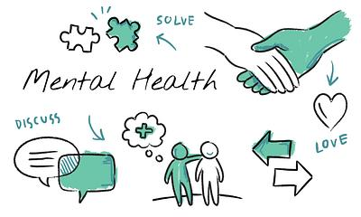
Improving the mental health of babies, children and young people: a framework of modifiable factors

Slide 2
Introduction
The mental health of babies, children and young people (BCYP) influences their future mental health, as well as their current and future physical health, affecting their wider life chances and outcomes. The early part of the life course, from birth to young adulthood (0 to 25 years), provides important opportunities for promoting and protecting mental health.

Slide 3
Factors that influence the mental health of babies, children and young people
Mental health is influenced by multiple risk and protective factors. Risk exposures that occur during developmentally sensitive periods, especially during early childhood, are particularly detrimental and can affect mental health or predispose towards mental health conditions later on in life. Conversely, protective factors experienced across the life course - such as secure attachment, supportive, sensitive and responsive parenting, living in safe and cohesive communities, and health-promoting education and workplace settings - can serve to strengthen mental health (see the UNICEF report The State of the World’s Children 2021).

Slide 4
Continued
Some factors are shaped at an individual level; others are influenced by family and social relationships, and in particular contexts such as education, work and community settings. Other factors operate at a wider societal or environmental level. These different levels are described in Dahlgren and Whitehead’s socio-ecological model of the determinants of health. Risk and protective factors not only occur across different levels, but they also have a temporal dimension.
At different points across the life course, these determinants will exert a greater or lesser influence on individual and population mental health. The adverse effects of risk factors accumulate through life so the earlier in the life course that action can be taken to protect the BCYP population, the greater the benefits.

Slide 5
Risk factors
While single risk or protective factors do not predict an individual’s state of mental health, the interacting determinants across the circumstances and experiences of BCYP’s lives can enhance or undermine mental health. These factors are often interconnected - for example, material circumstances, family relationships, school experience and neighbourhood environments.

Slide 6
Continued
The accumulation of risk factors in babies, children and young people’s lives can be particularly problematic for a range of outcomes including mental health. It is therefore the interplay of actions led by multiple stakeholders across a child or young person’s life course that has the potential to address the risk and protective factors and improve mental health outcomes.

Slide 7
Framework of modifiable factors to guide promotion and prevention
The conceptual framework outlined below (figure 1) is informed by the socio-ecological model of the determinants of health and builds on a conceptual framework for public mental health that was published by the National Institute of Health Research School for Public Health Research in (2021). The focus of this was the adult population. It is also helpfully complemented by Understanding and supporting mental health in infancy and early childhood - a toolkit to support local action in the UK published in by UNICEF UK, (2023) and the (University of Cambridge Centre for Research on Play in Education, Development and Learning, 2023).

Slide 8
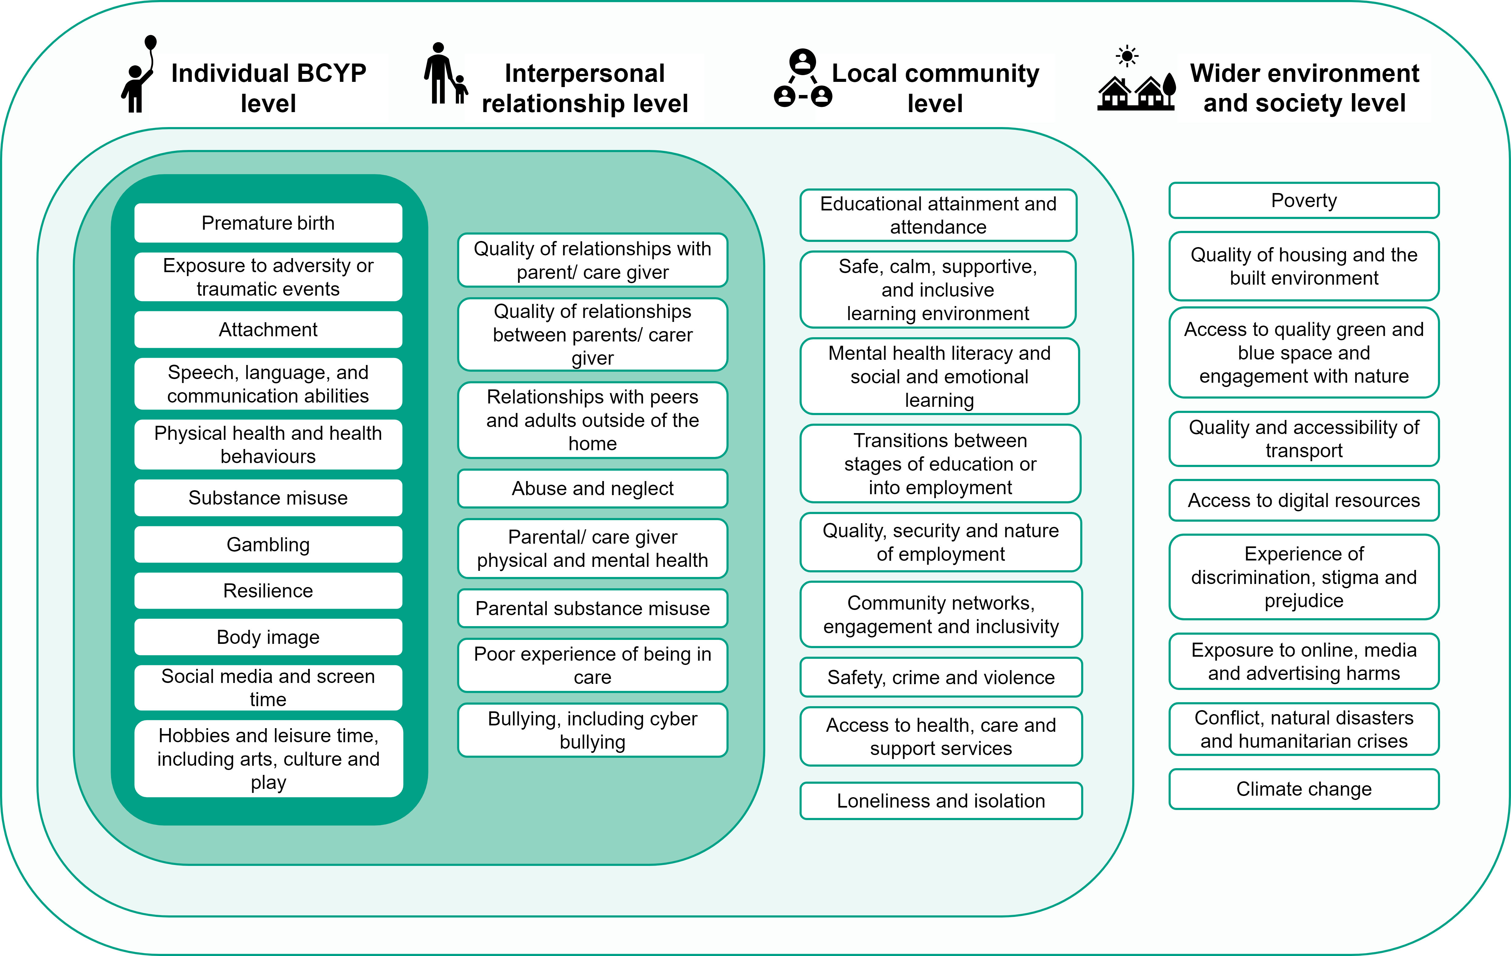
A framework of modifiable factors to guide promotion and prevention

Slide 9
Continued
Figure 1 contains 4 headings, each representing a different domain. These are, from left to right:
Individual level
Interpersonal relationship level
Local community level
Wider environment and society level
Underneath each heading is a list of modifiable factors that influence BCYP health and fall within the relevant domain.
The lists are contained within rectangles embedded within each other and increasing in size from left to right - conveying the widening scope of each domain. Individual-level factors are less broad than interpersonal relationship-level factors, which are in turn less broad than local community-level factors, which are in turn less broad than wider environment and society level factors. Factors within each domain may influence one another as well as factors across broader and/or narrower domains, represented by the embedding of the rectangles.

Slide 10
Any Questions?

