Slide 1

Teaching Toolkit 1
Key Teaching Strategies
Part Time
Year One
Post Compulsory Education and Training
Notes:
No idea how to start.

Slide 2
18.00
Teaching Cycle/Blooms Taxonomy
18.45
Activity /Coffee break Group discussions
19.45
Assessment & Reflective practice
20.15
Review & Close
19.15
Plenary Discussion

Slide 3

Learning outcomes
Explore the four stages of the Teaching Cycle
Examine how Bloom’s Taxonomy helps set learning objectives
Review how learning outcomes may be assessed
Familiarization with a model of the Reflective cycle

Slide 4
The four stages of the Teaching Cycle
Part one

Slide 5
The Teaching and Learning Process
Assessment and Feedback
Constructive feedback
Learning Needs Analysis
Learning outcomes
Design
Delivery
Deliver engaging teaching
Learner profile
Teaching and Learning
Subject specialism
Meet learner needs
Teaching effectiveness
Strategies and resources

Slide 6
Our focus in part 1
We will examine the way in which we can write learning objectives
and nd the assessment of those objectives
Stage 2: Delivery
Stage 3: Assessment
Assessment and Feedback
Constructive feedback
Design
Teaching and Learning
Subject specialism
Teaching effectiveness
Strategies and resources

Slide 7

Bloom’s Taxonomy and learning objectives
Design
Teaching and Learning
Subject specialism
Strategies and resources
Design

Slide 8

  In 1956, Benjamin Bloom headed a group of educational psychologists who identified three domains of educational activities:
    Cognitive – mental skills (Knowledge)
    Affective – growth in feelings or emotional areas (Attitude)
    Psychomotor – manual or physical skills (Skills)

Slide 9
Bloom’s Domains of Learning
Knowledge
Cognitive
One self
Affective
Doing
Psychomotor
Bloom et al.( 1956)

Slide 10


Cognitive Domain;
Knowledge
Comprehension
Application
Analysis
Synthesis
Evaluation

Slide 11

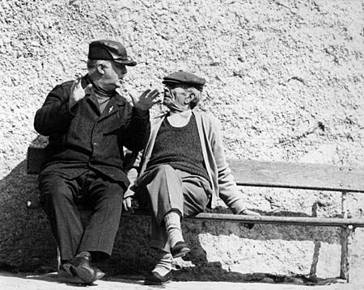
Affective Domain;
Receiving
Responding
Valuing
Organising
Characterising
(Krathwohl, Bloom and Masia, 1973)

Slide 12

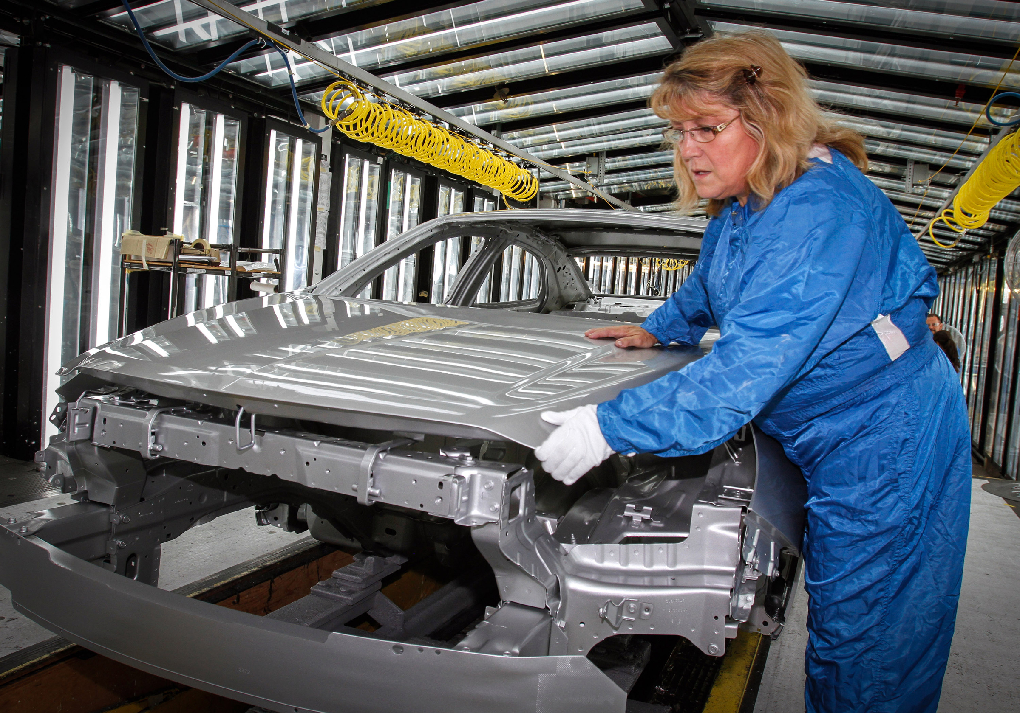
Psychomotor Domain;
Imitation
Manipulation
Precision
Articulation
Naturalisation
(Dave, 1975)

Slide 13
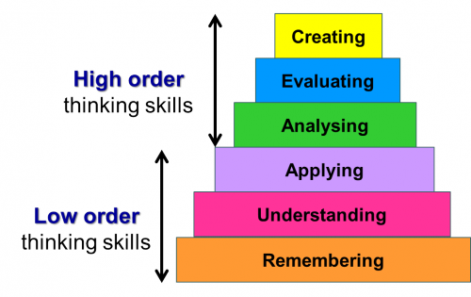
Bloom’s Taxonomy
This Photo by Unknown Author is licensed under CC BY-NC

Slide 14
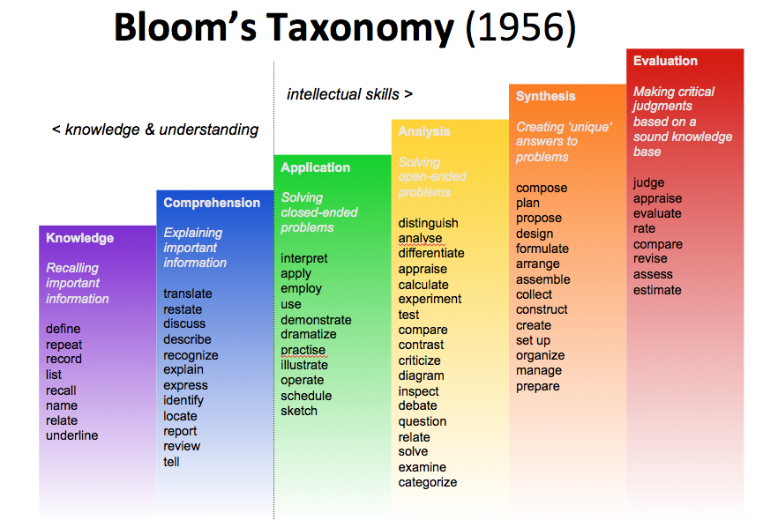
This Photo by Unknown Author is licensed under CC BY-NC-ND

Slide 15
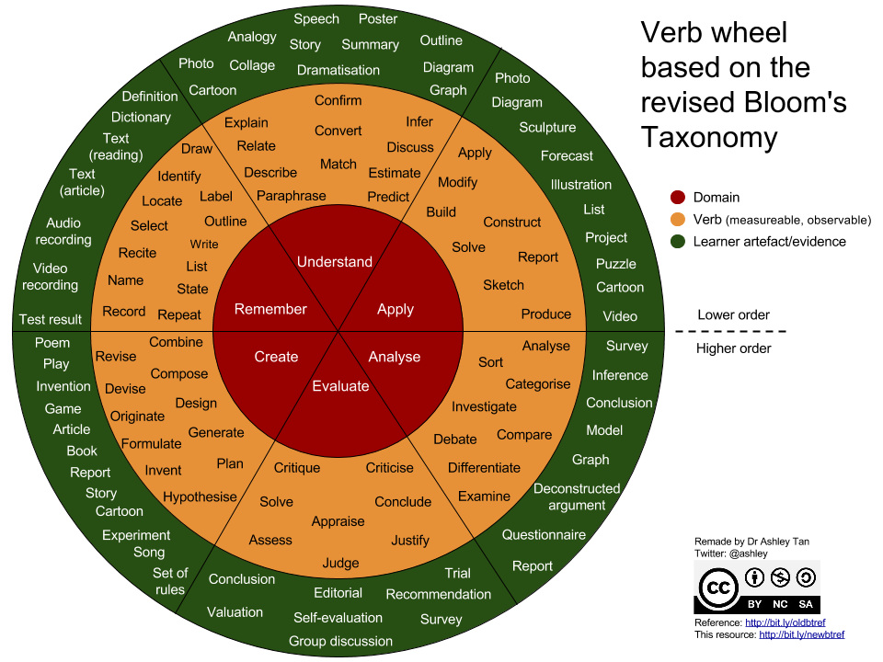
Bloom’s Taxonomy

Slide 16


Activity – Break
Back in the main Room 19.15

Slide 17

Activity : Groupwork ‘Bloom’s Taxonomy’
You are designing a two hour for a community youth group 16-19 year old.. who are known to have low esteem and are disruptive
Previous teachers have told you they just can’t get them to engage
You want to make an impression and convey immediate impact by using a fashion video that gets their attention
You got a room, dim the lights and play this clip
https://www.soccerbible.com/lifestyle/clothing/2020/09/adidas-spezial-and-new-order-drop-aw20-collection/
You want to use this video but the centre manager asks what's the point of showing the clip ..what’s your response …
Consider
Learning objectives
Blooms Taxonomy
How can you use this resource to teach something to the learners
Finally--I know it's marketing but we can exploit marketing back too

Slide 18
Example of a Learning Outcome
List the three domains of learning as identified in Blooms Taxonomy
Identify the key verbs that constitute Blooms Taxonomy

Slide 19
Answers: List the three domains of learning as identified in Blooms Taxonomy
    Cognitive – mental skills (Knowledge)
    Affective – growth in feelings or emotional areas (Attitude)
    Psychomotor – manual or physical skills (Skills)

Slide 20

19.15-19.45 Plenary
Why are you using that clip ?
Benefits
Learning Outcomes
Bloom’s Domains
Anything else ….

Slide 21
Identify the key verbs that constitute Blooms Taxonomy
This Photo by Unknown Author is licensed under CC BY-NC

Slide 22
Review
Knowledge of Bloom’s taxonomy helps teachers to Distinguish between different levels of difficulty
Apply action verbs to learning objectives set so that both they and the learners are clear about what specifically is required
Use the objectives to better plan learning experiences and appropriate evaluation devices.

Slide 23

Review how learning outcomes may be assessed.
Assessment

Slide 24

The scale of assessment
Assessment-related activities contribute up to 50% of what teachers do in classrooms
Stiggins(1992)

Slide 25
There are there Assessment points
Notes:
Clapping Game Activity
Interesting Questions
How does it feel to assess/be assessed without criteria? What are the implications of this?
What are the positive and negative implications of published criteria?
What is feedback?
What is feedforward?
What is the ‘backwash’ effect of assessment?

Slide 26
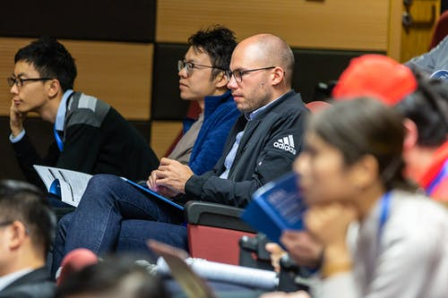
The Assessment Process
Learning Objectives
Learning Outcomes
Assessment Criteria
Assessment Methods

Slide 27

Summative assessment
High stakes summative assessment has been a significant element of educational policy in England and Wales for more than a decade.
Exams are norm referenced
However, considerable research evidence indicates that formative assessment is more likely to raise student achievement.

Slide 28

In summative assessment we are used to Norm referenced assessment
Assessment in relation to a stated group or population
Often uses ranking
Standards move with the population
E.g. 11 plus examination

Slide 29


And criterion-referenced assessment
Measured against published criteria
Absolute standards possible
Standards do not vary with the population
E.g. NVQ, GNVQ, GCSE, national curriculum
This Photo by Unknown Author is licensed under CC BY-SA

Slide 30

However we must not forget Formative assessment
“Formative assessment is at the heart of effective teaching. All those activities undertaken by teachers, and their students in assessing themselves, which provide information to be used as feedback to modify the teaching and learning activities in which they are engaged."
Black & William, (1998) : Inside the Black Box
Such assessment becomes ‘formative assessment’ when the evidence is actually used to adapt the teaching work to meet the needs.”

Slide 31
Summative or Formative
Assessment of Learning
judgments, measurements, quantitative, comparisons with criteria, comparisons with others
Assessment for Learning
interpreting observations, qualitative, comparison to student’s own targets or previous performance

Slide 32
Assessment for Learning
Teaching and Learning
Assessment

Slide 33
A virtuous circle
Use effective learning and revision strategies
Effective strategies develop metacognitive knowledge
More effective learning from assessment
Improve self efficacy
Students believe that ability is not fixed

Slide 34
Activity : How would we assess out learning outcomes
List the three domains of learning as identified in Blooms Taxonomy
Identify the key verbs that constitute Blooms Taxonomy

Slide 35

Familiarization with a model of ‘Reflective cycle.’

Slide 36
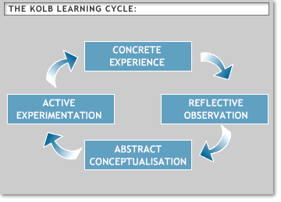
This Photo by Unknown Author is licensed under CC BY-SA-NC

Slide 37
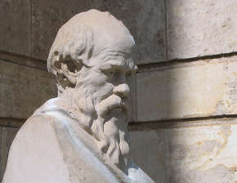
Why look back?
“An unexamined life is not worth living.”
Socrates

Slide 38

What it is and what it isn’t
It isn’t
  ◦ A simple recall of past events
  ◦ A description of events and feelings
It is
  ◦ A purposeful activity – i.e. to learn and apply something new
  ◦ An active process of exploration, questioning and self-discovery
  ◦ Evidence of outcomes, enhanced learning and improved teaching

Slide 39
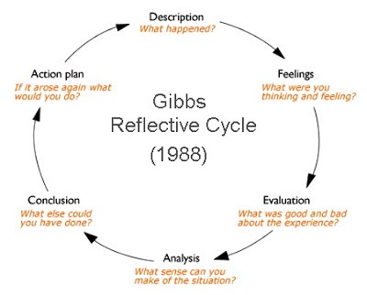
Gibbs Reflective cycle

Slide 40
Benefits of Reflection
It is motivational as we know what we are trying to achieve and why
It uses our existing knowledge and experience to help us to understand new concepts
It builds and strengthens our current learning through critical evaluation of previous experiences
It allows us to be self-directed and self-aware and helps us to identify and address our own strengths and areas for improvement
It provides a record of our growing understanding of the teaching process, and developing thoughts and ideas so that we can look back later and see the distance we have travelled.

Slide 41
Benefits of Reflection
Writing something down often helps to bring it to life and helps to clarify thoughts
Making associations and links between different aspects and subject helps us to remember more easily
It will help us to identify our preferred learning and teaching styles
It helps us to be better teachers

Slide 42
Asyncronous activity
Reflect on two learning experiences that you have had, one positive and one negative
From your learning experiences, are you able to identify/list the Hindering/Helping Forces involved?
How much are the Helping /Hindering Forces linked to ATTITUDE/SITUATION?
What are your self defeating beliefs-what positive beliefs can you put in their place?
How could this reflection you have just undertaken help you as a teacher?

Slide 43
Socrative Quiz
Go to student logon :www.Socrative.com
Enter : FLAGG1682

