Slide 1
FT-ir identification of organic compounds
Acda6020
e.kazimierska@uwtsd.ac.uk

Slide 2
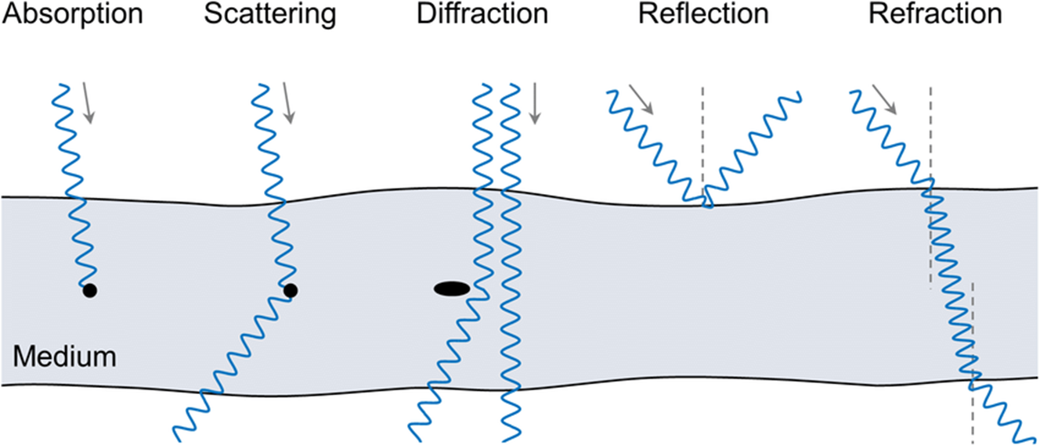
What is spectroscopy?
Spectroscopy is the study of how matter interacts with electromagnetic radiation (light). These techniques are usually non destructive, so the sample of investigated compound is not changed after the analysis.
  FT-IR
Identifies presence of various groups such as nitro groups common in explosives.

Slide 3
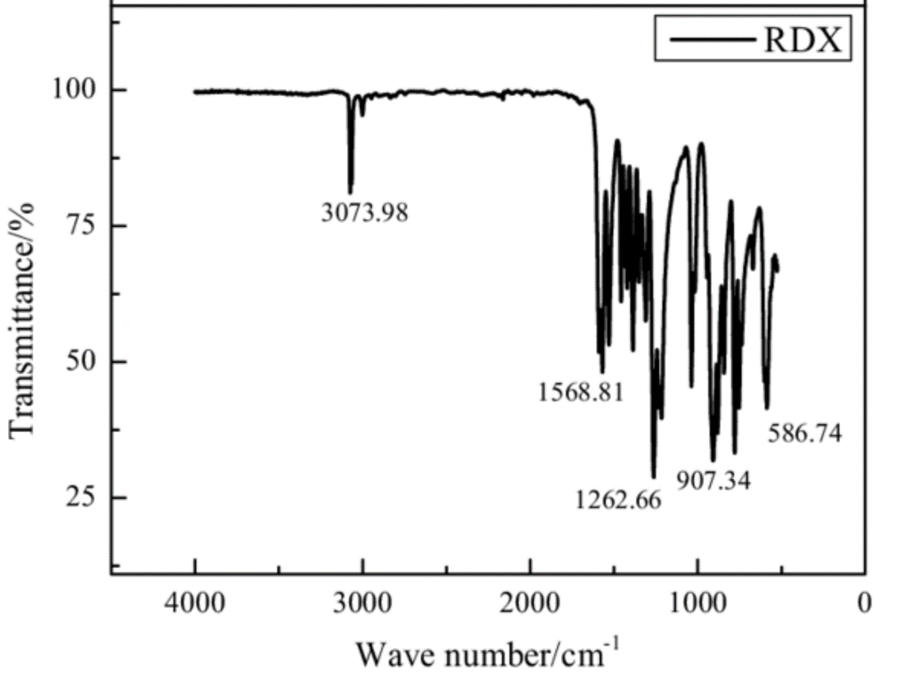
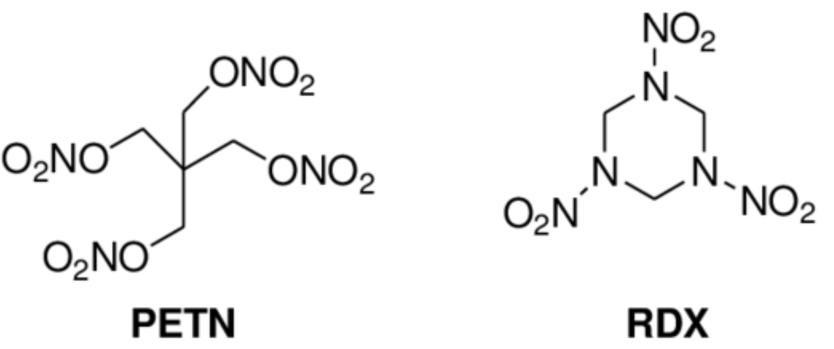
A spectrum:
nitramine

Slide 4
What is the wavenumber?
Wavenumber represents the number of wavelengths of light per unit distance.
It is used to represent the frequency of light absorbed or scattered by a sample.
It is the reciprocal of wavelength (cm⁻¹).
Wavenumber is directly proportional to the energy of the radiation and is used in FT-IR and Raman spectroscopy to identify molecular vibrations.
Formula for Wavenumber (ṽ):
ṽ =1\λ where:
ṽ is the wavenumber (cm⁻¹),
λ is the wavelength in cm
E = hν = hc ṽ where:
E is the energy,
h is Planck’s constant,
ν is the frequency (Hz),
c is the speed of light,
ṽ is the wavenumber (cm⁻¹).
As wavenumber increases, the energy of the absorbed or scattered radiation increases, which corresponds to higher-energy molecular vibrations.
Notes:
Wavenumbers are preferred in spectroscopy because they are directly proportional to energy, simplifying calculations. They provide better resolution in certain spectral ranges, especially in vibrational and rotational spectroscopy, where wavenumbers align naturally with molecular transitions. Additionally, wavenumbers make it easier to interpret spectra and are historically well-established in fields like infrared and Raman spectroscopy.

Slide 5
Absorbance vs transmittance
Absorbance and transmittance are key concepts in spectroscopy, particularly in FT-IR and UV-Vis, where they describe how light interacts with a sample.
• Absorbance (A) measures how much light a sample absorbs at a specific wavenumber. It is calculated from the intensity of light before and after passing through the sample. The higher the absorbance, the more light is absorbed.
• Transmittance (T) measures how much light passes through the sample without being absorbed. It is the ratio of the intensity of transmitted light (I) to the intensity of incident light (I₀). Transmittance is typically expressed as a percentage. If a material absorbs strongly, its transmittance will be low.
%T = I/I₀
• Absorbance and transmittance are related by the following formula:
A = −log⁡T

Slide 6
Principles of FT-IR Spectroscopy
FT-IR means Fourier Transform Infrared spectroscopy
FT-IR passes light through a sample, measuring IR absorption by molecules based on wavenumber (cm⁻¹).
IR light is divided into near infrared (NIR), mid infrared (MIR), and far infrared (FIR).
MIR is commonly used in typical IR spectroscopy as it aligns with the vibrational properties of chemical compounds.
Absorption relates to molecular vibrational transitions, specific to chemical bonds and functional groups.
Absorption is also directly proportional to the concentration.
Nitro groups (–NO₂) produce strong absorption bands in the IR spectrum.
Data is collected as an interferogram and converted into a readable spectrum using Fourier Transform.
The resulting spectrum is compared to known standards to identify explosive compounds.
This method is effective for detecting functional groups in explosives.

Slide 7
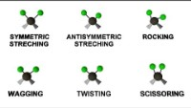
Vibrations of bonds
molecular bonds as springs with atoms attached: stronger springs take more energy to move around, so molecules with stronger bonds need to absorb light with more energy to keep those vibrations going
IR spectroscopy works by exposing a molecule to infrared (IR) radiation and measuring which wavelengths are absorbed as the bonds within the molecule vibrate. These vibrations, which are characteristic of specific chemical bonds and functional groups, produce an infrared spectrum. The spectrum shows the absorbed wavelengths, allowing for the identification and analysis of molecular structure based on their absorption patterns.
IR bands arise from a change in dipole moment

Slide 8
Key FT-IR Spectral Features
FT-IR spectrum provides a detailed view of how the molecules absorb infrared light at various wavenumbers.
This absorption corresponds to specific molecular vibrations, which are represented as peaks in the spectrum.
Wavenumber (cm⁻¹) is the inverse of wavelength and is used to represent the position of peaks in an FT-IR spectrum. Wavenumbers correspond to different vibrational frequencies in the molecule.
Absorbance measures how much infrared light is absorbed by the sample at each wavenumber.
The height of the peak corresponds to how much light is absorbed, which can provide information about the concentration of specific functional groups in the sample.
Transmittance refers to the amount of light that passes through the sample without being absorbed.
FT-IR spectra are often displayed in terms of transmittance (%) or absorbance.
A low transmittance value at certain wavenumbers indicates strong absorption, as seen in explosive materials.

Slide 9
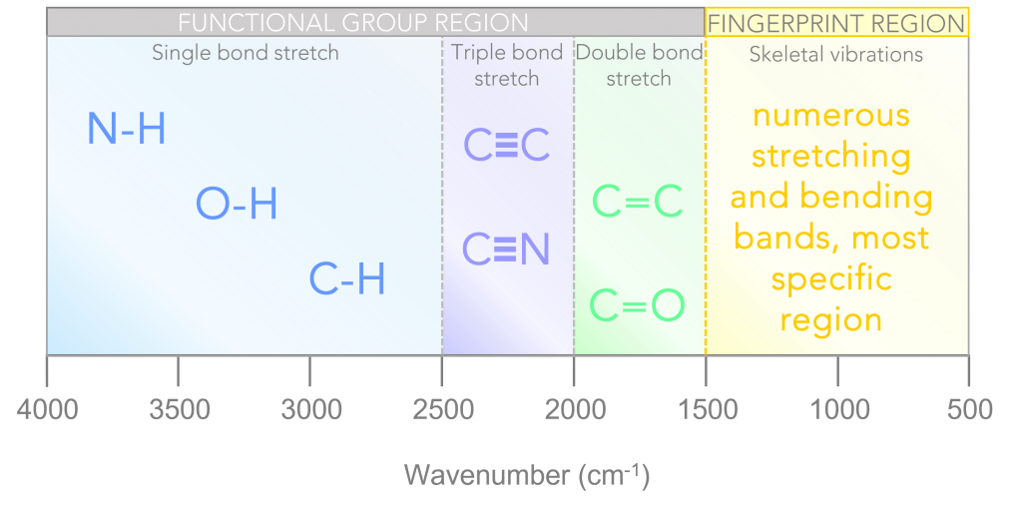
IR Spectral regions
Typical IR absorption values for various types of bonds
https://chem.libretexts.org/Bookshelves/Organic_Chemistry/Map%3A_Organic_Chemistry_%28Wade%29_Complete_and_Semesters_I_and_II/Map%3A_Organic_Chemistry_%28Wade%29/11%3A_Infrared_Spectroscopy_and_Mass_Spectrometry/11.05%3A_Infrared_Spectra_of_Some_Common_Functional_Groups
Notes:
The spectrum can be divided into four main sections, Figure 3. The high wavenumber end of the spectrum is where stretching vibrations of single bonds are present, for example the O-H in water will be strongly observed in this region as a broad peak. Between 2500 cm⁻¹ and 2000 cm⁻¹ stretching of triple bonds are observed, such as the C≡N in acetonitrile. The double bond stretching region is observed between 2000 cm⁻¹ and 1500 cm⁻¹, for instance the C=O bond in carboxylic acid will present a band in this region. The final part to consider in a typical IR spectrum is termed the fingerprint region. The fingerprint region is a complex area of the spectrum, containing several stretching and bending bands. Whilst it is the most difficult area of the spectrum to interpret, it also provides the most characteristic information providing a ‘chemical fingerprint’ of the sample.

Slide 10
A spectrum:
NO₂ asymmetric
NO₂ symmetric, C-N/N-O
Notes:
~3074 cm⁻¹ — C–H stretching (methylene / CH) (approx.)
Why: C–H stretching vibrations of aliphatic CH groups normally occur ~3000–2850 cm⁻¹. A weak/isolated feature near 3070 cm⁻¹ may be a C–H stretch (or a combination/overtone band). RDX contains CH₂ groups on the ring, so a C–H stretch assignment is the most plausible.
~1569 cm⁻¹ — ν_asym(NO₂) — nitro asymmetric stretch (strong/diagnostic)
Why: Nitro groups show a prominent asymmetric N–O stretch in the region ~1550–1600 cm⁻¹. For nitro-containing energetic materials this is typically one of the strongest, most diagnostic bands.
~1263 cm⁻¹ — ν_sym(NO₂) and/or C–N / N–O related stretching (symmetrical nitro stretch / nitramine-related mode)
Why: The nitro symmetric stretch commonly appears ~1350–1250 cm⁻¹ depending on environment; in nitramines and solid samples this mode often shifts and can overlap with C–N or N–O stretching contributions, so 1260 cm⁻¹ is consistent with the NO₂ symmetric/C–N region.
~907 cm⁻¹ — ring deformation / CH₂ wag / ring out-of-plane mode
Why: Low-frequency bands in the 900–700 cm⁻¹ region for cyclic nitramines are commonly assigned to ring deformation modes, CH₂ wagging or skeletal motions of the N-containing ring. This region helps fingerprint ring substitution/pattern.
~587 cm⁻¹ — skeletal deformation / ring bending (N–N / N–O bending)
Why: Bands below ~700 cm⁻¹ generally arise from heavier-atom skeletal motions (ring puckering, N–N, N–O bend). For RDX-type structures such low-frequency features are typical and useful as fingerprint bands.

Slide 11
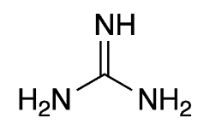
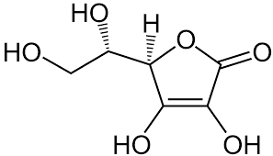
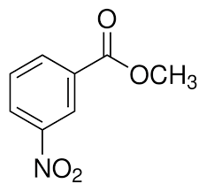

Objectives of today’s experiment
Design and write a reproducible FT-IR method.
Acquire high‑quality spectra for four solid samples.
Identify IR bands and assign functional groups.
A - Guanidinium salt (N‑rich ionic motif)
B - Acetaminophen (amide / phenol).
C - Ascorbic acid (polyhydroxy lactone)
D - Methyl 3‑nitrobenzoate (nitro‑aromatic ester).
ester group —OCO— as part of a ring
Notes:
ester group —OCO— as part of a ring

Slide 12
Diagnostic peaks (quick reference0
N–H / C=N / C–N: 3400–3000; 1680–1550; 1300–1000 cm⁻¹.
Amide / phenol: ~3300; 1665–1645; 1560–1510; 1240–1170 cm⁻¹.
Polyhydroxy / lactone: 3600–3000; 1750–1730; 1200–1000 cm⁻¹.
Ester / NO₂: 1735–1715; 1535 & 1355; 1260–1210 cm⁻¹.

