Slide 1

Cert HE Business skill for the workplace
    LCLM4006
Enterprise and Entrepreneurship
Individual presentation pitch to lecturer
Lecturer’s name: Chung Lai Johnny wan
Student Name: Murtaza Haris
Student Number: 2424512

Slide 2

Table of contents
Ladywood Restaurant
Legal format
Marketing management plane
Promotions & Offers
PESTEL Analysis
Disadvantage & Risk
Specify the amount of funding
Government grants and support
Cash flow
Management structure

Slide 3
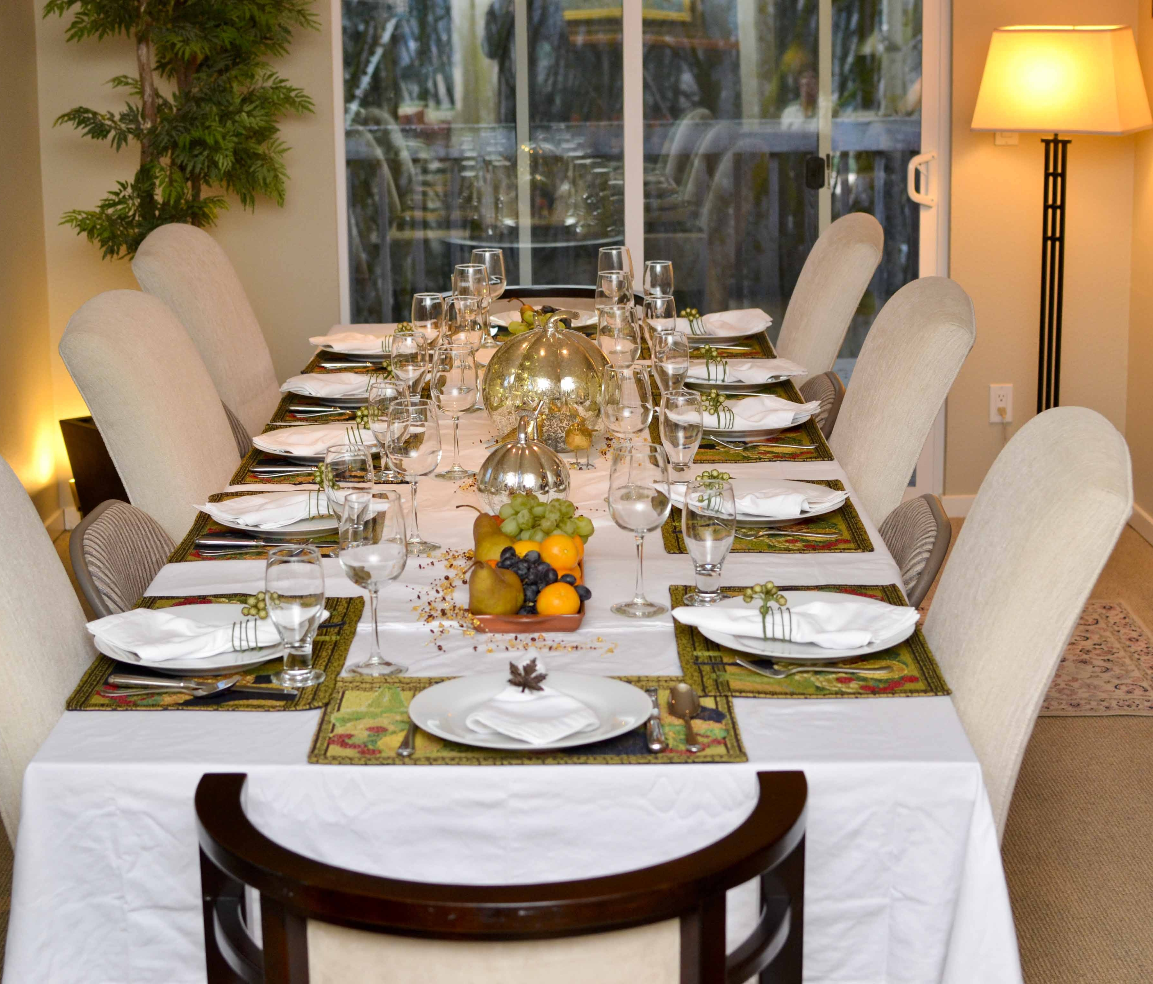
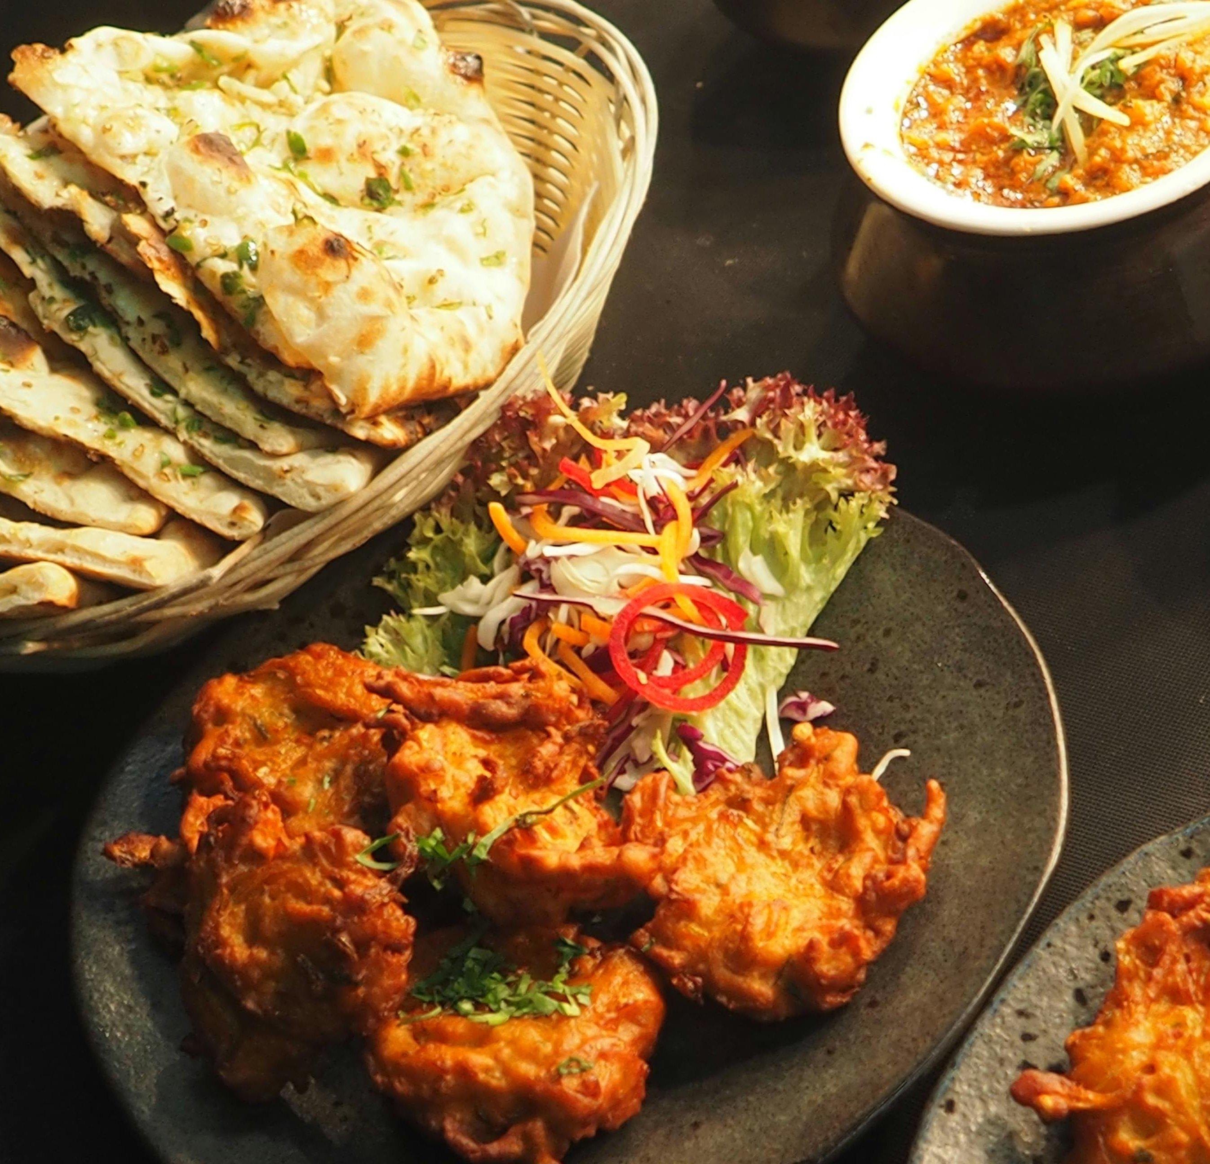
LADYWOOD RESTAURANT
Ladywood restaurant is a small, family mediterranean restaurant in Birmingham, UK.
Our restaurant unique point is serving farm-to-table and faithful to serving fresh food locally sourced, seasonal cuisine and warm welcoming atmosphere.
Ladywood restaurant mission is to reconnect community with traditional food by highlighting the regional test of produce.
Our target audience is enthusiasts and health-conscious diners who value quality, professionals who are seeking cosy dining experience.
Ladywood restaurant growing consumer demand for healthy eating, ethically sources (produce locally) food by partnering directly with local farmers and producer’s organic supplier.

Slide 4

Legal format
Ladywood restaurant is a limited company that provides protection from personal lability.
Our limited company is owned by members who have invested in the business as the name suggests they enjoy limited liability.
The company can gain credibility with suppliers and customers compare to a sole proprietorship.
Day to day management is separate from the ownership and undertaken by a CEO or board of directors, with core principle that they act in the interest of the company.
General communication for management to post important updates like policy, compliance, holiday hours, or promotions staff schedule due weekly shift changes and availability updates.

Slide 5
management structure
Manager has responsibility on daily operations, staff and customer service.
Assistant manager helps with scheduling and training staff.
Head chef in charge of the kitchen and menu.
Front of the house help with service host, communication, upcoming reservation and coordinate seating,
Our cleaner keeps restaurant clean before/after hours.

Slide 6
Marketing management plan
Ladywood restaurant building online platform on social media, we are posting short videos of cooking process, our staff, and events, behind the scenes on TikTok, Instagram, and Facebook.
Our Marketing tam working professionally to build a website on google.
We are adding our restaurant into google map to show our customer opening hours, contact information, and menu list.
We are taking online order such as Uber eat, and Just eat.
Our offer is 50% off on the first day of opening to promote and create loyal customer.

Slide 7
        PESTEL Analysis
PESTLE Analysis stands for six categories of macroeconomic ( Political, Economic, Socio-Cultural, Technological, Legal and Environmental).
Political: Government policies, political stability, trade regulations, and taxation.
Economic: Economic growth, inflation rates, interest rates, and consumer spending.
Technical: Technological advancements, automation, and digital disruption.
Legal: Laws and regulations such as consumer law, data privacy, and employment legislation.
Socio-Cultura: Demographic changes, cultural shifts, social trends, and consumer.
Environmental: Climate change, sustainability initiatives, pollution, and resource availability.
PESTLE Analysis is a strategic plan for business to understand the external macro-environmental factor that effect their operations.

Slide 8
Table PESTLE analysis AND
DISADVANTAGE
Political Factors | Economic factors | Social Factors | Tectological Factors | Legal Factors | Environmental Factors
European commission world trade organization, Brexit. Rising food cost ingredients especially for high-quality Mediterranean farm food. | Government international trade policies. Inflation and changes in consumer spending habits. | Distribution of income lifestyle Health. Choos to dine out less frequently. Stuff struggles to keep up with demand. | The internet revolution. Uber Eat, Just Eat taking the restaurant’s customer they are looking cheaper and faster. | Tax rates Labor laws Trade laws. Discretionary spending, could be a legal impact that the tax rates, people cannot spend more. | Environmental standards renewable energy, recycle. Lacks innovation, it can be environmental impact. Some people want to go a restaurant which is environmentally friendly.

Slide 9

Specify the amount of funding and government support
There are many methods to fine your business funding.
For business loan a company must approach bank from the bank and from the government to access funding.
There are some loans non-repayable, it can be great full for startups a new business.
To find those opportunities such as non-repayable grants, the Kink’s trust provides non repayable grant and loans up to 300,000 to cover new business.
Ladywood restaurant applied to Kink’s trust for an investment of £200,000 to start funding to cover our Restaurant setup, kitchen, equipment, marketing and our staff recruitment.
We needs to put our business plan together act professionally, have multiple shareholders, and investors to get that amount of funding to setup our business.

Slide 10
Chash in | Month
Loan- start-up capital | £12000
Sales (total sales of product and/or services) | £4,666
Other | £0
Total cash in-flows (A) | £16,666
Chash out expenses | Month
Rent or premises costs | £1500
Business rates for your business premises | £1000
Utilities (gas, electricity, water) | £2000
Insurance | £1000
Telephone and internet | £1500
Marketing and advertising expenses | £1000
Vehicle running costs | £1000
Equipment purchases or leasing | £1500
Postage, printing, stationery | £1000
Transport and delivery | £1000
Professional fees (legal, accounting etc.) | £500
Cost of sales (Cost of product) | £1000
Wages your own | £1000
Staff wages | £1666
Any other | £0
Any other | £0
Total cash out-flows (B) | £16,666
Your net cash flow (A-B) | £16,666

Slide 11

      Thank you for listening!
Any question?

