Slide 1


Who We Are
A charity dedicated to empowering individuals from minority ethnic backgrounds
Supporting personal development through sports, education, and mentorship
Creating pathways for youth to thrive and transition confidently

Slide 2

Renew Mind Centre Awards
Celebrating Progress, Opportunity & Potential
Nurturing resilience, growth, and community success
Honoring the journeys of those overcoming challenge

Slide 3

Our Mission
Provide access to quality education and sports programs
Encourage holistic, mental, emotional, and physical development
Address underrepresentation in key sectors through skills and guidance
Maximising Potential Through Support & Opportunity
Champion music and the arts as tools for expression and community building.
Inspire young people to care for others and support local and global causes.

Slide 4
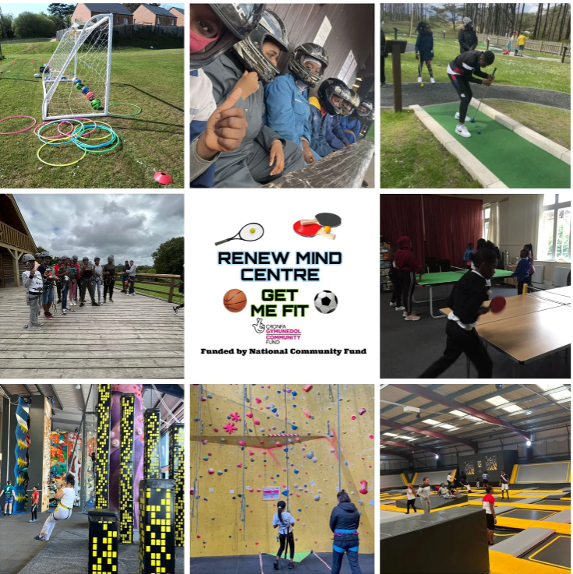
The Power of Sports & Education
Sport builds discipline, teamwork, and confidence
Education lays the foundation for long-term success
Together, they transform lives and open new doors

Slide 5

Opportunities in the Sector
Pathways Into the Sports & Education Sector
Coaching, physiotherapy, sports psychology, education support roles
Career workshops, training, and internships provided by Renew
Representation matters — we need diverse voices in decision-making roles

Slide 6

Our Impact
Stories of Change
100+ young people and family units supported into sports participation and further education
Growing national partnerships to expand impact

Slide 7

Want to make a difference? Get involved
Volunteer your time or expertise
Partner with us for mentorship or placement programs
Donations go directly toward life-changing support
Join us in celebrating our champions and honoring the dedication of our young people and community leaders​
Let’s applaud those pushing boundaries and creating new paths​
Together, we rise​

