Slide 1
Precise Brickwork Ltd
Business Plan Presentation
Jason Holmes
Student ID: 2441865
Lecturer:

Slide 2
Table of Contents
Executive Summary
Business Description
Legal Structure
Management Structure
Market Analysis
Pestel Analysis
Services
Marketing Strategy
Operations Plan
Financial Plan
SWOT Analysis
Conclusion

Slide 3
Summary
Bricklaying + training business
Addresses skills shortage
Income from construction + training

Slide 4
Business Description
Construction & training company
Provides high-quality brickwork
Offers hands-on training

Slide 5
Legal Structure
Limited Liability Company
Protects personal assets
Professional image
Supports growth

Slide 6
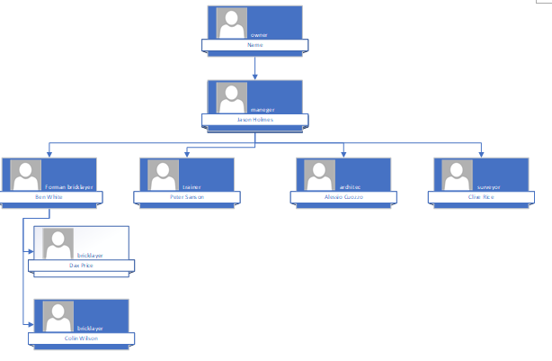
Management Structuretgted

Slide 7
Market Analysis
Target: homeowners, developers, trainees
High demand for bricklayers
Skills shortage

Slide 8
PESTEL Analysis
Political:
* housing investment
* Apprenticeships
Economic:
* inflation impact
* Economy may reduce demand
Social:
* trade demand
* Trade Shortage
Tech:
* social media
* Social Media Marketing
Environmental:
* Sustainability
* Adverse Weather
Legal:
* safety laws
* Employment insurance

Slide 9
Services
Bricklaying: walls, extensions, repairs
Training: beginner courses, on-site learning

Slide 10

Marketing Strategy
Social media promotion
Word of mouth
Focus on personal relationships
Build trust & repeat business

Slide 11
Operations Plan
Owner-led business
Small team
Training on-site

Slide 12
SWOT Analysis
Strengths: skills + dual income
Weaknesses: new business
Opportunities: demand
Threats: competition

Slide 13
Financial Plan
Startup cost |  |  | Fixed Costs | per month
Website | £200 |  | van hire | £300
Deposit for veachal | 1600 |  | Accountant | £150
Matirals + equapmant | 1200 |  | insurance | £200
Total | £3,000 |  | rent | £250
 |  |  | Total cost | £900

Slide 14
Variable Costs | Jan | Feb | Mar | Apr | May | Jun | Jul | Aug | Sep | Oct | Nov | Dec
utilities | £400 | £440 | £480 | £520 | £560 | £600 | £640 | £680 | £720 | £760 | £800 | £840
Petrol | £200 | £220 | £240 | £260 | £280 | £300 | £320 | £340 | £360 | £380 | £400 | £420
Equapment | £250 | £275 | £300 | £325 | £350 | £375 | £400 | £425 | £450 | £475 | £500 | £525
Weges | £2,000 | £2,080 | £2,160 | £2,240 | £2,320 | £2,400 | £2,480 | £2,560 | £2,640 | £2,720 | £2,800 | £2,880
Total Var cost | £2,850 | £3,015 | £3,180 | £3,345 | £3,510 | £3,675 | £3,840 | £4,005 | £4,170 | £4,335 | £4,500 | £4,665

Slide 15
 | Jan | Feb | Mar | Apr | May | Jun | Jul | Aug | Sep | Oct | Nov | Dec
Fixed | £900 | £900 | £900 | £900 | £900 | £900 | £900 | £900 | £900 | £900 | £900 | £900
Variable cost | £2,850 | £3,015 | £3,180 | £3,345 | £3,510 | £3,675 | £3,840 | £4,005 | £4,170 | £4,335 | £4,500 | £4,665
Total cost | £3,750 | £3,915 | £4,080 | £4,245 | £4,410 | £4,575 | £4,740 | £4,905 | £5,070 | £5,235 | £5,400 | £5,565
Revenue | £3,250 | £3,750 | £4,250 | £5,750 | £6,250 | £6,750 | £7,250 | £7,750 | £8,250 | £8,750 | £9,250 | £9,750
Profit/loss | -£500 | -£165 | £170 | £1,505 | £1,840 | £2,175 | £2,510 | £2,845 | £3,180 | £3,515 | £3,850 | £4,185
Investment capital needed = £3700

Slide 16
Conclusion
Strong growth potential
Meets market demand
Focus on quality & relationships

