Slide 1
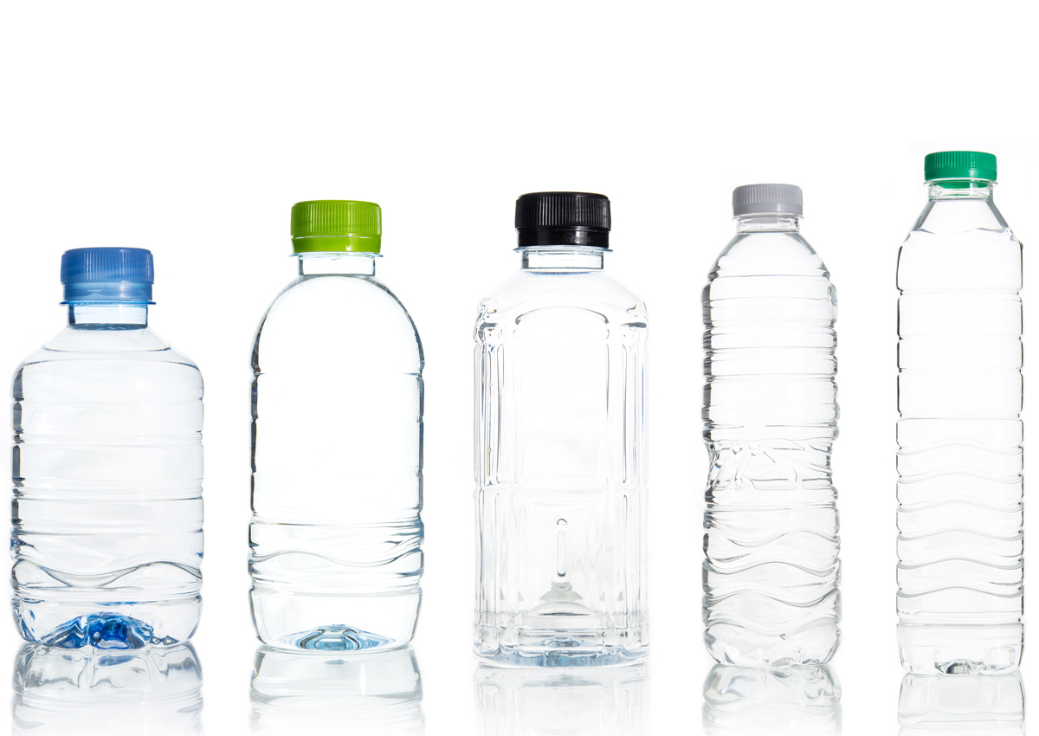



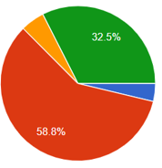
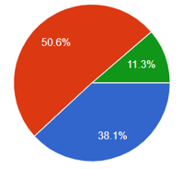

Reuse Behaviour: A Study of Consumer Perception Towards Reusable Containers
By Chloe Wilson (1810485)
Historically, reusable packaging has been used in certain sectors in the UK for decades.
This system has significantly declined since 1950, largely due to the discovery of polypropylene and the production of plastics for packaging purposes.
Today, reuse systems are viewed as an essential solution to reduce plastic pollution, reduce waste and achieve long-term sustainability.
The adoption of reusable containers is subject to consumer acceptance as the transition required involves individuals to change long-term shopping behaviours.
Methodology
Saunders Research Onion
Analysis and Discussion
Introduction
Closed-ended questions were statistically analysed using the IBM SPSS Software, specifically using the Mann-Whitney U Test.
The tests revealed that there were significant differences between general shoppers and zero-waste shoppers based on convenience, branding, packaging material, product label information and environmental concerns.
Empirical findings were largely similar to the literature review findings.
A deductive, ‘top-down approach’ was used for this study, specifically using a single quantitative mono method.
Surveys in the form of a questionnaire were created on Google Forms and 11 questions were selected which included a variety of closed-ended and open-ended questions.
Data was collected via Facebook and a total of 320 responses were obtained which ensured the data was representative of the population, reliable and valid.
Social desirability bias was identified as a limitation and ethical standards were considered.
Research Questions
If consumers are extremely aware of the environmental impact of single-use plastic packaging, will they seek sustainable alternatives?
Are consumers who live in West Wales aware of what a zero-waste store is?
What are the benefits and barriers of reusable container adoption from a consumer perspective?
Will there be different behaviours, perspectives and motivations between general shoppers and zero-waste shoppers?
Can consumers be encouraged by society to adopt a sustainable lifestyle?
Is there a need for incentivisation or legislation with regards to reusable containers?
Literature Review
Conclusion and Recommendations
If environmental awareness is increased then this will potentially inspire eco-friendly behaviour and have an impact on purchasing decisions (Borden,1997).
Many shoppers seek eco-friendly packaging once aware of the impact of single-use plastic, however, this is balanced against benefits including convenience (Lindh, et al 2016).
Consumers impulse purchase rather than take rational action (Stern,1962).
Enforcing taxes or providing incentives must be considered to encourage consumers to change long-term shopping behaviours (Welsh Government, 2020).
It would be necessary for Governments or businesses to take action to encourage general shoppers to use reusable containers.
This can be achieved through incentivisation rather than enforcement. For example, The Nudge Theory is a potential resource for Governments as well as businesses as it can be used to implement changes progressively without restricting freedom of choice.
Legislation would be challenging as it requires long-term habitual behaviours and motivations to be changed.
Recommendations include increasing awareness of reuse systems, increasing refill system accessibility and introducing vending machines.
General Shoppers
Main Findings
Zero-Waste shoppers
References
References
Borden, R. (1997). One More Look at Social and Environmental Psychology: Away from the Looking Glass and into the Future. Personal Soc Psychol Bull, 407-411
Lindh, H. Olsson, A, & Williams, H. (2016). Consumer Perceptions of Food packaging: Contributing to or Counteracting Environmentally Sustainable Development? Packaging Technology and Science, 1-23.
59% would be prepared to bring their own containers to a store to purchase products.
89% stated that they would or that they already do bring their own containers to a store.
Stern, H. (1962). The Significance of Impulse Buying Today. Journal of Marketing, 59-62
Welsh Government. (2020). Beyond Recycling: A Strategy to make the circular economy in Wales a reality. The Welsh Government

