Slide 1
Young People in Focus
Kirsty Allen | 2014114
ECYW6003 | Alana Enoch

Slide 2
Slide 1:
Hello, I’m Kirsty and I’m a student here studying youth work and social education, I will be exploring young people in focus with you. We will be talking about some sensitive issues today so if any point you would let to step out, feel free to do so. A lecturer will be able to provide further support should you need it.
*PowerPoint notes.

Slide 3
Agenda:
Issues facing young people
What are ACEs
Care leavers and their experiences of ACEs
Short term and long-term effects
Building resilience
Interventions for health and wellbeing
Lessons for youth work practice
Policies for interventions

Slide 4
Slide 2:
Today I will be looking into young people and exploring their experiences of adolescence and ACES, in particular leaving care young people and interventions that have been proven to enhance their health and wellbeing and look into lessons for youth work practice combined with polices and interventions.
*PowerPoint notes.

Slide 5
Young People in Focus.
Issues facing young people.

Slide 6
Slide 3:
What issues are facing young people today?
*PowerPoint notes.

Slide 7
Issues facing young people today?
Accommodation
Social media
Family life
Education and employment
Peer pressure
Mental health difficulties
Body image anxieties
Uncertainty
Sexual activity
Drug use
Alcohol Use
Finical struggles
Crime and violence
Covid disadvantages
LGBTQIA
Identity
Ambition
Lack of opportunities
Self esteem and confidence
Isolation
Community

Slide 8
Slide 4:
Let’s have a look at some of the issues that young people face today.
To name a few,
Confidence and self esteem
Education and job opportunities
Finding their place in society and being part of their community
Accommodation
Financial worries and cost of living crisis
And if you think about all issues facing young people in their transition to adulthood, imagine the impact that covid has had, making these issues even more prominent and being as issue on its own. However, imagine again the impact of everyday issues has on young people with ACEs.
*PowerPoint notes.

Slide 9
Young People in Focus.
Adverse childhood experiences.

Slide 10
Slide 5:
Let’s dive more into ACEs?
What are ACEs? Adverse childhood experiences.
Wisner (2022) Explains that ACES are traumatic experiences that children experience before the age of 18 that can have lasting impacts on their mental health, physical health, and general well-being.
*PowerPoint notes.

Slide 11
16 Strong Project
Recurrent physical, sexual or emotional abuse
Emotional or physical neglect
Domestic violence between parents
Alcoholic parent(s)
Substance abusing parent(s)
Incarcerated family member
Living with someone who is chronically depressed
Suicidal, institutionalized or mentally ill family member
Living with one or no biological parents (includes divorce)
Chronic or terminally ill family member
Loss of a family member or close friend
Bullying
Inability to afford food and housing
Homelessness
Experiencing racism
Violent neighbourhood
Weather related issues (e.g. hurricane, tornado)
Pandemic
(16 Strong Project, 2020).

Slide 12
Slide 6:
16 Strong Project (2020) identify these eighteen issues as ACEs, they explain their aim is to enhance peoples knowledge and understanding about ACEs and provided them with resources to help adolescents navigate their way through life.
16 strong project (2020) reported:
Over 60% of youths aged 17 and younger have been exposed to crime, violence and abuse.
39% of children ages 12 to 17 reported witnessing violence.
17% of children aged 12 to 17 reported being a victim of physical assault.
8% of children aged 12 to 17 reported being the victim of sexual assault.
*PowerPoint notes.

Slide 13
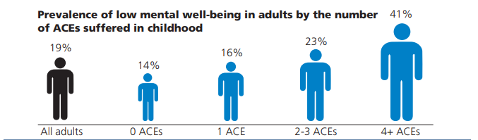
Public Health Wales:
47% of adults in Wales suffered at least one ACE in their childhood
14% suffered four or more
(Public Health Wales, 2016).

Slide 14
Slide 7:
Public health Wales (2016) states that:
47% of adults in Wales suffered at least one ACE in their childhood.
14% suffered four or more.
And for those who had suffered from ACEs had reported lower wellbeing and the more ACEs they had experienced the lower they reported their mental health, sowing the long term effect ACEs have on their mental wellbeing.
The area of young people experiencing ACEs that we that we are going to explore today are care leavers in particular.
*PowerPoint notes.

Slide 15
Young People in Focus.
Care leavers and their experiences of ACEs.

Slide 16
Slide 8:
Care leavers and their experiences of ACEs.
*PowerPoint notes.

Slide 17
0 ACE | 1 ACE | 2 ACEs | 3 ACEs | 4+ ACEs
Care leavers are more likely to take part in risky behavior.
There are currently over 70,000 children who are looked after in the UK and last year alone 11,000 16, 17 or 18 year olds left local authority care. Adverse childhood experiences such as abuse, neglect, or witnessing domestic violence can all impact on a child’s developing brain and statistics show these results in much higher levels of mental health problems in looked after children and care leavers, than in the general population.
45% of looked after children (and 72% in residential care) have a mental health disorder – compared to 1 in 10 in the general population; and looked after children and care leavers are between four and five times more likely to attempt suicide in adulthood.
(Smith, 2017).
RISK

Slide 18
Slide 9:
Smith (2017) explains that care leavers and looked after young people have experienced ACEs just by being placed in the care system. Pre-care experiences of abuse or neglect are categorised as an ACE, as is the act of going into care itself. For this reason, all looked after children and care leavers considered to be at-risk from the long term affects on mental health and wellbeing and life satisfaction.
Emerging evidence indicates that ACEs can increase the risk of a young person engaging in risky behaviours, and the more ACEs a young person experiences the more risks they are exposed to and likely to take.
*PowerPoint notes.

Slide 19
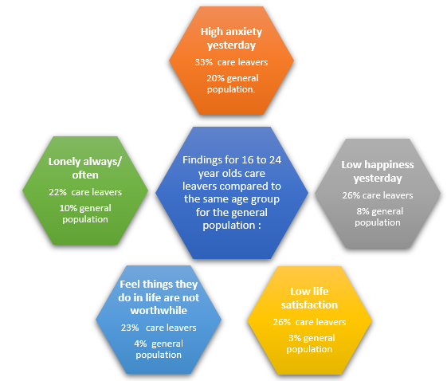
(Barnardo’s, 2022).

Slide 20
Slide 10:
Barnardo’s (2022) explain that care leavers report higher levels of stress and chronic loneliness that rise with age compared with young people in the general population where both stress and feelings of loneliness decrease with age, possibly because support services fall away at 18 and care leavers are left feeling the long-term impact of maltreatment and trauma experienced as children.
*PowerPoint notes.

Slide 21
Young People in Focus.
Short term and long term effects.

Slide 22
Slide 11:
Adolescent brain development with ACEs, short term and long tern affects.
*PowerPoint notes.

Slide 23
How do ACEs effects adolescent development?
Mental health issues which occur
Experience reactionary coping skills and behaviours
Functions negatively affected
Anxiety disorders
Depression
Feelings of worthlessness and hopelessness
Memory difficulties
Troubles regulating emotion
Problems concentrating
A change in routine thinking processes
Changes in behaviours
Yelling
Crying
Physically attacking a perceived danger
Shutting down emotionally
Hyperawareness (hypervigilance)
Consistent feelings of dread
Manipulating an environment in order to find perceived safety
Feeling the need to control everything in life
Organising thoughts and problem-solving
Foreseeing and weighing possible consequences of behaviour
Considering the future and making predictions
Forming strategies and planning
Ability to balance short-term rewards with long-term goals
Shifting/adjusting behaviour when situations change
Impulse control and delaying gratification
Modulation of intense emotions
Inhibiting inappropriate behaviour and initiating appropriate behaviour

Slide 24
Slide 12:
Davis (2019) explains that adolescence is a time of significant growth and development for the brain. The main change is that unused connections to the brain are ‘pruned’ away. At the same time, other connections are strengthened.
However, exposure to ACEs during influential development periods, such as childhood, can alter brain development and result in long run changes to stress response. Leading to impaired development of areas of the brain involved in logical thinking and memory.
On the other hand, areas involved in emotional responses become more active, resulting in that person becoming more vigilant to threatening information. Together, these changes may result in difficulties in regulating emotions, making decisions, and managing stress.
The Prefrontal Cortex. This area of the brain is located in the front and is vital for memory and attention plus emotional regulation and behaviour regulation. Interestingly, it is also necessary for inhibition, reasoning, and abstract thinking.
A young person experiencing ACEs, is likely to be flooded with stress hormones, in this portion of the brain, leading to when the brain is fully developed, it will be smaller than a young person who hasn’t experienced ACEs.
Meaning that once the brain starts cutting the unused connections, the brain continues to develop from the disadvantage stage and strengthening the damaged areas meaning the young persons brain is injured and when they become adults, they may be incapable of processing emotions and handle challenges adequately. Leading to adults, with severe personality and other problems directly related to their adverse childhood experiences.
*PowerPoint notes.

Slide 25
Short term affects
Eating disorders
Sexual health
Risk of injury
Sleep disruption
Fear
Loneliness
Emotional burnout
Soft skills impacted
Puberty/ Menstrual disorders
Mental heath
Heart disease
Brain development
Week immune system
Brain development
Long term affect to decision making, attention and learning
Maternal and child health problems (including teen pregnancy, pregnancy complications, and fetal death)
Cancer
Diabetes
Heart disease
Suicide
Soft Skills undeveloped
Long term affects

Slide 26
Slide 13:
Care leavers with ACES are more likely to take part in risky behaviour than young people in general, not only leading to short term problems but to long term health issues, as well as long term mental health issues.
There is an increase of leaving care young people are engaging.
McCowen (2022) explains that all young people face issues as they transition into adulthood. However, young people that have experienced ACEs such as care leavers are unable to deal with them as positively as young people in the general population. Whereas they often have a close family network to help and support them, care leavers do not have that support network to help them make choices and guide them on their chosen path.
There are many short-term issues that are caused by ACEs however they often develop into long term issues and have a server impact on bot both physical and metal health.
*PowerPoint notes.

Slide 27
Young People in Focus.
Building resilience.

Slide 28
Slide 14:
Why is building resilience important?
*PowerPoint notes.

Slide 29
Resilience has been described as the capacity for positive outcomes despite challenging or threatening circumstances.
“
”
Byron Egeland et al, (1993).

Slide 30
Slide 15:
Quote
*PowerPoint notes.

Slide 31
How can we build on young people’s resilience?
Give them hope
Social support
Problem solving skills
Control on their own choices
Optimism
Local resources
Flexibility in goal setting
Confidence
Self efficiency
Social opportunities
Good health
Praise
Why is building resilience important?
See challenges
Commit to goals
Focus on what they can control
Don’t blame themselves
Enables them to be empathic
Helps them think positively

Slide 32
Slide 16:
How can we build on young people’s resilience?
By providing young people with support networks and interventions to build on their resilience, can help them see challenges and commit to goals whilst developing their soft skills and helping them achieve a better quality of life.
*PowerPoint notes.

Slide 33
Building Care Leavers resilience
Problems, challenges and services.
Risk Factors | Protective factors
Leaving Care | YPA service
Self esteem and confidence | Bloom Service
Family and relationship issues | Mediation – Supported lodgings
Fanatical issues | Care leaving grants and BIB payment
Lack of independent living skills | Training flats
Work and education | NEETS
Alcohol and drug use | Barod
Social and community | Bloom service
Accommodation | Supported loggings
Heath issues | Local Doctors and health services
Transitioning into adulthood | Above services

Slide 34
Slide 17:
Building care leavers resilience, what problems they face and what services are available.
These are some issues affecting care leavers and the services are available build their residence and build support networks.
*PowerPoint notes.

Slide 35
Young People in Focus.
Interventions for health and wellbeing.

Slide 36
Side 18:
Interventions which have proven to enhance health and well-being and mitigate adversity.
Carranza (2022), explains that positive interventions help transform trauma and toxic stressed caused by ACEs into resilient Attitude helping young people build connections, develop healthy energy, and strengthen skills needed to achieve their personal and professional goals and transition into adulthood prepared to take on challenges in a healthy way.
*PowerPoint notes.

Slide 37
Interventions
Cognitive‐behavioural therapy
Life Coaching
Acceptance and commitment therapy
Build Knowledge
Build Practice
Build Community
Pledge cards
Goal setting and creating plans

Slide 38
Slide 19:
Parton (2005) explains that interventions should be developed to use within practice, by challenging the way young people think and teaching them new problem solving and coping skills, we are helping them prevent problems in their future before they occur and help bring in preventative measures into practice.
*PowerPoint notes.

Slide 39

Bloom project
Life Coaching - Coaching gives young people the power to unlock their own potential for positive change, by providing them with the tools to build resilience, improve wellbeing and understand themselves better. Coaching empowers young people to think about and move forward positively in their lives, by creating and working towards specific goals
Volunteer support, befriending and peer mentoring
  Volunteers – to help with activities and provide an adult mentor where this is considered more appropriate
  Befriending - members of the local community to befriend and provide ongoing assistance to vulnerable young people who have moved to independence from the ‘looked-after’ system
  Peer mentors slightly older care leavers who will guide their young people through the complex process of leaving care and moving to independent living by drawing on their own experiences
Activities – regular opportunities to get together to experience activities not easily accessed by care leavers, group events and regular supper clubs
Out of hours support – the intention is to provide some out of hours support into early evenings and weekends as this is often when vulnerable care leavers are at their most isolated and lonely
(Barnardo’s, 2022).

Slide 40
Slide 20:
Bloom
*PowerPoint notes.

Slide 41

Transitional Training Flats
The Transition and Training Flats Service aims to enable young people 16+ to make informed decisions in their journey to independence by providing young people with the practical experiences, skill building opportunities and qualifications which will evidence their readiness for their chosen pathway therefore reducing the number of failed tenancies for vulnerable young people. The service provides training flat experiences and one to one independent living and life skills support for young people aged 15 to 25 living in care, semi-independently or independently.
Health & Well-being
Housing
Benefits
Finance & Budgeting
Education & Training
Employment & Careers
Practical support
Their future
(Barnardo’s, 2022).

Slide 42
Slide 21:
Training flats
*PowerPoint notes.

Slide 43
Young People in Focus.
Lessons for youth work practice.

Slide 44
Slide 22:
Lessons for youth work practice:
You need to be considerate with young people with ACEs. Leaving care young people may still be vulnerable and would have experienced ACEs in their life. You need to take the time to listen to them, understand their needs and work with them to develop their future.
*PowerPoint notes.

Slide 45





Slide 46
Slide 23:
Youth work practises should strive to increase young people’s wellbeing and takes a young person centred approach. According to Principles and Purposes of Youth Work in Wales (2022) youth work should start at whatever point a young person is with their life and recognise their full potential. As well supporting young people’s wellbeing and realising this part of the core values of youth work.
The National Youth Work Strategy for Wales 2014-2018 (Welsh Government, 2014) notes that voluntary engagement is one of the fundamental aspects of youth work and that all young people should choose to engage in the service and the provisions it provides. Practices should work to build and maintain a voluntary relationship with young people, and they are more likely to engage with workers and activities when they choose to, knowing that workers are there to work flexible with them and keep the young person involved with the planning prosses. This is another strength all practises should do when working and supporting young people.
To learn more about these and how you can ensure them in your youth work practice, I have included the links at the end.
*PowerPoint notes.

Slide 47
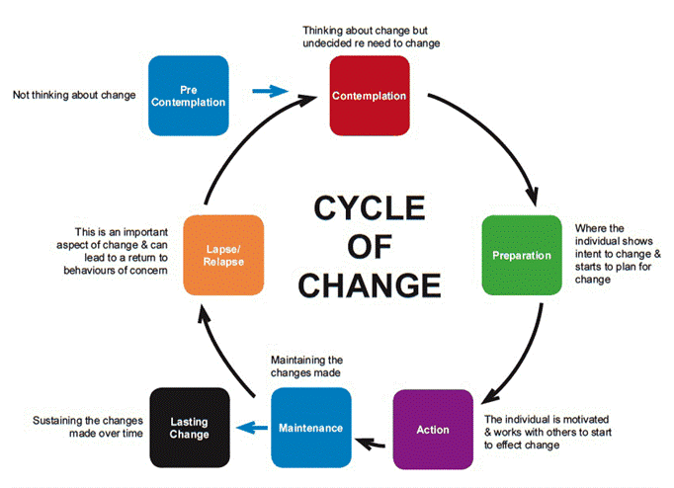
(Scottish Government , 2012).

Slide 48
Slide 24:
Cycle of change:
Prochaska and DiClemente (1983) explain that these stages of change play and important role for a young people to change their habits and work towards a better future. The key part being contemplating and rejecting change is this could be because the young person is unsure of new services or hasn’t built a repour with a worker yet. And preparation is where we step up our game and help motivate the young person.
Young people do not like being told what to do, none of us do. We do not like to be pushed. So when a young person is in pre contemplation mode, we need to help them carefully and in the right way, we need to be reassuring and let them know we are here for them.
And then when they are ready to take action, that’s when we step in with our resources, getting them motivated with easy to reach step to reaching their goals.
*PowerPoint notes.

Slide 49
What to include in Interventions?
Helping young people find purpose.
Helping young people to believe in themselves.
Helping young people develop a social network.
Help young people embrace change.
Helping young people become optimistic.
Help young people develop problem-solving skills.
Help young people establish goals and take steps to reach them.
Helping young people build on their skills
Helping young people develop their knowledge of the community and become a part of it.

Slide 50
Slide 25:
What to include in your interventions with young people?
Helping young people find purpose.
Helping young people to believe in themselves.
Helping young people develop a social network.
Help young people embrace change.
Helping young people become optimistic.
Help young people develop problem-solving skills.
Help young people establish goals and take steps to reach them.
Helping young people build on their skills.
Helping young people develop their knowledge of the community and become a part of it.
By incorporating these into your intervention practice you are working with The Youth Work in Wales National Occupational Standards (CLD standards council Scotland, 2019) by enabling young people to identify, reflect and use their learning to enhance their future development and by engaging with young people to promote their emotional wellbeing and mental health through interventions and activities to support and explore their emotional health and wellbeing and through planning and teaching coping strategies.
*PowerPoint notes.

Slide 51
Skills and Tools
Skills
  Open Questions
  Affirmations
  Reflective Listening
  Summaries
  Signposting abilities
  Be engaging, open and honest
Tools
  Session and activity plans
  Scaling questions
  Pros and Cons
  Skill building worksheets
  Planning
  Goal setting

Slide 52
Slide 26:
What skills and tools do you need for planning interventions with young people?
*PowerPoint notes.

Slide 53
Young People in Focus.
Policies for interventions.

Slide 54
Slide 27:
What are some policies to support interventions?
*PowerPoint notes.

Slide 55
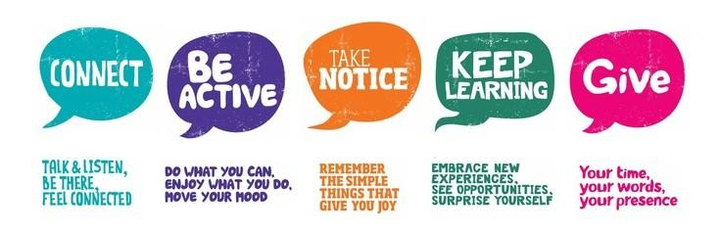
Policies to support interventions
  5 ways of Well-being
  The Well-being of Future Generations Act
  Care Leavers Strategy
(Mind , 2023).

Slide 56
Slide 28:
Youth work and mental health wellbeing go hand in hand and Mind (2023) explain 5 ways of well-being is a 5 step process you can take to help improve your mental health and wellbeing, these are connected, be active, take notice, keep learning and give. By influencing policy to include these steps we are able to create a step-by-step process to focus on young people’s wellbeing.
The Well-being of Future Generations Act requires public bodies in Wales to think about the long-term impact of their decisions, to work better with people, communities, and each other, and to prevent persistent problems such as poverty, health inequalities and climate change.
Care Leavers Strategy (HM Government, 2013). Care leavers should expect the same level of care and support that other young people get from their parent. Our strategy is based on the principles of good corporate parenting. It sets out the government’s commitment to remove some of the practical barriers that care leavers face as they progress into adulthood.
*PowerPoint notes.

Slide 57
Summary
Whatever intervention method you chose to do with your young people, remember to keep The Youth Work in Wales National Occupational Standards (CLD standards council Scotland, 2019) at the heart of it, by maintaining and building your relationships with young people, you build relationships and trust with them. Help plan and prepare their learning, developing their skills. Help them access resources and sign post them, so they can make informed decisions. Use your interventions to help young people explore their mental health and well-being to build reliance and develop coping mechanisms, making use of all resources, networks and series available.

Slide 58
Slide 29:
To summarise adverse childhood experiences can have a range of serious negative impacts Laurance (2022) explains that there is a need to understand what interventions are effective to improve outcomes for young people who have experienced ACEs most approaches focus on migrating the individual from psychological harms however there needs to be more approaches that address the social pathways which may mediate the negative impacts of ACEs.
Whatever intervention method you chose do to with your young people, remember to keep The Youth Work in Wales National Occupational Standards (CLD standards council Scotland, 2019) at the heart of it, by maintaining and building your relationships with young people, you build repours and trust with them. Help plan and prepare their learning, developing their skills. Help them access resources and sign post them, so they can make informed decisions. Use your interventions to help young people explore their mental health and well-being to build reliance and develop coping mechanisms, making use of all resources, networks and series available.
*PowerPoint notes.

Slide 59
Thank you
Kirsty Allen
2014114@student.uwtsd.ac.uk
Any questions?
ECYW6003 | Alana Enoch

Slide 60
Slide 30:
Thank you questions?
*PowerPoint notes.

Slide 61



Useful links:
Bloom
Barnardosswansea@barnardos.org.uk
NEET with Evolve
Evolve@abertawe.gov.uk
Training Flats
Barnardosswansea@barnardos.org.uk
Barnardosswansea@barnardos.org.uk
Barod
Info@barod.Cymru
01792 472002
Supported loggings
01792 797289
01792 484010
01792 797289
01792 797289
1
2
3
4
5

Slide 62
Slide 31:
I have included some useful links to support services available and I have added in some resources to your pack to help build reliance.
*PowerPoint notes.

Slide 63
References:
16 Strong Project. (2020) Children and Trauma. Available at: Did You Know? — 16 Strong Project (Accessed 14th January 2023).
Barnardo’s. (2021) Barnardo’s & the Moondance foundation supporting care leavers in Wales. Barkingside: Barnardo’s.
Carranza, J. (2022) You are here | You are ready | Life Coaching | It’s Time. Available at: ACES LIFE COACHING (Accessed 14th January 2023).
CLD standards council Scotland. (2019) The youth work in Wales National occupational standards. Cardiff: CLD standards council Scotland.
Davis, S. (2019) Adverse Childhood Experiences and Changes to the Human Brain. Available at: Adverse Childhood Experiences and the Changes to the Human Brain | CPTSDfoundation.org (Accessed 14th January 2023).
Egeland, B., Carlson, E., & Sroufe, L. A. (1993) Resilience as process. Development and psychopathology, 5(4), 517-528.
HM Government. (2013) Care Leavers Strategy. Available at: Care Leavers Strategy (publishing.service.gov.uk) (Accessed 14th January 2023).
Lorance, T. (2020) Interventions to support people exposed to adverse childhood experiences: systematic review of systematic reviews. Available at: Interventions to support people exposed to adverse childhood experiences: systematic review of systematic reviews | BMC Public Health | Full Text (biomedcentral.com) (Accessed 14th January 2023).
McCowen, H. (2022) Care Experienced Young People Need Protection From The Cost Of Living Crisis. Available at: Care-experienced young people need protection from cost of living crisis | CYP Now (Accessed 14th January 2023).
Mind. (2023) 5 ways of wellbeing. Available at: Five ways to wellbeing - Mind (Accessed 14th January 2023).
Parton, N. (2005) Safeguarding Childhood: Early Intervention and Surveillance in a Late Modern Society. London: Palgrave Macmillan.
Prochaska and DiClemente (1983) Stages and Processes of Self-Change: Toward An Integrative Model of Change. Journal of Consulting and Clinical Psychology, 1983, Vol. 51, No. 3, 390-395
Public Health Wales. (2016) Adverse Childhood Experiences. Available at: https://phw.nhs.wales/files/aces/ace-and-their-association-with-mental-well-being-in-the-welsh-adult-population-pdf/ (Accessed 14th January 2023).
Scottish Government. (2012) National Risk Framework to Support the Assessment of Children and Young People. Available at: THE CYCLE OF CHANGE - National Risk Framework to Support the Assessment of Children and Young People - gov.scot (www.gov.scot) (Accessed 14th January 2023).
Smith, N. (2013) Neglected Minds. Available at: neglected-minds.pdf (barnardos.org.uk) (Accessed 14th January 2023).
Welsh Assembly Government. (2015) Well-being of Future Generations (Wales) Act 2015. Cardiff: Welsh Assembly Government.
Welsh Government. (2014). The National Youth Work Strategy for Wales 2014-2018 Supporting young people to reach their potential and live fulfilled lives. Cardiff: Welsh Government.
Wisner, W. (2022) What are adverse childhood experiences (ACEs)? Available at: What Are Adverse Childhood Experiences (ACEs)? (verywellmind.com) (Accessed 14th January 2023).
Youth work in Wales Review group. (2022). Principles and Purposes of Youth Work in Wales. Cardiff: Youth work in Wales Review group.

