Slide 1
Critical Engagement
Critical Engagement

Slide 2
What is critical engagement?
Critical engagement means a number of different things.
There is critical engagement with the ancient sources
There is critical engagement with modern scholarship
And, MOST IMPORTANTLY, there is critical engagement with the question, topic and subject.

Slide 3
Planning and Critical thought

Slide 4
Why is planning important?
Because arguments (when backed with evidence) are complicated.
If you do not plan (and just start writing), then you are in danger of:
  FORGETTING THINGS
  LEAVING THE EVIDENCE OUT
  NOT CONNECTING THE INDIVIDUAL POINTS SO THAT THE ARGUMENT FOLLOWS A LOGICAL SEQUENCE

Slide 5
Questions to ask
Does point B follow on from point A?
Does the evidence support my point?
Is there another way to view the evidence?

Slide 6
Delivery of argument and critical thought

Slide 7
Issues to consider
Am I saying what I want to say?
Am I presenting a point so that it is relevant to the argument?
Are there any holes in the argument?
How do I fill the holes in?

Slide 8
Example
What is actually in my assignment
What I want to argue
Mines were extremely important in the Greek world. This explains why Athens attacked Thasos and why Thasos revolted.
Thasos had access to mines. Mines were important and made a polis strong financially. Athens did not want Thasos to be strong. So Athens tried to take Thasos’ mines.
And you have not explained:
That this is financial importance
That Athens was concerned about Thasos’ power.
Why Thasos being strong was a danger to Athens.
How the mines are connected to the revolt.

Slide 9
Criticism of modern scholarship

Slide 10
Main issues/blocks
I don’t know enough about the subject…
What the article/book says looks persuasive…
But I might be making a mistake…
But I think I agree with the article/book…

Slide 11
Agreement vs. Disagreement
Criticism of modern scholarship does not mean that you must disagree.
As long as you take a critical approach to the argument/point presented by the scholar, there is nothing stopping you from agreeing.

Slide 12
Showing agreement with a critical attitude
Juxtapose two scholarly views:
  X argued this, Y argued the opposite. I agree with Y because his argument takes into account ancient source Z, which I think is more reliable on this subject due to reasons A, B, C.
Support a scholar’s argument with extra evidence:
  I agree with D’s position on issue F. D’s position can be further strengthened if one considers ancient source G, which shows H,F,U.

Slide 13
Disagreement with a scholarly view
Due to lack of sources used in the argument.
Because he/she does not consider the weaknesses/issues of source A.
Because the argument ignores sources B,C,D.
Because the opposite scholarly view as demonstrated by scholar X and based on sources E,F,G is more persuasive and adheres more closely to the picture created by the evidence.

Slide 14
Reverse engineering
Simon Hornblower , ‘The Religious Dimension to the Peloponnesian War, or, What Thucydides Does Not Tell Us’, Harvard Studies in Classical Philology , Vol. 94, (1992), pp. 169-197

Slide 15
First steps
So you are researching Thucydides, probably with an interest in Thucydides’ weaknesses, or with a specific task relating to either Thucydides and religion, or Greek historians and religion.
Hornblower’s article will come up top in most searches where Thucydides and religion are combined.
It is not the only one however, and you need to make certain that you have other aspects of the debate to research, not just one scholar’s opinion and argument.

Slide 16
What is the article about? i.e. SPECIFICALLY
IN a recent paper, E . Badian speaks of Thucydides and his "contempt for established Greek religion."' This is strong language, but justified. I am not, however, concerned in this article with the tricky question of Thucydides' own religious beliefs, if he had any. My theme is a different one, namely: the consequences for our understanding or misunderstanding of the second half of the fifth century, of Thucydides' neglect of the religious factor in his narrative. The speeches will concern me less; they admittedly go some way to redress the general imbalance.
Hornblower (1992: 169)
Not about Thucydides’ religious beliefs.
About the problems that Thucydides’ account creates for us as historians
He will not work too much on the speeches.
  WHY?
  IS THIS IMPORTANT?
  WILL THIS ARGUMENT BE LESS ENCOMPASSING BECAUSE OF THIS?

Slide 17
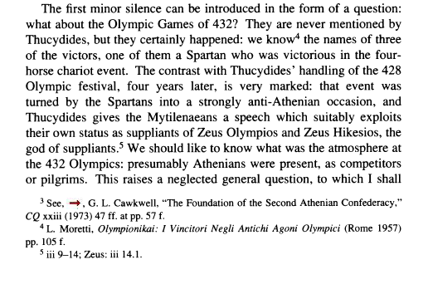
Close reading and checking of sources
Have you checked Thucydides? Does he indeed not mention these Games?

Slide 18
Close reading and checking of sources

Slide 19
Close reading and checking of sources

Slide 20
Questions?

