Slide 1
Social Epidemiology and Public Health Development
Jan 26 (Term 1)
Foundations of Social Epidemiology
Needs Assessment
Dr Hamdi Hussain

Slide 2
Aims of the Session
To understand
The term needs
The Difference between the different types of needs
The term Health Needs Assessment (HNA)

Slide 3
Health needs
To be able to plan an effective health promotion the assessment of what a population group needs is quite essential to achieve a healthy living.

Slide 4
Health needs
People’s wants and demands are limitless
Therefore, “identifying health needs is about identifying priorities”(Naidoo and wills, 2009)
According to Maslow hierarchy of needs (1954), all human needs are classified as health needs.
These are all universal needs.

Slide 5
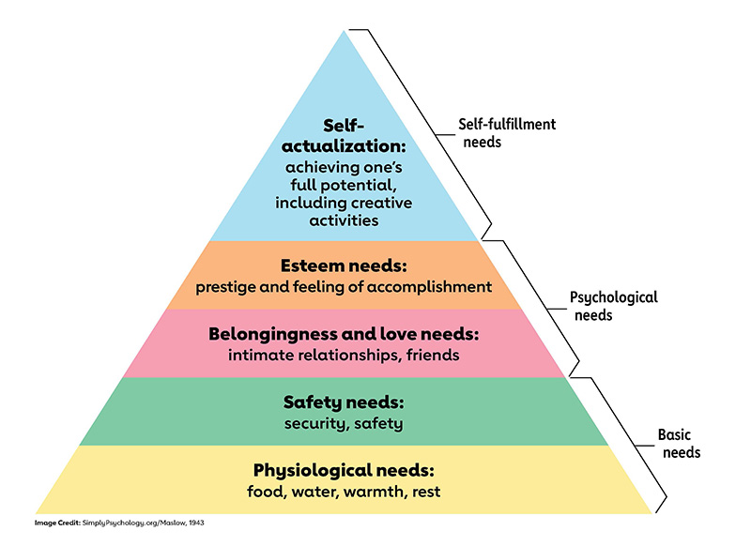
Maslow hierarchy of needs
(Maslow, 1954)

Slide 6
Needs
A need could be something people want or something that they lack when compared to others.
For example, people may believe they “need” a new coat because someone observed that the old coat is worn out or
Because it looks old compared to other people’s coat.
(Naidoo and Wills, 2009)

Slide 7
Health needs
There are two major understanding of what constitutes a health needs. These are
Subjective
Objective

Slide 8
Health needs
Subjective concept is when needs is judged from the perspective of an expert/professional and this can be influenced by whether the needs can be met.
Objective concept is a universal concept that is a fundamental human right
(Naidoo and Wills, 2009)

Slide 9

What is a needs assessment ?

Slide 10
Needs assessment
The term needs assessment describes the process of gathering information through data collection.
It is the “systematic method of reviewing the health needs and issues facing a given population leading to agreed priorities and resource allocation that will improve health and reduce inequalities”.
(Cavanagh and Chadwick, 2005)

Slide 11
What is the purpose of health needs assessment ?

Slide 12
Purpose of health needs assessment
To identify which actions to improve health should be given greatest priority
To choose which particular groups or communities should be prioritised
To help in targeting interventions and commissioning services appropriately.
To identify and respond to specific needs of the minority groups
To target people/groups at higher risk
To properly allocate resources
(Naidoo and Wills, 2009)
Notes:
Risk group are population group vulnerable to certain diseases or conditions

Slide 13
What are the different types of need?

Slide 14
Different types of need
Bradshaw (1972) distinguished four different types of health and social needs. These include
Normative needs defined by professional
Felt needs (wants) defined by client
Expressed needs (Demands)
Comparative needs

Slide 15
Normative needs
Normative needs: These are objective need that is defined by experts.
Normative needs are not absolute and there may be different standards laid down by different experts because they identify the way these needs can be met.
This normative need reflects a professional judgement that may be different from their client's judgement based on what they can provide.
  E.g., Vaccinations, a decision by a surgeon that a patient needs an operation
  A decision by a health visitor that a child needs supplementary feeding through bottle feeding in addition to breastfeeding due to the baby growth failure.
(Naidoo and Wills, 2009)

Slide 16
Felt needs
Felt needs (wants): Need perceived/identified by an individual/client.
Felt needs are limited by individual perceptions and knowledge of services.
It is what people really want through service provision and necessary support (service user views and patient/public involvement in health decision making
  E.g., Having a headache, feeling knee pain
(Naidoo and Wills, 2009)

Slide 17
Expressed needs
Expressed needs are felt needs that people act on. In other words, when someone actually asks for help, information, or uses a service, their need becomes "expressed.“
Examples:
A person with toothache goes to the dentist.
A patient calls their GP for advice.
Someone joins a stop-smoking service.
Expressed needs are often used to judge whether services are meeting people’s demands (for example, by looking at waiting lists or service uptake).
Limitations:
Not everyone with a need seeks help—many suffer in silence or don’t know where to go.
Services people use may not fully meet their real needs (e.g., they use the only option available, even if it’s not ideal).
Therefore, expressed needs only represent a small, visible portion of the total health needs in a community—like the “tip of the iceberg.”

Slide 18
Comparative needs
Individuals or group of people are said to be in comparative needs when their situation when compared to other group are found to lack certain services and resources that are required.
For example, if a person with a mental health condition in area A was living a sheltered accommodation with required support service given but this is not the case of a person with the same condition in area B.
Therefore, the person in area B will be said to be in need of certain services that other people in the same situation are getting.

Slide 19
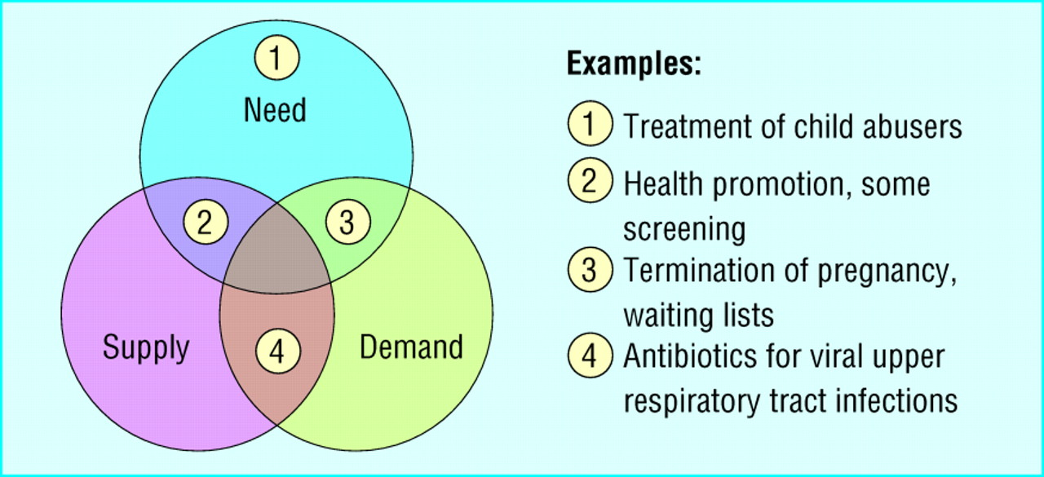
Relation between need, supply, and demand —central area shows ideal relation

Slide 20
Health needs assessment
Not simply a process of listening to patients or relying on personal experience
The development and refinement of well-established approaches to understanding the needs of a local population.
Must balance clinical (what should be done), ethical (what can be done), and economic (what can be afforded) considerations.

Slide 21
What are the questions to guide health need assessment?

Slide 22
Questions to ask when assessing health needs
What is the area of interest that defines the scope of needs to be addressed. Is the need focusing on specific population group or whole
What is the problem?
What is the size and nature of the problem?
What are the current services?
What do patients want/views?
What are the most appropriate and effective (clinical and cost) solutions?
What are the resource implications?
What are the outcomes to evaluate change and the criteria to audit success?
What should be done in future

Slide 23
What are the approach to health needs assessment?

Slide 24
Approaches to health needs assessment
Wright, 1998

Slide 25
Further reading
Health needs assessment. Latest from The BMJ: https://www.bmj.com/specialties/health-needs-assessment
Williams, R. (1998) Epidemiological issues in health needs assessment BMJ. 316: 1379
Murray, S.A. (1995) Practice based health needs assessment: use of four methods in a small neighbourhood BMJ. 310:1443
Naidoo J, Wills J (2009) Foundations for Health Promotion. Fourth edition. Elsevier, New York NY
Naidoo J, Wills J (2016) Foundations for Health Promotion. Fourth edition. Elsevier, New York NY
Wright. J. (1998) Assessing health needs in developing countries. BMJ. 316:1819
Public Health England () Health matters: public health issues Available at: https://www.gov.uk/government/collections/health-matters-public-health-issues (Accessed: 28th September 2022)

