Slide 1

Effective team working and communication
Strategies for effective communication in a business setting
BMSW4002
Lecturer: Akash Puranik
Students:
Nicoleta Damian (2120244)
Alexandru- Dumitru Otvos (2117470)
Melitsa Ahmed (2111603)
Georgian Ionut Pavel (2030935)

Slide 2

NHS England London
The NHS in London provides over than £15 billion in services to the capital's 8.17 million residents. General proffesionals (GPs) and over 140 specialised service industries, including such:
HIV Treatment
Mental Illness
Congenital heart disease treatment for children
Therapies for genetic disorders
Complex spinal surgery
Healthcare for people involved in the lawbreaker judicial scheme
(NHS England 2022)

Slide 3

Significant challenges for the London NHS include:
An increasing ageing and rising service demand
More of us are living with long-term diseases
Significant differences through quality and health consequences. (NHS People Plan 2020/2021)

Slide 4

There are two kinds of communications in health and social care settings:
Communication among healthcare staff.
Customer (and/or family representative) interaction with healthcare team members.
Communication is described effective in NHS settings whenever the receiver, either the client, a close relative, or a health and social care employee, fully knows the message given by the sender. To accomplish this, the information sharing should be evident, coherent, transparent, available, but also inclusive.

Slide 5

Poor communication in communication between the NHS and healthcare users:
Poor communication - the inverse of communicating effectively.
Poor communication takes place whenever the receiver allocates a mixed message to the one intended by the sender.
It occurs when the message is inaccurate, unclear, opaque, or inaccessible. Inconsistency can lead to confusion and the loss of important information.

Slide 6
Barriers existing in communication that impede it to be effective for NHS London:
Main barriers between nurses and patients:
Competitive requirements
Lack of privacy
Noise level
Use of jargon
Information overload
Patients’ diagnosis, medicines, pain or even anxiety
NHS workers’ and patients’ cultural and religious values and beliefs
(Ali M (2017) Communication skills 2: overcoming barriers to
effective communication Nursing Times)

Slide 7
How should NHS London use The Shannon-Weaver Model of communication and The Schramm’s Model of communication?
The Shannon- Weaver Model of communication is the solution for one important barrier in effective communication – Noise (external and internal)
This model clearly explains that is important for NHS London to minimise or stop the noise to eliminate the barrier and create effective verbal communication.
(Shannon-Weaver,1948)
The Schramm’s Model - another helpful solution for verbal and written barriers by getting feedback.
When a communicator transmits data to a receiver, the recipient must perceive this in the shape that the communicator desires and provide valuable feedback or react appropriately. Any information sharing in which the communicator does not receive feedback is incomplete and therefore inefficient.
(Schramm,1954)

Slide 8
Effective communication enables a person to participate in constructive discussion with NHS London .
Employees may need to change their tone and content to satisfy the needs of an individual, or they may want to use special methods or communication facilitates.
Employees must encourage using all necessary communication aids and sustain whenever applicable.
Effective communication in NHS London healthcare institutions is critical as it can have a direct or indirect effect on the patient and social care provided, the patient's wellbeing, and communication with patients, relatives, or coworkers.

Slide 9

Effective communication enables:
The sharing of precise information and guidance on care requirements.
Giving the service user (or relatives) or workmates direct (or indirect) moral support.
The formation of healthy relations.

Slide 10

Benefits of effective communication in NHS London:
In NHS London, effective communication is used to:
Optimize care facilities.
Benefit the health experience.
Increase accountability and inclusiveness.
Minimize the complaints.
Increase trust in the health-care system.
Help reduce stress.
Improve the working conditions for caregivers.
Improve your self-esteem, professional reputation, job opportunities, as well as work satisfaction.
Source:
(Effective communication in health and social care 2021)

Slide 11

Channels of communication used by NHS London:
Verbal communication ( phone calls, appointments)
Non-verbal communication (or body language)
Written communication (letters, text messages and emails)
Formal communication
(Department of health and social care 2010)

Slide 12
To encourage effective communication in the NHS, it is critical to recognise that this atmosphere can be a cause of anxiety but also worry for service users. Because of the reasons listed:
Concerns regarding health and wellbeing.
Distancing from relatives and everyday routines.
Noises.
Safe privacy and individual space are severely restricted.
Emotionless or cold surroundings.
(NHS Trust 2021)

Slide 13
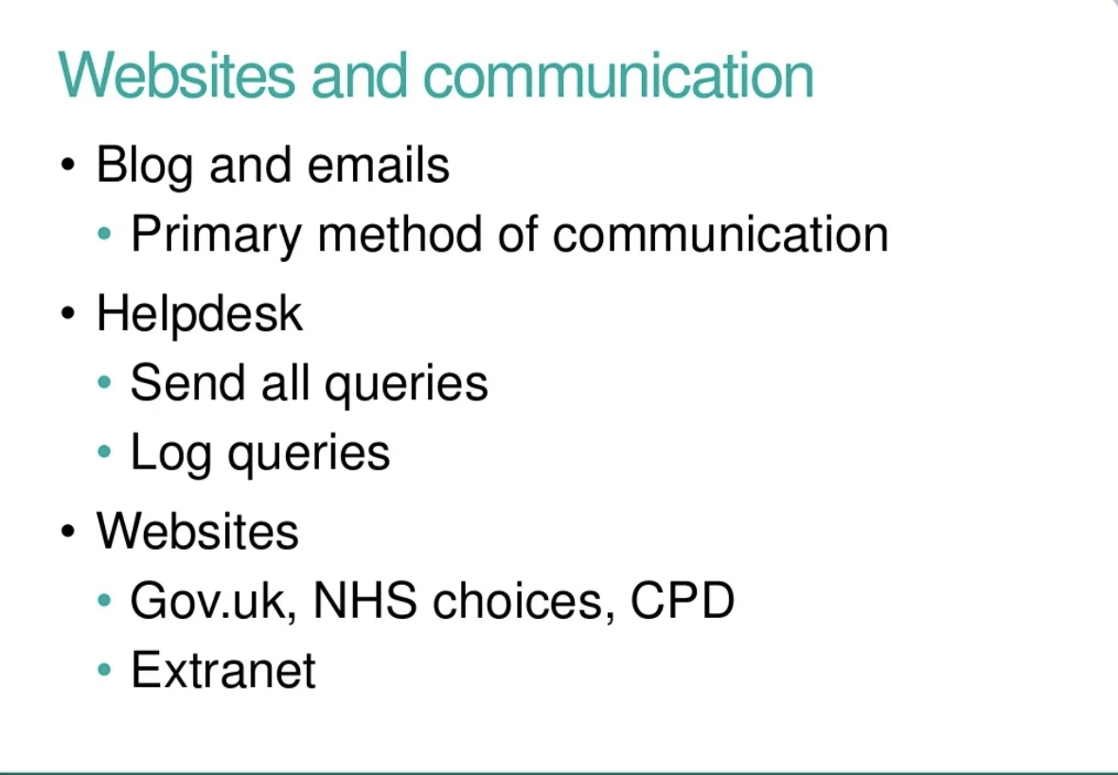
To ensure effective interaction, care workers must know the challenges that patients experience when adjusting to their new environment and help individuals with various tactics, including such:
actively listening and providing a safe space for them to express their feelings.
In times of danger, comforting and comforting clients.
To avoid exclusion, assist patients in remaining active and facilitating connections with others.
(AAA London Network event 2015)

Slide 14

Why verbal communication is more effective?
When using verbal communication by NHS London care providers:
•Make direct eye contact.
•Make room for questions and double-check that the message was comprehended.
•Complement verbal communication with coherent nonverbal cues.
•Confront the receiver at the same height as him, rather than through a dominant role.
•Maintain a good attitude.
•Show concern while remaining friendly and polite at all points of time.
•Contact out the receiver's identity.
(National health services England)

Slide 15
Importance of written communication
Written communication is essential in NHS London because it serves several functions:
To keep track of private information.
Keeping health history.
To prescribe medication or make appropriate referrals for medical treatment.
To write letters, email messages, and text messages informing but also reminding recipients of clinic, gp, and doctor appointment scheduling, among other things. To create wellness programs.
To distribute mailings as well as update notice boards.
To delegate responsibilities.

Slide 16
Reference list
Contributor, N., 2017. Communication skills 2: overcoming the barriers to effective communication | Nursing Times. [online] Nursing Times. Available at: https://www.nursingtimes.net/clinical-archive/assessment-skills/communication-skills-2-overcoming-the-barriers-to-effective-communication-18-12-2017/ [Accessed 19 July 2022].
Drew, C., 2022. [online] Monoskop.org. Available at: <https://monoskop.org/images/b/be/Shannon_Claude_E_Weaver_Warren_The_Mathematical_Theory_of_Communication_1963.pdf> [Accessed 20 July 2022].
England, N., 2022. NHS England » NHS People Plan. [online] England.nhs.uk. Available at: https://www.england.nhs.uk/ournhspeople/ [Accessed 17 July 2022].
England.nhs.uk. 2016. [online] Available at: https://www.england.nhs.uk/wp-content/uploads/2016/11/nhse-access-info-comms-policy.pdf [Accessed 15 July 2022].
England.nhs.uk. 2022. NHS Identity Guidelines | Do the NHS Identity guidelines apply to internal communications?. [online] Available at: https://www.england.nhs.uk/nhsidentity/faq/internal-communications/ [Accessed 21 July 2022].
Janse, B., 2021. Schramm Communication Model. [online] toolshero. Available at: https://www.toolshero.com/communication-methods/schramm-communication-model/ [Accessed 20 July 2022].
Lee, E., 2021. Effective Communication in Health and Social Care. [online] CPD Online College. Available at: https://cpdonline.co.uk/knowledge-base/care/effective-communication/ [Accessed 24 July 2022].
London, N., 2022. NHS England — London » About NHS England London. [online] England.nhs.uk. Available at: https://www.england.nhs.uk/london/about/ [Accessed 15 July 2022]
Slideshare.net. 2015. AAA London Network Event 27 Nov 2015 Patrick Rankin education and t…. [online] Available at: https://www.slideshare.net/PHEScreening/aaa-london-network-event-27-nov-2015-patrick-rankin-education-and-training-update-abridged-presentation [Accessed 19 July 2022].

Slide 17
Teamwork Evaluation | Team responses.
Who was in your team? | Nicoleta Damian, Georgian Ionuț Pavel, Melitsa Ahmed and Alexandru Dumitru Otvos
What were the key strengths of your team? | Everyone took the responsibility for this presentation. We decided carefully and agreed to everything that was discussed.
What were the challenges that you overcame as a team? | Initially, I wanted to write about another company, but everyone agreed for NHS so we kept NHS.
What would you do differently if you worked as a team again? | We need to meet in person from now on for a better communication.
How would you rate your team working? Out of 10? | 7

