Slide 1

Benefits of multilingualism
The importance of language awareness skills for hotel staff
Recording-20231027_212441.webm
HOTEL MANAGER
Ovidiu Trasc

Slide 2
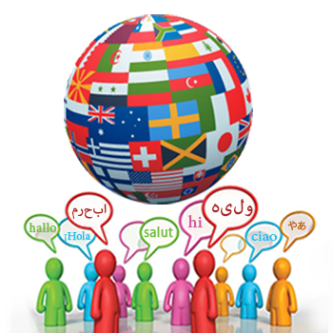
Benefits of multilingualism
Diversity Hotel & Spa London is dedicated to offering exceptional guest experiences.
Multilingualism represents the capacity to offer services in a variety of languages and in different departments.
Benefits:
Makes guests feel valued, resulting in increased guest satisfaction and loyalty.
Expanded Market Reach – can attract more turists
Cultural Sensitivity - gain respect by being polite

Slide 3

France
French language
French is the official language in France and other 27 countries.
It is a romance language.
Over 270 million speakers all over the world.
French it is not heavy to learn and it is a very often spoken language.

Slide 4
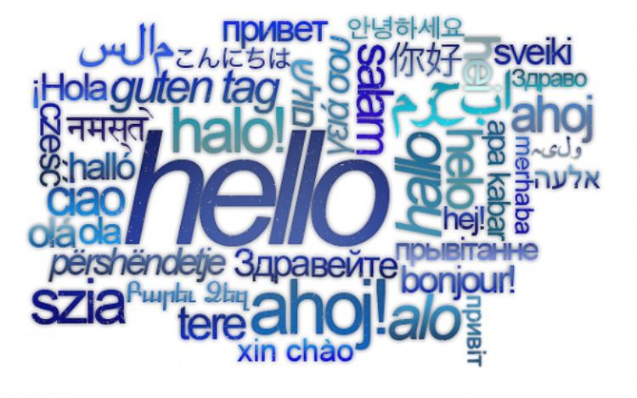
Polite/impolite in business context
Create a positive and welcoming environment. Polite expressions:
"Nous sommes à votre disposition" (We are at your service)
"Bonjour et bienvenue" (Good afternoon and welcome)
Impolite expressions:
"Qu'est-ce que vous voulez?" (What do you want?)

Slide 5

The importance of language awareness skills for hotel staff
Effective Communication
Cultural Sensitivity
International Appeal
Competitive Edge
Guest Loyalty
Professional Development
DIVERSITY HOTEL & SPA LONDON

Slide 6

Conclusion
We conclude with the following:
Overall, multilingualism is a valuable asset for the hospitality industry, fostering positive guest experiences and business growth.
Having French speaking employees will definitely help improving our French guests satisfaction and exceed their expectation.

Slide 7
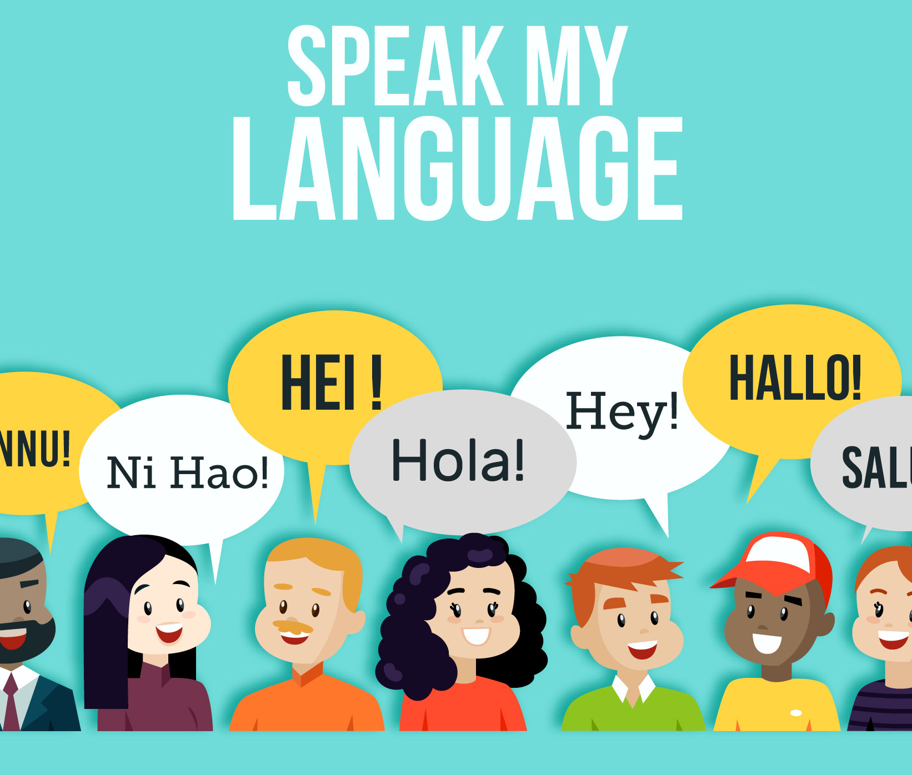
References
Cobb, T., & Horst, M. (2004). Is there room for an academic word list in french?. In P. Bogaards, & B. Laufer (Eds.), Vocabulary in a Second Language: selection, Acquisition, and testing (pp. 15–38). Amsterdam: John Benjamins Publishing.
Hofstede, G., Hofstede, G. J., & Minkov, M. (2005). Cultures and organizations: Software of the mind (Vol. 2). New York: Mcgraw-hill.
García, M. (2018). Language Skills: A Competitive Advantage in the Hospitality Industry. Hotel Management.
Smith, J. (2020). The Importance of Multilingualism in the Hospitality Industry. Hospitality Net.
Sullivan, L. (2019). 5 Benefits of Being Multilingual in the Hotel Industry. Glion Online.
DIVERSITY HOTEL & SPA LONDON

