Slide 1
Engineering Project: Rubber-band Car
By Group A

Slide 2
Introduction
Our Aims for the car:
To go further than 2 metres
To be reliable
To be efficient
Bethan Lane
Cade Gibbons
Kurtis Mitchell
Gabriel Jenkins-Handy
Ben Armour
Jack Flannagan
2502536
2516743
2516494
2501670
2405183
2502520

Slide 3
The Design Process
Design Research
Building a sturdy frame
Making the wheels
Axle mounting
Spacers
Tuning elastic band attachment
Front wheel drive
Adding grip

Slide 4
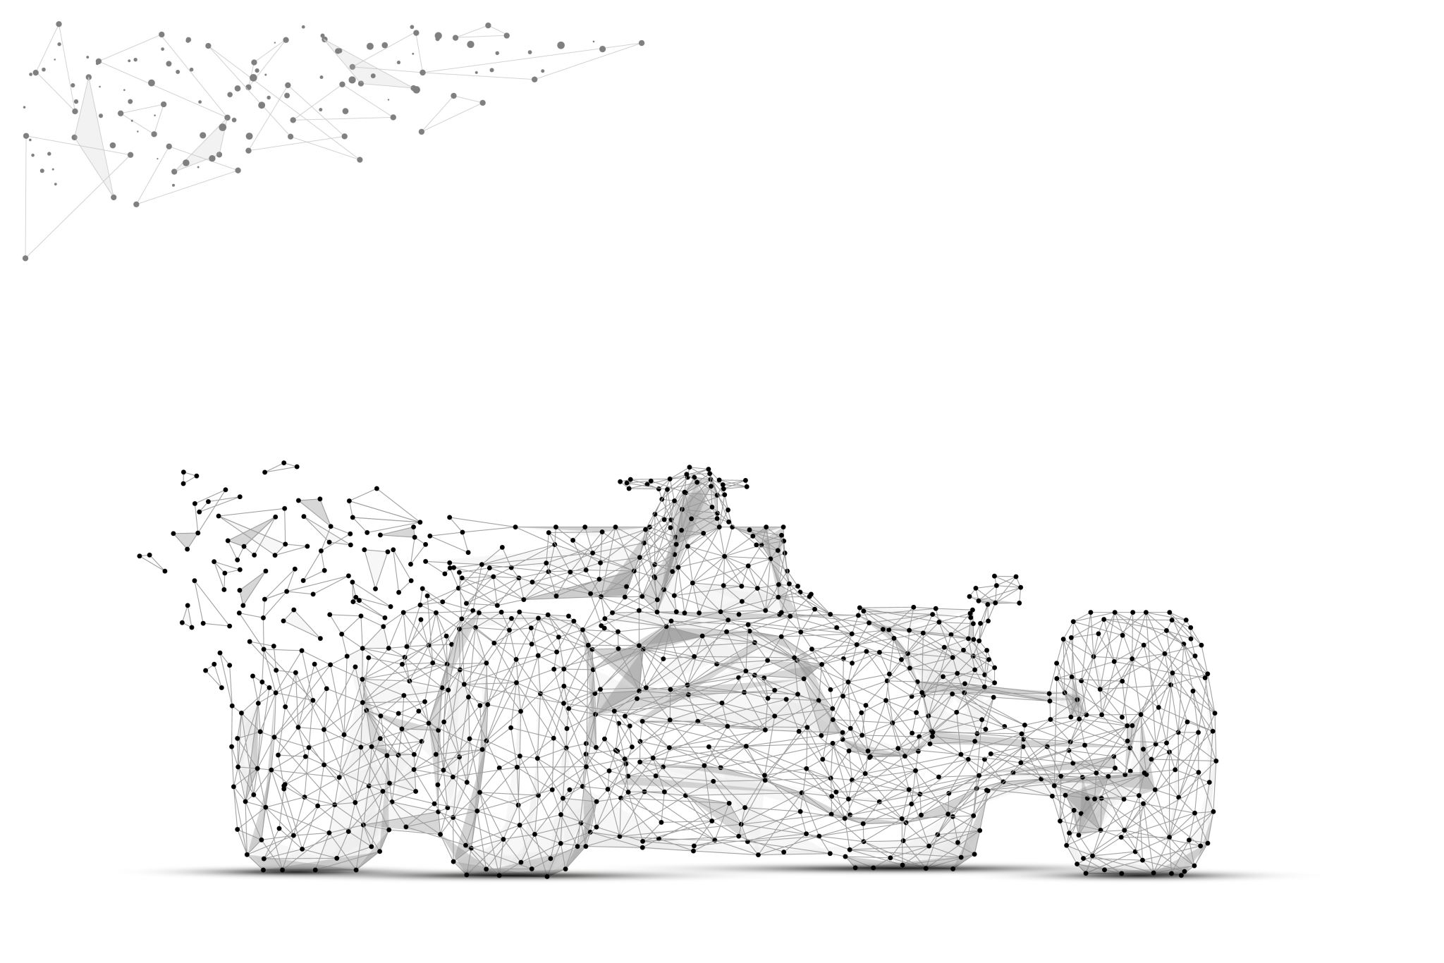
1. Design Research
Based our design off video from YouTube made by STEM Inventions
Discussed as a group how we would build our car with the materials we’d be given
Referenced back to every-day vehicles for our design

Slide 5
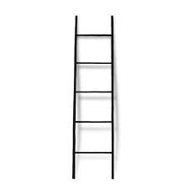
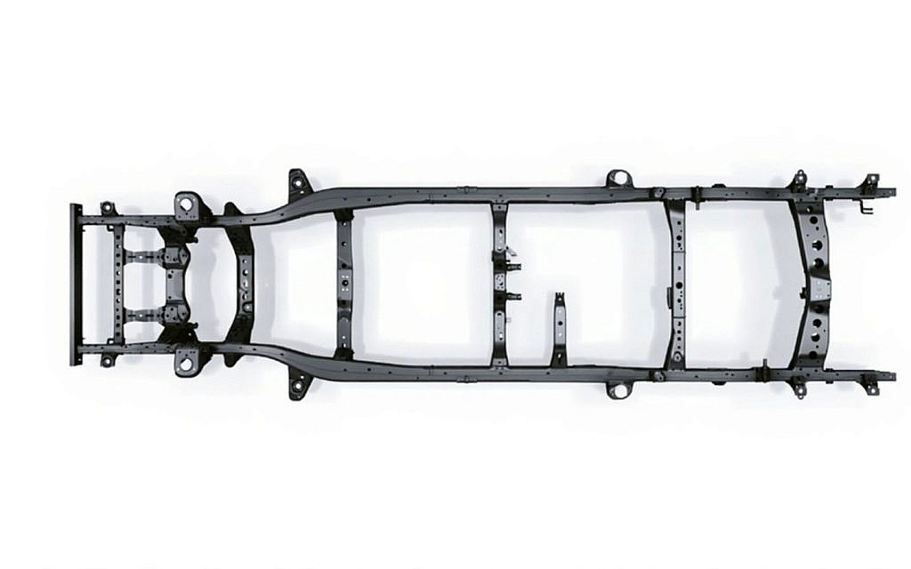
2. Building a Sturdy Frame
Ladder frame design
Based on real-world design

Slide 6

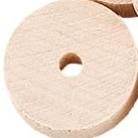

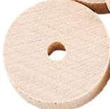
3. Making the Wheels
CD wheels have large diameter
Wooden wheels have more weight
Combine both
Notes:
CD wheel with larger diameter it will cover more ground with less rotations than just having the smaller wooden wheel.
Small wooden wheel adds weight and gives a flywheel effect.

Slide 7
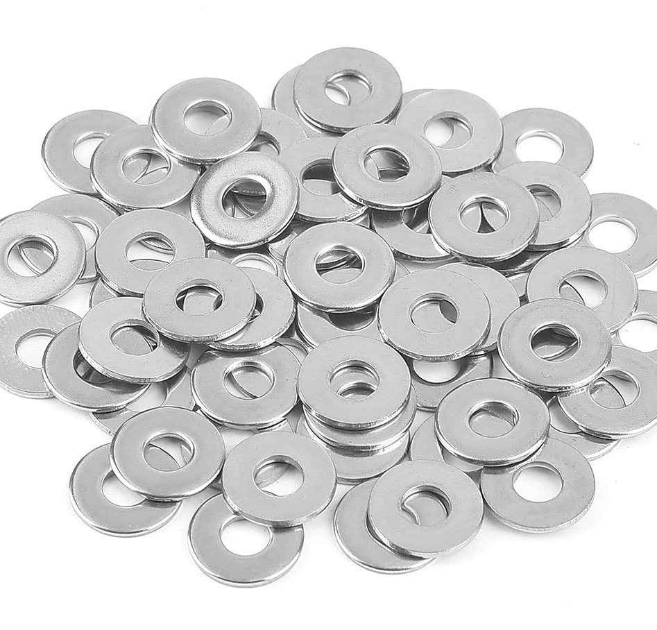
4. Axle Mounting
Glued washers together
3x3 on each wheel side
Fixed the same on both front and back
Notes:
The washers being metal allowed for much less friction than the paper straw to wood method.
The more washers stuck together meant more stability when attached to the frame.

Slide 8
5. Spacers
Spacers were needed to stop side-to-side movement of the axle
Straws were used
Glue was put on the ends of the axles to hold the wheels in place
Possibly also washers

Slide 9
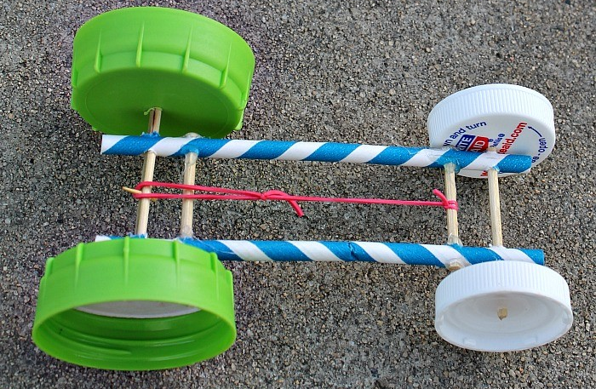
6. Tuning Elastic Band Placement
Solid point
Moving point

Slide 10
7. Front Wheel Drive
Prevents chance of wheelieing
“The horses must pull the carriage, not push it” – Enzo Ferrari

Slide 11
8. Add Grip
Only the powered wheels need grip
Can be made from clay/rubber bands/cello tape

Slide 12
Implementation of the Design Process
Frame – made from lollypop sticks, glue and a straw- ladder frame
Axels- washers, more glue, straws as spacers
Wheels- CDs glued to wooden wheels.
Rubber band tied to frame and hooked onto hardened glue nub on driven wheels dowel
Grip- clay on driven wheels, not on rear to reduce drag

Slide 13
Testing
Tested different strengths of rubber bands
How many rubber bands
Different “tyres” e.g. cello tape, glue. Rubber bands and clay
Supports for the axel due to failure

Slide 14
Reflection
Pros | Cons
Fast | Chassis can’t handle torque
Goes far | Flimsy materials
Good torque delivery | Glue didn’t glue
Everyone played to their strengths | Wheels flexed
Real world inspiration | Inconsistent manufacturing
Simple wheel design | Used lots of materials
Simple rubber band attavhment | Needed better planning

Slide 15
Conclusion
successful
Targets met
Exceeds expectations
Future improvements
Less/more reliable material
Straighter chassis
More precise manufacturing for the wheels/contact patch
Better overall planning

