Slide 1
Athens and Rome: Life and Culture in Classical Antiquity
Roman Portraits
Images
CLCS4007

Slide 2
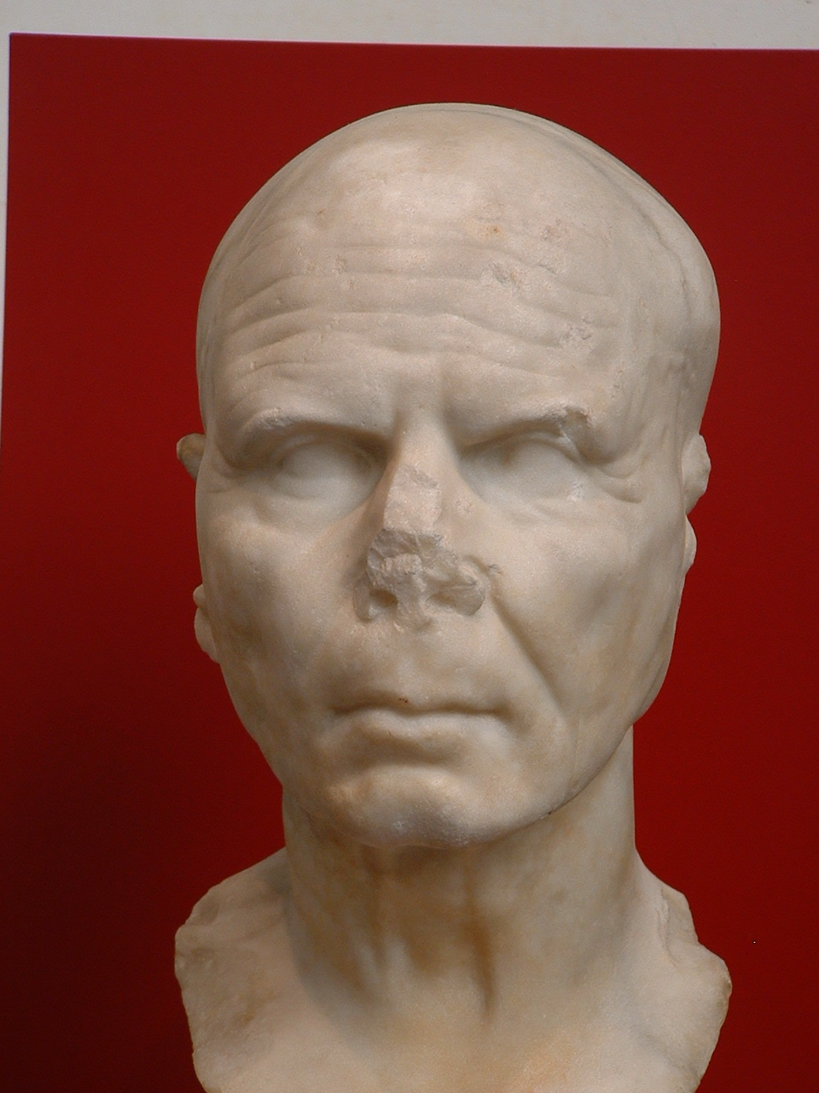
Republican style
‘veristic’ portrait,
Palazzo Massimo
Museum, Rome

Slide 3
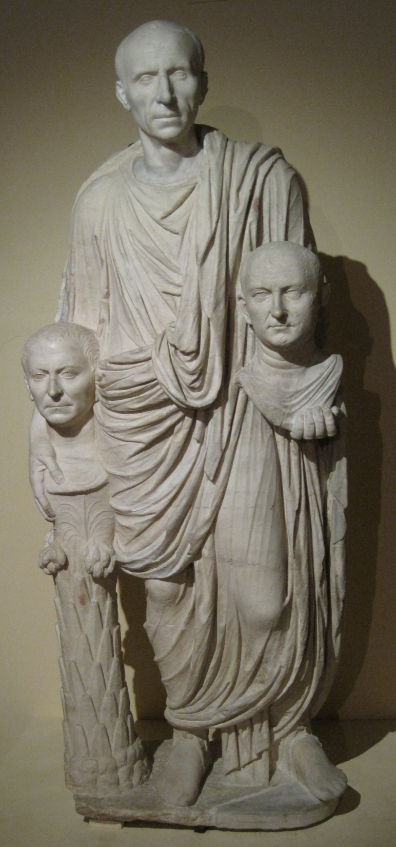
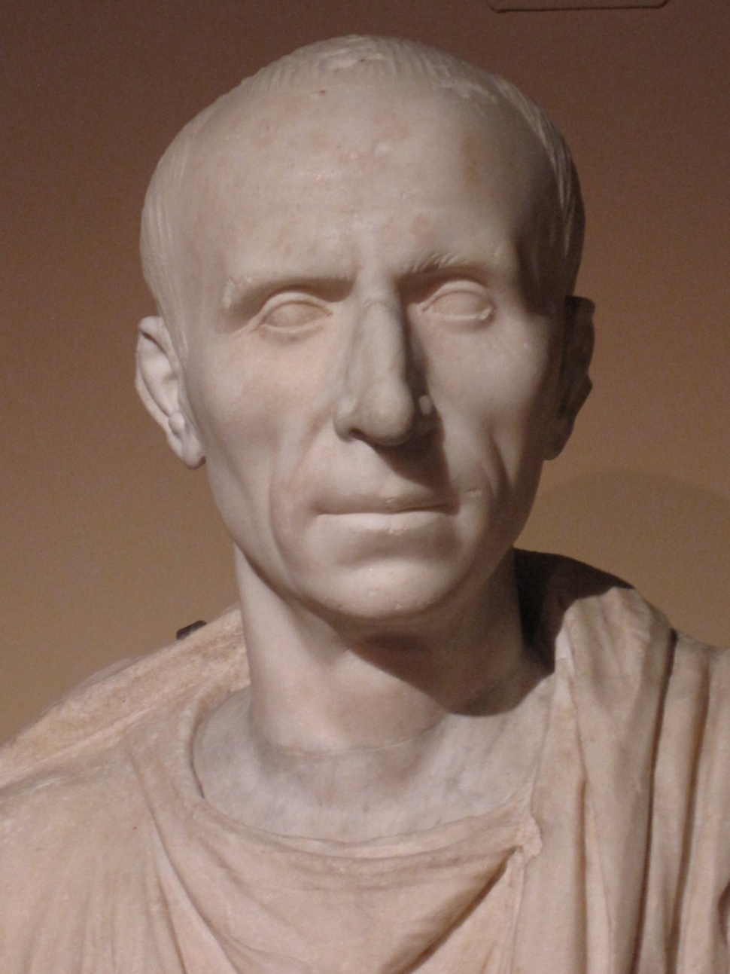
Montemartini Museum, Rome
1st cent. BC?

Slide 4
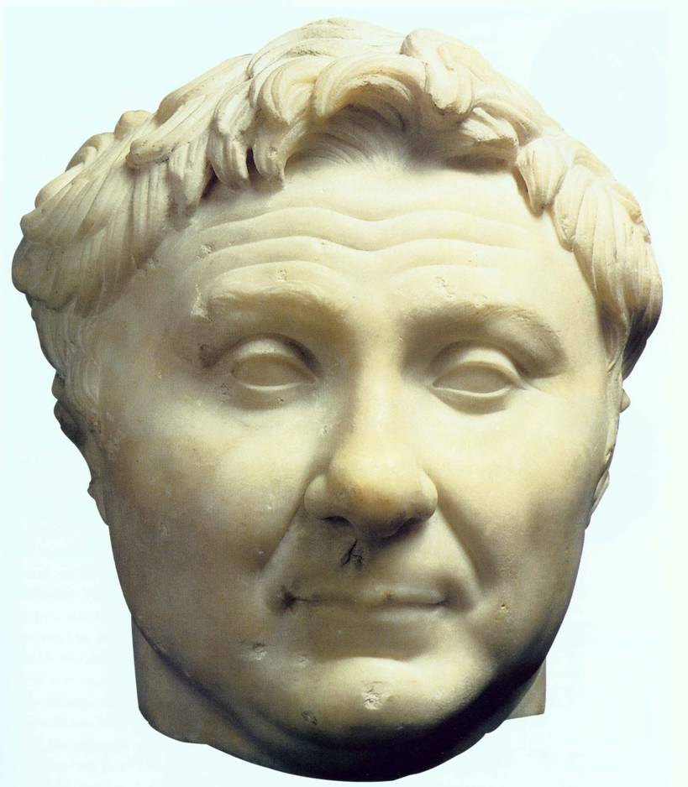
Pompey the Great
(original c. 50 BC?)
Ny Carlsberg
Glyptotek,
Copenhagen

Slide 5
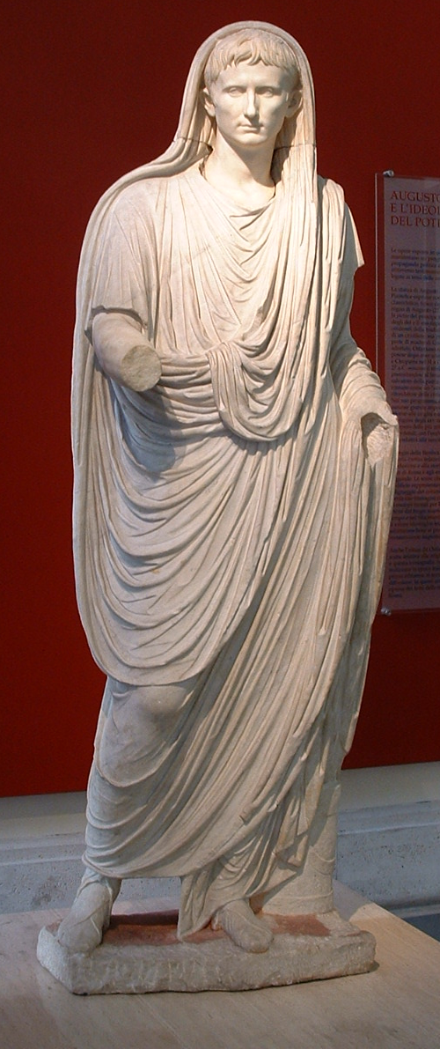
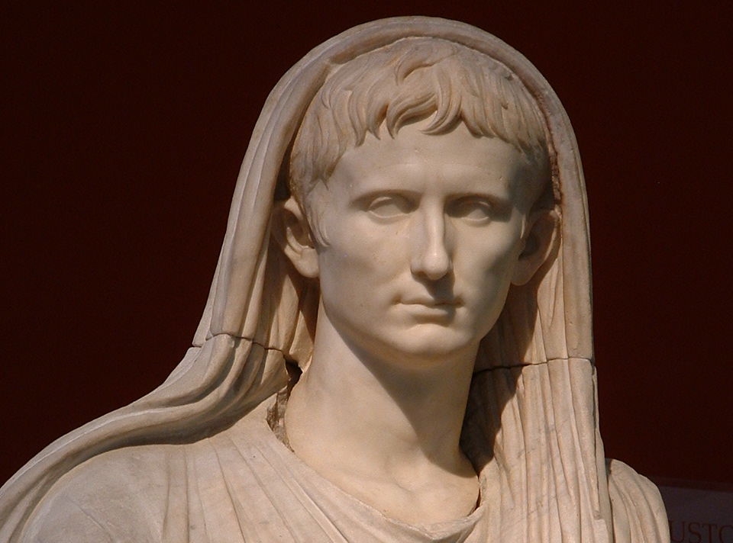
Via Labicana
Augustus as priest,
Palazzo Massimo
Museum, Rome

Slide 6
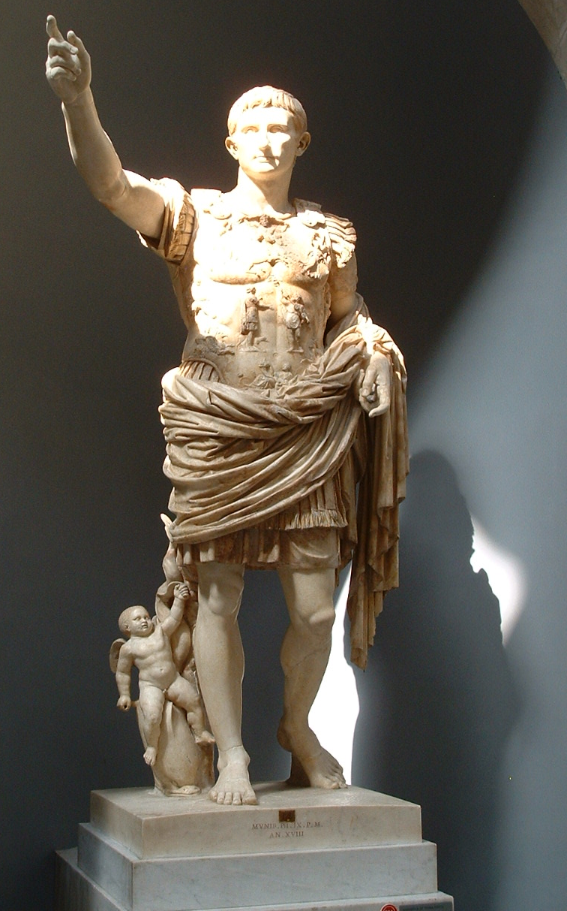
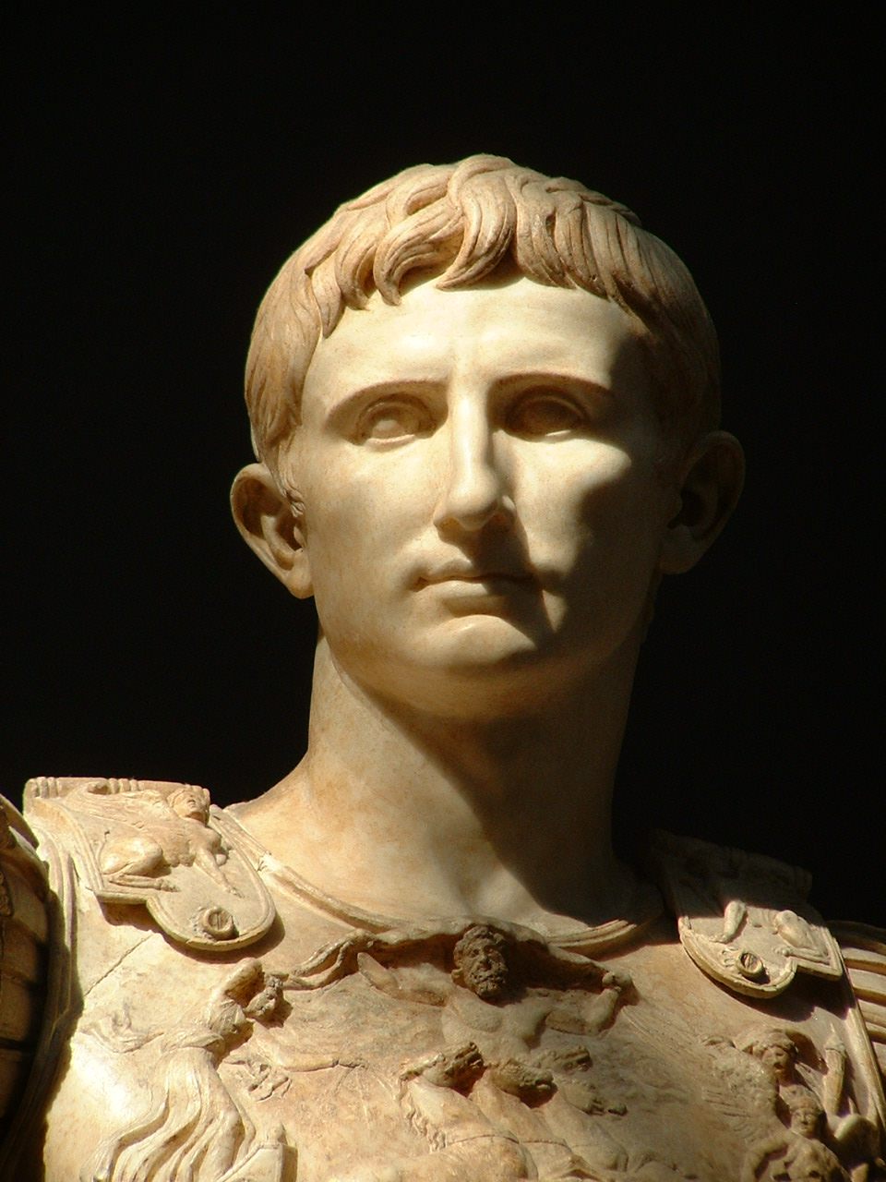

Slide 7
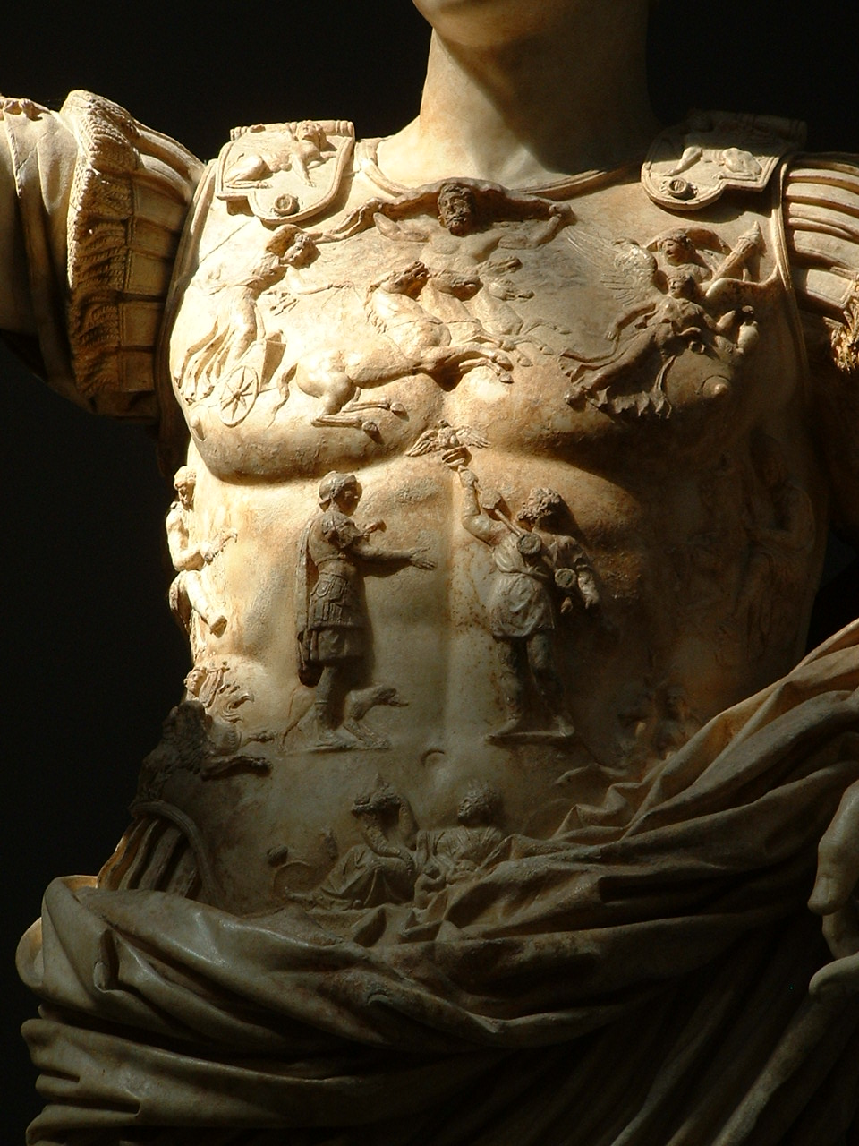
Prima Porta
Augustus,
Vatican
Museums

Slide 8
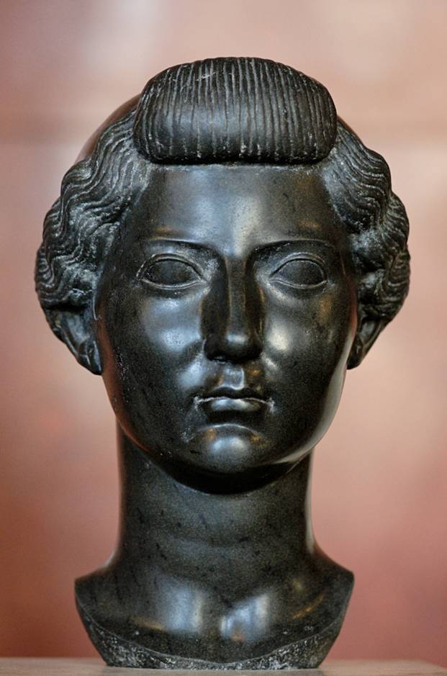
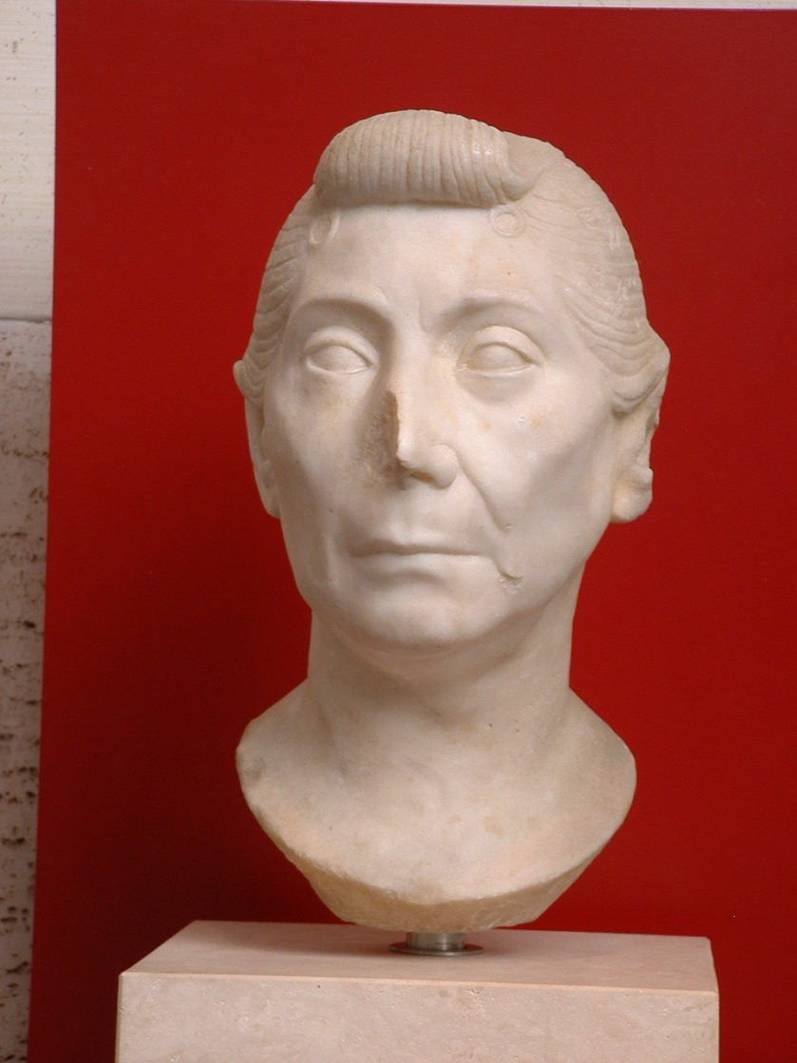
basalt head of Livia (left)
Unknown woman (freedwoman?), marble, Palazzo Massimo Museum, Rome

Slide 9
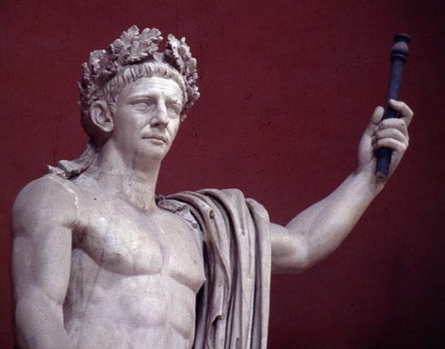
Claudius, c. AD 40s, Vatican Museum

Slide 10
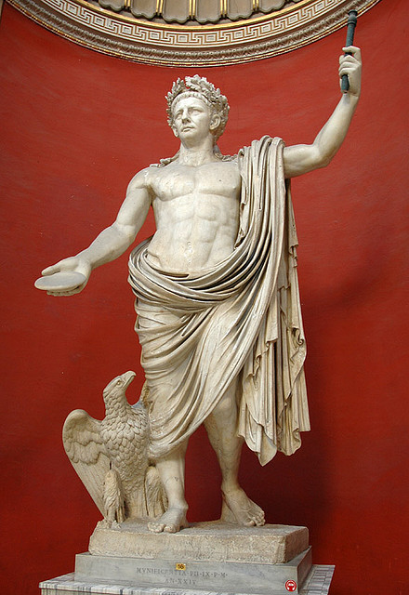
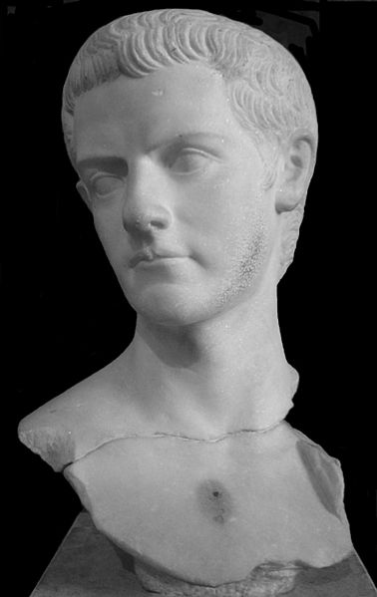
Bust of Caligual, Louvre

Slide 11
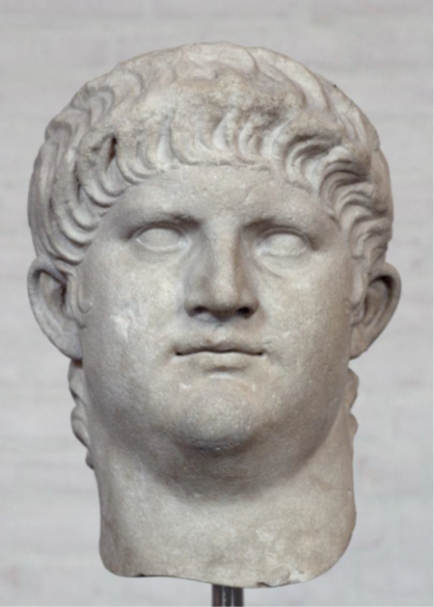
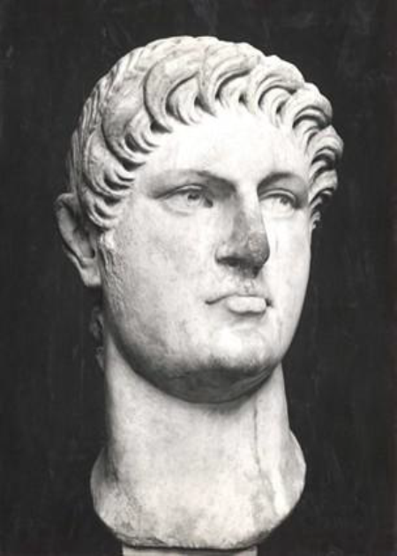
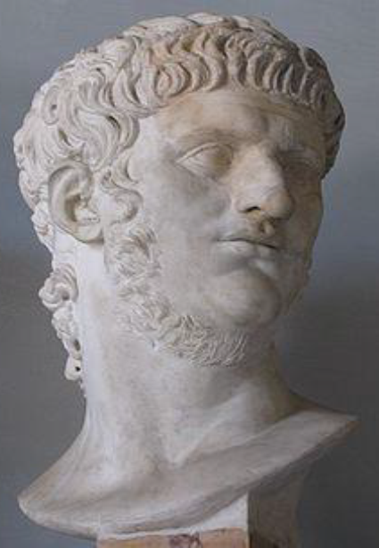
Glyptothek, Munich
British Museum, London
Musei Capitolini, Rome

Slide 12


