Slide 1



Assignment Title: Component 1- Individual Presentation
Module Code: LCLM5002
Module Title: Developing and Managing Individuals and Teams
Student Name: George Lupsa
Student ID Number: 2416879
Lecturer’s Name: Nishi Ramsurrun

Slide 2


Table of Contents
Slide Number | Content
1 | Cover page
2 | Agenda
3 | Introduction
4 | Chosen Company Background
5 | Recruitment Process (Job Analysis)
6 | Recruitment Process (Job Description)
7 | Recruitment Process (Person Specification)
8 | Different Types of Interviews: In-person interview
9 | Different Types of Interviews: Virtual Interview
10 | Different Types of Interviews: Panel Interview
11 | Interview Questioning Technique
12 | Interview Questioning Technique
13 | Interview Questioning Technique
14 | Comparison Between Face-to-Face and Online Interviews for a Project Manager
15 | Comparison Between Face-to-Face and Online Interviews for a Financial Analyst
16 | Comparison Between Face-to-Face and Online Interviews for a Change Manager
17 | Conclusion
18 | References

Slide 3
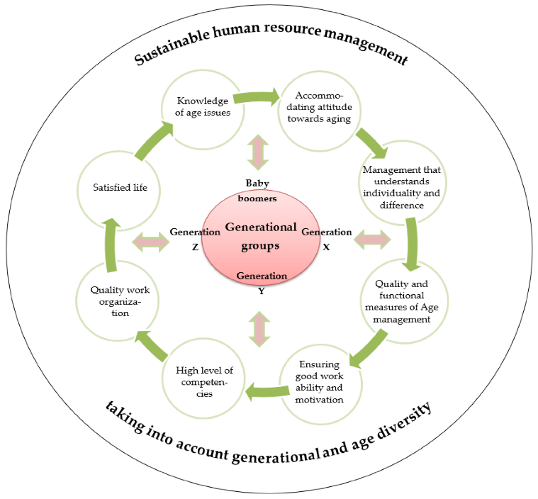
Introduction
Human resource planning comprehensive process of recruiting and retaining employees.
Sustainable human resource management places importance on people, considers strategic value (Vraňaková, Gyurák, Babeľová and Chlpeková, 2021).
This presentation explores different steps of human recruitment.
Figure 1: Sustainable human resource management
(Source: Vraňaková, Gyurák Babeľová and Chlpeková, 2021)
Notes:
This presentation analyses different steps involved in recruiting eligible candidates, different types of interviewing methods, questioning techniques, and compares the differences between face-to-face and online interview processes for project managers, financial analystst and change managers. The goal of sustainable human resource planning is to recruit the right candidates, taking care of their needs and considering them as a strategically valuable resource.

Slide 4
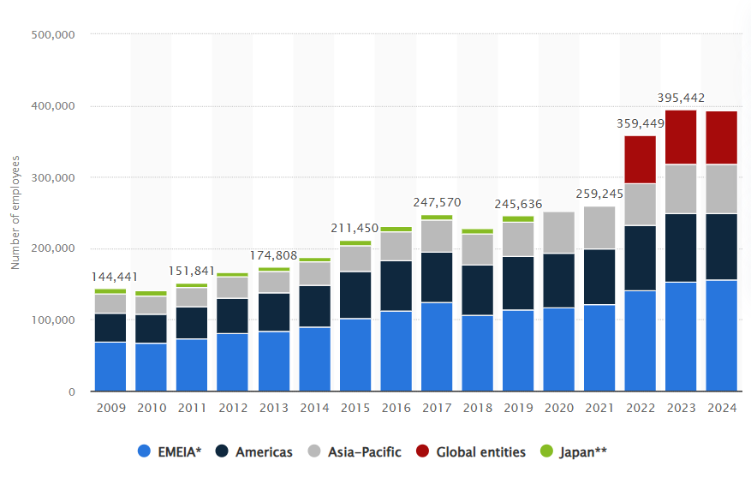
Chosen Company Background
The chosen company for this presentation is EY (Ernst & Young), a London-based professional services network.
The global workforce consists of 400,000 employee’s majority of whom belong to the EMEIA region (Bohne, 2024).
This presentation focuses on recruiting employees for the London Branch of EY.
Figure 2: Global workforce distribution of EY
(Source: Bohne, 2024)
Notes:
The selected company for this presentation is a London-based multinational servicing network, EY, which was formerly known as Ernst & Young. The majority of the workforce, roughly 157,000 out of 400,000 staff, belongs to the EMEIA (Europe, Middle East and Asia) region. This presentation is based on the standardised employee recruitment process for the London branch of EY.

Slide 5
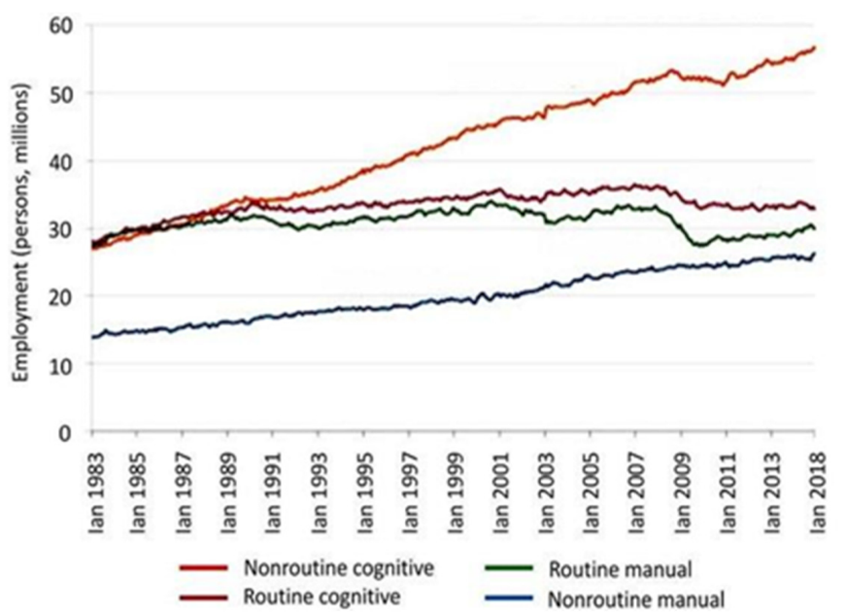
Recruitment Process (Job Analysis)
The recruitment process will focus on candidates for 3 different job roles.
Job analysis is a systematic process for gathering and analysing information about duties, responsibilities and required skills (Cimini et al., 2023).
It involves analysing market criteria and candidates' preferences.
Figure 3: Employment type in the job market
(Source: Cimini et al., 2023)
Notes:
Job analysis is the first responsibility of human resource managers to set criteria for vacancies. It involves the entire process of accumulating and analysing information regarding duties, responsibilities and skills required for the job role. HRM of EY examines different departments to find out job posts which have vacancies. The recruitment board of EY sets eligibility criteria for candidates to handle job responsibilities according to posts. The process of job market analysis sets compensation, perks and other facilities that might attract deserving candidates to enthusiastically join the EY company.

Slide 6


Recruitment Process (Job Description)
EY HRM describes three different types of job roles: project manager, financial analyst, and change manager.
The job description process involves daily workload, behavioural criteria, accommodation type and leave policies of these three departments.
High-quality job description attracts eligible candidates who have faith in the company’s values, vision and culture (Morelli, 2023).
Notes:
Three different job roles have been described by HRM for hiring, attracting those candidates who value EY’s vision, culture. Project managers, financial analysts and change managers have individual job responsibilities, working hours, and behavioural aspects in EY. The job description step involves clearly mentioning daily workloads, company culture, expectations of higher authority from the candidates, in detail, leave policy and other necessary criteria. It helps candidates to test their eligibility against the job posts and then make a decision on the application.

Slide 7

Recruitment Process (Person Specification)
Person specification involves demographic expectation, knowledge, qualification and skills possessed by the candidates.
Person specification in hiring is written documentation of the ideal candidates required for the job role (Morris, 2025).
Person specification involves educational degrees, skills, experience and references.
Notes:
The person specification is the third step of recruitment, mentioning specific criteria of employees to join EY as project manager, financial analyst and change manager. It involves age, gender, educational qualification, skills, years of experience, and any specific project that candidates have previously worked on. This written documentation abbreviates the expectation of EY for the candidates to tackle these job roles. On the other hand, candidates also get the opportunity to examine their fitness for the job vacancies in EY. Thus, mentioning essential, desirable attributes for the job roles helps both HRM and candidates to shortlist recruitment process.

Slide 8

Different Types of Interviews: In-person interview
2
1
An in-person interview allows the recruitment board to capture attitude, emotional aspects, and guides about non-verbal cues regarding the personality type of the candidate (Lobe, Morgan and Hoffman, 2023).
An in-person interview might be applied for the project manager team, where candidates have to visit the office.
3
Page 02 of 07
Notes:
The first type of interview is in-person, which might be suitable for hiring project managers, expecting the candidate to visit the office floor. Since the job role of project manager requires extreme dedication, collaboration, negotiation, communication, and a challenge-facing spirit, an in-person interview might help the recruitment board to cross-check these behavioural and emotional aspects. A drawback of these ininterviewson-flexible, travelling accommodation and establishment costs to cross-test employees. However, it will help HRM professionals to cross-check the behaviour, attitude, and personality of the candidate and then make a decision regarding recruitment.

Slide 9

Different Types of Interviews: Virtual Interview
STRONG ONLINE PRESENCE
The virtual interview might be suitable for a finance analyst job role to live test competency through Microsoft Teams.
The benefits of virtual interviews are time and cost savings, reduction of travelling and carbon footprint burden (Domingo et al., 2022).
Notes:
A virtual interview can be conducted through Microsoft Teams to test the credibility and eligibility of a finance analyst at EY. With the help of this tool, the recruitment board can live test the working strategy, speed of financial data prediction and accuracy of calculation. Since the job role of a finance analyst requires intense calculative speed, budgeting skills and technical usage. Therefore, if the recruitment board allows candidates to interview from their comfort zone, then candidates can demonstrate their financial analysis skills, specialisations. Moreover, the job role of a financial analyst in EY does not require frequent interaction with other staff, as analysts have to work mainly with a data set. Thus, a virtual interview of a finance analyst could be a cost-time saving approach to check the eligibility of a candidate.

Slide 10

Different Types of Interviews: Panel Interview
A panel interview mode might be fostered for choosing a change manager of EY to test the potency by a software developer, an HR manager, a finance specialist and project supervisors.
Panel interview has the flexibility of face-to-face as well as online interactions, telephone consultation (Cornesse et al. 2022).
Notes:
A panel interview can be conducted to check the skills, eligibility of a change manager at EY. The job role of change management requires skills to ensure project sustainability, software upgradation, budget management, and human resource handling techniques to implement changes in the project. Through the panel mode of interview, department heads can test the eligibility of a candidate in real time. Moreover, a panel interview has the flexibility of online and offline accommodation, allowing distance interviewers to check candidate eligibility through telephone or virtual communication modes.

Slide 11

Interview Questioning Technique
The interviewing of the project manager might follow a Socratic questioning technique to check the critical thinking ability of the candidate through open-ended questions.
Inspired by the philosophy of Socrates, Socratic questioning nurtures curiosity, critical thinking competency through effective communication (Muhammad and Niazi, 2022).
Notes:
The questioning technique for interviewing the credibility of a project manager can follow open open-ended Socratic method, allowing interviewers to check critical thinking, decision-making capacity. This questioning method was proposed by the famous philosopher Socrates for university and school students, for creating a “question and answer (Q&A) session” to make learning exciting and interactive. This interviewing method would allow candidates to share their previous project management experience in managing project management issues at EY. Software networking project management requires intense critical thinking skills, flexibility, adaptability and resilience. Q&A session of questioning for interviewing candidates to meet all of these criteria.

Slide 12


Interview Questioning Technique
The “leading” questioning method can be followed to interview a finance analyst of EY, to comprehend the accuracy of the financial results by in-depth analysis.
A particular outcome is suggested in the leading questioning method during the interview (Hesto and Khun, 2023).
Notes:
A leading questioning technique is applied for measuring the accuracy of a financial analyst. Unlike other questioning techniques, it has only one result: if the outcome of the financial data matches, then candidates would be considered eligible for the job post. In order to apply this questioning technique, a senior financial specialist would set up a data database and obtain results by themselves at first. After a virtual interview of the candidate, there will be only one possibility, that is candidate has accurately conducted a financial analysis or failed completely. The interview board of EY allocates a stipulated time for interviewees to conduct financial analysis, and after that, they are asked to obtain results. Thus, a cost-saving leading questioning technique can be followed to interview the eligibility of candidates for a finance analyst position.

Slide 13
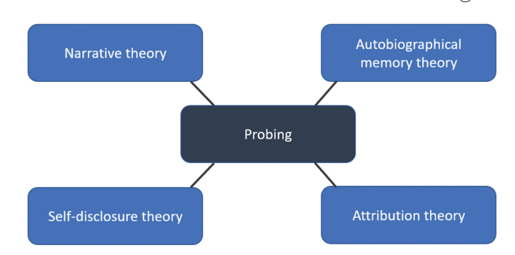
Interview Questioning Technique
The probing questioning technique is suitable for interviewing problem-solving, resilience, and active listening competency for an individual applied as a change manager.
DICE (descriptive, idiographic, clarifying and explanatory) taxonomic model is followed in the probing method of skiing questions (Robinson, 2023).
Figure 4: Theoretical framework of probing
(Source: Robinson, 2023)
Notes:
The DICE taxonomic framework of probing questions that the candidates applied for the change manager position. The ‘WH’ questions starting with “what”, “why” or “how” would be used to check reasoning and critical thinking ability in diverse situational criteria. Members in the interview panel might ask questions such as “How would you manage budgeting risk in networking projects in developed nations?” The descriptive answers with supporting evidence, scenario examples might encapsulate in-depth thinking and situation management competency of candidates.

Slide 14
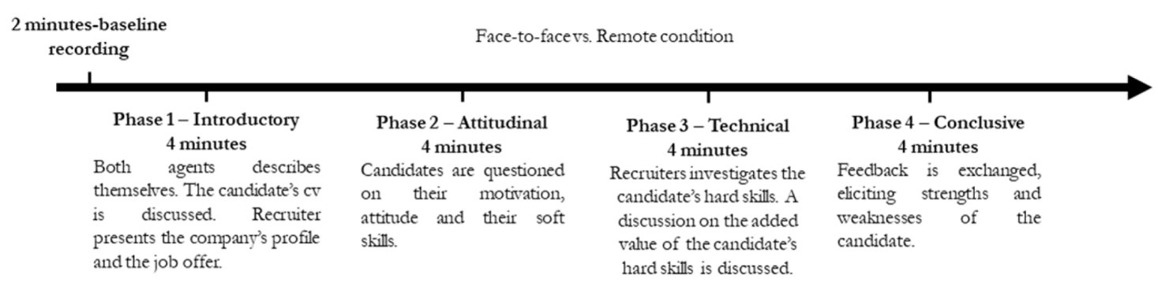
Comparison Between Face-to-Face and Online Interviews for a Project Manager
Face-to-face interview captures non-verbal behaviours such as posture, facial expression, and gaze, which are important for making a training program for candidates (Balconi, Crivelli and Cassioli, 2022).
An online interview might fail to investigate organisational skills and, behaviour of interviewees applied for project management.
Figure 5: Difference between face-to-face and remote conditioning online interview
(Source: Balconi, Crivelli, and Cassioli, 2023).
Notes:
A face-to-face interview is suitable for checking the eligibility of a candidate for managing project operations. Although online, virtual interviews are less time-consuming, budget-friendly, they fail to capture personal attributes, facial expressions, and body language changes of candidates. In contrast, an in-person face-to-face interview is justifiable to comprehend the potency, skills and practical decision-making strategy of the candidate.

Slide 15
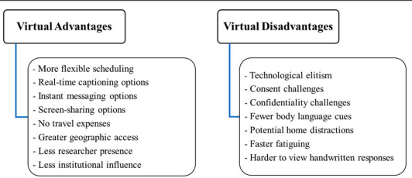
Comparison Between Face-to-Face and Online Interviews for a Financial Analyst
Online virtual interviews are flexible, have screen sharing options, instant messaging options, but rarely detect body language cues (Keen, Lomeli-Rodriguez, and Joffe, 2022).
This interviewing method is suitable for detecting candidate data analysis competence by sharing the screen.
Figure 6: Advantages and disadvantages of virtual online interviews
(Source: Keen, Lomeli-Rodriguez, and Joffe, 2022)
Notes:
Compared to face-to-face interaction, an online virtual interview method is suitable for checking the financial analysis compatibility of candidates by sharing the screen. Interviewees can continuously monitor every step of problem solving and database analysis from the shared screen. The justification of online virtual interviews over face-to-face is their cost, a resource-saving opportunity that allows the recruitment board to check deserving qualities from a distance.

Slide 16
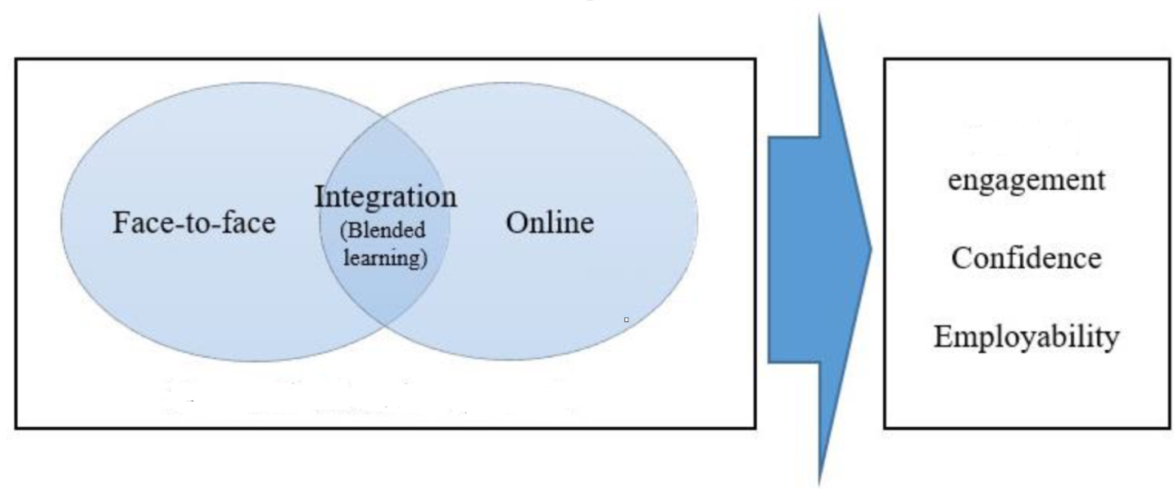
Comparison Between Face-to-Face and Online Interviews for a Change Manager
A blend of Face-to-face and online interviewing can be followed to examine the eligibility of candidates who applied for the change manager position.
The integration of face-to-face and online interviews meets the objectives of engagement rate, confidence level and employability skills (Hsu, 2025).
Figure 7: Significance of blended face-to-face and online interviews
(Source: Inspired by Hsu, 2025)
Notes:
A panel interviewing method blending face-to-face and online questioning can be followed to check the eligibility of the candidate as a change manager. A change manager has to accommodate every department, from finance, sustainability, to human resources, and technology. However, seniors from every department might not be physically present in the interview premises; for them, the online interview method is preferred. Thus, the blend of face-to-face and online interviewing through panels is justified for hiring candidates for the change manager post.

Slide 17
Conclusion
The interview process ensures the eligibility of candidates for project manager, finance analyst and change manager in EY.
Face-to-face and online interviewing methods are followed based on job roles.
Notes:
In conclusion, the choice of interviewing method depends on the job role criteria, skill testing approach and behavioural aspects.

Slide 18
References
Balconi, M., Crivelli, D. and Cassioli, F. (2022) ‘“We Will Let You Know”: An Assessment of Digital vs. Face-to-Face Job Interviews via EEG Connectivity Analysis’, Information, 13(7), p. 312.
Bohne, R. (2024) Number of employees of EY worldwide by region 2009-2024. Available at: https://www.statista.com/statistics/189247/number-of-employees-of-ernst-young-by-area/?srsltid=AfmBOoo42Qk7_3-jQjb85bgd_yr6qdue9Z0OSGWemqGeGpZ5JQ6IByf3 (Accessed: 23 October 2025).
Cimini, C., Romero, D., Pinto, R. and Cavalieri, S. (2023) ‘Task classification framework and job-task analysis method for understanding the impact of smart and digital technologies on the operators 4.0 job profiles’, Sustainability, 15(5), p. 3899.
Cornesse, C., Felderer, B., Fikel, M., Krieger, U. and Blom, A.G. (2022) ‘Recruiting a probability-based online panel via postal mail: experimental evidence’, Social Science Computer Review, 40(5), pp. 1259-1284.
Domingo, A., Rdesinski, R.E., Stenson, A., Aylor, M., Sullenbarger, J., Hatfield, J., Walker, S., Hervey, S., Singer, J., Cois, A. and Cheng, A. (2022) ‘Virtual residency interviews: applicant perceptions regarding virtual interview effectiveness, advantages, and barriers’, Journal of graduate medical education, 14(2), pp. 224-228.
Heston, T.F. and Khun, C. (2023) ‘Prompt engineering in medical education’, International Medical Education, 2(3), pp. 198-205.
Hsu, T.C.J. (2025) ‘Redesigning a Career Development Course in Post-Pandemic Higher Education: Integrating Blended and Cooperative Pedagogies for Enhanced Student Engagement and Employability’, Education Sciences, 15(7), p. 895.
Keen, S., Lomeli-Rodriguez, M. and Joffe, H. (2022) ‘From challenge to opportunity: virtual qualitative research during COVID-19 and beyond’, International journal of qualitative methods, 21, p. 16094069221105075.
Lobe, B., Morgan, D.L. and Hoffman, K. (2022) ‘A systematic comparison of in-person and video-based online interviewing’, International journal of qualitative methods, 21, p. 16094069221127068.
Morelli, N. (2023) Why Quality Job Descriptions Still Matter In Today’s World Of Work. Available at: https://www.forbes.com/councils/forbeshumanresourcescouncil/2023/01/04/why-quality-job-descriptions-still-matter-in-todays-world-of-work/ (Accessed: 21 October 2025).
Morris, A. (2025) Person Specification: Guide for Employers. Available at: https://www.davidsonmorris.com/person-specification/ (Accessed: 23 October 2025).
Muhammad, N.H.M. and Niazi, J.A. (2022) ‘Socratic questioning: a philosophical approach in developing critical thinking skills’, Al-Hikmah: International Journal of Islamic Studies and Human Sciences, 5(4), pp. 143-161.
Robinson, O.C. (2023) ‘Probing in qualitative research interviews: Theory and practice’, Qualitative Research in Psychology, 20(3), pp. 382-397.
Vraňaková, N., Gyurák Babeľová, Z. and Chlpeková, A., (2021) ‘Sustainable human resource management and generational diversity: The importance of the age management pillars’ Sustainability, 13(15), p. 8496.

Slide 19

THANK
You

