Slide 1








Jean Piaget's theory of cognitive development.
- Brief history.
-Main assumptions.
-Stage development.
-Strengths and limitations.
-Use in health and social care.
Hannah Marie Parsons.
Student number: 2011029

Slide 2
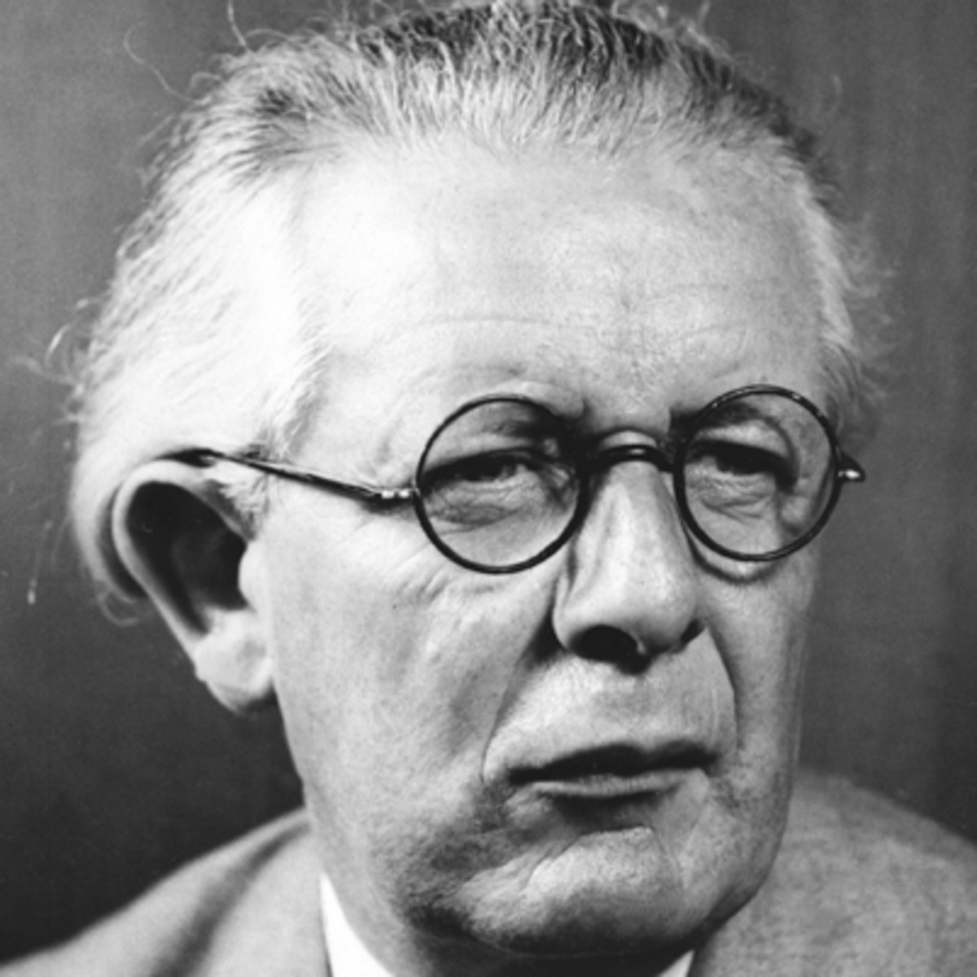

Jean Piaget.
(1896-1980)
-Psychologist born in Switzerland.
-Known for theories on cognitive and moral development.
-Research between 1920 through to 1930 (Augustyn, A. 2020).
-Biology and psychology.
-Children seek knowledge.
-Operating on the world gains understanding.
-All children go through same stages in the same order, each permit certain thinking (Griggs, R.A. 2012).

Slide 3

Stages of development.
Made up of 4 stages of cognitive development.
Stage one- The Sensorimotor Stage.
Birth-2 years.
Stage two- The Preoperational Stage.
2-7 years.
Stage three- The Concrete Operational Stage.
7-11 years.
Stage four- The Formal Operational Stage.
11 upwards.

Slide 4
Major characteristics and development points from each stage.
Birth-2 years.
-basic sensations.
-Actions can cause things to happen.
-Things exist although cannot be seen.
-Language and interaction.
2-7 years.
-Symbolic thinking.
-Thinking develops.
-Concrete terms.
-'Imaginative play'.
7-11 years.
-More organised and logical.
-Other people's point of view.
-Begin to understand other people's feelings.
Ages 11 upwards.
-Increase in logic.
-Moral and social element.
-Problem solving.
(Cherry, K. 2020)

Slide 5
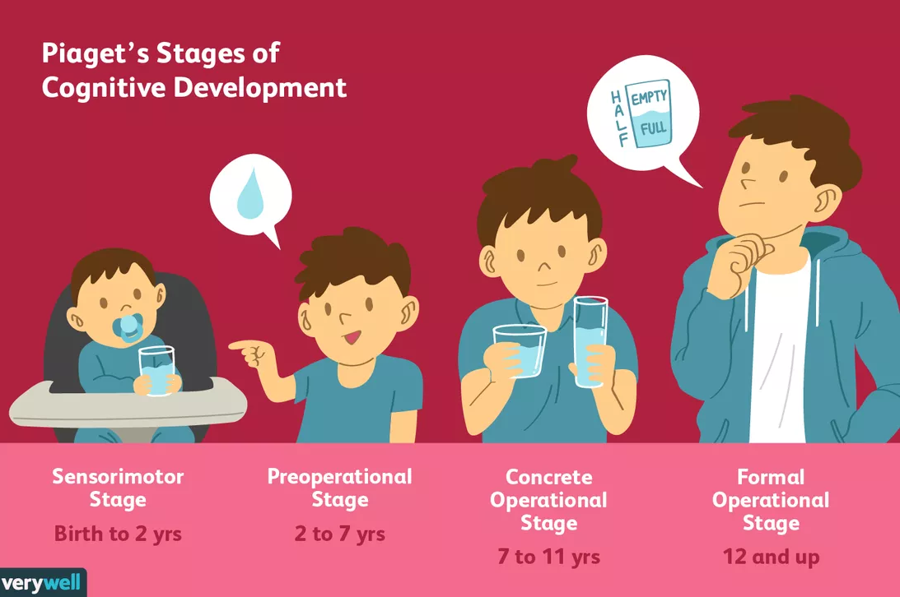
(Seong, J. 2020)

Slide 6


Assumptions.
To move onto the next stage of development, the child must over-come the stage based challenges.
Adapt with new information, incorporate this into what they have already learnt about the world.
Healthy pattern of cognitive development(Guarino, G. 2020).

Slide 7


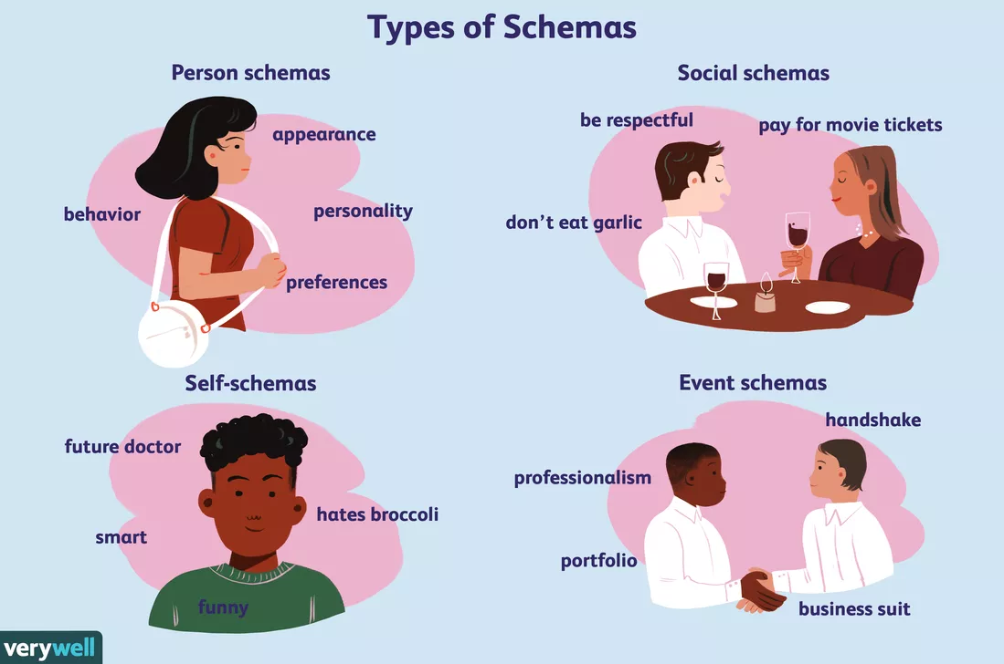
Schemas
What is a schema?
-Mental blocks that help us organise and categorise our thoughts.
-Mental short cuts.
-Learn and think quicker.
-Different types of schemas.
-Schemas change as we learn more information on a topic and process more knowledge (Vinney, C. 2019).
(Roberts, E. 2019)

Slide 8

Strengths and criticisms of Piaget's theory.
-Improved understanding of development.
-methods of study in school, communication techniques
(Erwin,Z. 2012).
-Class planning, central to learning. Visual aids, props (Williams, A. 2020).
- Other's were based off laboratories or animals where as Piaget' theory is based off his observation of children (Gillibrand, R. et al., 2011).
-Doesn't take into account children's upbringing.
-Doesn't take learning disabilities into consideration.
-Underestimate children's abilities (Cherry,K. 2019).
-Healthy home environment, parent being first teacher (Raja, D. 2019).

Slide 9

Piaget theory in health and social.
Milestone charts used by health visitors highlight developmental delay (Pethe, A. 2020).
Classroom use of Piaget's theory;
-Making instructions simple.
-Using props where possible.
-Using range of 'hands on' experiences (Mclendon, K. 2011).

Slide 10
reference list.
Augustyn, A. (2020), Jean Piaget, Swiss psychologist. Available at: http://www.britannica.com/science/behavioral-science. (Accessed: 03/11/2020).
Cherry, K. (2020), The Four Stages Of Cognitive Development: Background and key concepts of Piaget's theory. Available at: http://www.verywellmind.com/piagets-stages-of-cognitive-development-2795457. (Accessed: 03/11/2020).
Cherry, K. (2020), Support and criticism of Piaget's stage theory. Available at: http://www.verywellmind.com/support-and-criticism-of-piagets-stage-theory-2795460. (Accessed: 03/11/2020).
Erwin, Z. (2012) Benefits of Piaget's theory. Available at: http://www.benefitof.net/benefits-of-piagets-theory/. (Accessed: 03/11/2020).
Gillibrand, R. Virginia, L. L. O'donnell, V. (2011), 'Developmental Psychology', Essex: Pearson Education Limited.
Griggs, R.A. (2012), 'Psychology, a concise introduction', United States Of America: Worth Publishers.
Guarino, G. (2020), Jean Piaget's theory of cognitive development, psychpoint. Available at: http://www.psychpoint.com/mental-health/articles/jean-piagets-theory-of-cognitive-development/. (Accessed: 03/11/2020).

Slide 11
Reference list continued.
Mclendon, K. (2011), Jean Piaget: Cognitive development in the classroom. Available at: http://www.funderstanding.com/educators/jean-piaget-cognitive-development-in-the-classroom/. (Accessed: 03/11/2020).
Pethe, A. (2020), Cognitive Developmental Milestones In Children. Available at: https://www.parentcircle.com/article/cognitive-developmental-milestones-in-children/ (Accessed: 15/11/2020).
Raja, D. (2019), How Does The Environment Influence A Child's Growth And Development? Available at: https://www.momjunction.com/articles/environment-influence0on-child-growth_00332016/ (Accessed: 16/11/2020).
Roberts, C. (2019), The role of a schema in psychology. Available at: http://www.what-is-a-schema-2795873. (Accessed: 03/11/2020).
Seong, J. (2020), Background and key concepts of Piaget's theory. Available at: https://www.verywellmind.com/piagets-stages-of-cognitive-development-27954457. (Accessed: 03/11/2020).
Vinney, C. (22/07/2019), Thought co. What is a schema in psychology? Definition and examples. Available at: http://www.thoughtco.com/schema-definition-4691768. (Accessed: 01/11/2020).
Williams, A. (2020), How do we use Piaget’s cognitive theory in schools? Available at: https://www.ehow.co.uk/how_587940_set-English-second-language_-classes.html (Accessed: 17/11/2020).

