Slide 1
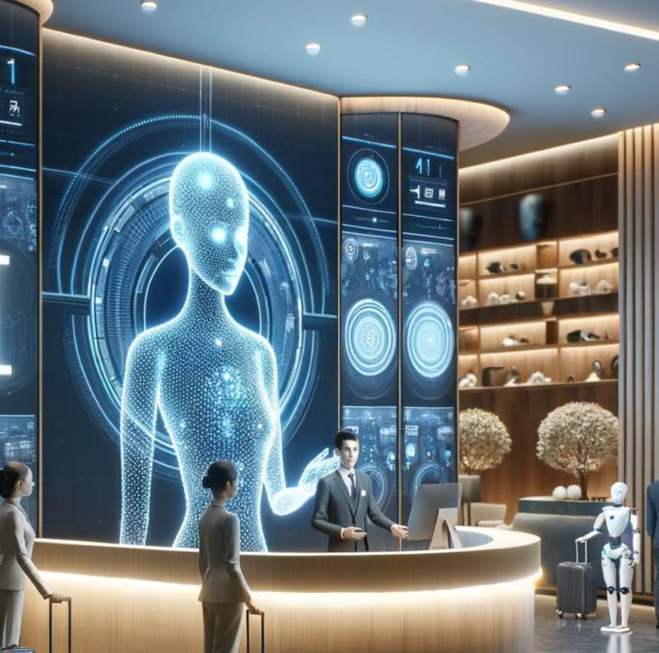
Module Code: BMIH6001
Course: BA (Hons) International Hotel Management
The Future of Work: Artificial Intelligence and Human Collaboration in the Hotel and Hospitality Industry
Conference presentation
Student: Gergana Nikolova 2213953
Tutor: Christopher Wilkins

Slide 2

Introduction
Artificial Intelligence (AI) is reshaping how services are delivered across the hospitality industry.
Hotels now use AI for booking, check-ins, customer interaction, and back-end optimisation (Ivanov and Webster, 2019).
This digital shift challenges the traditional, human-driven service culture of the industry.
As AI becomes more capable, questions emerge about its effect on guest satisfaction and workforce stability (Buhalis and Leung, 2018).
This presentation explores key literature, a PEST analysis, real-world examples, and practical recommendations to assess how humans and AI can collaborate effectively in hospitality.

Slide 3
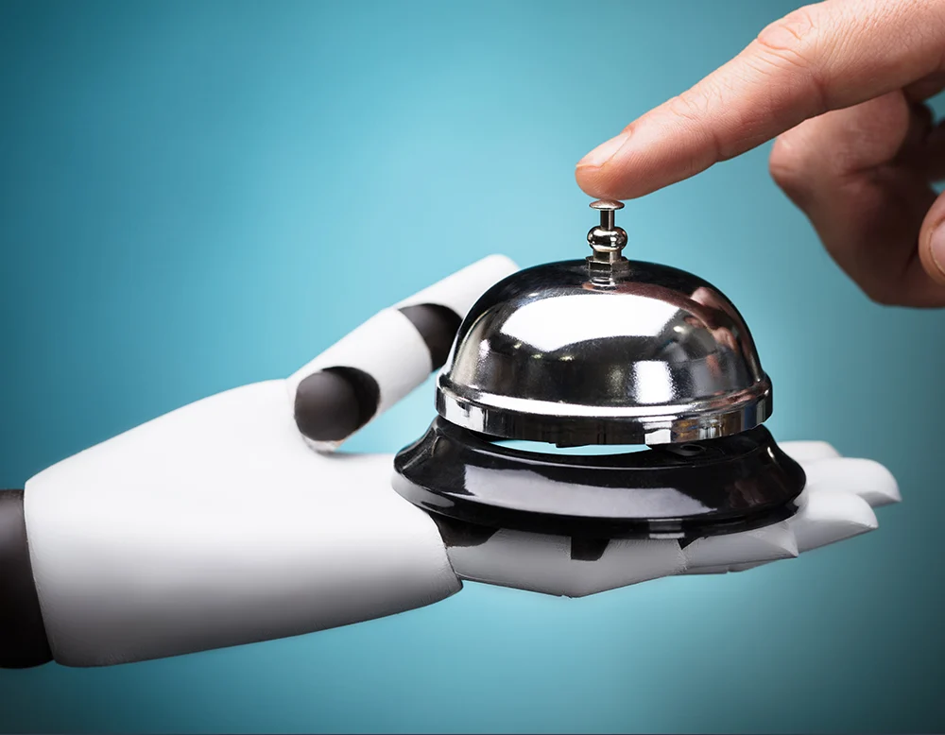
Context and Research Focus
The hospitality industry is evolving rapidly due to AI advancements and digital transformation.
Labour shortages, rising costs, and guest expectations are pushing hotels to automate routine services.
While AI improves speed and consistency, it often lacks emotional intelligence and contextual judgment (Gursoy, Chi and Lu, 2019).
Concerns around workforce disruption and loss of personalised service continue to grow (Pizam, 2020).
This research aims to explore how AI and human employees can co-exist and co-create value in a modern hospitality setting.

Slide 4
Literature Review: AI in Hospitality
AI is widely adopted in customer-facing and operational areas.
Includes chatbots, service robots, and self-check-in systems (Ivanov and Webster, 2019)
Enables contactless interaction and faster service (Gursoy, Chi and Lu, 2019)
AI enhances personalisation and data-driven service design.
Smart rooms adjust automatically to guest preferences.
Predictive analytics improve loyalty targeting (Accenture, 2024)
Operational efficiency motivates automation across hotel chains.
Reduces labour costs and automates repetitive tasks (Buhalis and Leung, 2018)
Used in scheduling, inventory, and dynamic pricing (EY, 2024)
Guest acceptance is influenced by age, culture, and service expectations.
Gen Z prefers digital tools; older guests value personal service
Luxury markets remain human-centred (Tung and Au, 2018)
Emotional service gaps remain a limitation of AI.
AI lacks empathy and situational judgment.
Complex or sensitive issues still require human intervention (Pizam, 2020)

Slide 5
Literature Review: Human Collaboration
Human staff bring emotional intelligence, adaptability, and empathy to service encounters (Tung and Au, 2018).
Critical for complex complaints and emotionally sensitive interactions.
AI lacks discretion and cultural awareness in high-context situations (Pizam, 2020).
Staff interpret guest tone, urgency, and non-verbal cues better.
Collaboration between humans and AI enhances service quality and trust (Wirtz, Patterson and Kunz, 2018).
Hybrid service models increasingly adopted across global chains.
Staff anxiety
systems
from unclear roles
and skill
mismatches.
Upskilling reduces
fear and increases
confidence (Costa
and Costa, 2022).
A strategic human-AI balance strengthens brand experience and operational resilience.
Hotels retain warmth and efficiency without sacrificing either.

Slide 6
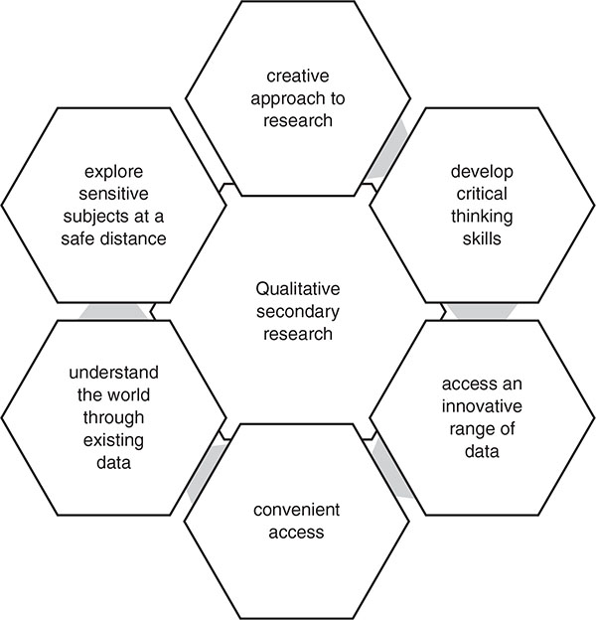
Methodology & PEST Overview
This research uses a secondary qualitative approach to analyse AI-human collaboration in hospitality.
Literature and reports from academic databases and industry sources were systematically reviewed.
PEST analysis was used to evaluate Political, Economic, Social, and Technological factors (Cooper and Hall, 2019).
Thematic patterns were drawn from over 25 sources published between 2017 and 2024.
Combining theory with real-world examples improves the relevance of the findings (Batabyal and Das, 2019).

Slide 7
PEST Analysis: Key Findings
PEST Factor
Key Insight
Political
Government policy supports tech innovation
with ethical safeguards (World Economic Forum, 2023)
Economic
AI lowers labour costs but raises staff replacement concerns
(McKinsey & Company, 2017)
Social
Tech preferences differ by guest age, culture, and service tier.
Technological
AI enables dynamic pricing, smart rooms,
and predictive operations (EY, 2024)

Slide 8
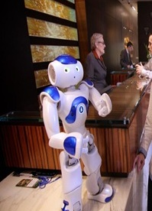
Real-World Examples
Global hotel brands are actively adopting AI to improve efficiency and guest experience. Hilton introduced “Connie,” a robot concierge that answers guest queries in real time, enhancing front-desk operations (Ivanov and Webster, 2019). Marriott has implemented AI-powered smart rooms, enabling guests to control lighting, temperature, and entertainment systems via voice or mobile apps (Accenture, 2024). Accor Hotels uses chatbots for customer service and relies on AI for dynamic pricing. CitizenM offers a fully digitised guest journey, where mobile apps manage check-in, room access, and personalisation. These implementations vary by brand and segment, but all reflect a shift towards AI-human collaboration rather than replacement.

Slide 9
Conclusion & Recommendations
Artificial Intelligence is becoming a core component of modern hospitality, enhancing speed, personalisation, and operational control.
Successful implementation depends on integrating AI with human capabilities rather than replacing them (Costa and Costa, 2022).
Staff must be upskilled and supported through digital transformation to reduce fear and increase collaboration.
Ethical standards around data use, transparency, and algorithmic bias must be upheld to maintain guest trust (Wirtz, Patterson and Kunz, 2018).
A hybrid model—where AI handles efficiency and humans deliver empathy—offers the most balanced path forward for service excellence.

Slide 10
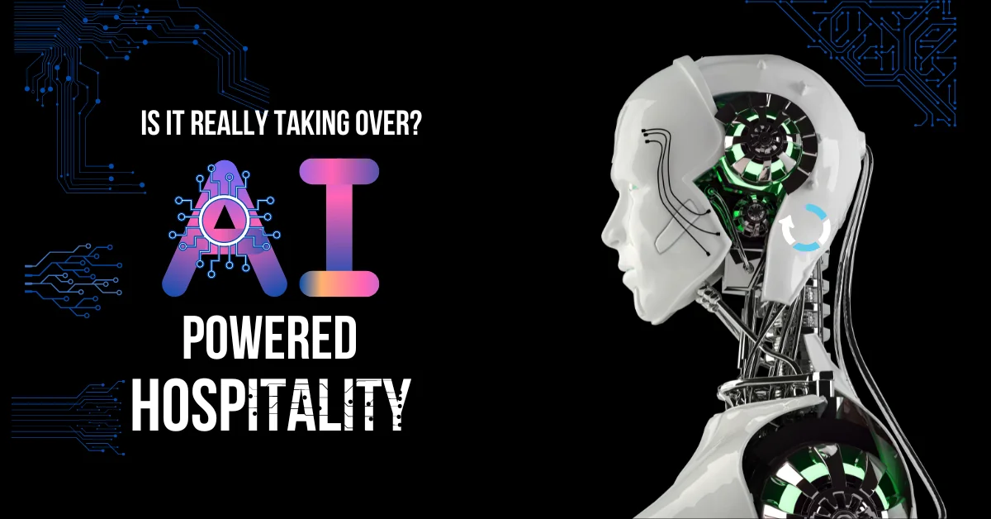
THANKS

Slide 11
References
Accenture (2024). The travel industry's new trip: How generative AI can redefine customer experiences and unlock new value for organisations. [PDF] Available at: https://www.accenture.com/content/dam/accenture/final/accenture-com/document-3/The-Travel-Industrys-New-Trip-Final.pdf [Accessed 27 May 2025].
Buhalis, D. and Leung, D. (2018) ‘Smart hospitality—Interconnectivity and interoperability towards an ecosystem’, International Journal of Hospitality Management, 71, pp. 41–50. doi:10.1016/j.ijhm.2017.11.011.
Deloitte (2024). Embracing the future: AI's transformative impact on travel and hospitality. [online] Available at: https://www.deloitte.com/uk/en/Industries/consumer/blogs/embracing-the-future.html [Accessed 26 May 2025].
EY (2024) AI in hospitality: Enhancing hotel guest experiences. [online] Available at: https://www.ey.com/en_us/insights/hospitality/ai-in-hospitality-enhancing-hotel-guest-experiences [Accessed 26 May 2025].
Gursoy, D., Chi, C.G. and Lu, L. (2019) ‘Examining the impact of AI service robots on hospitality consumers’ emotional responses’, Journal of Hospitality Marketing & Management, 28(7), pp. 803–828. doi:10.1080/19368623.2019.1570737.

Slide 12
References
Ivanov, S. and Webster, C. (eds.) (2019) Robots, artificial intelligence, and service automation in travel, tourism and hospitality. Bingley: Emerald Publishing.
Kuo, C.-M., Chen, L.-C. and Tseng, C.-Y. (2017) ‘Investigating an innovative service with hospitality robots’, International Journal of Contemporary Hospitality Management, 29(5), pp. 1305–1321. doi:10.1108/IJCHM-08-2015-0414.
McKinsey & Company (2017). Automation, employment, and productivity. [PDF] Available at: https://www.mckinsey.com/~/media/mckinsey/featured%20insights/Digital%20Disruption/Harnessing%20automation%20for%20a%20future%20that%20works/MGI-A-future-that-works-Executive-summary.ashx [Accessed 26 May 2025].
Pizam, A. (2020) ‘Technological disruption and the hotel industry’, International Hospitality Review, 34(1), pp. 1–3. doi:10.1108/IHR-01-2020-0001.
Tung, V.W.S. and Au, N. (2018) ‘Exploring customer experiences with robotics in hospitality’, International Journal of Contemporary Hospitality Management, 30(7), pp. 2680–2697. doi:10.1108/IJCHM-06-2017-0322.

Slide 13
References
World Economic Forum (2023). Future of Jobs Report 2023: Up to a Quarter of Jobs Expected to Change in Next Five Years. [online] Available at: https://www.weforum.org/press/2023/04/future-of-jobs-report-2023-up-to-a-quarter-of-jobs-expected-to-change-in-next-five-years/ [Accessed 25 May 2025].
World Economic Forum (2023). The Future of Jobs Report 2023. [online] Available at: https://www.weforum.org/publications/the-future-of-jobs-report-2023/ [Accessed 25 May 2025].

