Slide 1
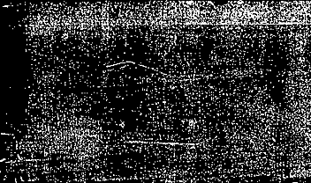
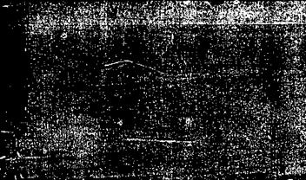
The Postmodern Turn in Historiography
From Objective Truth to Narrative Construction
(or history as a "science" to history as a "discourse“)

Slide 2


Defining Modernist Historiography
The Goal: To reconstruct the past "as it actually was" (Leopold von Ranke).
Methodology: Strict empiricism, archival "discovery," and the separation of fact from value.
Foundational Belief: The historian is a neutral observer capable of uncovering a singular, objective reality.
Key Figure: Leopold von Ranke, the father of modern source-based history.

Slide 3
Modernism and the
"Grand Narrative"
Metanarratives: The belief in overarching stories that explain human history (e.g., the march toward liberty or the triumph of reason).
Progress: A view of time as linear and teleological (moving toward a specific end).
Scholarly Example: G.R. Elton, who defended the idea that the past is a solid reality that can be objectively captured through the "autonomy of history."

Slide 4
The Seeds of Postmodernism
Context: Post-WWII disillusionment with "progress" and the Enlightenment.
The Critique: If human reason led to the Holocaust and the atomic bomb, can we trust "objective" rationalism?
The Shift: Focus moves from "what happened" to "how do we talk about what happened?"

Slide 5
The Linguistic Turn
Core Idea: We cannot access the past directly; we only access texts about the past.
Language as a Filter: Language does not reflect reality; it constructs it.
Key Scholar: Hayden White (Metahistory, 1973). White argued that historical works are essentially "literary artifacts" and that historians "emplot" facts into stories (Tragedy, Comedy, Satire).

Slide 6
Michel Foucault – Power and Knowledge
Archaeology & Genealogy: Foucault rejected linear history in favour of uncovering the "ruptures" and "discontinuities" in past thought.
Knowledge/Power: He argued that what we accept as "truth" is actually an expression of power structures.
Key Insight: History is not a search for truth, but a study of how "regimes of truth" are established to control society.

Slide 7
Deconstructing the Archive
Modernist View: The archive is a treasure trove of facts.
Postmodernist View: The archive is a site of exclusion and power.
Key Scholar: Jacques Derrida. His concept of "Archive Fever" suggests that the way information is gathered and saved determines what can even be "known" as history.
Focus: Who was silenced? Whose records were destroyed?

Slide 8
The Death of the
"Grand Narrative"
The End of Universals: Postmodernists reject the idea that one story can explain everyone’s experience.
Key Scholar: Jean-François Lyotard. He famously defined postmodernism as "incredulity toward metanarratives."
Result: The rise of Micro-history (focusing on small, local, or marginalised events) rather than "World History."

