Slide 1

Scrap Reduction Project
Group Project
Tomos Blizzard - 1402861

Slide 2

Introduction
Marelli is based in Llanelli.
They produce car radiators. This process includes metal pressing and plastic moulding. The company is also embarking on a new venture of battery cooling plates for electric cars.
Marelli is the 2nd biggest radiator manufacturer in the world.

Slide 3
Aims
Overview of the project.
Introduce members of the team.
Methods used when forming the team.
Show scrap reductions main source.
Introduction to timing plan.

Slide 4



reduce scrap on the machine.
Achieve 85% OEE
Complete work within 8 weeks

Slide 5
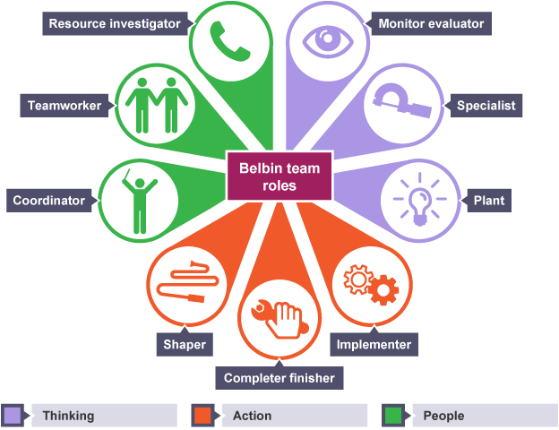
Team Members
Project Engineer
Quality Engineer
Maintenance Technician
Operator

Slide 6
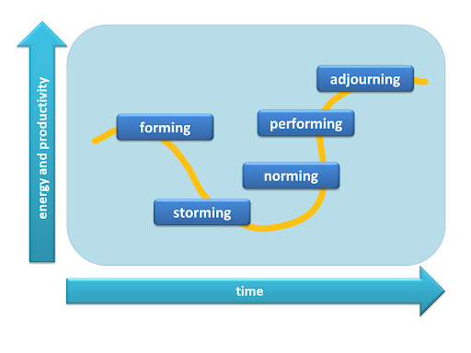
Forming – Start of the project
Storming – Fractures within the team
Norming – Well rounded team
Performing – Completing tasks efficiently and effectively.
Adjourning – Closure of project and team.

Slide 9
Conclusion
Members of the team have been introduced, roles and responsibilities explained.
Belbin and Tuckman’s theory have been explained and implemented within the team.
Sources which impacted the project have been shown.
Gantt chart has been reviewed and explained.

Slide 10
Thanks for listening!

