Slide 1
Problem Solving and Decision Making
Bethan Harris
2116541
Problem Solving and Decision Making
BMSW 4004
Zahra
Addressing the problem of staff shortages in Proper Care, UK

Slide 2
Introduction
Included in this presentation will be a discussion on the nature and impact of the complex problem regarding employees and their organisations, methods of PESTLE analysis of the macro-environmental factors contributing to the issue of lack of staff within Proper Care, UK.
Aswell as this using the Fishbone diagram to research the cause and effect of low staffing numbers.
At the end of the presentation will be an evaluation of alternative solutions and a decision of which is best in order to reduce staffing issues.

Slide 3
Outline of the problem and who is affected
Proper Care ,UK are facing an issue regarding staff shortages meaning that there isn't enough staff to cover the demand of the work load needed to satisfy patients.
Having a shortage of staff can have a detrimental effect on a numerous variety of people as well as the organisation as a whole – lack of staff means that for the staff that are working within the organisation their work load increases furthermore leading to increased stress levels and job dissatisfaction.
Patients also suffer from staff shortages as this means there will be less appointments, medical negligence hightens and the quality of care decreases.
Deakin(2022) found that there are over 110000 vacancies for adult social care workers along side nursing vacancies which stands at 5000 meaning that this is contributing to the increasing workload for existing staff further meaning that due to stress and unavailibility there is a risk of a failing service being provided to patients.

Slide 4
The impact of staff shortages
Some of the impact of staff shortages are that -
Longer waiting list for appointments for patients
High pressure put onto existing staff
Increases the chances of medical negligence as staff become overworked meaning that the quality of care decreases
Less students want to choose to study nursing as the staff shortages are publicised it may not be worth the stress
Gives the organization a bad reputation as people will complain about the service
Higher morbidity and mortality rates

Slide 5
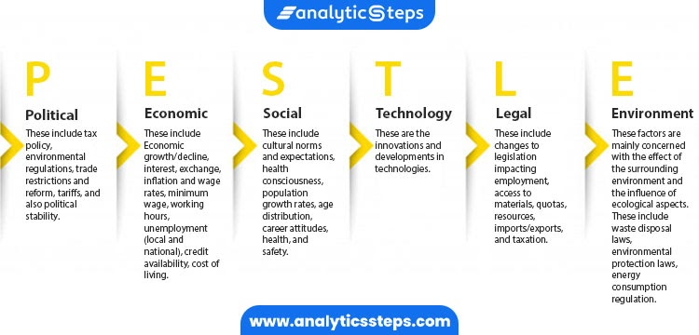
Pestle analysis is a strategic framework commonly used to evaluate an environment in which a firm operates. Political, Economic, Social, Technological, Environmental and Legal factors as well.
Pestle helps an organization to establish external factors impacting on decisions that are made inside of the organization. By understanding the impact these external factors can have on an organization, it becomes handy for organizations to plan better.

Slide 6
Political
Governments removing bursaries
Not being able to close the gap on NHS and adult social care staff shortages
Economic
Rate of pay for staff not reflecting on their work
Rise in prices for courses for students – may not be able to afford to enrol or even afford to repay student loans etc.
Company may not be able to afford to hire more staff
Social
An ever growing population means that there is an increased work load
Inadequate staffing- hiring the wrong people for the job wether that be because of attitudes to work, qualifications, language barriers etc.
Staff finding new jobs with less negative issues
Staff retiring
Technology
Technology like the machines that are used within hospitals are expensive – may not be able to afford if they need replacing
More online courses being offered – people may not have access due to lack of resources eg internet, laptops etc.
Legal
Law affects health and social care legislations
Environmental
People coming from overseas that have experienced natural disasters meaning that lists of patients waiting to be seen by the organisation increases
Staff not disposing of harmful waste correctly

Slide 7
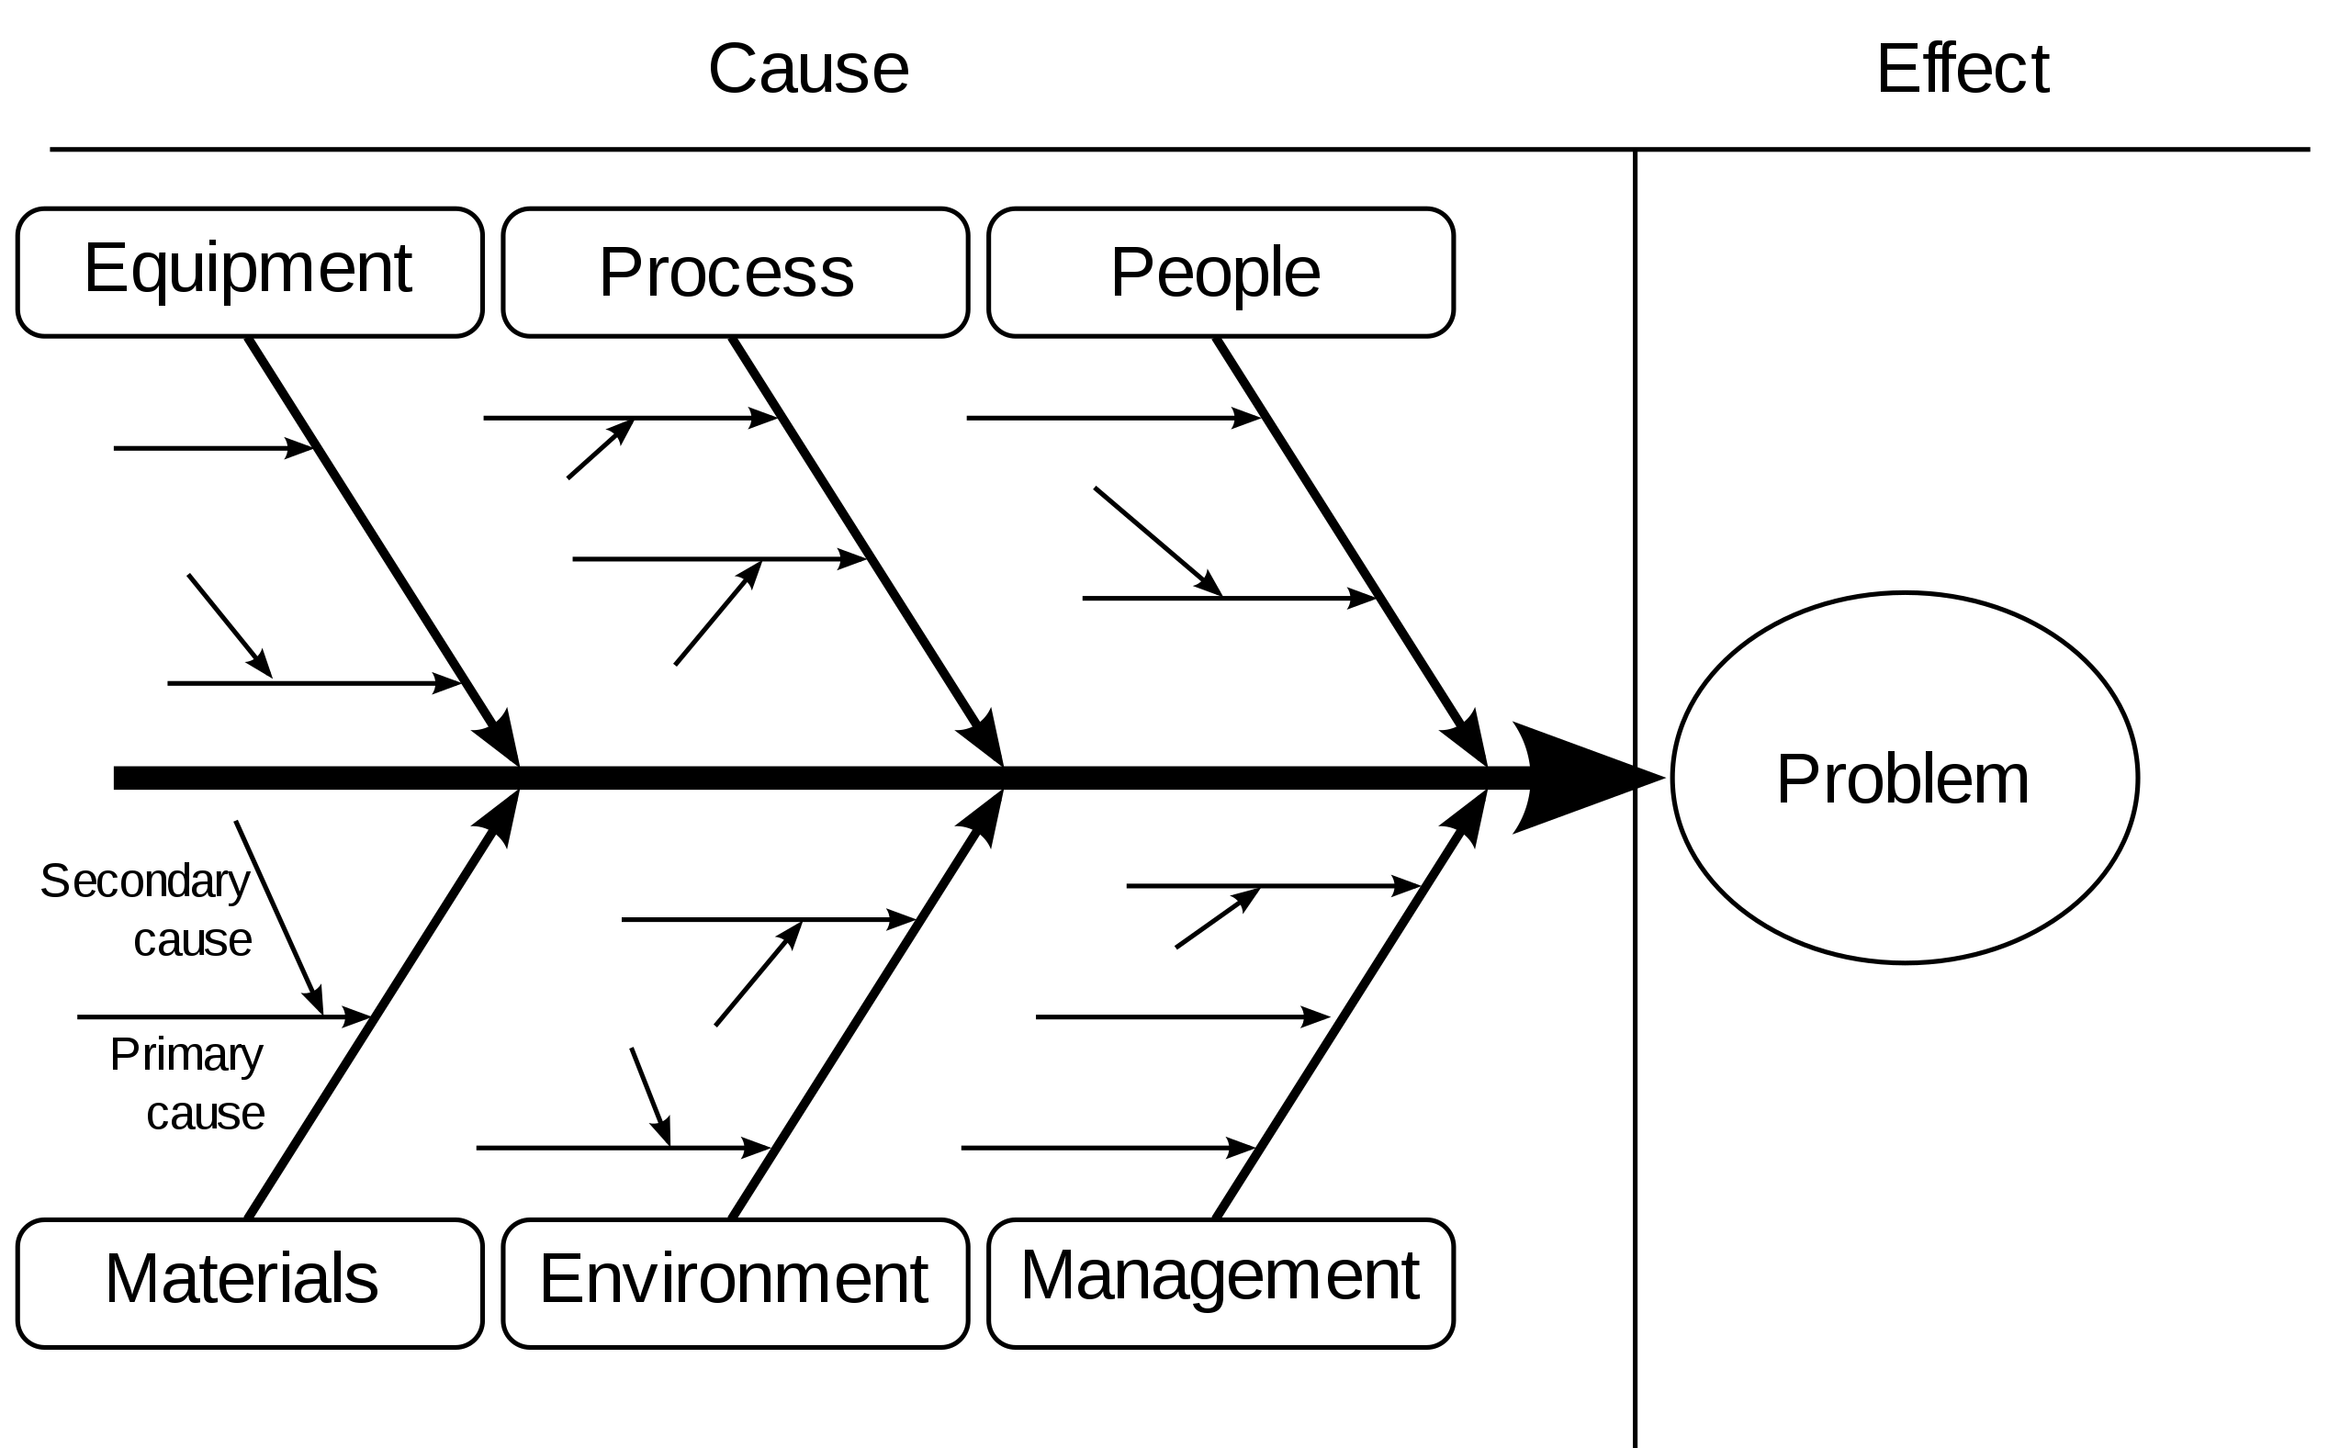
Fishbone Technique
A fishbone diagram is a technique for identifying all of the possible causes associated with a particular problem, before narrowing down to the small number of main root causes which need to be addressed.

Slide 8
Fishbone
This strategy can help the organisation by looking in depth at the staffing issues being faced by -
Provides a clear insight as to why the problem has occurred which gives an all around picture
Focuses on the causes instead of the symptoms
Allows the organisation to gather further data and actions
Gives a framework for planning onto how to solve the issues of no staff
Allows a visual representation

Slide 9
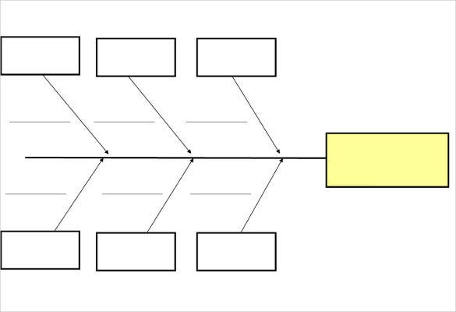
Lack of students enrolling on nursing courses
Companies not hiring enough staff
- Bosses not realising the supply and demand issue
- People not meeting the criteria for the jobs
-Lack of interest
-Not worth the stress
- affordability for courses and resources
Staffing issues within Proper Care UK
-Stress and pressure levels
-Ill health due to overworking
- Job disatisfaction
Staff leaving their jobs

Slide 10
Possible solutions for Low staffing Issues
Programs to encourage students to complete nursing degrees
Higher wages for existing nurses
Recruiting Globally
Increase advertisements for jobs
Offer incentives for staff – rewards for their hard work ie giving staff bonuses, recognition for their work
Free training programmes to educate nurses on the increasing work load

Slide 11
PMI
Originally PMI is a strategy was developed by Dr. Edward De Bono(1985). In order to create process that helps with not only brainstorming ideas but also making decisions quickly by weighing up the pros, cons and implications of the decision being made. Finley (2012) summarised PMI into three streps
Step 1. Consider the Plus Points
In this step, simply enumerate all of the positive things you can think of.
Step 2. Consider the Minus Points
In this step, enumerate all of the negative things you can think of
Step 3. Consider the Interesting Points of the Situation.
In this step, enumerate all the interesting points that you can think of. Rather than positive or negative, they are simply points of interest that you should direct your attention to.
Make Your conclusion
In this step, you make your judgement because you’ve scanned and organised three important aspects: the positives, the negatives, and the interesting.

Slide 12
PMI relating to solution for low staff numbers- hiring more staff
PLUS | MINUS | INTERESTING
Takes some work load off existing staff members | It’s a long process recruiting people | New members and faces added to the staffing teams
Allows more patients to be seen due to staff availability increasing | Having to now accomodate the extra staff intake and appointments | Patients become satisfied that they are now being seen by the relevant people

Slide 13
PMI - Free training programs to educate nurses on the increased work load
Plus | Minus | Interesting
Increased quality of care as new things can be learnt | Cost of having to outsource someone to come in and give training | Long term quality of care for patients improving
Increased number of higher educated nurses | Could be a timely process – staff may not have the free time to take part as they are busy working | A higher level of knowledge can lead to a better service being provided
Creates doors opening for people to apply for higher positions | Spaces for lower level vacancies become free that may be hard to fill | Less waiting time for patients as there are trained staff to take their appointments

Slide 14
PMI - Recruiting staff globally
PLUS | MINUS | INTERESTING
Filling staffing spaces | Having to advertise overseas –may not be cost effective | Existing staff could learn new things from people from different countries and vice versa
Giving an individual from overseas the oppertunity to come and work in the UK | Could also be a costly process – the individual having to relocate etc | New life for the individual being recruited – better quality of life for them

Slide 15
Conclusion
To conclude Proper Care, UK should use the fishbone method in order to try and analyse the issue of being understaffed as by doing so not only will the overall issue be identified but by expanding the main issue into smaller root causes it may help to solve the issue a lot quicker as for example the main issue is being under staffed however this can be down to a number of factors such as not having enough new students enrolling for nurses courses – this being identified the company can find a solution as to how they can gain more enrolments onto nursing courses whether that be by offering bursaries, online courses etc.
The recommended solution for staff shortages would be to offer better training programmes/courses for students enrolling on nursing courses could be another better possible solution as by offering things like bursaries, study while you work schemes etc this can take the financial worries off people that may be put off wanting to study a nursing degree . Also by offering more flexible courses it may appeal to a wider audience as people have children etc o they may feel like they don’t have the time to study but by offering online courses this can eliminate that problem.
By enrolling more students on courses, when they qualify this means that they can go on to fill the current vacancies that need to be filled in order to upkeep the supply and demand issue that the current health sector is facing .

Slide 16
Reference List
Finley, T. (2012). Three Steps to Critical Thinking. Edutopia. Retrieved from https://www.edutopia.org/blog/three-steps-to-critical-thinking-todd-finley
Deakin, M. (2022) NHS workforce shortages and employee burnout are taking a toll . Retrieved from https://www.bmj.com/content/377/bmj.o945
De Bono, E. (1985). De Bono's thinking Course. Ariel Books : London ( Accessed – 09/07/2022)
Charlesworth, A (2021) What action is required to make NHS workforce shortages a thing of the past? The health foundation. Retrieved from https://www.health.org.uk/news-and-comment/blogs/what-action-is-required-to-make-nhs-workforce-shortages-a-thing-of-the-past
Anonymous (2019). 5 Challenges and Solutions for Nurse Staffing Managers. Retrieved from https://scrubsmag.com/5-challenges-and-solutions-for-nurse-staffing-managers/amp/
Aiken LH, Cheung RB, Olds DM (2009). Education policy initiatives to address the nurse shortage. Health Aff ( Millwood). (4): w646-56.
Macdonald N(2022). NHS staff shortages having 'serious and detrimental impact'.Retrieved from https://www.hospitaltimes.co.uk/nhs-staff-shortages-having-serious-and-detrimental-impact/. (Accessed- 10/07/2022)
Laskowski-jones L, Toulson K(2014). Top 10 tips for coping with short staffing. Nursing2005.34(12):61.

